Slide 1
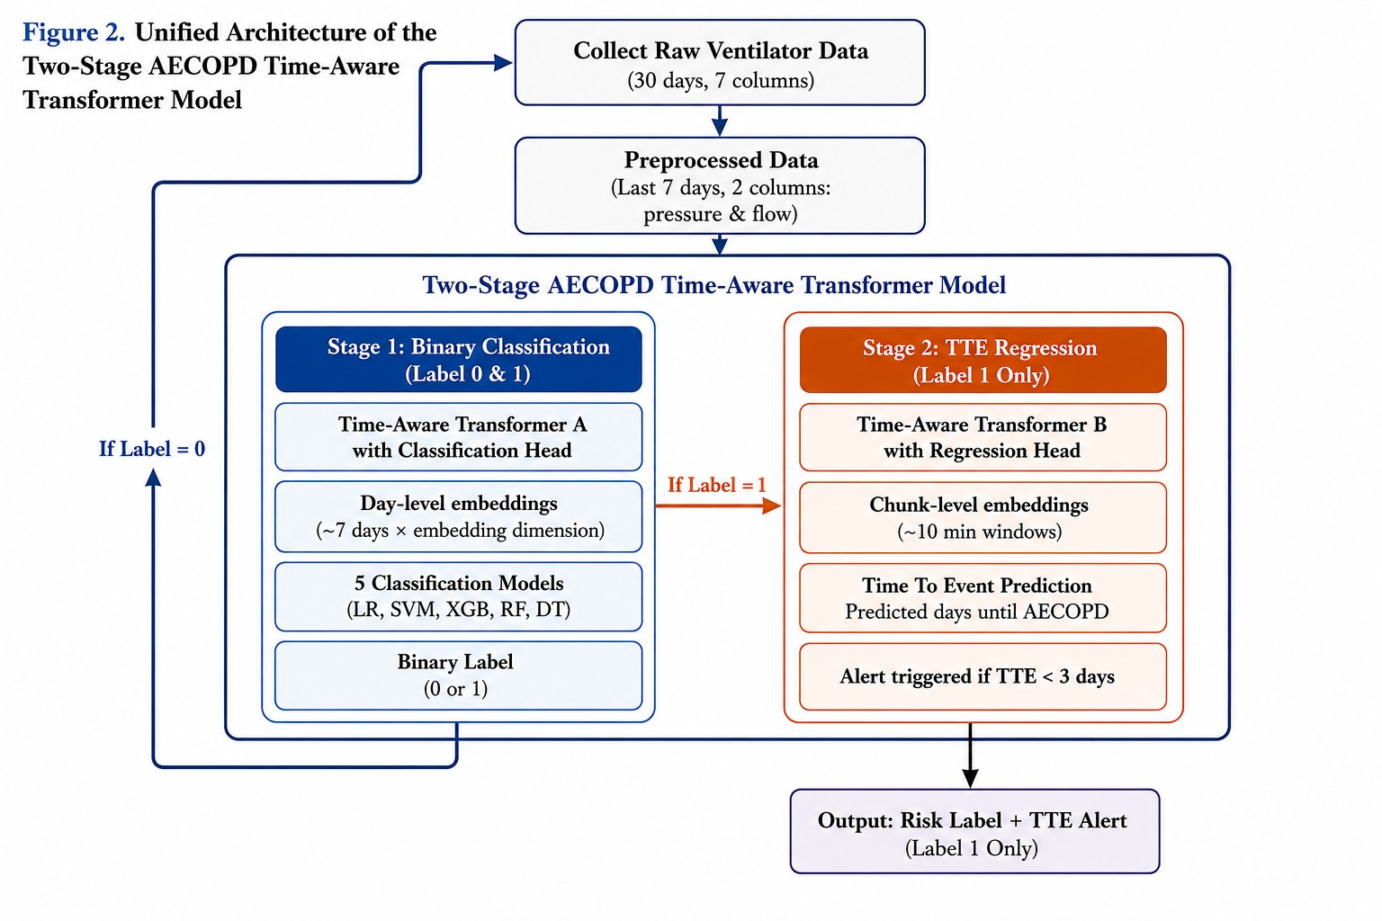
Collect Ventilator Data
(30 days,
7 columns)
Preprocess Data
( 7 days, 2 columns, pressure & flow)
Output: Risk Label + TTE Alert (Label 1 Only)

Slide 2
