Slide 1
Sentia
Transformation and Migration to the Public Cloud

Slide 2

Agenda
Current infrastructure
Issues
Migration to Azure cloud
Assumptions and Decisions
Time log

Slide 3
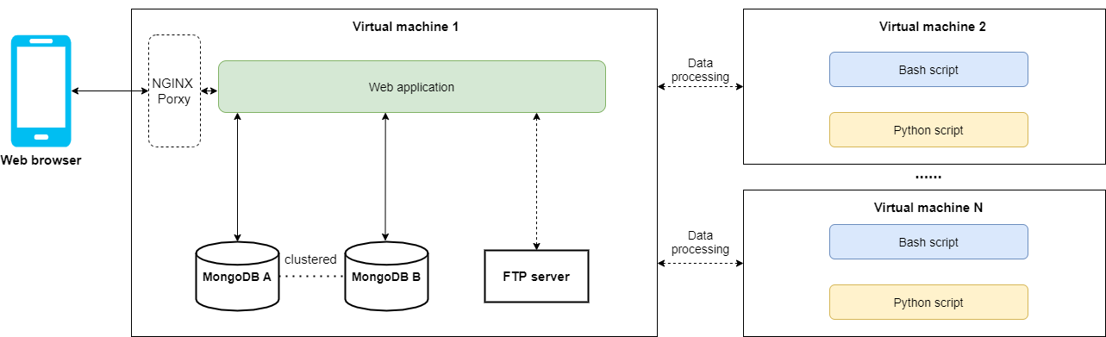
Current infrastructure

Slide 4
2. Issues
High costing fee
Potential data loss due to sever down
Redundant servers and VMs
Hard to implement release automation

Slide 5
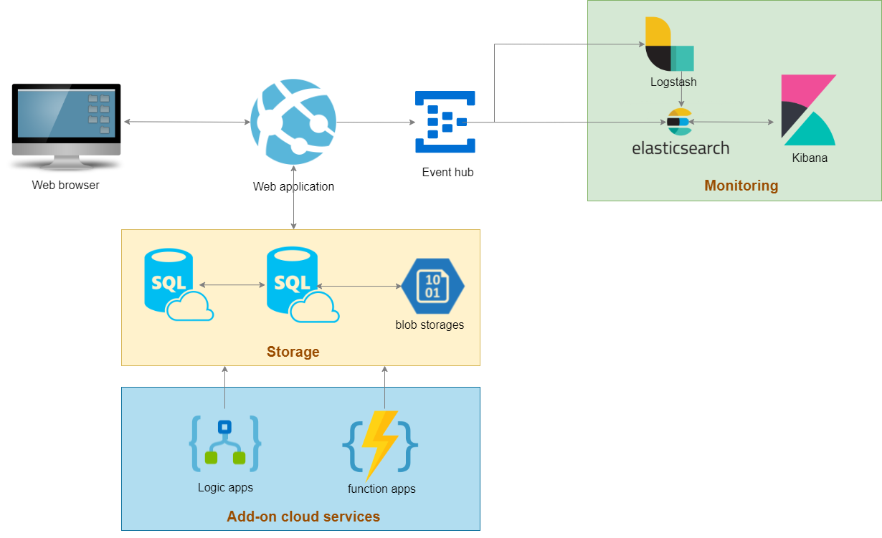
3. Migration to Azure cloud
Deploy the web app as an app service in Azure
(add application insights for track and trace)
Add logic apps/functions to process daily or regular data
Expose Kibana to the headquarters of client

Slide 6
3. Migration to Azure cloud
Pay as what you need
Implement clustered azure DBs to avoid data loss
Set up logic apps or function apps to process internal or external data as needed
Set up Azure pipelines for automation

Slide 7
3. Migration to Azure cloud
A bicep document is added in GitHub as an example for deploying the web app: mywebapp.json

Slide 8
4. Assumptions and Decisions
Clang or Salesforce can be applied for marketing promotions if needed.
The web app can be separated by front-end and backend APIs. The APIs can be used in the future for implementing a mobile app.

Slide 9
5. Time log
Activities | Time cost
Visualize current architecture | 4h
Visualize cloud architecture | 2h
Investigate on Elastic search | 4h
Create Bicep file for deploy web app | 2h
Make slides | 2h
Study on relevant knowledge | 4h

