Slide 1
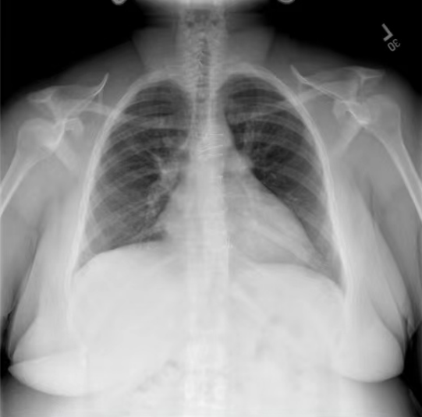
The lungs are well expanded and clear, the
cardiomediastinal and hilar contours are i normal, and there is no pleural effusion or i pneumothorax. A small left-sided pleural ! effusion is present, but no displaced rib fracture was seen.
### Patient:
Medical VLM
Linear Transformation
MedicalLLM
### Doctor: What are
the main findings and impression for the given x-ray?

Slide 2

### 报告: 根据X射线图像，心脏大小正常，肺部看起来很清晰。已经排除了肺炎、积液、水肿、气胸、腺病、结节或肿块的存在。该发现表明一切正常。换句话说，总体印象是胸部正常。你对这个X射线结果有什么问题或担忧吗？
Medical VLM
The lungs are well expanded and clear, the
cardiomediastinal and hilar contours are i normal, and there is no pleural effusion or i pneumothorax. A small left-sided pleural ! effusion is present, but no displaced rib fracture was seen.
### Patient:
Linear Transformation
MedicalLLM
### Report: Based on the x-ray image, the heart size is normal and the lungs appear clear. The presence of pneumonia, effusions, edema, pneumothorax, adenopathy, nodules or masses has been ruled out. The finding indicates everything is normal. In other words, the overall impression is that of a normal chest. Do you have any questions or concerns about this x-ray result?
### Doctor: What are
the main findings and impression for the given x-ray?

Slide 3
### 报告: 根据X射线图像，心脏大小正常，肺部看起来很清晰。已经排除了肺炎、积液、水肿、气胸、腺病、结节或肿块的存在。该发现表明一切正常。换句话说，总体印象是胸部正常。你对这个X射线结果有什么问题或担忧吗？
Medical VLM
The lungs are well expanded and clear, the
cardiomediastinal and hilar contours are i normal, and there is no pleural effusion or i pneumothorax. A small left-sided pleural ! effusion is present, but no displaced rib fracture was seen.
### Patient:
### Report: Based on the x-ray image, the heart size is normal and the lungs appear clear. The presence of pneumonia, effusions, edema, pneumothorax, adenopathy, nodules or masses has been ruled out. The finding indicates everything is normal. In other words, the overall impression is that of a normal chest. Do you have any questions or concerns about this x-ray result?
Linear Transformation
MedicalLLM
### Doctor: What are
the main findings and impression for the given x-ray?

Slide 4
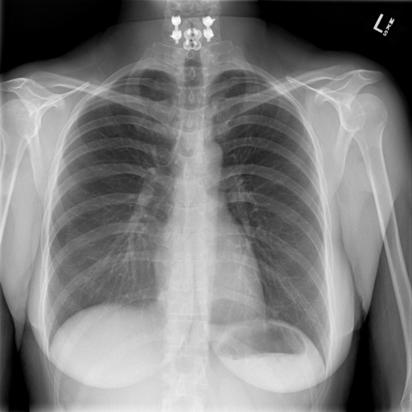



### Report: Based on the x-ray image, the heart size is normal and the lungs appear clear. The presence of pneumonia, effusions, edema, pneumothorax, adenopathy, nodules or masses has been ruled out. The finding indicates everything is normal. In other words, the overall impression is that of a normal chest. Do you have any questions or concerns about this x-ray result?
诊断一下这个X光片
EN
病人的X光片显示无急性心肺疾病。具体而言，心脏、肺血管和纵隔均在正常范围内。此外，没有胸腔积液或气胸的证据，也没有呈现肺炎的局部气腔密度。然而，有一个暂存的颈椎融合部分评估，可能需要进一步检查。
VisualGLM-6B
### 报告: 根据X射线图像，心脏大小正常，肺部看起来很清晰。已经排除了肺炎、积液、水肿、气胸、腺病、结节或肿块的存在。该发现表明一切正常。换句话说，总体印象是胸部正常。你对这个X射线结果有什么问题或担忧吗？
中文
.
.
.
### 提示词: 通过这张胸部X光影像可以诊断出什么？

