Slide 1


IvyGPT: InteractiVe Chinese pathwaY language model in medical domain
CAAI International Conference on Artificial Intelligence 2023 Demo Paper
lvyGPT：...
Demo：http://81.71.71.157:52022/

Slide 2
CAAI International Conference on Artificial Intelligence 2023 Demo Paper
Introduction
LLMs in Medical field

Advantages
Large language models (LLMs) are an important research direction in the field of artificial intelligence and have experienced rapid development since the introduction of ChatGPT in 2022.

1. Provide diagnostic advice, medication recommendations, interpretation of medical reports...
2. Respond quickly, effective in alleviating hospital patient congestion.

Disadvantages
1. LLMs are general-purpose models that are not trained for medical domain.
2. LLMs need to be adapted to local medical practices and treatment methods.

Slide 3
CAAI International Conference on Artificial Intelligence 2023 Demo Paper
literature Review
HuaTuo
ShenNong-TCM
ChatMed
MedicalGPT-zh
LLaMA-7B
LLaMA-7B
Chinese Medicine
Field
LLaMA-7B
LoRA
ChatGLM-6B
LoRA
Instruct-tuning
LoRA
These models have some shortcomings:
1. Small number of parameters for the base model (6B, 7B).
2. Lack of high quality datasets that match real doctor-patient scenarios.
3. Lack of a comprehensive model training process.

Slide 4
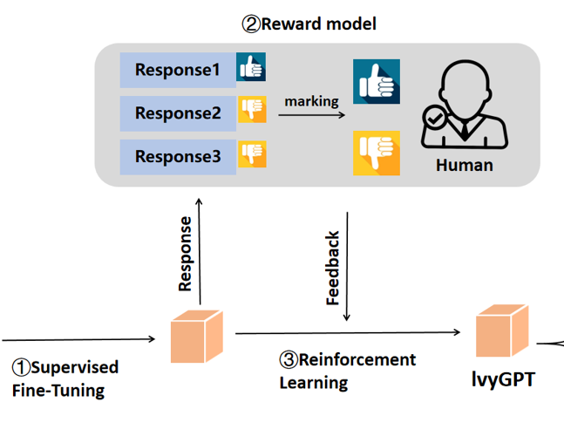
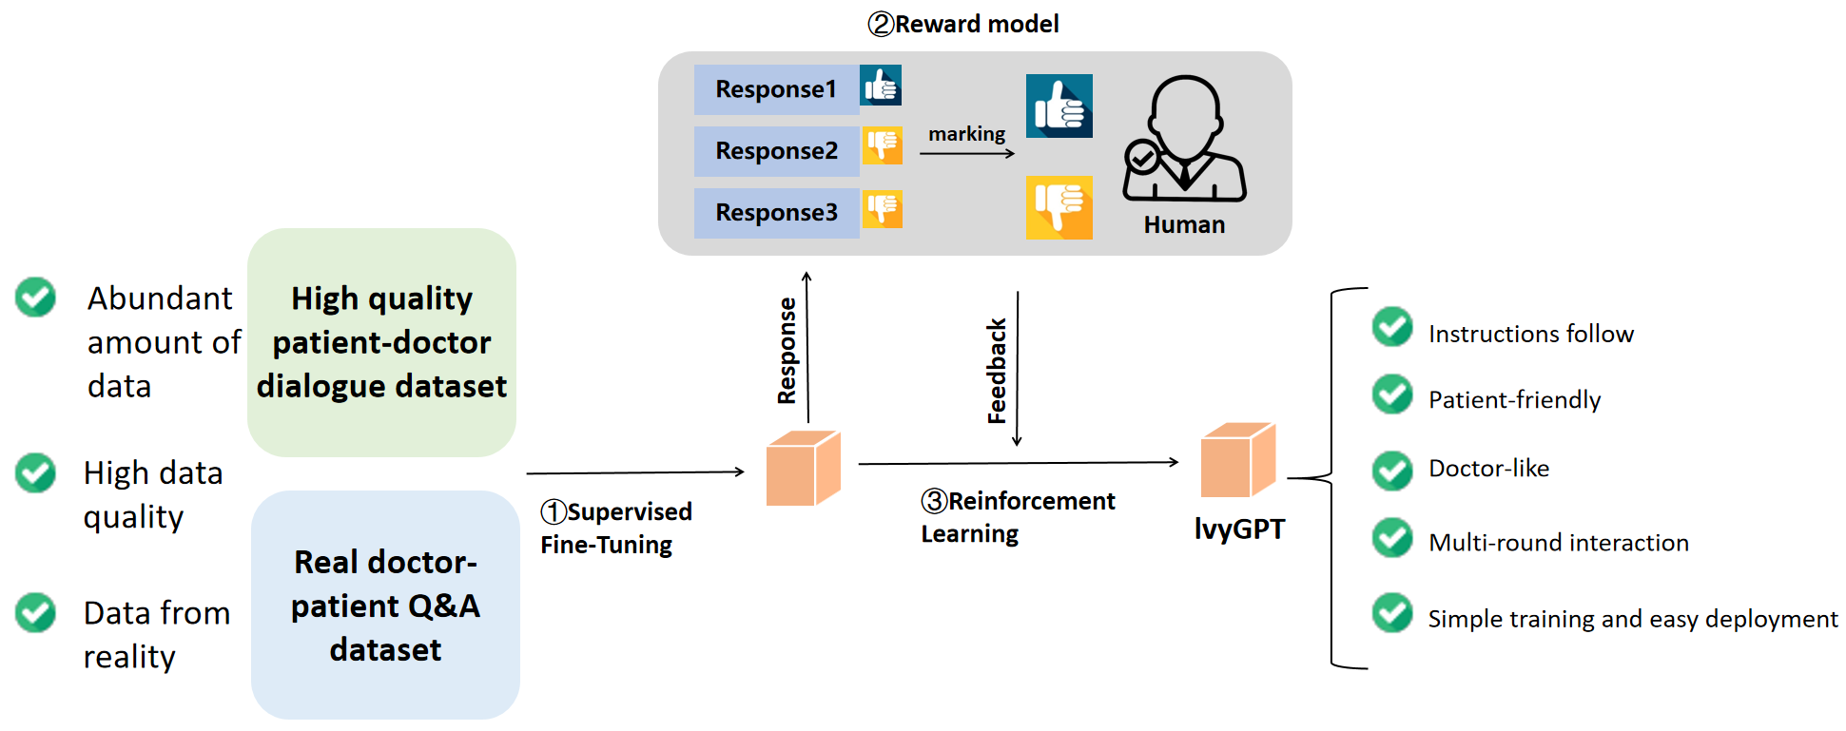
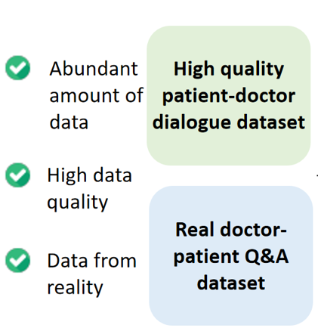
CAAI International Conference on Artificial Intelligence 2023 Demo Paper
Methodology
Instructions follow
Patient-friendly
Doctor-like
Multi-round interaction
Simple training and easy
deployment

Slide 5
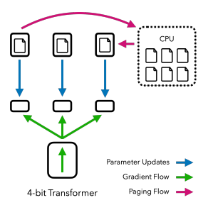
CAAI International Conference on Artificial Intelligence 2023 Demo Paper
Methodology
Two-stage training strategy:
Supervised Fine-tuning (SFT) with mixed data and Reinforcement Learning (RL) with human feedback.
QLoRA
Supervised Fine-tuning (SFT)
Reward Model
Reinforcement Learning
(RL)
1. We use reward model to guide IvyGPT to get better answers through reinforcement learning.
2. We introduce the KL divergence to prevent model deviating too far.
1. We use real conversations as training data, sampling multiple responses from our fine-tuned model.
2. Human scores responses.

Slide 6
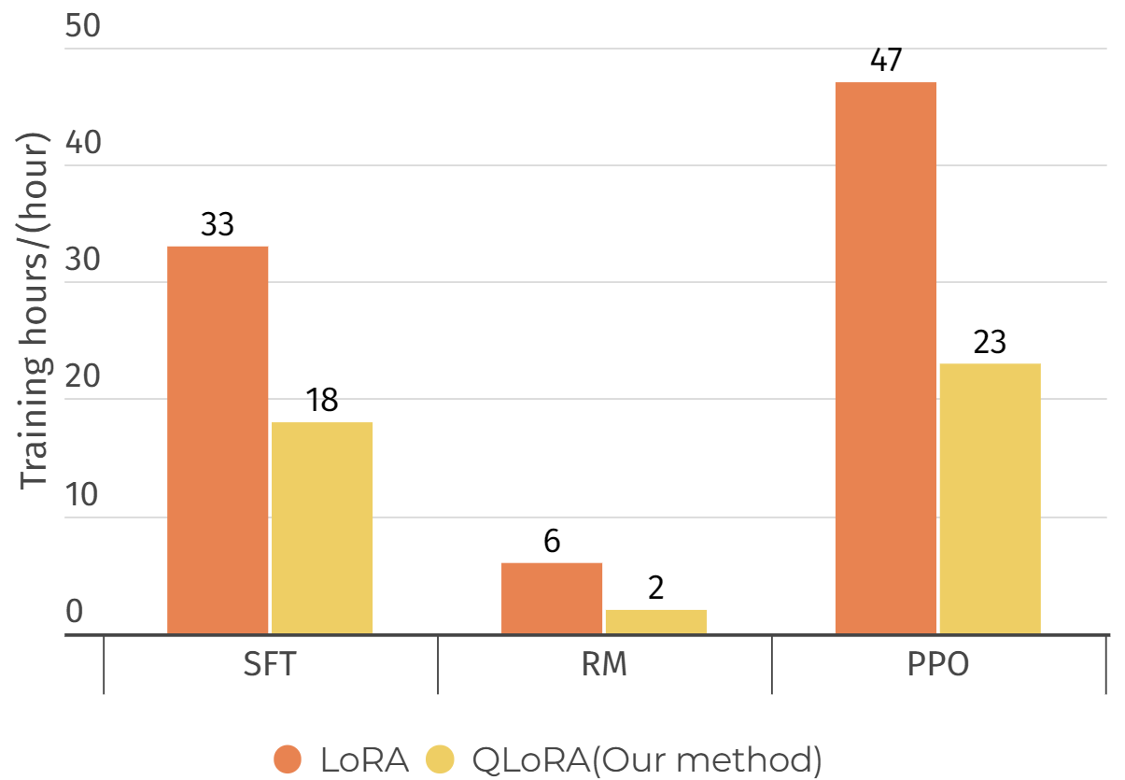
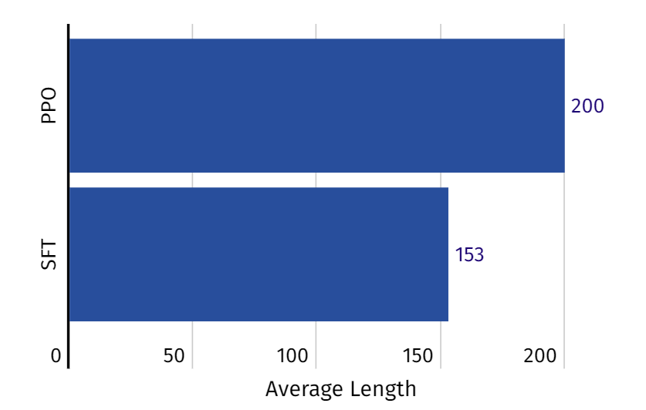
CAAI International Conference on Artificial Intelligence 2023 Demo Paper
Evaluation
Comparison of the Training Hours on different fine-tuning methods.
Generate the average length of the responses.
(b) is the training duration under different fine-tuning meth

Slide 7
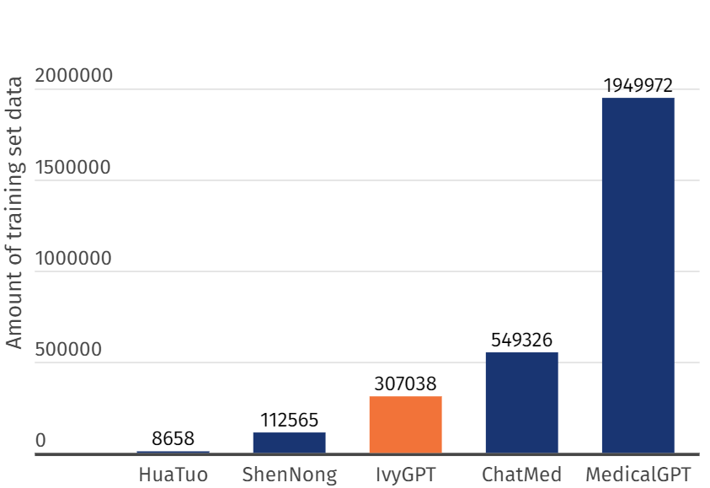
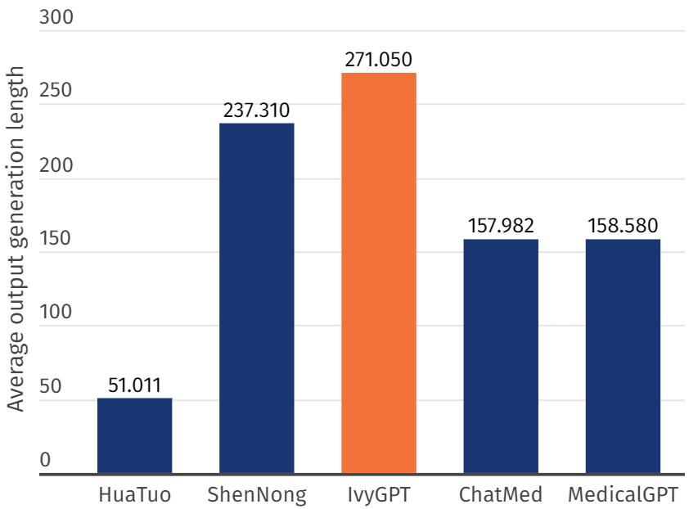
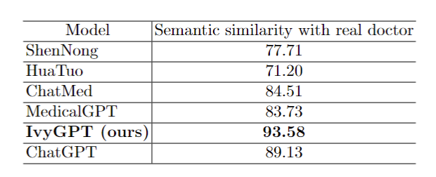
CAAI International Conference on Artificial Intelligence 2023 Demo Paper
Evaluation
We used a Word2Vec-based method of computing cosine similarity to evaluate semantic similarity of AI answers and human answers.

Slide 8
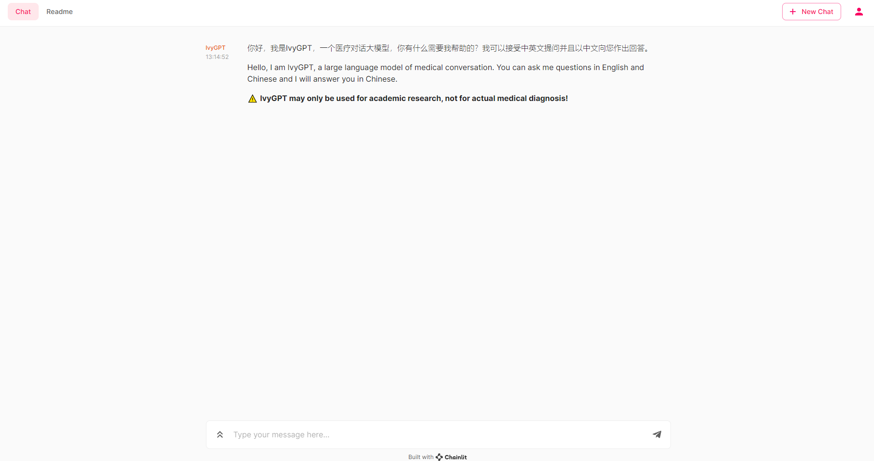
CAAI International Conference on Artificial Intelligence 2023 Demo Paper
Model Deployment

Slide 9
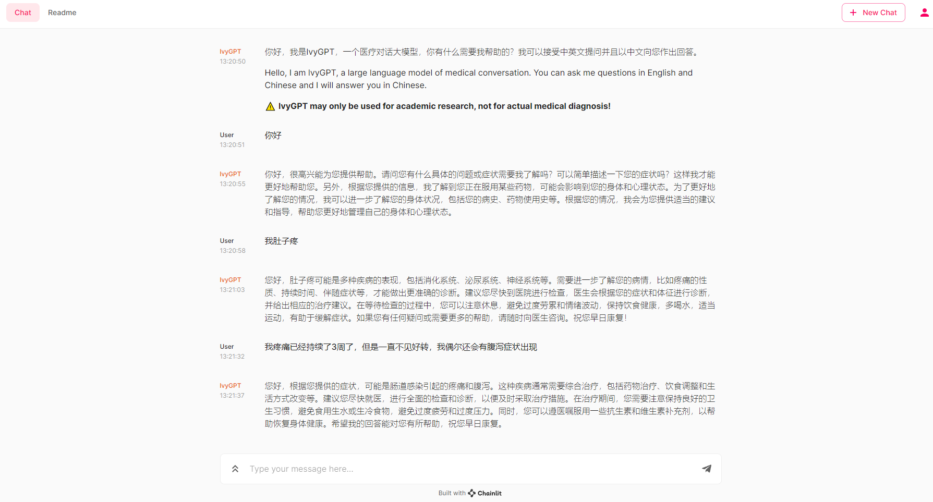
CAAI International Conference on Artificial Intelligence 2023 Demo Paper
Model Deployment
The service interface of IvyGPT aligns with the OpenAI interface.
Use the Python-based chainlit package to create the user interface.
Generate a unique ID code for each new user to differentiate their identities.
1
2
3

Slide 10
CAAI International Conference on Artificial Intelligence 2023 Demo Paper
Conclusion and Discussion
IvyGPT
Limitations
Summary
IvyGPT,
a medical large language model trained through supervised fine-tuning using high-quality medical Q&As instances and reinforcement learning based on human feedback.
Data insufficiency.
Limited model capacity.
Ethical and Responsibility Issues need to be carefully addressed .
With 33 billion parameters
Capable in limited computational resources
Future Work
Front-end and back-end separation
techniques to facilitate the
practical implementation
Combine with medical expert.
Exploring model compression techniques.
Conducting evaluations and trials in real-world medical settings.

Slide 11




Thank you

