Slide 1
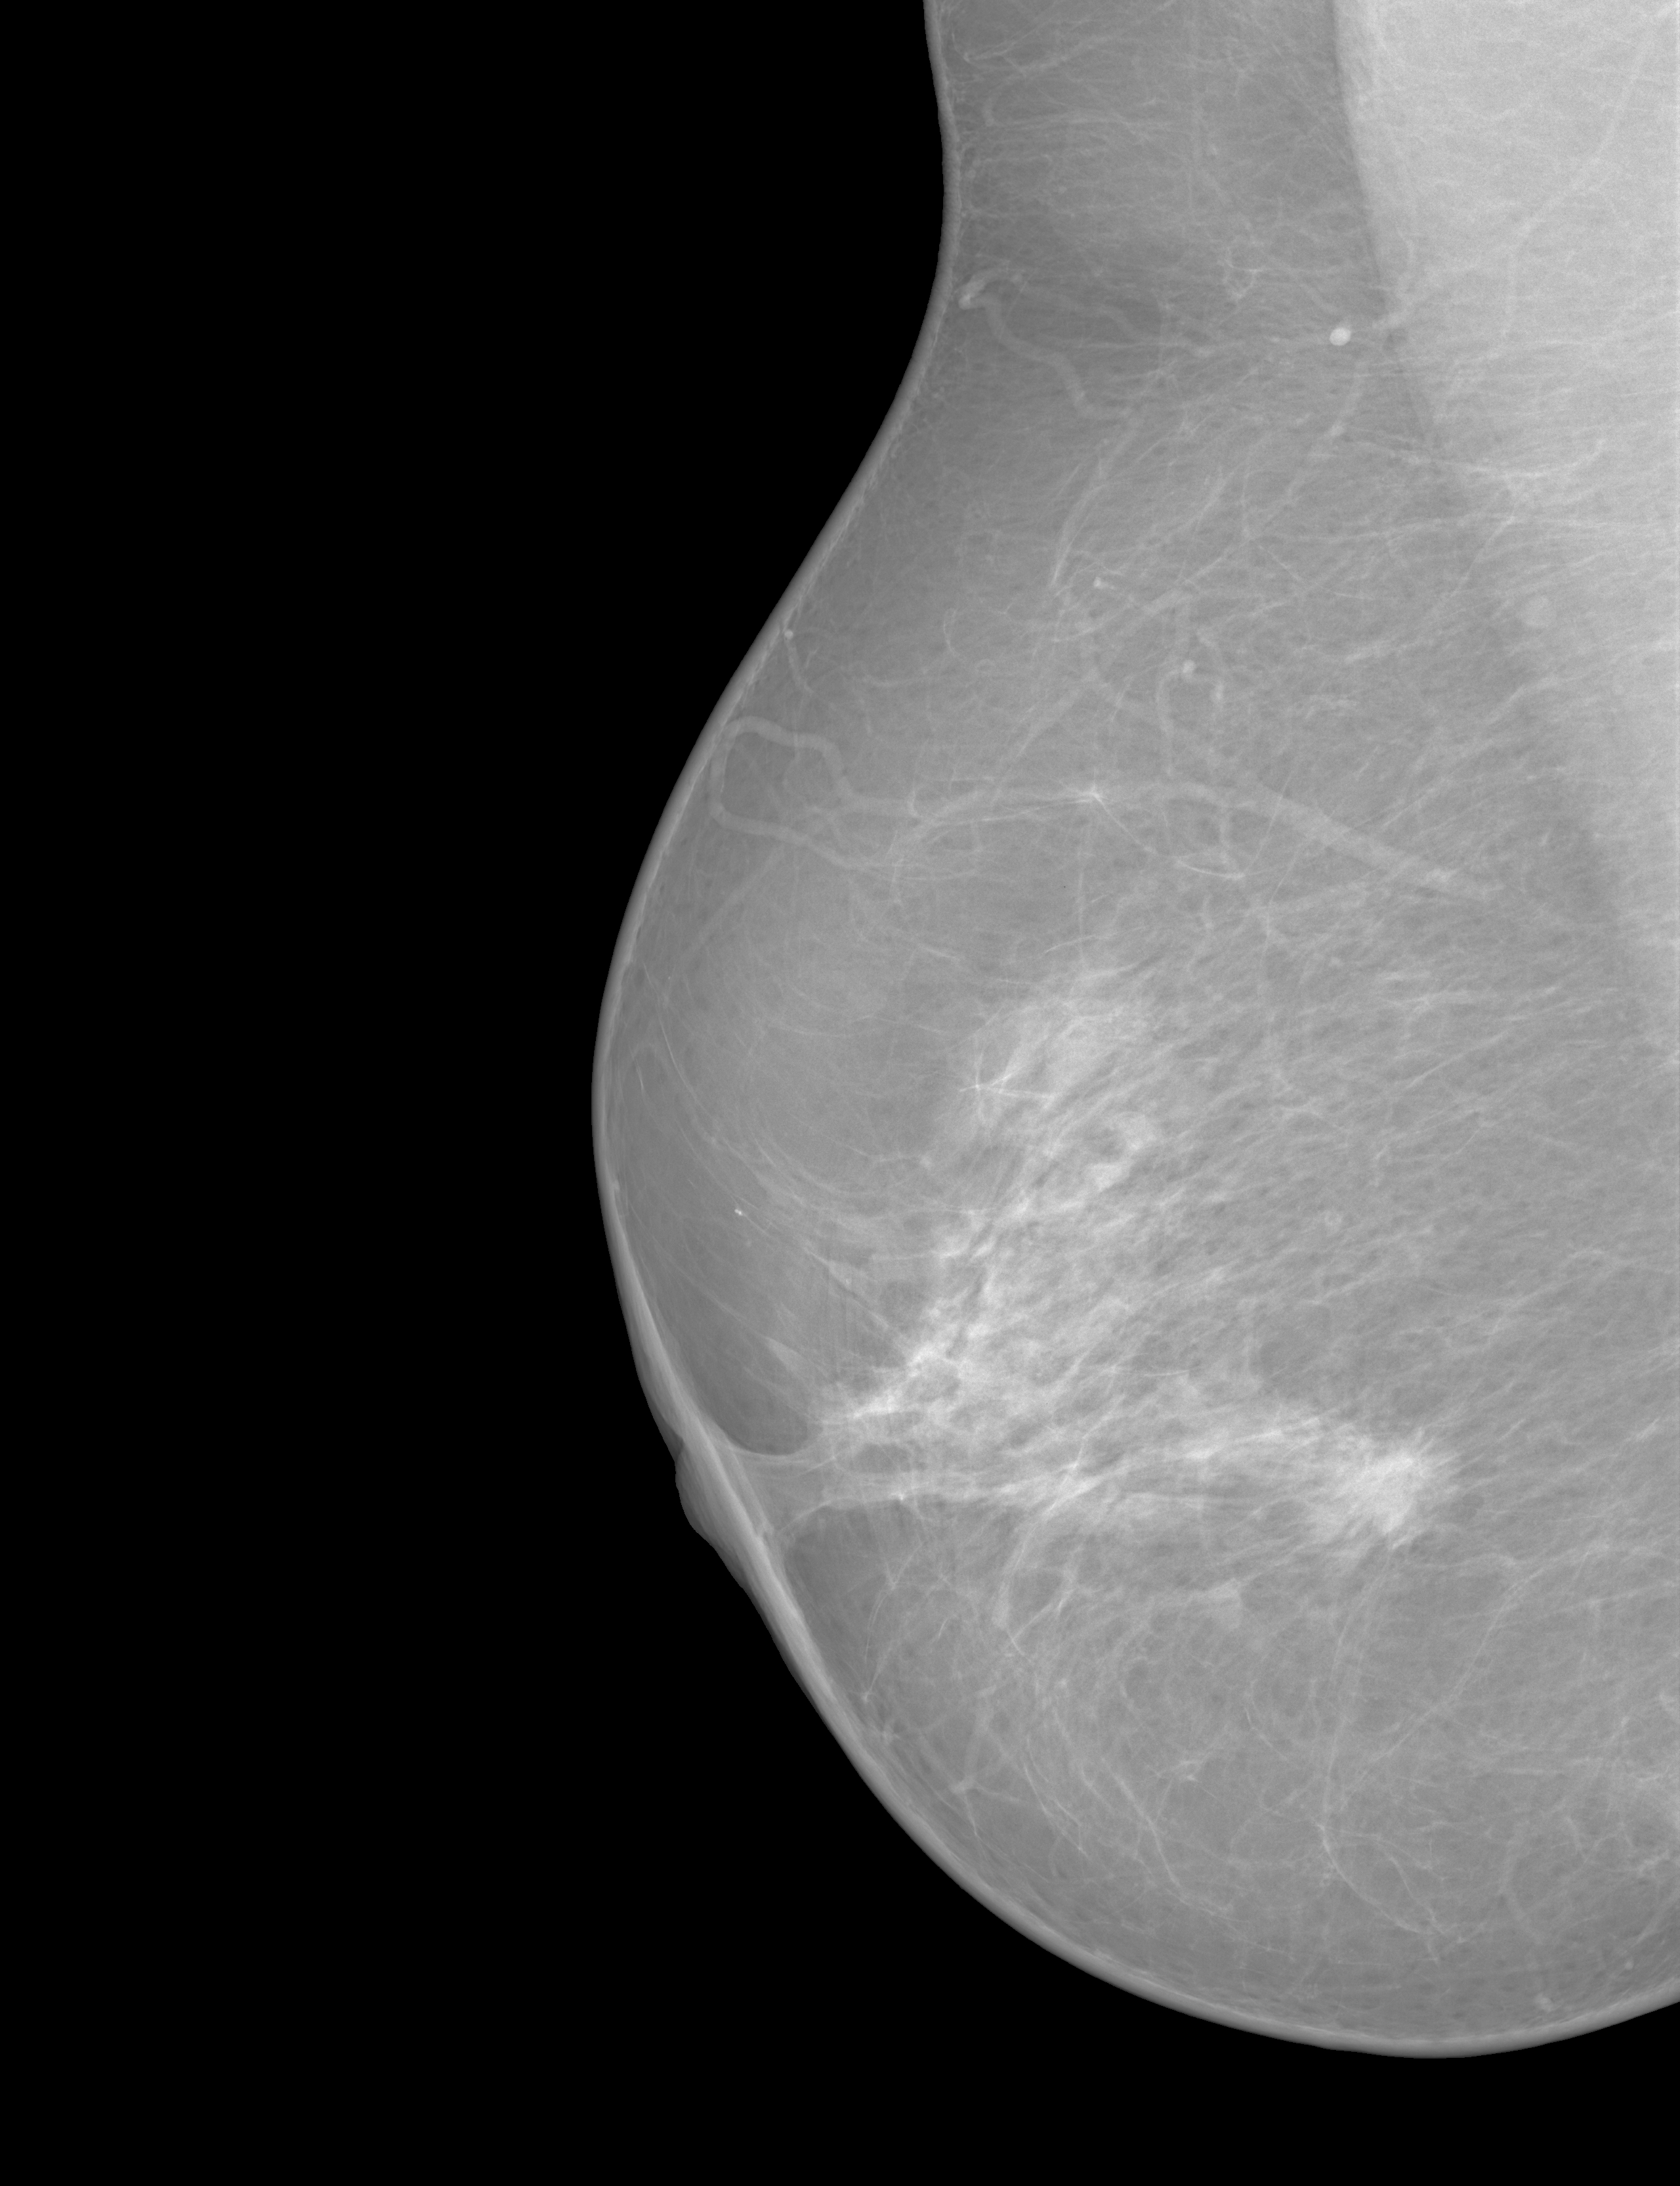


Patch Partition
Liner Projection
Liner Embedding
Patch Expanding
2 * VSS Block
Skip Connection
2 * VSS Block
mass
Patch Merging
Patch Expanding
2 * VSS Block
Skip Connection
2 * VSS Block
calcification
Patch Merging
Patch Expanding
2 * VSS Block
2 * VSS Block
...
Skip Connection
Patch Merging
Patch Expanding
Encoder
Decoder
1 * VSS Block
1 * VSS Block
embedding
CLIP
Notes:
By @avsthiago

