Slide 1
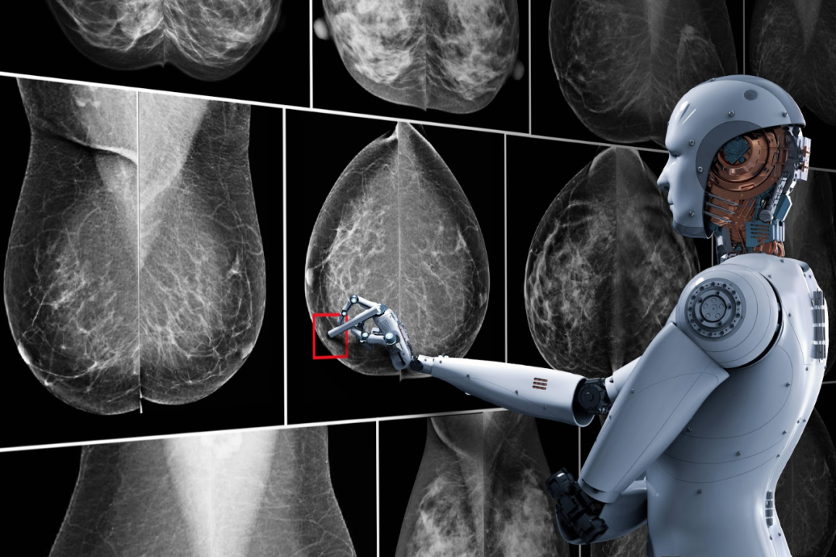

Mammographic Disease Detection System
GEM Lab

