Slide 1





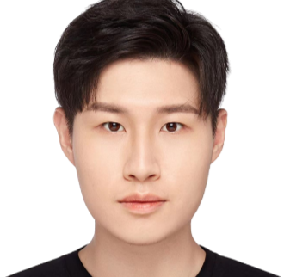


PCTMF-Net: Heart Sound Classification with Parallel CNNs-Transformer and Second-Order Spectral Analysis Paper ID: 115
Rongsheng Wang¹
Yaofei Duan¹
Yukun Li¹
Dashun Zheng¹
Xiaohong Liu²
Tao Tan*^{,1}
Macao Polytechnic University¹, Shanghai Jiao Tong University²
*Email: taotanjs@gmail.com
Notes:
Hello everyone, I will introduce our work, PCTMF-Net: Heart Sound Classification with Parallel CNNs-Transformer and Second-Order Spectral Analysis. Our paper ID is 115.
I'm today's oral presenter Rongsheng Wang.

Slide 2
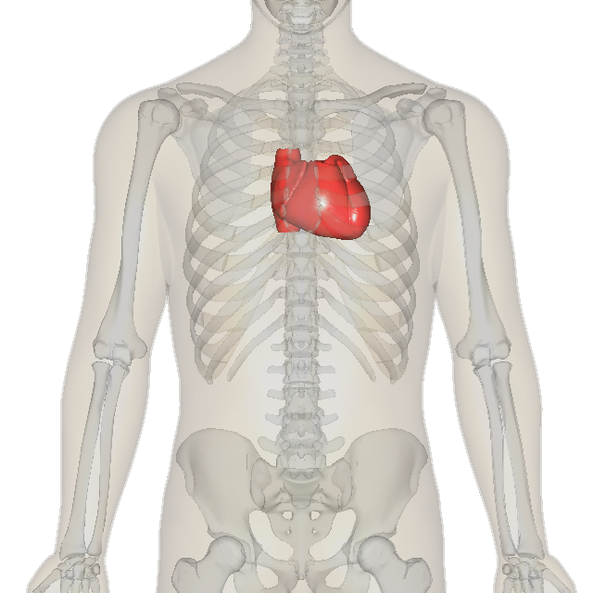
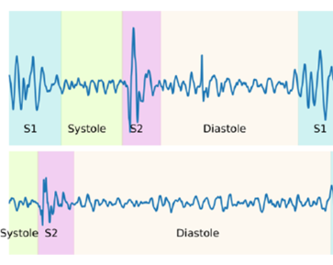
Introduction
The heart is one of the most vital parts of the human body, and heart disease has become a major cause of illness and death worldwide. Using heart sounds to assess the early health condition of the heart is an effective method.
Non-invasive
Quick and easy
Real-time assessment
Affordable and accessible
Notes:
The heart is one of the most important parts of the human body, and heart disease has become a major cause of illness and death worldwide. Using heart sounds to judge the early health condition of the heart is an effective method.
Using heart sound diagnosis is more convenient and faster, so it is the best method.

Slide 3
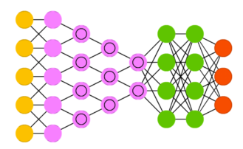
Introduction
Pre-processing
1. Signal De-noising
2. Signal Splitting
3. Feature Extractions
Heart sound
Deep Learning Model
Deep learning models are widely used in the diagnosis of heart sound health to achieve automated health monitoring. This process involves heart sound preprocessing and deep learning model construction.
❌ Feature extraction from heart sounds is typically high-dimensional and diverse, and existing feature extraction methods are not sufficient.
❌ In the design of deep learning models, usually only local heart sound features are considered, without considering the continuous global relationships of heart sounds.
Notes:
Heart sounds can be used by doctors to diagnose the health of the heart, but it requires broad experience. In areas with limited resources, doctors are limited, making it more challenging to conduct heart health screenings. Computer-Helped diagnosis is gaining increasing attention, especially artificial intelligence and deep learning.
Deep learning models are widely used in the diagnosis of heart sound health to achieve automated health Controlling. This process involves heart sound preprocessing and deep learning model construction.
However, there are also some drawbacks to this:
1. Feature extraction from heart sounds is typically high-dimensional and diverse, and existing feature extraction methods are not enough.
2. In the design of deep learning models, usually only local heart sound features are considered, without considering the constant global relationships of heart sounds.

Slide 4
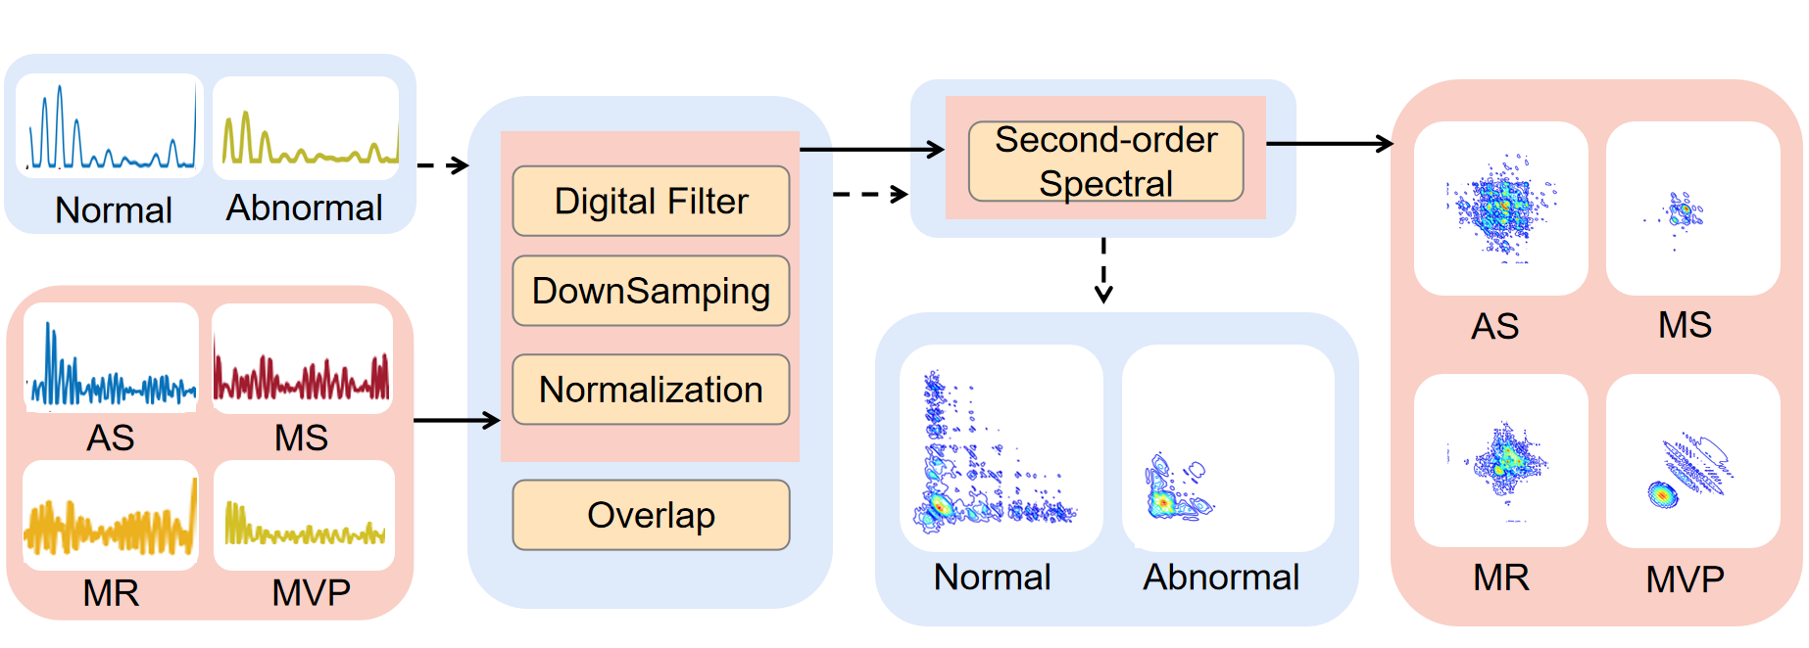
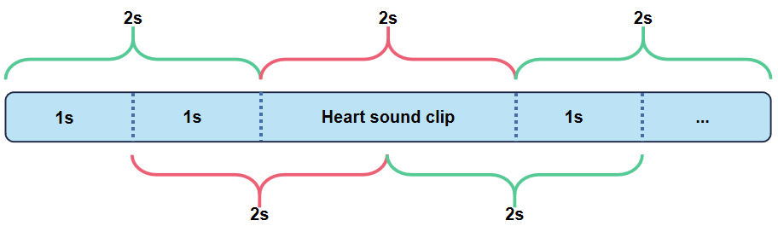
Proposed Method(Pre-processing)
Data pre-processing flow
Overlap (50%)
We process the audio signals by applying digital filtering to remove noise, downsampling to reduce the amount of feature information, and normalization to balance signal differences across different datasets. Finally, we split the data using overlap, which generates more effective datasets.
Notes:
We process the audio signals by applying digital filtering to remove noise, downsampling to reduce the amount of feature information, and normalization to balance signal differences across different datasets.
Finally, we split the data using overlap, which generates more effective datasets.

Slide 5
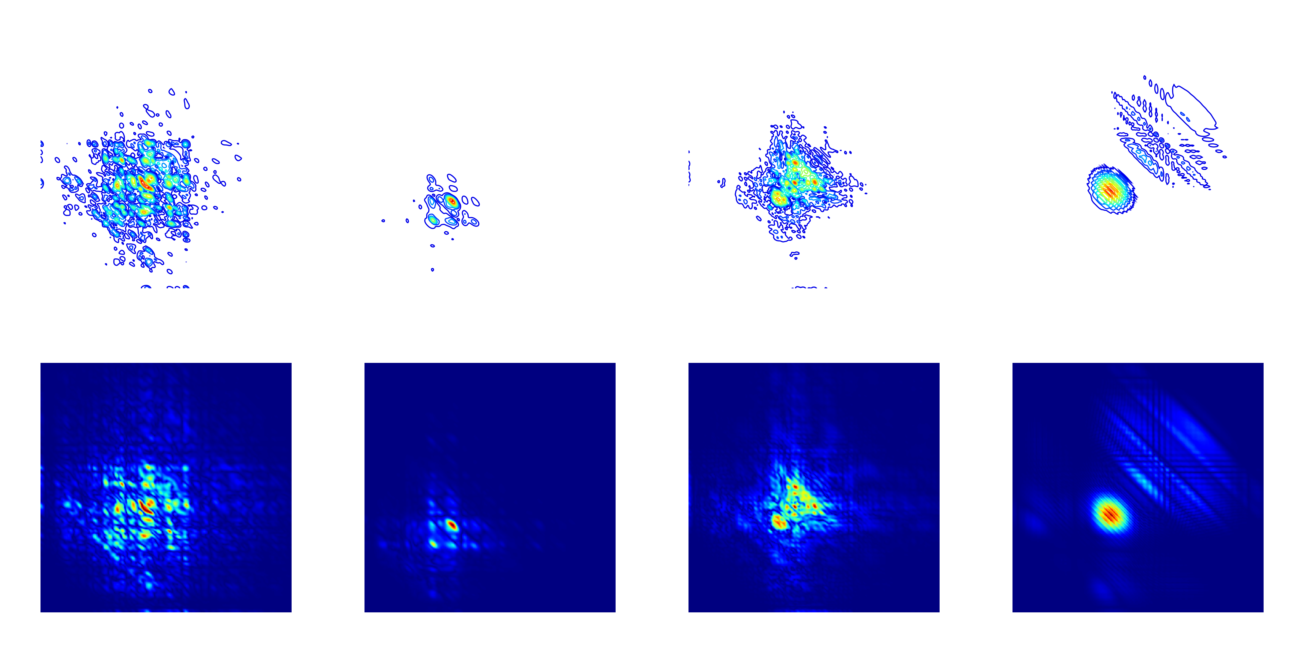
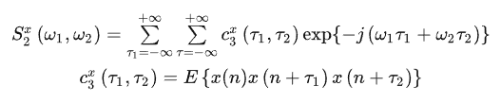
Proposed Method(Pre-processing)
Second-order Spectral Equation (math.)
The first line is a contour map and the second line is a heat map.
By performing second-order spectral feature extraction on the heart sound signals, we can obtain a feature matrix of size 256 by 256. This feature matrix can be visualized using contour plots and heatmaps, where there are distinct feature differences between heart sounds associated with different diseases.
Notes:
Advanced spectral analysis methods in the field of modern digital signal processing yield significantly better results in feature extraction compared to lower-order methods such as wavelet transform. Among these advanced spectral methods, the second-order spectral method is widely used. It effectively Controls stage relationships in signals and detects and quantifies stage connecting in non-Gaussian signals. It is commonly used for Unstable medical signals such as EEG, ECG, and EMG.
By performing second-order spectral feature extraction on the heart sound signals, we can obtain a feature matrix【没吹格斯】 of size 256 by 256. This feature matrix【没吹格斯】 can be visualized using contour plots and heatmaps, where there are distinct feature differences between heart sounds associated with different diseases.

Slide 6
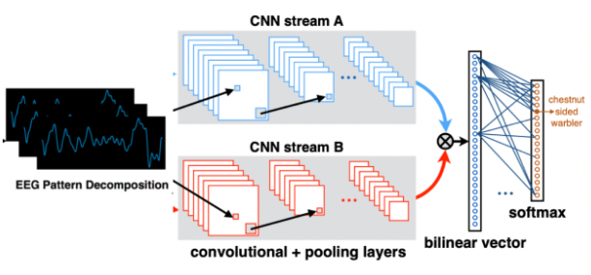
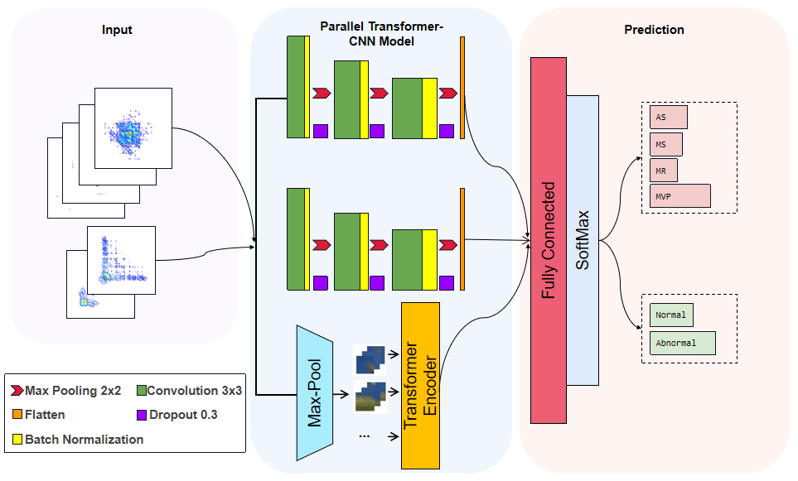
Proposed Method(Deep Learning Model)
Two-branch CNN models
PCTMF-Net Execution Flow (ours)
CNN networks are better at extracting local features for improved classification. However, when it comes to extracting sequential information from heart sounds, using only CNN can lead to significant loss of global information. Therefore, we proposed the PCTMF-Net model, which is a parallel network with branching.
Notes:
CNN networks are better at obtaining local features for improved classification. However, when it comes to obtaining sequential information from heart sounds, using only CNN can lead to significant loss of global information. Therefore, we proposed the PCTMF-Net model, which is a parallel network with branching.

Slide 7
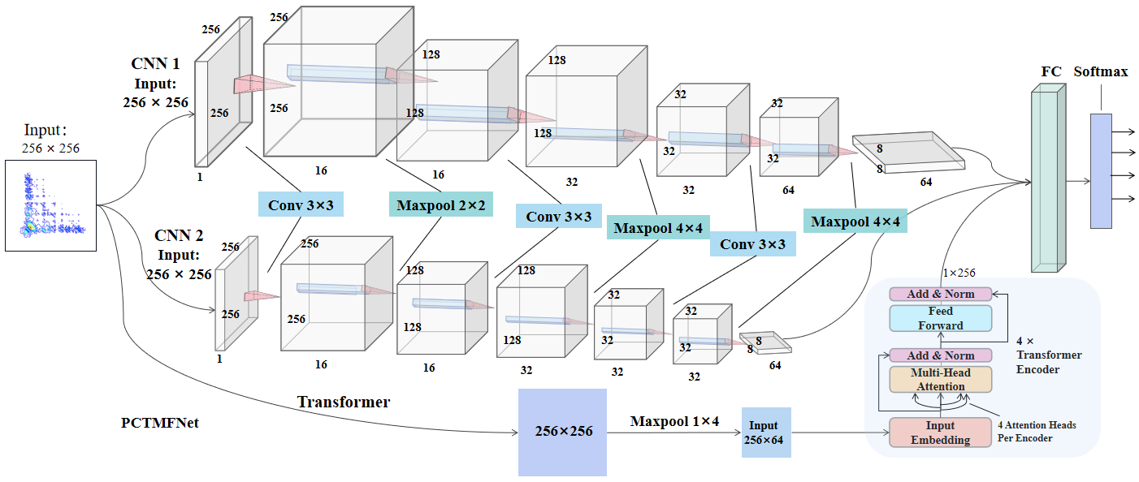
Proposed Method(Deep Learning Model)
PCTMF-Net (ours)
We propose a parallel CNN-Transformer structure. The parallel two-branch CNN can better learn different features from each convolutional layer, increasing the diversity of information flow. The Transformer has stronger parameter sharing capability, making it easier to share features and enhance the model's ability to model multi-scale information. It also has a stronger sense of contextual semantics.
Notes:
We propose a parallel CNN-Transformer structure. The parallel two-branch CNN can better learn different features from each convolutional layer, increasing the diversity of information flow. The Transformer has stronger parameter sharing ability, making it easier to share features and enhance the model's ability to model multi-scale information. It also has a stronger sense of meaning in context.

Slide 8
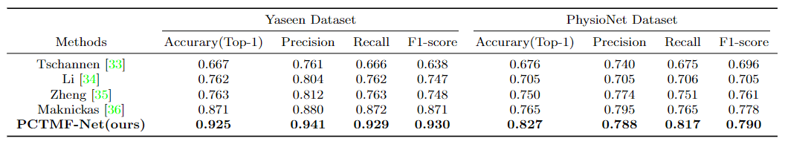
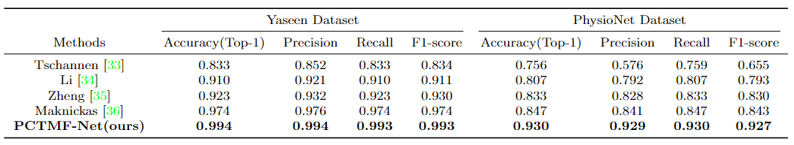
Experiments
Comparison of performance metrics of different models on MFCC feature extraction
Comparison of performance metrics of different models on second-order spectral analysis feature extraction
Experimental demonstration of the results of the second-order spectral feature extraction method and the PCTMF-Net design in heart sound classification and diagnosis
Notes:
To validate the effectiveness of our method, we compared it with other methods on two publicly available datasets.
Table 1 shows the best results obtained using the traditional MFCC feature extraction method and our PCTMF-Net model.
Table 2 presents the best results achieved using the second-order spectral analysis method and the PCTMF-Net model.
Both experiments shows the effectiveness of our proposed method.

Slide 9
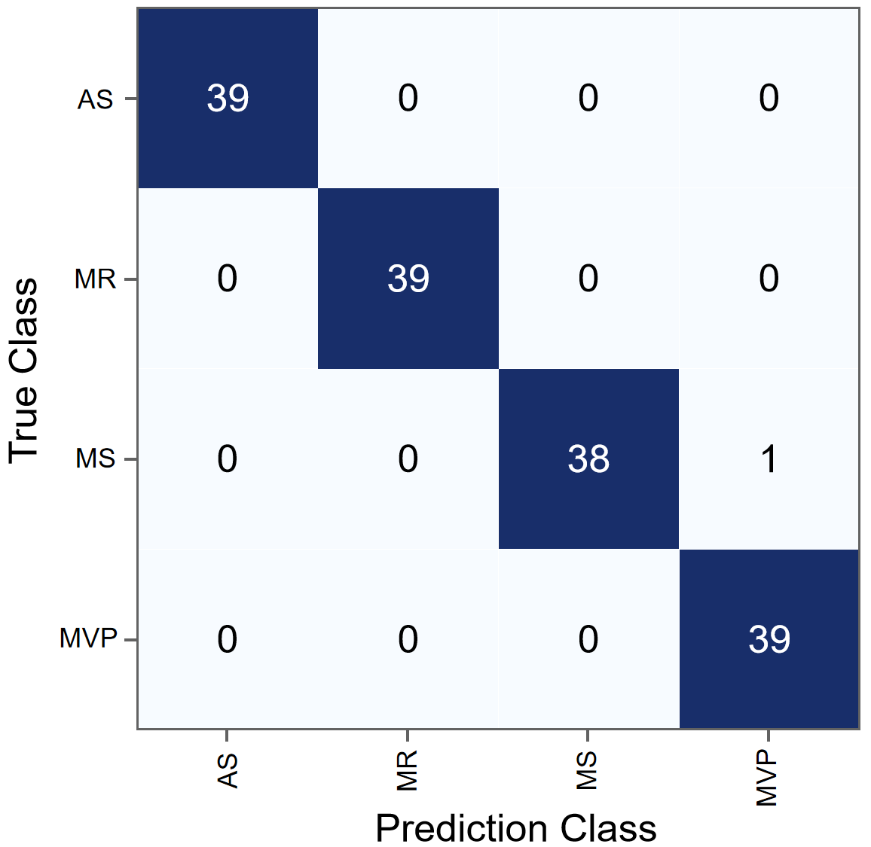
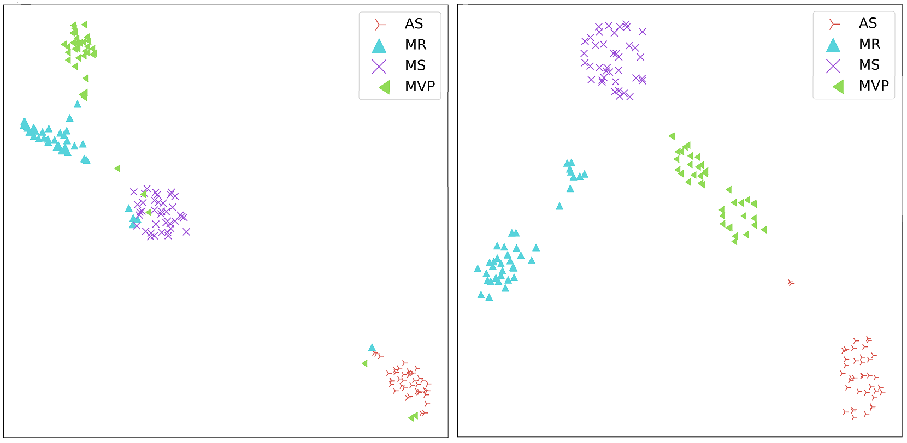
Visualisation
Confusion matrix of PCTMF-Net
Visualisation of t-SNE results
PCTMF-Net achieved the highest accuracy in the Confusion matrix. In the t-SNE visualization, the left side shows the results of the previous methods, while the right side shows the results of PCTMF-Net, which demonstrates better classification outcomes.
Notes:
Finally, here are the visualizations of our results. PCTMF-Net achieved the highest accuracy in the Confusion matrix【没吹格斯】. In the t-SNE visualization, the left side shows the results of the previous methods, while the right side shows the results of PCTMF-Net, which Shows better classification outcomes.

Slide 10
Thanks
Notes:
That is all. Thanks!

