Slide 1
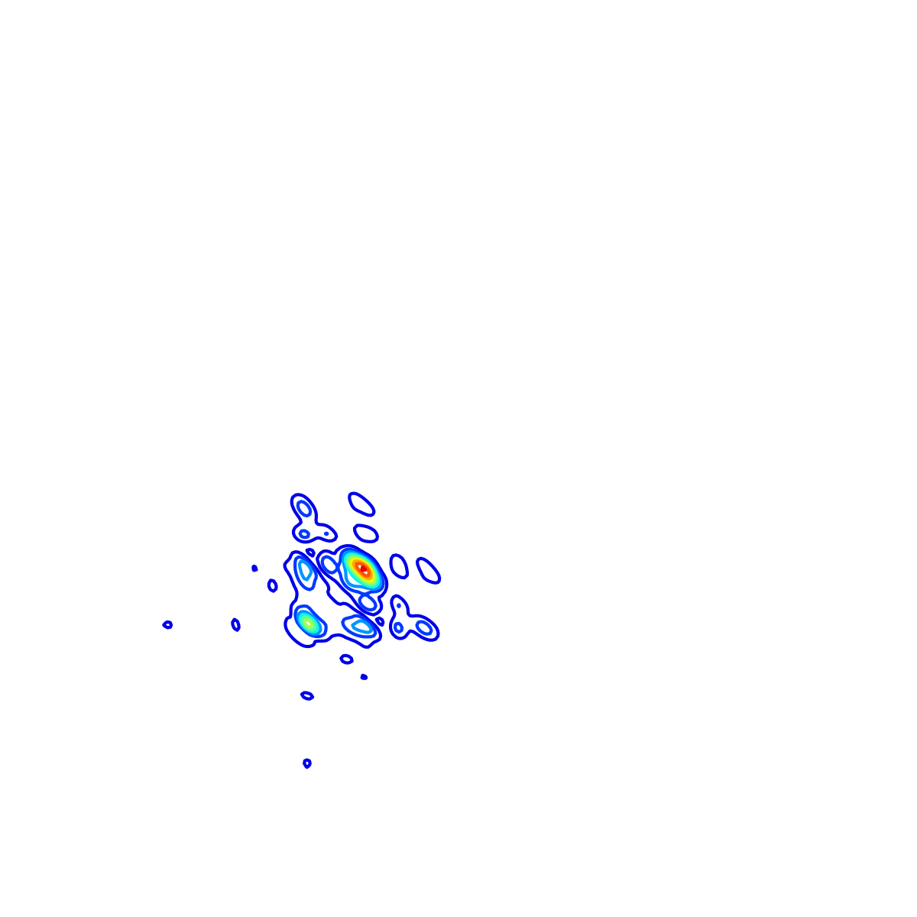
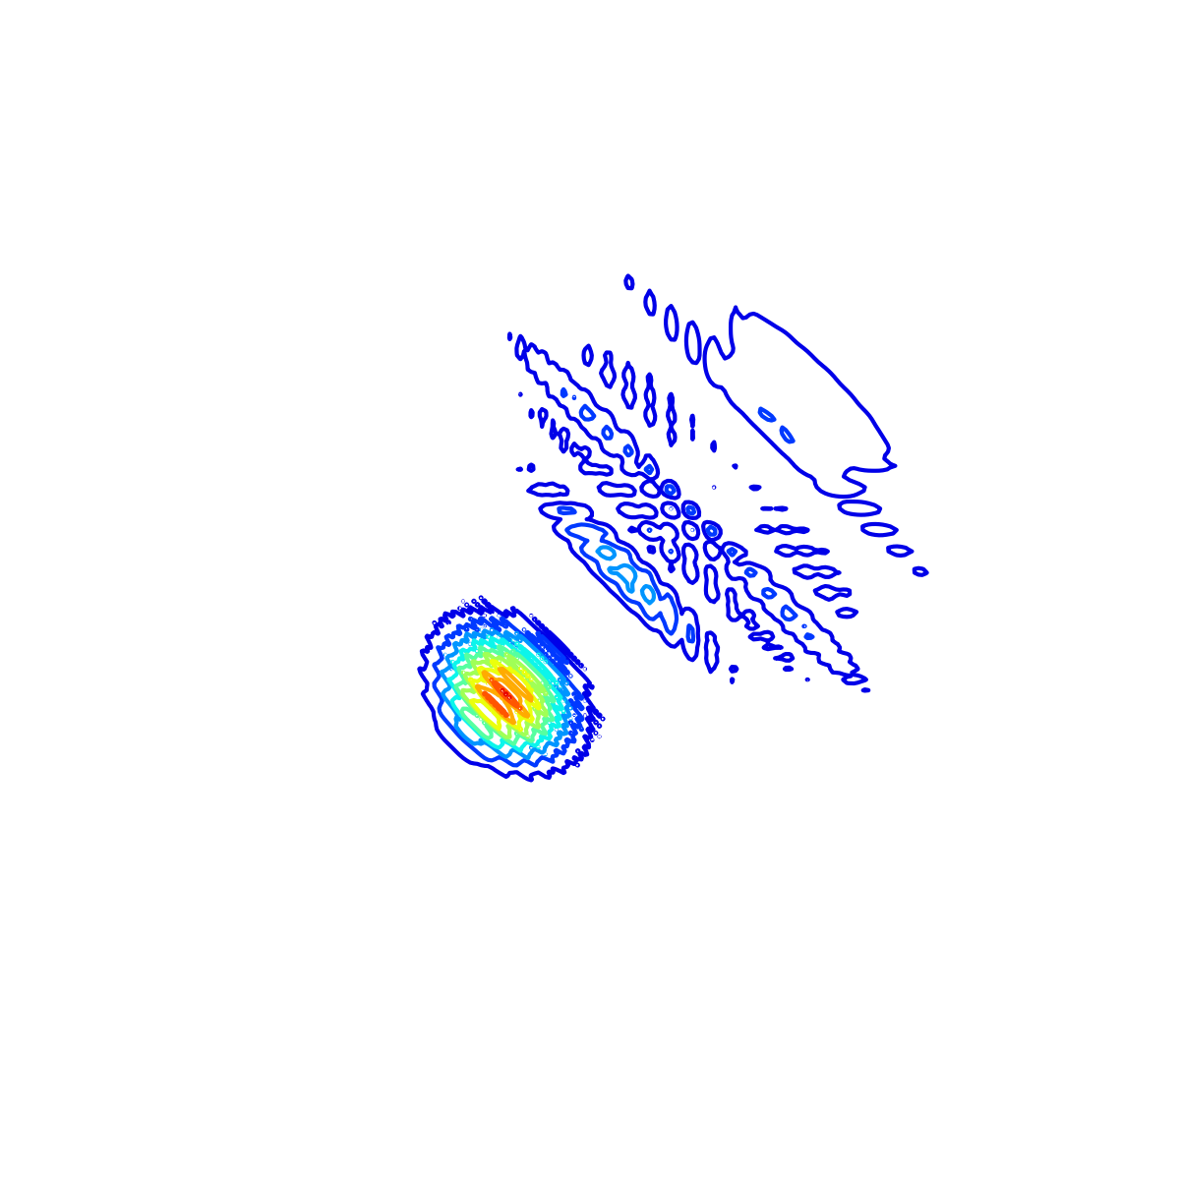
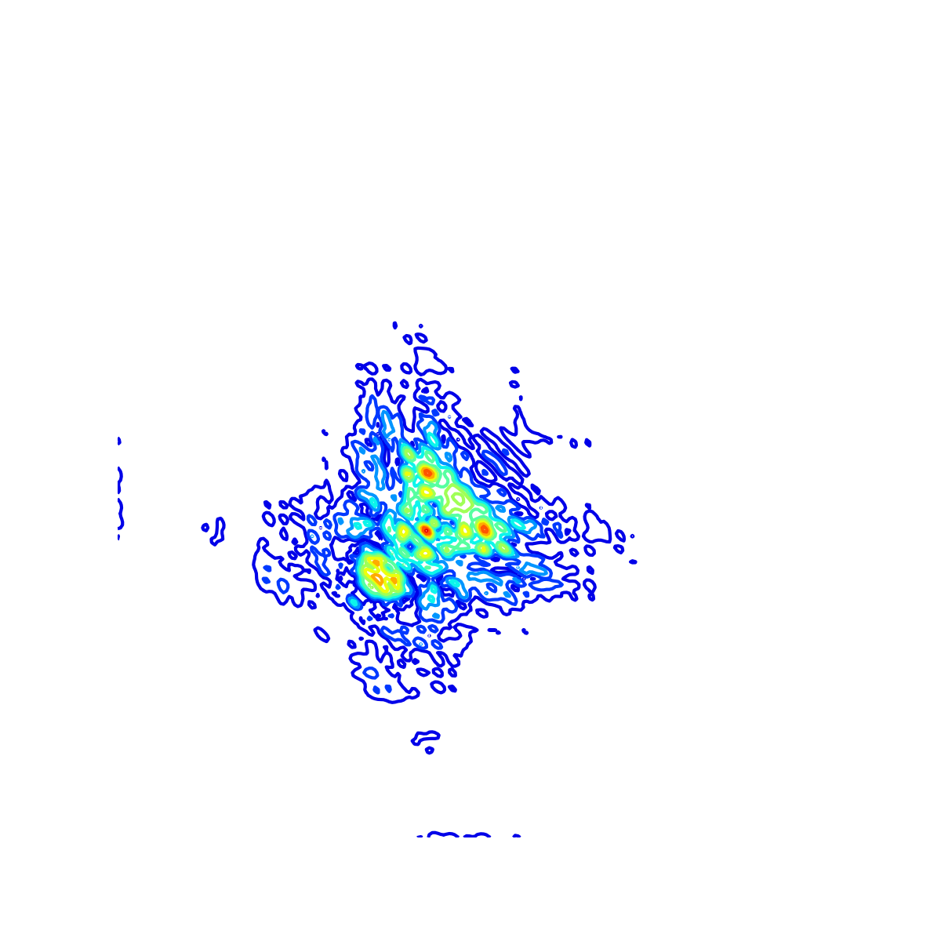
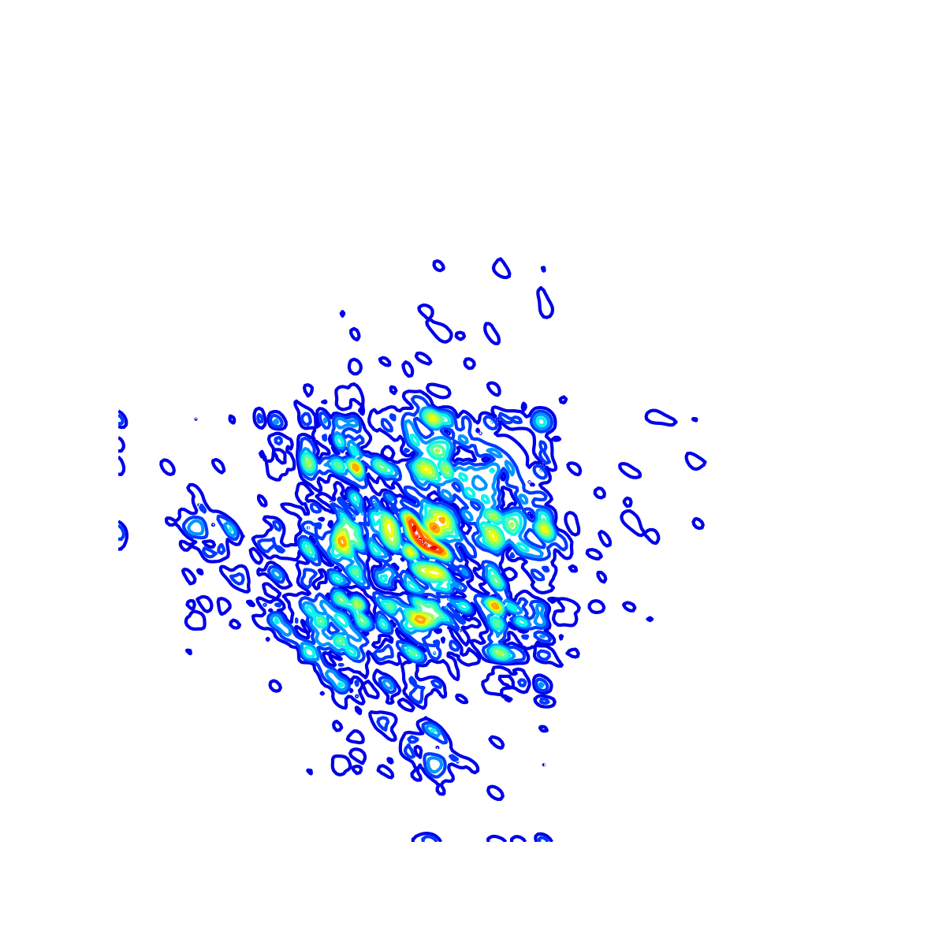
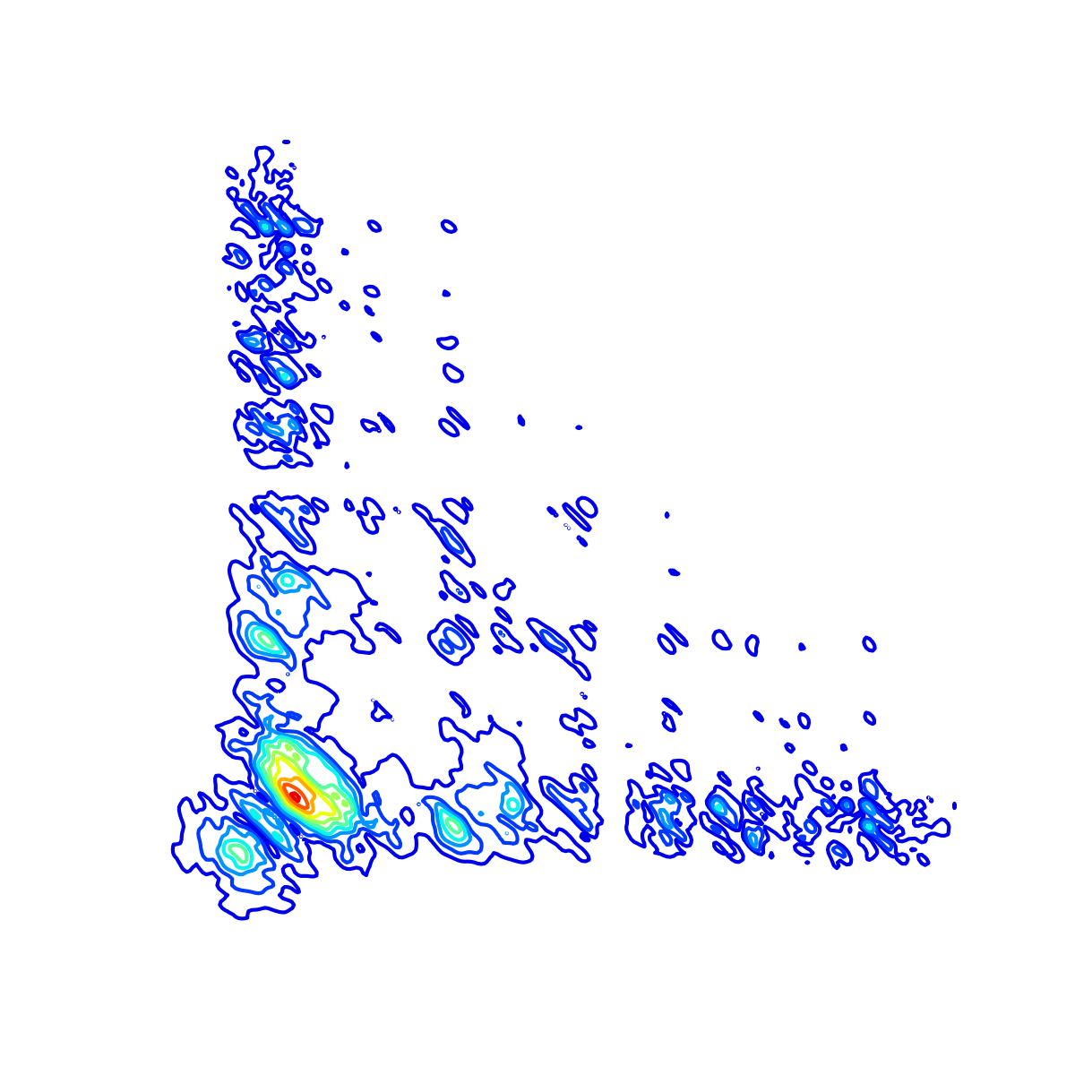


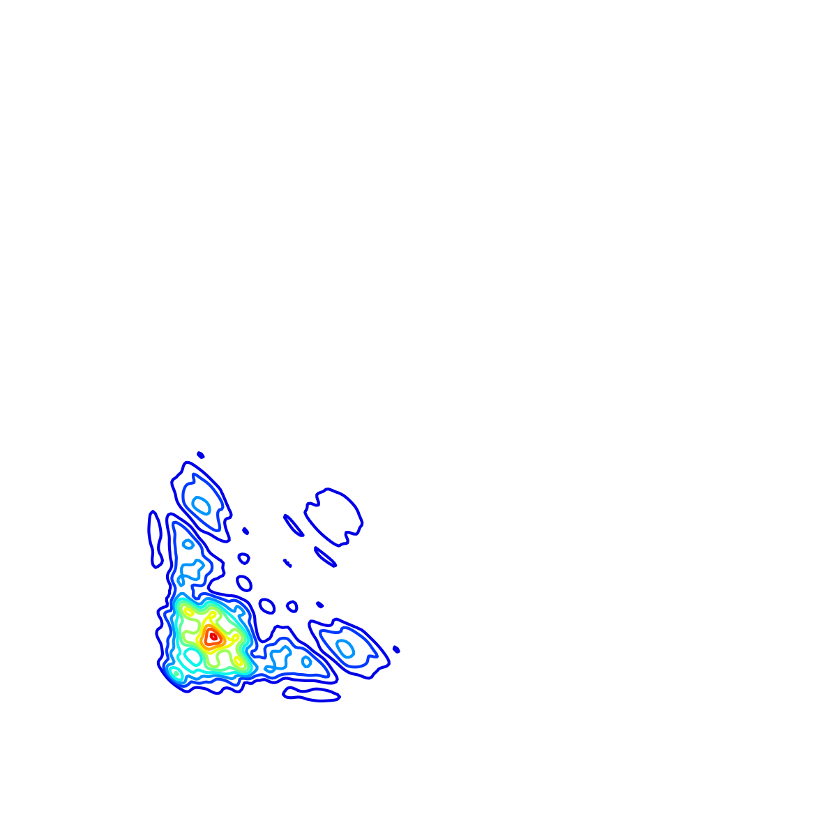
Fully Connected
SoftMax
Max-Pool
Transformer
Encoder
Convolution 3x3
Dropout 0.3
...
Max Pooling 2x2
Block copied

Slide 2
Input
Parallel Transformer-CNN Model
Prediction
AS
MS
MR
MVP
Fully Connected
SoftMax
Normal
Abnormal
Max-Pool
Transformer
Encoder
Max Pooling 2x2
Convolution 3x3
...
Flatten
Dropout 0.3
Batch Normalization

Slide 3
Fully Connected
SoftMax
Max-Pool
Transformer
Encoder
Max Pooling 2x2
Batch Normalization
Dropout 0.3
...
Flatten
Convolution 3x3

