Slide 1
Global Happiness and Life Satisfaction: Exploring the Factors
Yiping Bai, Wanting Cui, Jiaqi Wang, Keying Wang,
Ruoxi Wang, Xianghan Yi & Zhuorui Yu
2023.02

Slide 2




ABSTRACT
Abstract
Introduction
Methodology
Result
Conclusion
Introduction of the contents covered in this report.
Specify the research methods used in this study
Specifically analyze the collected data and present the results.
-1-

Slide 3


Introduction
Economic Prosperity — GDP
Who is happier, people of the past or present?
How satisfied are people from different social classes and societies with their lives?
Different
Countries
-2-

Slide 4
Literature Review
Social Support
Wealth
Personal Factors
Social support and life satisfaction are important factors that influence individuals' happiness.
(Maslow 1943; Steptoe, 2019; Lindenberg 2013; Tay & Diener, 2011; Diener, Oishi & Tay, 2018)
The question of whether money can buy happiness has been a topic of serious social science inquiry.
Some evidence can support almost any theory about wealth and happiness.
(Arthaud & Near, 2005).
Individual's physiological factors and acquired environment are also closely related to their happiness.
(Steptoe, 2019; Bartels, 2015; Clark et al., 2018)
-3-

Slide 5
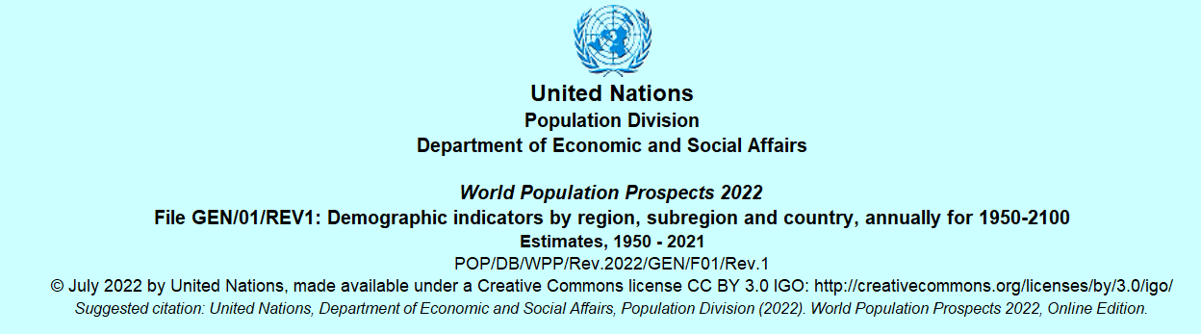
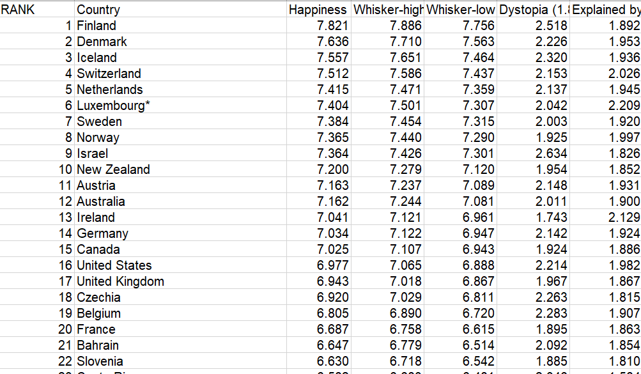
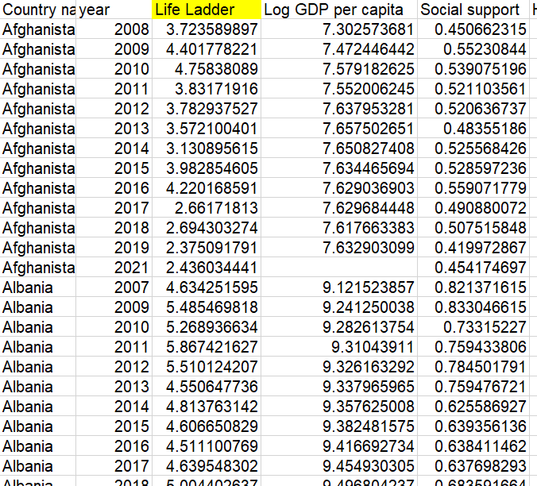
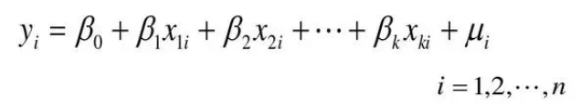
Methodology
Data Visualization
Data is obtained from an open source database called Our Word in Data
Depict the changing trends
Modelling
Use regression to explore the latent factors affecting the different happiness and life satisfaction.
PPT模板 http://www.1ppt.com/moban/
-4-

Slide 6
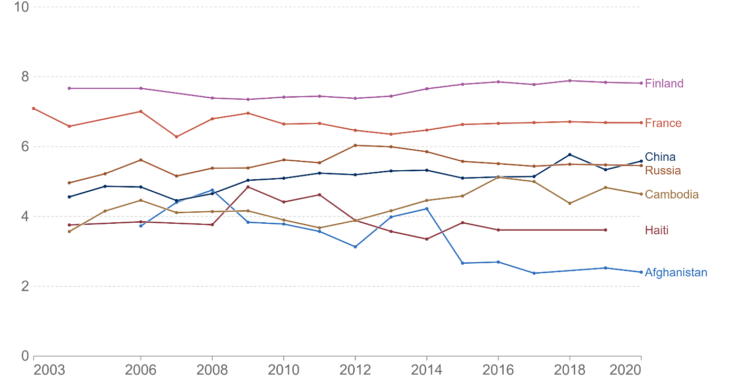
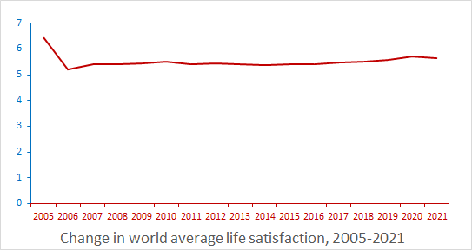
Result — Data Visualization of Global Happiness and Life Satisfaction
A global line graph to preliminarily explore the trend of changes in average life satisfaction among the world's population.
Use the classification standard of average life satisfaction in the ranges of 2-3, 3-4, 4-5, 5-6, 6-7and above 7.
Select seven representative countries and plot their residents' average life satisfaction over time.
-5-

Slide 7

Result — Related Factors: Life Expectancy
01
Average life expectancy around the world
Life Expectancy
Three graphs
02
Comparison of life expectancy between China and USA
03
The relationship between life expectancy and happiness
-6-

Slide 8
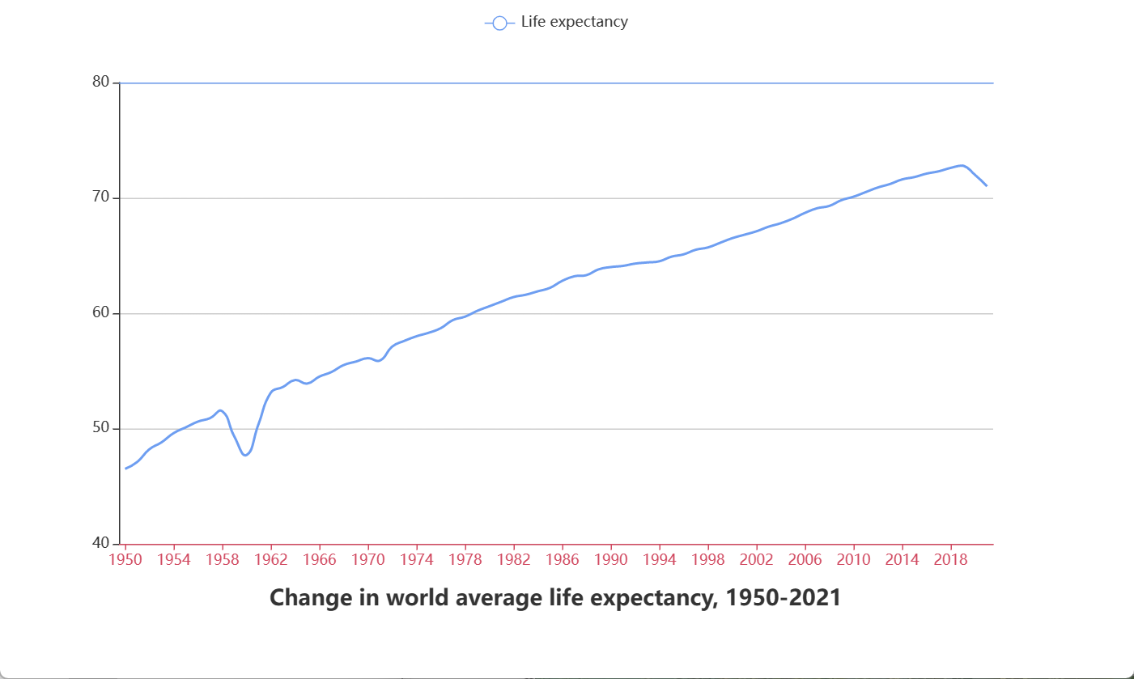
Result — Related Factors: Life Expectancy
01
The world’s average life expectancy （ 1950 to 2021 ）
Life expectancy：a steady growth trend（46.5 years in 1950 to 71 years in 2021）
The highest in 2018 (72.8 years)
-7-

Slide 9
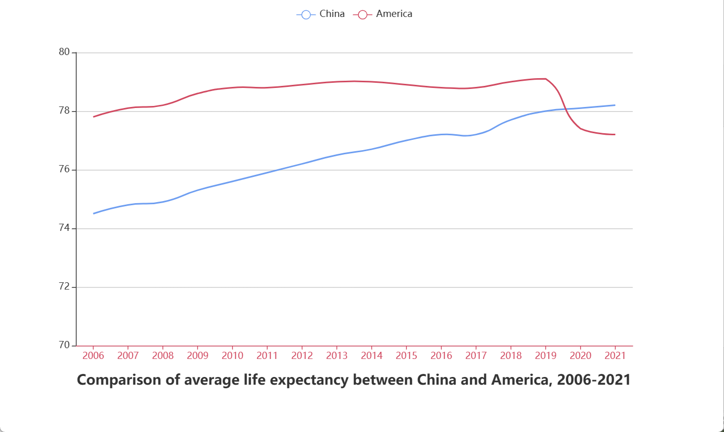
Result — Related Factors: Life Expectancy
02
Life expectancy：China < USA（before 2019）
Gap gradually narrowed
China > USA（after 2020）
-8-

Slide 10
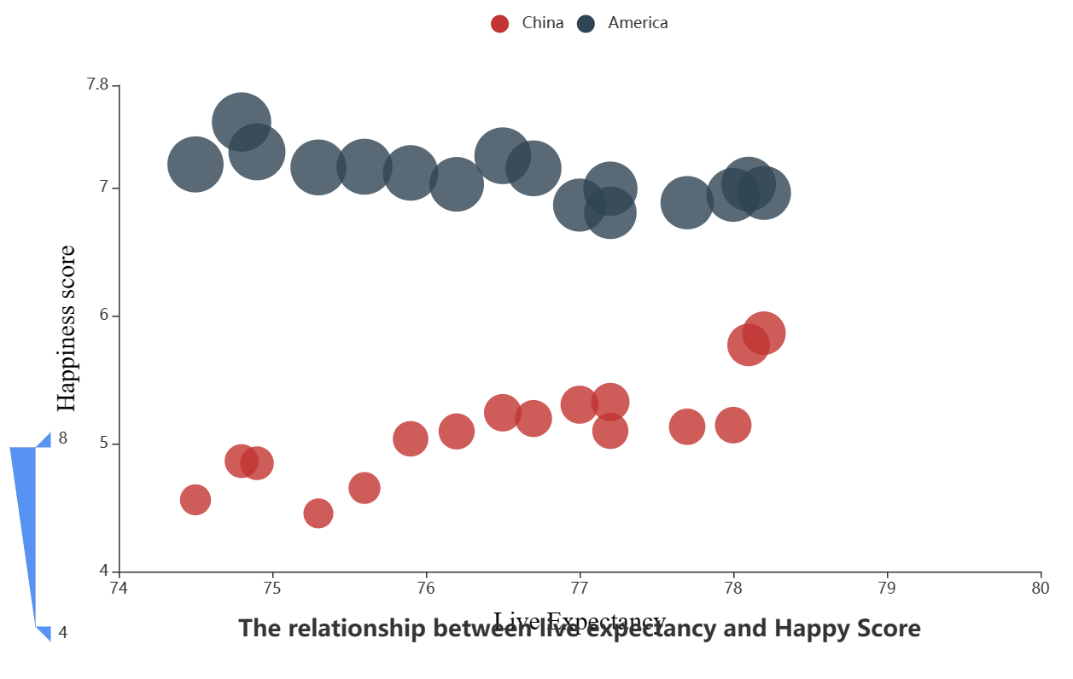
Result — Related Factors: Life Expectancy
03
A scatter plot：life expectancy and happiness
China’s happiness index < USA（2.0 gap）
Improving life expectancy, happiness: China↑, USA →
-9-

Slide 11
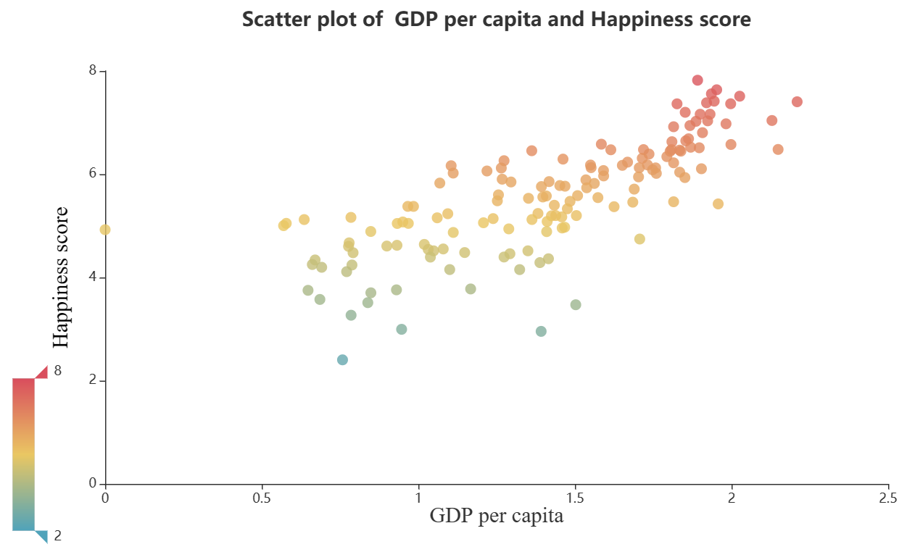
Result — Related Factors: GDP
01
Per capita GDP↑, happiness index ↑
Thermal colors: 8(red) , 2(blue)
Higher happiness index, higher GDP
-10-

Slide 12
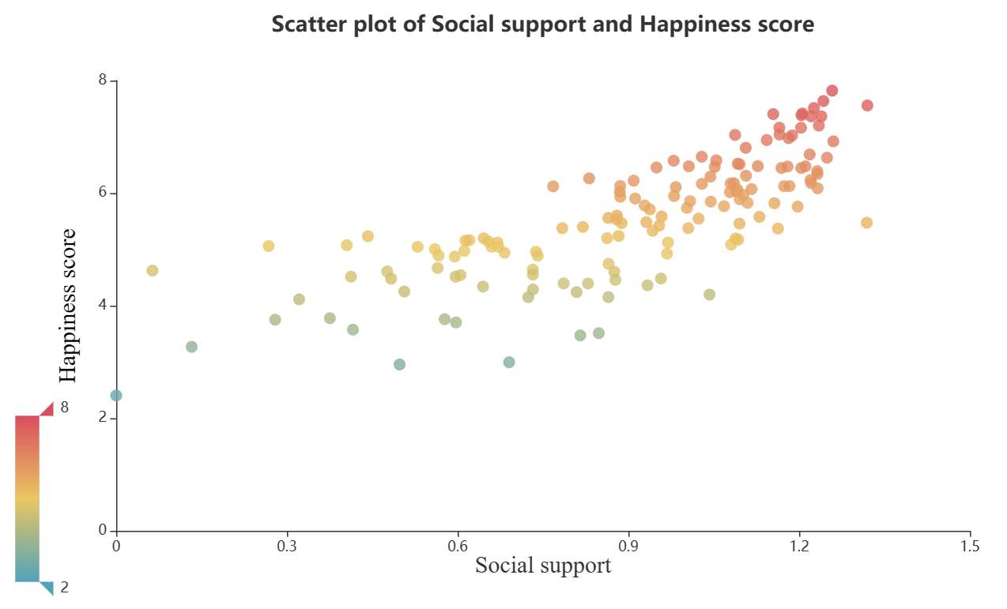
Result — Related Factors: Social Support
01
Social support level(0.6), happiness index(below 3.5)
Social support level(0.7), happiness index(above 5)
Social support affect: extremely high or low
-11-

Slide 13
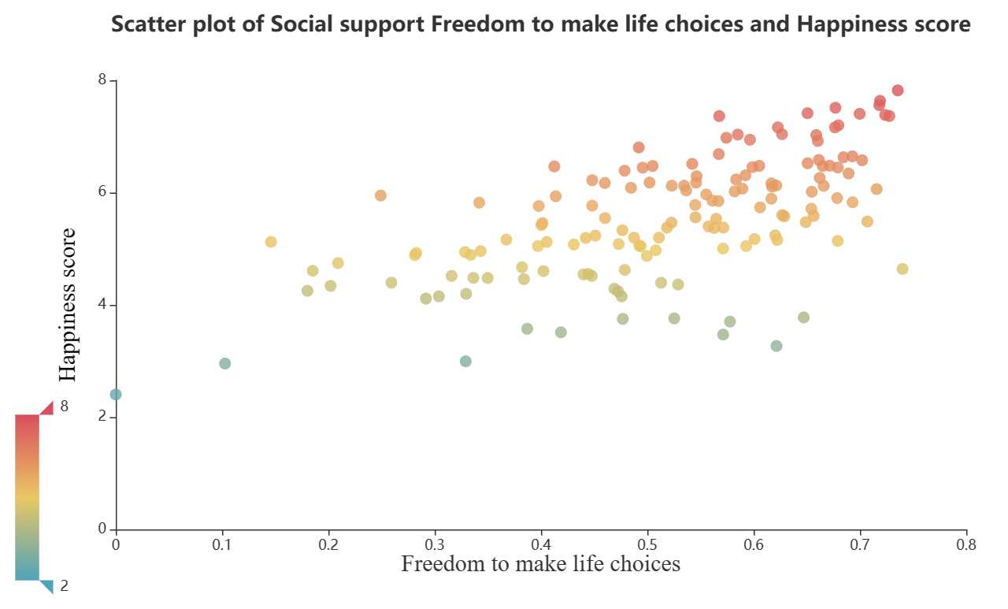
Result — Related Factors: Degree of freedom of life choice
01
Degree of freedom(0.5), happiness index(below 3.5)
Degree of freedom(0.7), happiness index(above 5)
Relation: not obvious
Notice: high happiness index (above 7), high freedom(above 0.6)
-12-

Slide 14
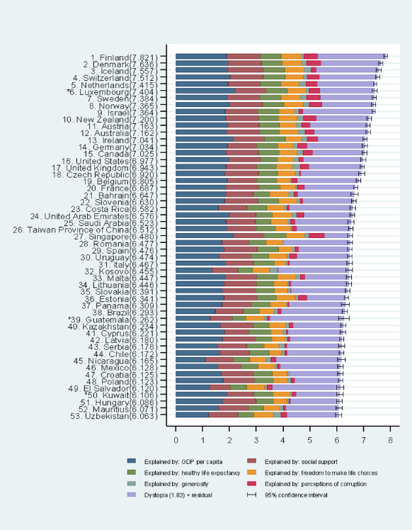
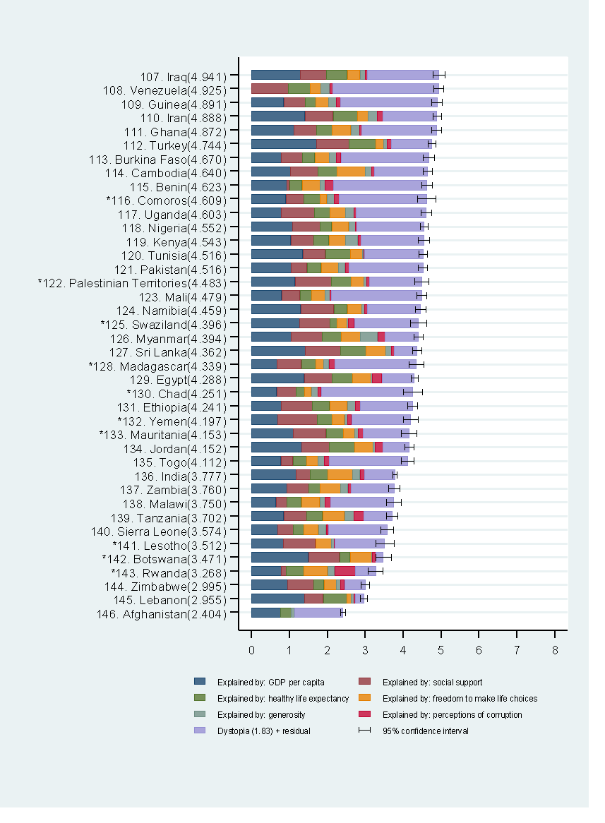
Result — Related Factors: Different interpretations of life satisfaction
Finland: the highest happiness index
Afghan: the lowest
GDP (contributed the most)
Generosity and Perceptions of corruption (contributed the least)
-13-

Slide 15
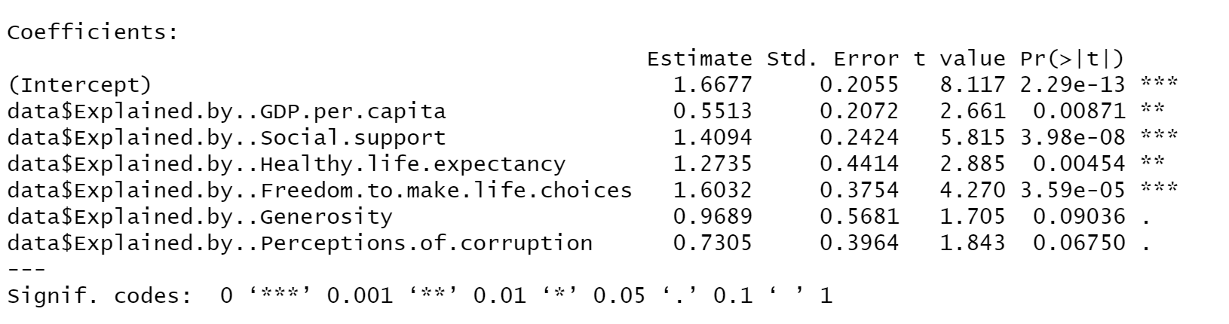
Result — Modelling: Regression
01
Happiness Score=1.6677+0.5513*GDP+1.4094*Social support+1.2735*Life expectancy+1.6032*Freedom+0.9689*Generosity+0.7305*Corruption
Coefficients are positive: independent variable↑, happiness index ↑
Alpha is 0.01, independent variables are significant (except the generosity and corruption)
Multiple correlation coefficient reached 0.7737
-14-

Slide 16
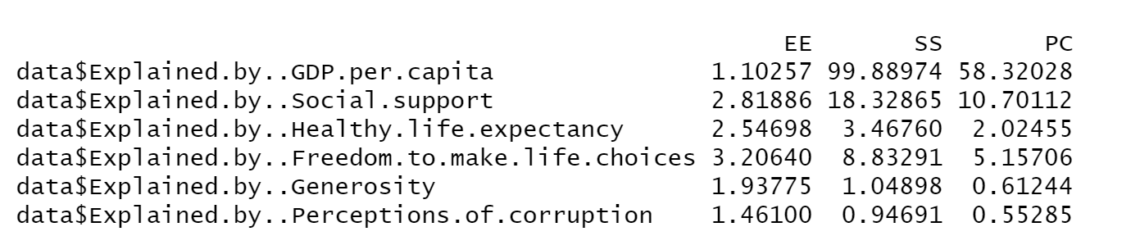
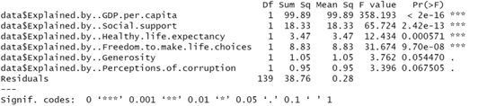
Result — Modelling: Regression
02
Sum of square and PC: the explanation degree of GDP is greatest
GDP determines the level of happiness
-15-

Slide 17

Conclusion & Future Study
Conclusion
The background of the study
Data visualization
Regression model construction
Future Study
The above factors can be used to improve the happiness of the people of a country, and the happiness of the people of a country can be calculated more accurately according to the regression model we have built.
PPT模板 http://www.1ppt.com/moban/
-16-

Slide 18
Thank you !!

