Slide 1
Explore Data Analysis
How treatments and growth factors influence gene expression

Slide 2
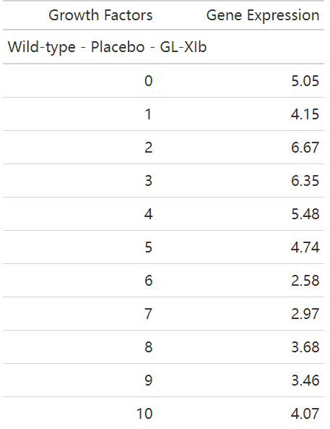
Experiment Summary
Table 1: An example Table of cell “GL – Xib”.
2 Cell lines
- Wild – type
- Cell – type 101
2 Treatments
- Placebo
- Activating factor 42
4 cells in each cell line in pairs
using different treatments.
11 growth factors in each treatment were used to generate gene expression

Slide 3
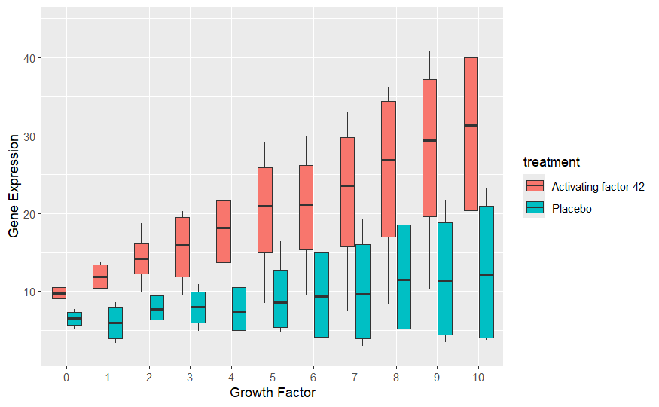
EDA - Boxplots
Median (bold horizontal lines):
Figure 1: Boxplots of the gene expression vs growth factors with various treatments.
Median increased as the growth factors increased.
“ Activating factor 42” significantly outperformed the “Placebo” for all growth factors.
IQR (height of boxes):
Variance increased as the growth factors increased.
Maximum/Minimum & Outliers
There were no outliers in the data.
The minimum gene expressions of ”Activating factor 42” can be far from the medians.

Slide 4
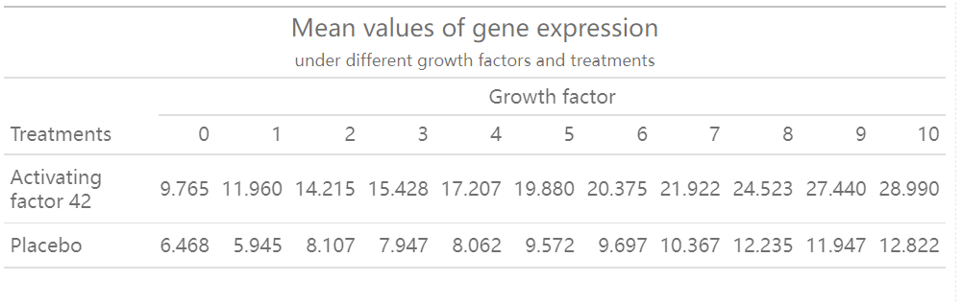
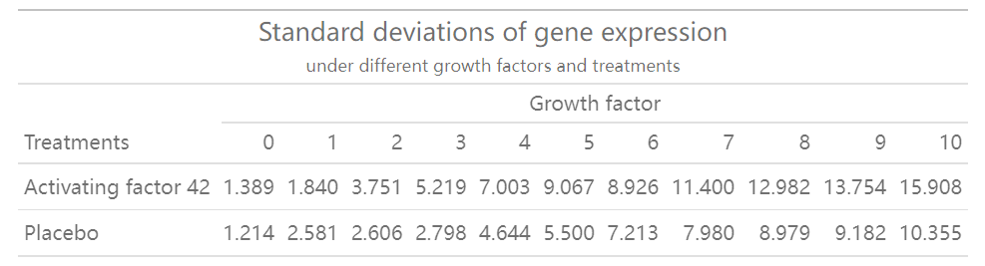
EDA – Mean & Variance
Table 2: Mean of gene expression.
Mean:
Mean grew as the growth factors increased in general.
2. “ Activating factor 42” led to a larger mean than “Placebo”.
Table 3: Variance of gene expression.
Variance
Variance grew as the growth factor increased in general.
” Activating factor 42” led to a larger variance than ”Placebo”.

Slide 5
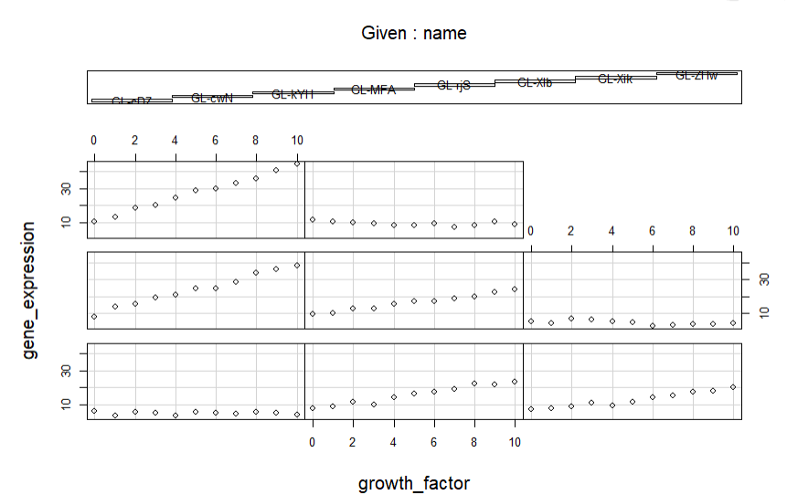
EDA - Coplot
Figure 2: Coplot of gene expression and growth factor with interaction of cells.
Every subplot represents how gene expression changes with the values of growth factors for different cells.
The cells significantly influenced the relationship between gene expression and growth factors.

Slide 6
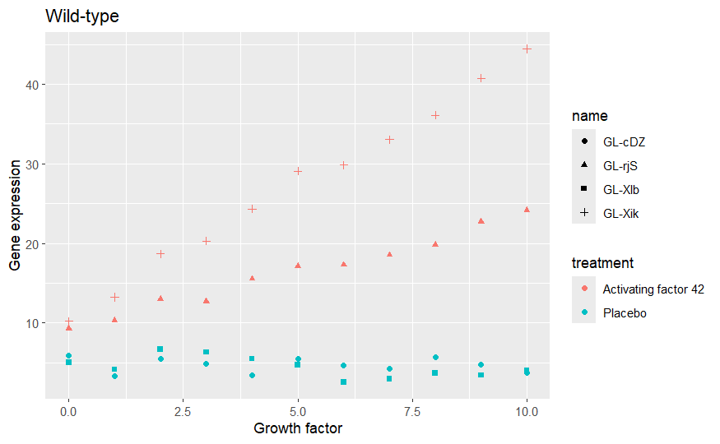
EDA – Scatter plot
Figure 3: Scatter plots of gene expression vs growth factors of ”Wild-type” cells.
Strong linear relationship between gene expression and growth factors.
For cells with the treatment “Activating factor”, there were clear increasing trends between growth factor and gene expression.
For cells with the treatment “Placebo”, growth factor seems to have no significant impact on gene expression.
“Activating factor 42” outperformed “Placebo” with all growth factors.

Slide 7
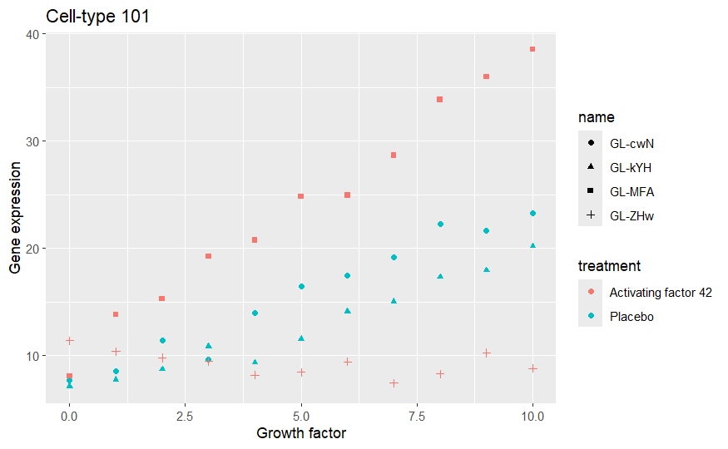
EDA – Scatter plot
Figure 4: Scatter plots of gene expression vs growth factors of ”Cell-type 101” cells.
Strong linear relationship between gene expression and growth factors.
For cells with the treatment “Placebo”, there were clear increasing trends between growth factor and gene expression.
For cells with the treatment “Activating factor 42”, the effect of growth factor on gene expression depended on cells.

Slide 8
Summary
Overall, as the growth factor increased, the mean and median gene expression increased, but the variance also grew.
2. The treatment “Activating factor 42” led to a larger mean and median but higher variance of gene expression, compared with “Placebo”.
3. The effect of treatments on the effect of growth factor on gene expression significantly depended on the cells.

Slide 9
Thank you!

