Slide 1
Introduction to Information Systems and Programming
Effective Java

Slide 2
Effective Java
Write effective Java code
  Clearer
  Correct
  Robust
  Reusable
Programming
  Algorithms, syntax and concept
  Data structures, operations (E.g., ArrayList, Comparable)
  Effective way to structure the code

Slide 3
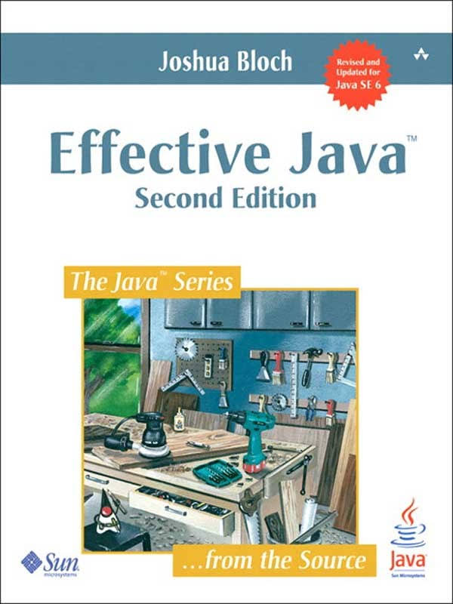
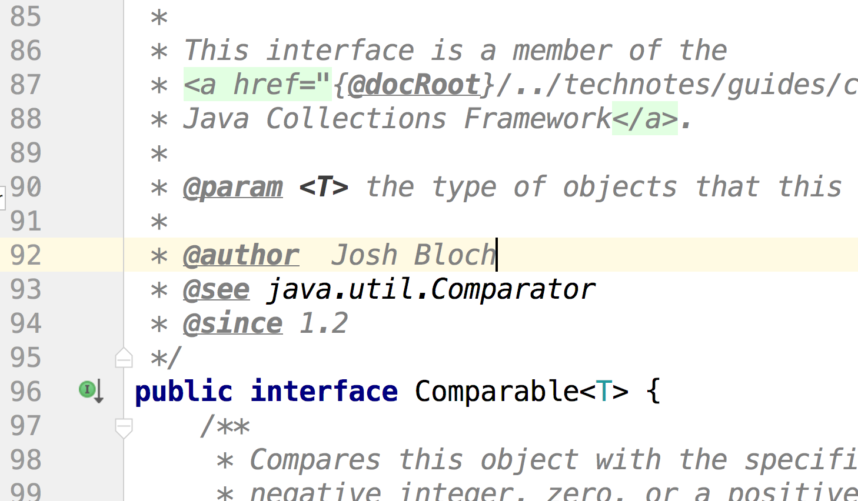
Effective Java

Slide 4
Item 52: Refer to objects by their interfaces
Uses interface as type
Program will be more flexible: easy to switch implementations (for better performance)
The surrounding code would continue to work as they use methods specified by the interface
List<Integer> w = new ArraryList<>();
// rather than: ArrayList<Integer> w = new ArrayList<>();
List<Integer> w = new LinkedList<>();

Slide 5
Item 39: Make defensive copies when needed
Robust for ill-behaved clients
  Unexpected behavior due to mistake
  Purposely attack your system
Destroy the invariants of your class
  interestRate < 0
  startTime > endTime
  Etc.

Slide 6
Item 39: Make defensive copies when needed
// Not exactly an immutable class, client may modify private variable and break invariant
public class Period {
private final Date startTime;
private final Date endTime;
public Period(Date startTime, Date endTime) {
if (startTime.compareTo(endTime) > 0) {
// throw exception
}
this.startTime = startTime;
this.endTime = endTime;
}
}

Slide 7
Item 39: Make defensive copies when needed
Client can access and modify private variable and break invariant
public class TestPeriod {
public static void main(String[] args) {
Date startTime = new Date();
Date endTime = new Date();
Period p = new Period(startTime, endTime);
endTime.setTime(0);
}
}

Slide 8
Item 39: Make defensive copies when needed
Immutable class with invariant
public class Period {
private final Date start;
private final Date end;
public Period(Date start, Date end) {
if (start.compareTo(end) > 0 ) {
// throw exception
}
this.start = new Date(start.getTime());
this.end = new Date(end.getTime());
}
}

Slide 9
Item 23: Don’t use raw types in new code (and use generic class or interface)
Generic type: class or interface with an angle-bracketed list of actual type parameters: List<Circle>
Raw type: List (to provide compatibility for the old code)

Slide 10
Item 23: Don’t use raw types in new code (and use generic class or interface)
//Bad code: use raw types
List t = new ArrayList();
t.add( new Circle(2));
t.add( new Circle(3));
t.add( new Integer(5)); // by mistake
mysum =0;
for (Object o: t) {
Circle c = (Circle) o;
mysum += c.getRadius();
}
No static checking; discover error until runtime
Once you see the runtime error (exception), need to search through the code to find the error (the mistake is far away from the exception)
Compiler cannot locate the error

Slide 11
Item 23: Don’t use raw types in new code (and use generic class or interface)
//Good code: use generic
List<Circle> w = new ArrayList<>();
w.add( new Circle(2));
w.add( new Circle(1));
w.add( new Circle(3));
double mysum=0;
for (Circle c:w)
mysum += c.getRadius();
Static checking; discover error before runtime
Compiler can locate the mistake

