Slide 1
Introduction to Information Systems and Programming (ISTD 50.001)
Recursion 1

Slide 2
Recursion 1 (Week 4 Session 2)
What is recursion?
Common scenarios from our experience
Structured problem solving using recursion
Some simple examples
Uses of recursion
Example – recursive listing / searching in directory structure of he Linux OS
Cohort exercises

Slide 3
What is recursion?
Recursion in computer science is a method where the solution to a problem depends on solutions to smaller instances of the same problem (as opposed to iteration).
Recursion in programming, is a tool a programmer can use to invoke a function call on itself. Fibonacci sequence is the textbook example of how recursion is used. Most recursive code if not all can be expressed as iterative function, but its usually messy.

Slide 4

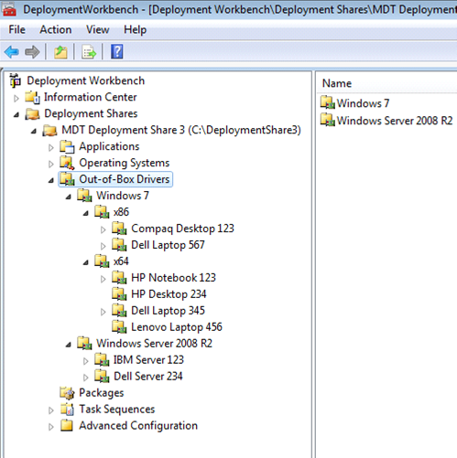
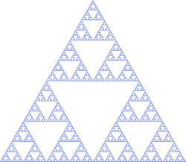
Some examples
The Sierpinski triangle—a confined recursion of triangles that form a fractal
(Source: wikipedia)

Slide 5
Recursion
Recursion: When a function (method) calls itself
Example: Factorial
n! = n * (n-1)!
in Java,
factorial (n) = n * factorial (n-1)

Slide 6
Iterative factorial - ifact
public class MyClass {
public static void main (String[] args) {
int n = 4;
System.out.println (ifact(n));
}
public static int ifact (int k) {
int result = 1;
for (int i = 1; i <= k; i++) {
result = result * i;
}
return (result);
}

Slide 7
Recursive factorial - rfact
public class MyClass {
public static void main (String[] args) {
int k = 4;
System.out.println (rfact(k));
}
public static int rfact (int k) {
return (k * rfact (k-1));
}

Slide 8
Recursion - rfact
What’s the problem?

Slide 9
Recursion – corrected version
public static int factorial (int k) {
if (k == 0 ) return 1;
else return (k * factorial (k-1));

Slide 10
Recursion – Three steps
Base case – no recursion
Divide and conquer – frame the problem in terms of the solution of a smaller, but identical sub-problem
Complete the recursive invocation

Slide 11
Illustration of Recursive rfact call stack
main
k ---- 4
temp ---- ?
1st frame

Slide 12
Illustration of Recursive rfact call stack
main
k ---- 3
k ---- 4
temp ---- ?
temp ---- ?
2nd frame
1st frame

Slide 13
Illustration of Recursive rfact call stack
main
k ---- 2
k ---- 3
temp ---- ?
k ---- 4
temp ---- ?
3rd frame
temp ---- ?
2nd frame
1st frame

Slide 14
Illustration of Recursive rfact call stack
main
k ---- 1
k ---- 2
temp ---- ?
k ---- 3
temp ---- ?
4th frame
k ---- 4
temp ---- ?
3rd frame
temp ---- ?
2nd frame
1st frame

Slide 15
Illustration of Recursive rfact call stack
main
k ---- 0
k ---- 1
k ---- 2
temp ---- ?
5th frame
k ---- 3
temp ---- ?
4th frame
k ---- 4
temp ---- ?
3rd frame
temp ---- ?
2nd frame
1st frame

Slide 16
Illustration of Recursive rfact call stack
return 1
main
k ---- 0
k ---- 1
k ---- 2
temp ---- ?
5th frame
k ---- 3
temp ---- ?
4th frame
k ---- 4
temp ---- ?
3rd frame
temp ---- ?
2nd frame
1st frame

Slide 17
Illustration of Recursive rfact call stack
return 1
main
k ---- 1
k ---- 2
temp ---- 1
k ---- 3
temp ---- ?
4th frame
k ---- 4
temp ---- ?
3rd frame
temp ---- ?
2nd frame
1st frame

Slide 18
Illustration of Recursive rfact call stack
main
return 2
k ---- 2
k ---- 3
temp ---- 2
k ---- 4
temp ---- ?
3rd frame
temp ---- ?
2nd frame
1st frame

Slide 19
Illustration of Recursive rfact call stack
main
return 6
k ---- 3
k ---- 4
temp ---- 6
temp ---- ?
2nd frame
1st frame

Slide 20
Illustration of Recursive rfact call stack
main
return 24
k ---- 4
temp ---- 24
1st frame

Slide 21
Illustration of Recursive rfact call stack
main
Answer = 24

Slide 22
Fibonacci - revisited
Assuming n > 2
public static int ifib( int n) { int f1=0; int f2=1;
int result = 0; for ( int i = 2; i <= n; i++){ result = f1+f2; f1=f2; f2=result; } return result; }

Slide 23
Recursive Fibonacci
public static int rfib (int k)
if (k == 0) return 0;
else if (k == 1) return 1;
else {
return rfib (k - 1) + rfib (k - 2);
}
}

Slide 24
Tree of recursive calls and returns from fibonacci
1
fib(5)
18
fib(3)
2
fib(4)
17
11
12
fib(3)
fib(2)
fib(2)
fib(1)
3
10
13
16
9
14
15
8
fib(1)
fib(0)
fib(1)
fib(0)
fib(2)
fib(1)
4
7
Note that this subtree will be evaluated only after the left subtree is evaluated
5
6
fib(1)
fib(0)

Slide 25
Example
A^{n} = A * A * A … * A
O(log(n)) – time complexity
Fast exponentiation
Key idea – divide the problem into sub-problems by dividing the exponent by two.

Slide 26
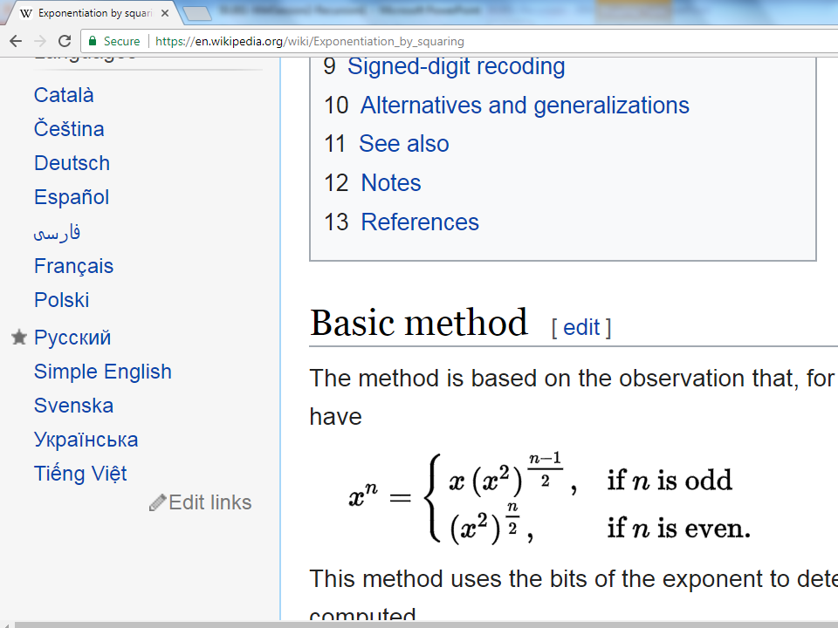
Solution – wikipedia algorithm

Slide 27
Pseudocode (from wikipedia)
Function exp_by_squaring(x, n)
if n < 0 then return exp_by_squaring(1 / x, -n);
else if n = 0 then return 1;
else if n = 1 then return x ;
else if n is even then return exp_by_squaring(x * x, n / 2);
else if n is odd then return x * exp_by_squaring(x * x, (n - 1) / 2);

Slide 28
Tail-recursive functions
Do not build up any deferred operations.
gcd function is tail-recursive, however the fib function is not tail-recursive
Can you say Why?
Tail recursion:
// INPUT: Integers x, y
// such that x >= y and y > 0
int gcd (int x, int y) {
if (y == 0)
return x;
else
return gcd (y, x % y);
}
Not tail recursion:
// INPUT: n is an Integer
// such that n >= 0
int fib (int n) {
if (n < 2) return 1
else return fib(n-1) + fib(n-2)
}

Slide 29
Tail-recursive functions
A compiler or interpreter treats tail-recursive calls as jumps rather than function calls, a tail-recursive function such as gcd will execute using constant space. Thus the program is essentially iterative, equivalent to using imperative language control structures like the "for" and "while" loops.
The significance of tail recursion is that when making a tail-recursive call, the caller's return position need not be saved on the call stack; when the recursive call returns, it will branch directly on the previously saved return position. Therefore, in languages that recognize this property of tail calls, tail recursion saves both space and time.

Slide 30
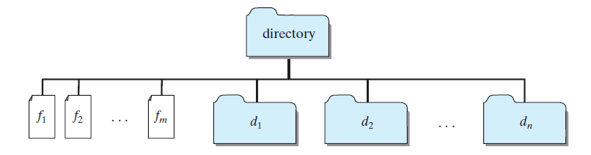
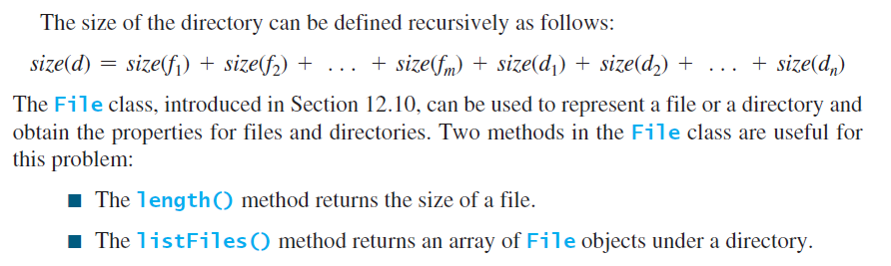
Case Study: Finding the Directory Size
(Source: “Introduction to Java Programming” Y. Daniel Liang)

Slide 31
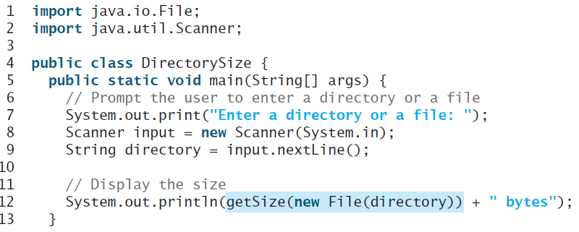
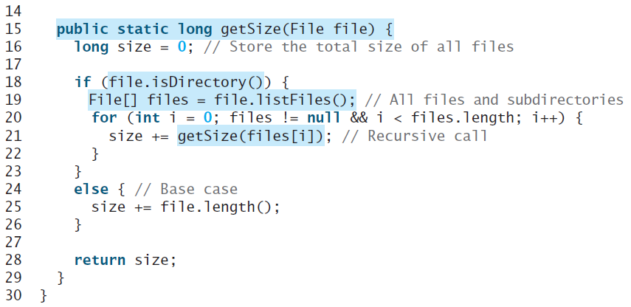
Case Study: Finding the Directory Size
(Source: “Introduction to Java Programming” Y. Daniel Liang)

Slide 32
Types of recursion and related topics
Multiply recursive functions, eg. Tree traversal
Mutually recursive functions – eg. f calls g and g calls f
Structural versus generative recursion
Complexity issues
Time
Space

Slide 33
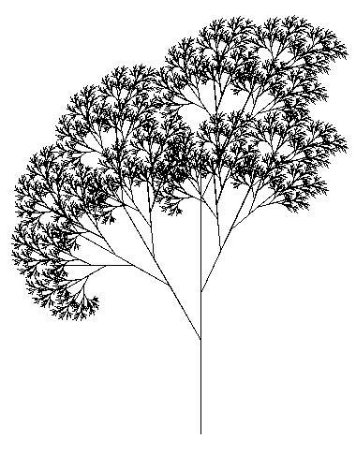
Uses of recursion
Operating systems
Programming languages
Computer graphics
Computational mathematics
Data analytics
Big data
…
Tree printed using logo, a programming language that makes extensive use of recursion

Slide 34
Recursion with Strings - example 1
Given a string, compute recursively a new string where all the lowercase ‘k' chars have been moved to the end of the string. Hint: You may use the following Java string functions:
String s.substring (i,j) where i and j are indices within the string.
int s.indexOf (“abc”); returns index of 1st occurrence of “abc” in s
endX(“kkre") → "rekk"
endX(“kkhikk") → "hikkkk"
endX(“khikhik") → "hihikkk"

Slide 35
Recursion with Strings - example 2
Given a string, compute recursively a new string where identical chars that are adjacent in the original string are separated from each other by a "*". Note an empty string shouldn’t crash your program!
moveInStars("hello") → "hel*lo"
moveInStars("xxyy") → "x*xy*y"
moveInStars("aaaa") → "a*a*a*a“
moveInStars(“Massachussetts”) → “Mas*sachus*set*ts”

Slide 36
Recursion with Strings - example 3
Given a string, write a recursive program to test whether it is a Palindrome or not. (Note a Palindrome is a string that reads the same, both ways). You may assume case insensitivity.
testPalindrome("Pp") → true
testPalindrome("Annna") → true
testPalindrome(“Palindrome") → false
testPalindrome("abba") → true

Slide 37
Cohort Activity (from PS2B)
Title: RecurMulti
Q3. [5 points] Write a recursive program, RecurMulti that computes the multiplication of two numbers. For example, 7 multiplied by 4 equals 28.
Test cases
System.out.println(multiply(4,7));
System.out.println(multiply(0,7));
System.out.println(multiply(4,0));

Slide 38
Cohort Activity (from PS2B)
Title: SumDigits
Q4. [10 points] Write a recursive method, sumDigits(int number) that will compute the sum of the digits in an integer number. For example, if the number is 55, the return result is 10. If the number is -54, the return result is 9. The method signature is below:
public static int sumDigits(int number)

