Slide 1
NTU
College of Computing and Data Science
Full-Stack Web Development of an
Automated Assessment Platform
for UML Diagrams
Wang Yu Teng
U2122796L
Supervisor: Dr. Loke Yuan Ren
Examiner: Prof. Zhang Hanwang
CCDS25-0233
2026
1
Notes:
Good morning. My name is Wang Yu Teng, and I'll be presenting my final-year project — a full-stack web platform for automated assessment of UML diagrams. This is project CCDS25-0233 under Dr. Loke.

Slide 2
Outline
01
02
03
Background
Demo
Implementation
Problem · Prior work · Objectives · Contributions
Pre-recorded walkthrough of the platform
Architecture · Lifecycle · AI pipeline · Deployment
04
05
Experiment
Conclusion
RQs · Setup · Metrics · Results · Threats
Summary & future work
CCDS25-0233
2 / 35
Notes:
I'll walk through five sections — start with the problem and what's already been tried, show you the system in action, dig into how it's built, present the empirical results from comparing six LLMs, and wrap up.

Slide 3

01
SECTION
Background
CCDS25-0233
3 / 35

Slide 4
The Grading Bottleneck
~5 min
per diagram (conservative pace)
Per-cohort grading effort
1,000
diagrams · 200 students × 5 each
≈83 hrs
of TA effort per cohort
?
Inconsistency
different graders interpret rubrics differently — a recognised threat to assessment validity
1 grader · 1,000 diagrams · 5 criteria each
CCDS25-0233
4 / 35
Notes:
Computer-science enrollments have more than doubled in the last decade. UML is still core to software-engineering curricula, but it's the worst-case grading workload. Even at a conservative pace of five minutes per diagram, a 200-student cohort with five diagrams produces a thousand artifacts — roughly 83 hours of TA grading per assignment. And that's before we factor in inconsistency between graders.

Slide 5
Prior Work & The Research Gap
Traditional methods
LLM-based methods
UMLGrader — heuristic, IBM Rational Rose only
Bian et al. — Levenshtein + WordNet, class-only
Modi / Jebli — XMI parsing, Modelio-locked
✗ Tied to specific tools, class-only,
no semantic richness
Wang et al. — GPT-4o on 40 students, 1.18-pt gap, weak on class/sequence
Bouali et al. — GPT-o1-mini + Sonnet + Llama, ICC = 0.76
DUET — GPT-4o + Mistral-7B, formative only
⚠ Earlier-generation models, weaker reasoning,
format-compliance issues
The gap: No study has revisited LLM-based UML grading using SOTA models with API-level structured-output enforcement — and no production-grade assessment platform embeds such a pipeline.
CCDS25-0233
5 / 35
Notes:
Two waves of prior work. Traditional rule-based and ML approaches were promising but tightly coupled to specific tools — Modelio, Rational Rose — and limited to class diagrams. Then LLM-based studies emerged: Wang et al. evaluated GPT-4o, Bouali et al. compared multiple models in early 2025 and got ICC of 0.76. But all of these used earlier-generation models with weaker reasoning and no structured-output enforcement. The gap I'm addressing is twofold — revisit the empirical question with SOTA models, and embed the result in a deployable platform.

Slide 6
Project Objectives
01
[O1] Full-stack platform
02
[O2] LLM grading pipeline
03
[O3] Reduce TA effort
End-to-end assessment lifecycle from course setup to grade publication.
Structured-output enforcement, schema validation, score clamping.
Streamlined two-panel review UI with accept/reject workflow.
04
[O4] Empirical evaluation
05
[O5] Containerised deployment
Compare SOTA LLMs across accuracy, cost, consistency.
Docker + Kubernetes for on-premise NTU infrastructure.
CCDS25-0233
6 / 35
Notes:
Five objectives, each tied to a measurable outcome. The first three are platform engineering. The fourth is the empirical contribution. The fifth is operational deployability — non-negotiable for a school context.

Slide 7
My Contributions
01
Full-stack platform
02
AI grading pipeline
03
Custom UML editor & viewer
React 19 SPA + Hono backend + Drizzle/PostgreSQL + Graphile Worker. 16 tables across 5 functional groups; 130+ endpoints across 11 route modules.
Provider-agnostic factory (OpenAI / Anthropic in production; Gemini via experiment harness), hybrid symbolic + neural grading, Zod-validated structured output with score clamping, human-in-the-loop accept/reject.
React Flow with custom UML node/edge types. Structured JSON ↔ PlantUML DSL — the editor's typed shape enables a deterministic graph-diff against the reference answer.
04
Empirical LLM evaluation
05
Containerised deployment
6 models × 32 submissions × 5 runs = 960 API calls. Weighted aggregate across accuracy, consistency, cost, feedback, speed, rubric adherence.
Multi-stage Docker on Node 20 Alpine + Kubernetes manifests with HPA on web tier, single-replica worker.
CCDS25-0233
7 / 35
Notes:
(critical slide — slow down) Five contribution areas. The platform is the engineering layer — sixteen tables, well over a hundred endpoints across eleven route modules. The AI grading pipeline is where the design effort is concentrated, and I'll come back to the hybrid symbolic-neural approach in detail. The custom UML editor was necessary because no off-the-shelf component preserved the structured shape we needed for the symbolic diff layer. The empirical evaluation involved 960 API calls across six frontier models. And the deployment story uses a single Docker image that serves both web and worker tiers.

Slide 8

02
SECTION
Demo
CCDS25-0233
8 / 35

Slide 9

Demo
Course management & CSV roster
Student attempt · auto-save 30s
Question pool with filtering
Focus monitoring · auto-submit
Assignment builder · timing + focus
AI grading: written + UML
Two-panel grading interface
Accept / reject AI suggestions
Grade override with audit trail
Cost & token tracking dashboard
Demo video plays here · ~3 min
openscreen-edited · annotations + highlights
Staff workflow (60s) → Student workflow (60s) → Grading loop (60s)
CCDS25-0233
9 / 35
Notes:
Before the architecture deep dive, I want you to see it working. The demo is about three minutes — I'll show you the staff workflow, then the student workflow, then the AI grading loop. Hit play.

Slide 10

03
SECTION
Implementation
CCDS25-0233
10 / 35

Slide 11
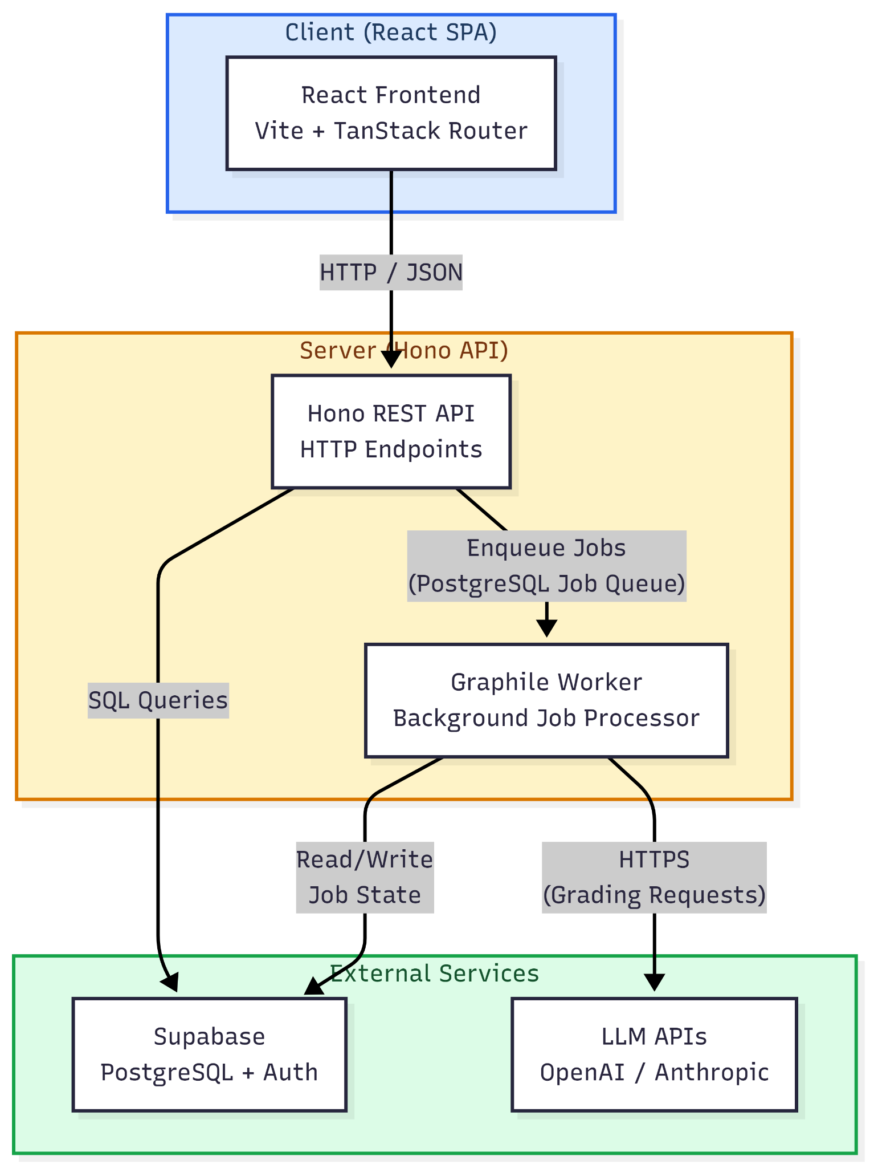
System Architecture
01
Monolithic, not microservices
Single codebase, modular route files; one Docker image, one deployment unit.
02
Web ↔ worker separation
LLM calls take 5–60s; decoupling keeps the request path responsive during exam-period spikes.
03
PostgreSQL job queue
Graphile Worker — no Redis, transactional with application data.
Figure 3.1 — Three-tier architecture
CCDS25-0233
11 / 35
Notes:
Three logical tiers. The critical decision was separating the web server from the background worker. LLM grading takes anywhere from five to sixty seconds — running that inside the request cycle would block the event loop for every concurrent user. By decoupling job enqueueing from job processing through PostgreSQL, the web server stays responsive even under exam-period load.

Slide 12
Design for Trust & Consistency
01
Defence-in-depth — JWT → RBAC → RLS
Three independent gates per request. JWT verified at the edge → requireRole() enforces role and course scope → every query runs in a Postgres transaction switched to the authenticated role with row-level policies. A forgotten auth check in one layer still cannot leak another student's data.
02
One image, two roles
The same multi-stage Docker image starts the web server by default, or the Graphile worker via a CMD override. Web tier scales horizontally on HPA for exam bursts; worker stays at a single replica to avoid LLM rate-limit contention. Same code, same migrations — no drift between tiers.
03
Stateless per-job grading
Each grading job opens a fresh generateText() call — no message history, no app-level prompt or response cache, temperature 0.0 where supported. Submission B never sees A's prompt or output, so identical inputs always produce identical scoring — reproducibility is structural, not policy.
CCDS25-0233
12 / 35
Notes:
Three architecture decisions worth calling out before the specifics. First, defence-in-depth — every request passes through three independent gates: JWT verification at the edge, role-based access control in middleware, and row-level security at the database. Even if a route handler forgets an auth check, RLS catches it. Second, one Docker image runs both the web service and the Graphile worker, with the role chosen by start command — same code path on both, no drift between tiers. Third, every grading job is completely stateless: a fresh LLM call with no message history, no application cache, temperature zero. Grading submission B is unaffected by what was graded before it — so the empirical results from Section 04 directly transfer to production.

Slide 13
Tech Stack
Language & Runtime
TypeScript 5.9 · Node.js 20
Frontend
React 19 · Vite · TanStack Router · TanStack Query · Tailwind CSS · React Flow (xyflow 12.10)
Backend
Hono 4.11 · Drizzle ORM · Zod 4.3 · Graphile Worker 0.16
Auth
Supabase Auth · Custom JWT (dual-validation)
AI
Vercel AI SDK 6.0 → OpenAI / Anthropic
UML
plantuml-encoder
Testing
Vitest · Playwright
DevOps
Docker (multi-stage Node 20 Alpine) · Kubernetes / k3s · GitHub Actions
CCDS25-0233
13 / 35
Notes:
(don't read it — pattern-match for the audience) Standard modern TypeScript stack with two non-default choices. Hono over Express for performance. Graphile Worker over Redis-backed queues so the school deployment doesn't need a second data store. Everything else is conventional.

Slide 14
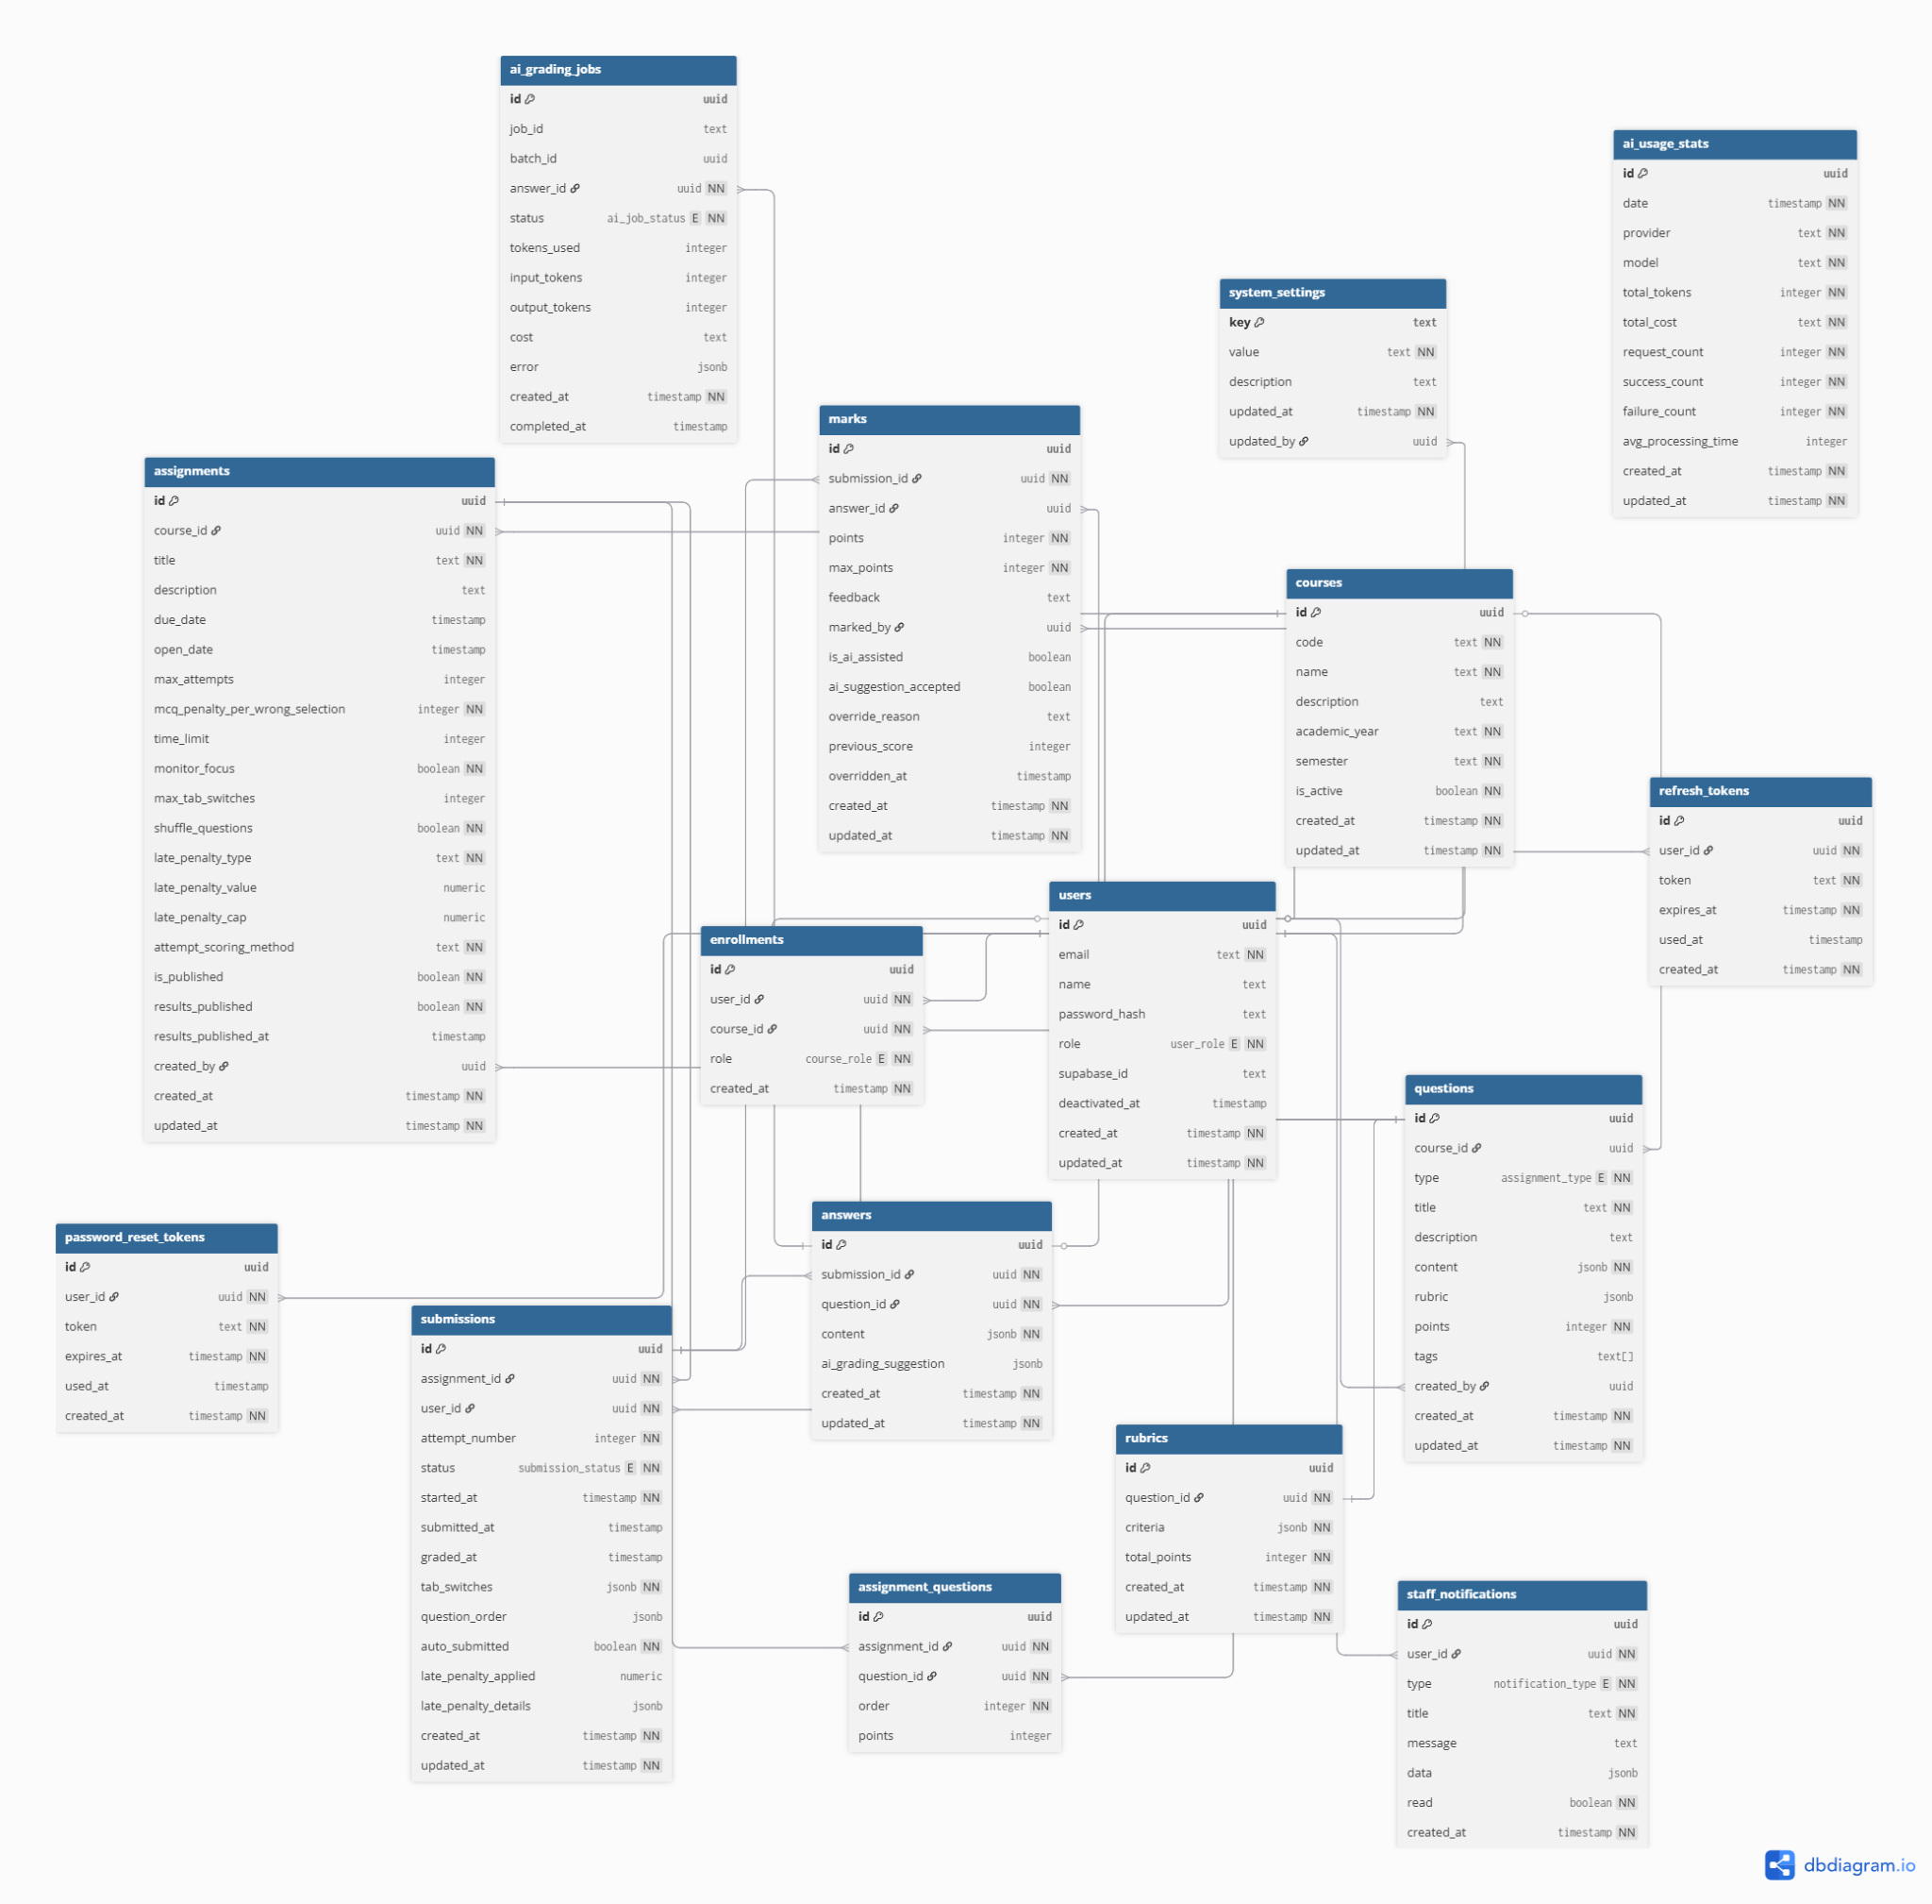
Database Design
01
JSONB polymorphic content
Three question types (MCQ / written / UML) without messy joins.
02
Postgres enums for state
submission_status: draft → submitted → late → grading → graded, enforced at DB level.
03
Composite uniqueness
Guarantees integrity under concurrent exam load — race conditions cannot create duplicates.
Figure 3.2 — Entity-Relationship Diagram (16 tables, 5 functional groups)
CCDS25-0233
14 / 35
Notes:
Sixteen tables in five functional groups. Two design choices worth flagging — JSONB for question content lets me support three different question shapes without three separate content tables, and PostgreSQL enums enforce the submission state machine at the database level rather than in application code. Composite unique constraints on submissions and answers prevent retry-storm duplicates during real exam load.

Slide 15
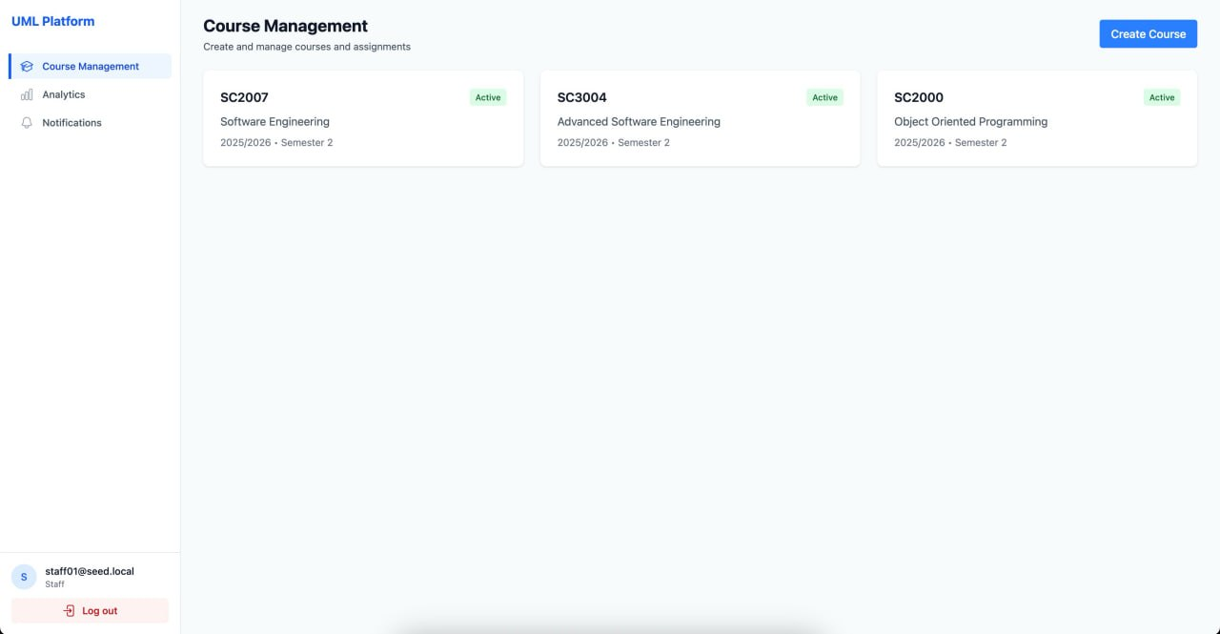
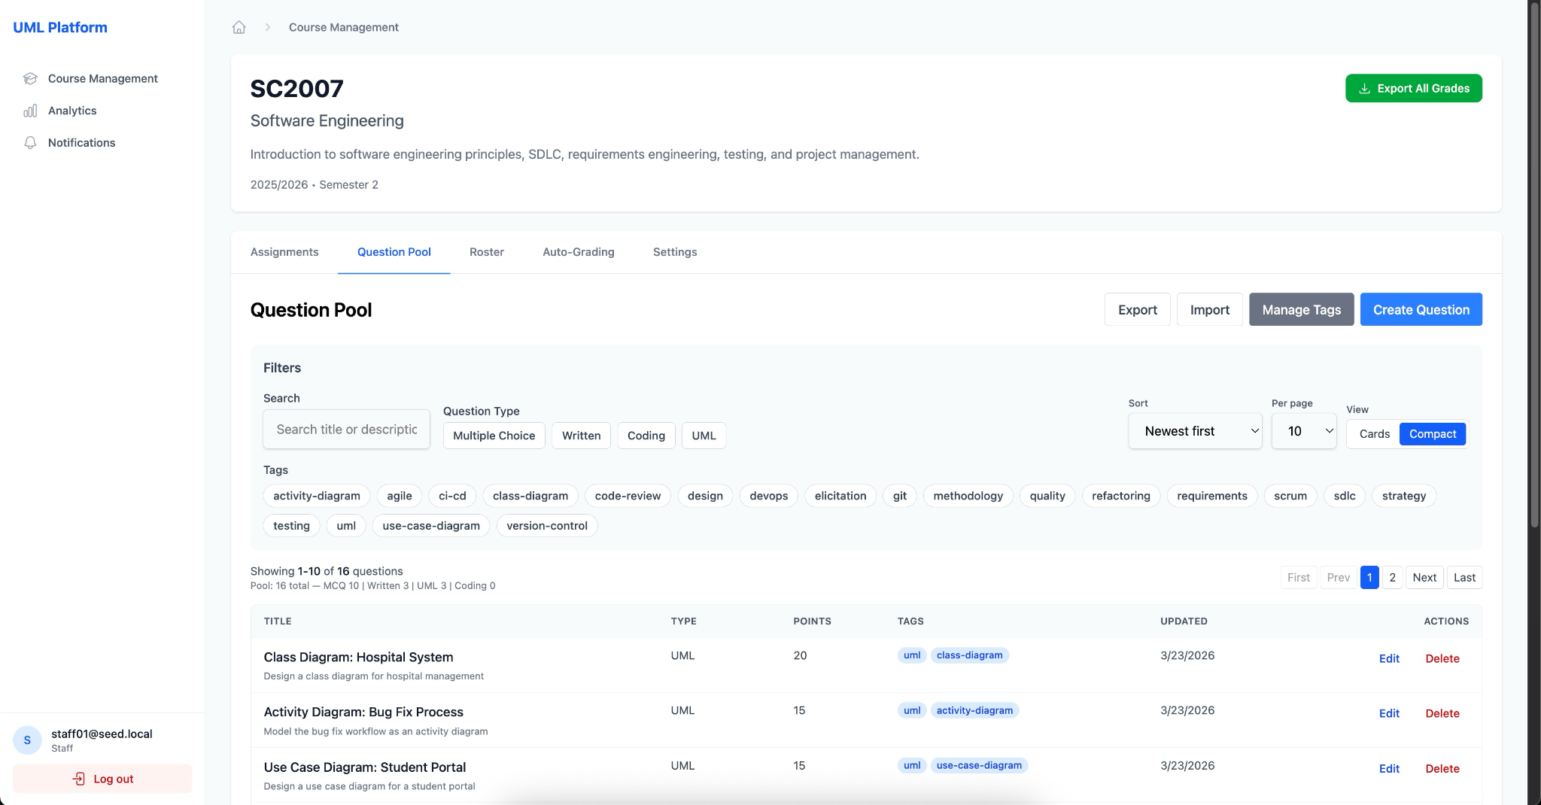
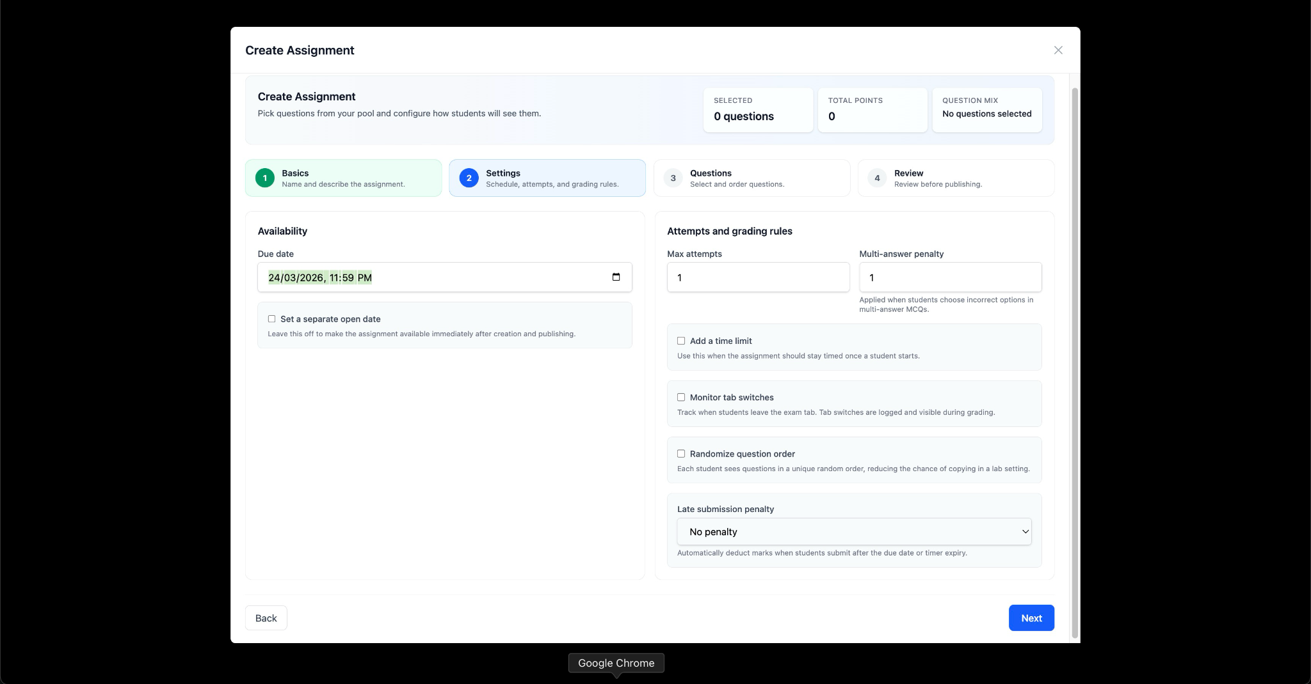
Lifecycle · Staff Side
Course Management
Question Pool
Assignment Builder
Individual + bulk CSV enrollment with per-row status reporting.
Course-scoped, tag-filterable, reusable across assignments.
Due date · time limit · attempts · late penalty · shuffle · focus monitor.
CCDS25-0233
15 / 35
Notes:
The staff workflow has three stages. Courses come first — bulk-enrollment via CSV validates each row independently and reports per-email status, so a single bad email doesn't block the rest. Questions live in a course-scoped pool that can be reused across multiple assignments. The assignment builder configures every policy — timing, attempts, late penalties, randomisation, focus monitoring.

Slide 16
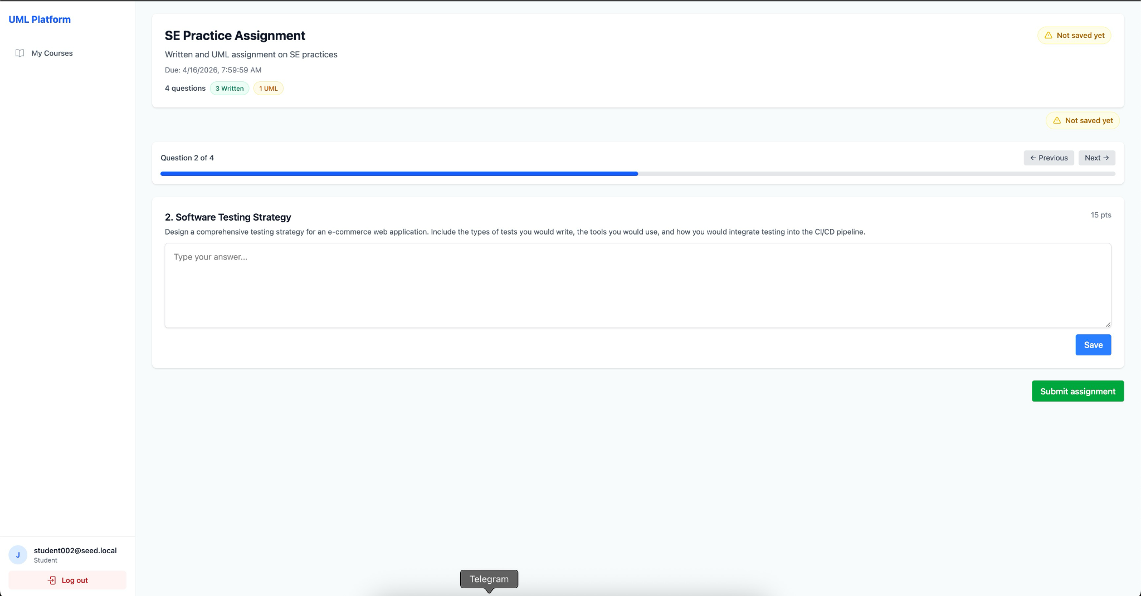
Lifecycle · Student Side
01
Idempotent start
If a draft exists, return it; never duplicate.
02
Auto-save every 30s
Visible timestamp indicator on changes.
03
Dual-layer timer
Client countdown for UX + server cron polling every 60s for expired drafts.
Figure 3.6 — Student attempt UI with auto-save indicator
04
Opt-in focus monitoring
Tab switches counted; threshold breach → auto-submit current state.
Submission state machine
05
Atomic submission
draft
→
submitted
→
late
→
grading
→
graded
Entire submission pipeline wrapped in one DB transaction.
CCDS25-0233
16 / 35
Notes:
The student attempt is the riskiest UX surface — a browser crash mid-exam can't lose work, and a dishonest student can't game the timer. So we have three independent enforcement layers: auto-save every thirty seconds, a server-side cron that force-submits expired drafts within sixty seconds, and opt-in focus monitoring that auto-submits if the student switches tabs too many times. The submission itself is wrapped in a single database transaction — atomic by construction.

Slide 17
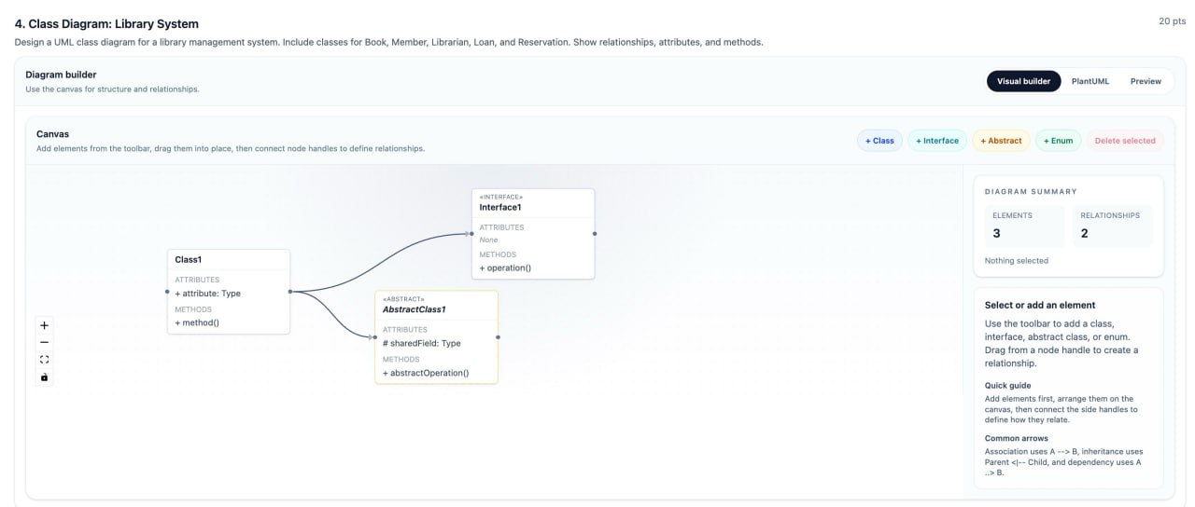
Custom UML Diagram Editor
Figure 3.11 — UML editor with structured forms, relationship popovers, and PlantUML / Preview tabs
01
React Flow base
02
Structured input
03
Two-export design
04
Component reuse
Class + sequence diagrams. Custom nodes/edges: associations, inheritance, lifelines, messages.
Visibility selectors + typed names — not freeform UML notation.
Serialises to PlantUML DSL and PNG; both deterministic from editor state.
Same UMLEditor for student attempts; UMLViewer for staff grading.
CCDS25-0233
17 / 35
Notes:
The editor is custom-built. Off-the-shelf options either lacked grading hooks or output formats incompatible with the symbolic diff layer I'll show next. It's structured rather than free-text — students pick visibility from a dropdown and type the attribute name, instead of writing raw UML notation. That typed input is what makes both the deterministic PlantUML export and the graph diff possible. The same component renders for the student during their attempt and for staff during grading.

Slide 18
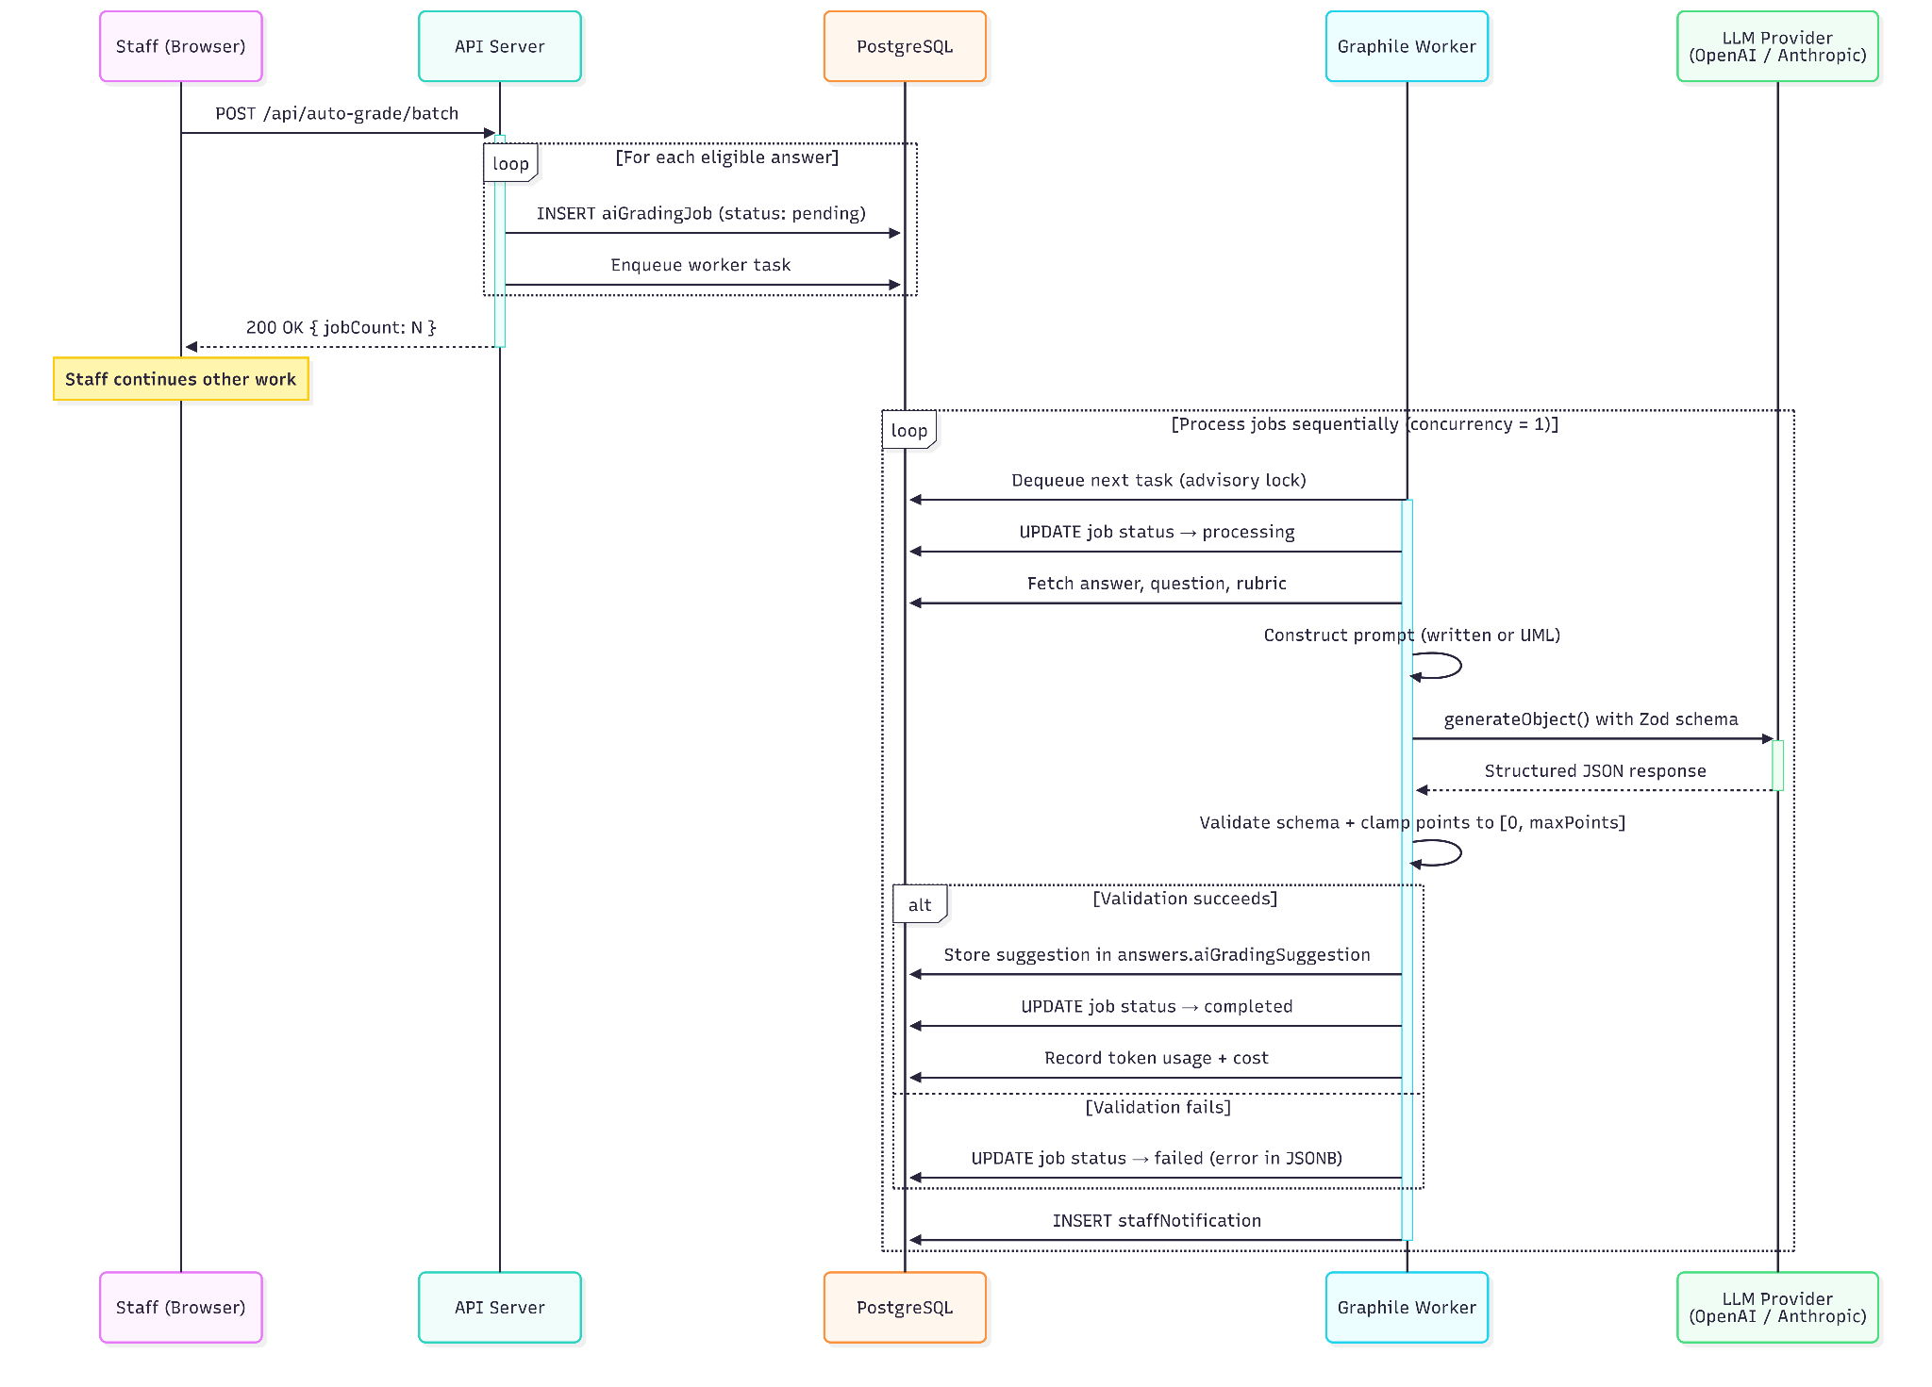
AI Grading · Async Job Architecture
01
Fire-and-return
API enqueues N jobs and returns immediately with jobCount.
02
Concurrency = 1
Sequential processing avoids LLM rate-limit contention.
03
Pipeline
Fetch → prompt → call → validate → store, with token usage logged.
04
Visible failures
Figure 3.9 — Batch AI grading sequence
Errors recorded with full message + staff notification — never silent.
CCDS25-0233
18 / 35
Notes:
Grading is asynchronous and Postgres-queued. Staff trigger a batch, the API immediately returns with a job count, and the worker processes them sequentially. Concurrency is deliberately set to one — parallel LLM calls risk rate-limit errors and unpredictable latency, and at the school scale of fifty to a hundred students per course, sequential processing finishes in a reasonable window. Every job is logged. Failures are surfaced to staff, not swallowed.

Slide 19
★ Hybrid Symbolic + Neural Grading
deterministic graph-diff anchors structural correspondence; the LLM grades semantic criteria
PlantUML DSL
Alternatives considered
Editor state
class User {
+id: int
+login()
}
User "1" -- "*" Order
LLM Prompt
Pure text LLM
Misses fine structure
{ classes: [...],
edges: [...],
visibility: ...
}
+ Student DSL
+ Reference DSL
+ Structural diff
+ Rubric (5 criteria)
→ per-criterion scores
→ reasoning text
Pure vision LLM
Hallucinates labels
Structural diff
Graph matching only
No semantic judgment
✓ Library, Book matched
⚠ Member renamed
✗ Loan missing
similarity = 0.78
Code generation
Lossy translation
structured JSON · student & reference
Zod-validated
✅ Hybrid: diff + LLM
Best of both worlds
Why it works: the diff catches what LLMs are unreliable at — precise structural correspondence — and frees the LLM to focus on naming, design judgment, and partial credit.
CCDS25-0233
19 / 35
Notes:
(slow down — this is the kernel) This is the technical core. The standard LLM-grading literature splits into pure-text and pure-vision approaches, and both have known failure modes — text-only LLMs miss fine structural correspondences, vision-only models hallucinate labels and are sensitive to layout noise. The platform takes a hybrid approach. A deterministic graph-diff function compares the student's structured editor state against the reference and produces a precise list of matched, missing, renamed, and extra classes and edges — including a similarity score. That diff goes into the LLM prompt alongside the two PlantUML representations and the rubric. So the LLM never has to recompute structural correspondence — that's already done symbolically. It focuses on what LLMs are actually good at: judging naming quality, awarding partial credit, and producing readable feedback. This division of labour is what produces the empirical results in Section 04.

Slide 20
Structured Output & Defensive Validation
schema.ts — Zod schema for grading output
01
API-level enforcement
const gradingSchema = z.object({
points: z.number().min(0),
reasoning: z.string().min(10),
confidence: z.number().min(0).max(100),
criteriaScores: z.array(z.object({
criterion: z.string(),
score: z.number(),
comment: z.string(),
})).optional(),
});
// Symbolic step: deterministic graph-diff
const diff = diffClassDiagrams(student, reference);
// Neural step: structured-output LLM call
const { object } = await generateText({
model: getModel(settings),
output: Output.object({ schema: gradingSchema }),
prompt: buildPrompt(student, reference, diff, rubric),
});
// Defensive clamp
object.points = Math.min(object.points, maxPoints);
Vercel AI SDK Output.object() enforces the schema at the provider level — no fragile JSON parsing.
02
Schema validation
Malformed output → job fails explicitly. No corrupt data ever reaches the gradebook.
03
Score clamping
Bounded to [0, maxPoints] — guards against out-of-range hallucinations.
04
Result
100% parse rate on Claude Opus and Sonnet (see Section 04).
CCDS25-0233
20 / 35
Notes:
Two layers of defence. Schema validation through Zod and the AI SDK guarantees the LLM returns valid JSON or fails the job. Score clamping catches the known LLM tendency to occasionally hallucinate out-of-range numbers. Together they ensure that no corrupt suggestion ever reaches the staff review interface — a structural invariant, not just convention.

Slide 21
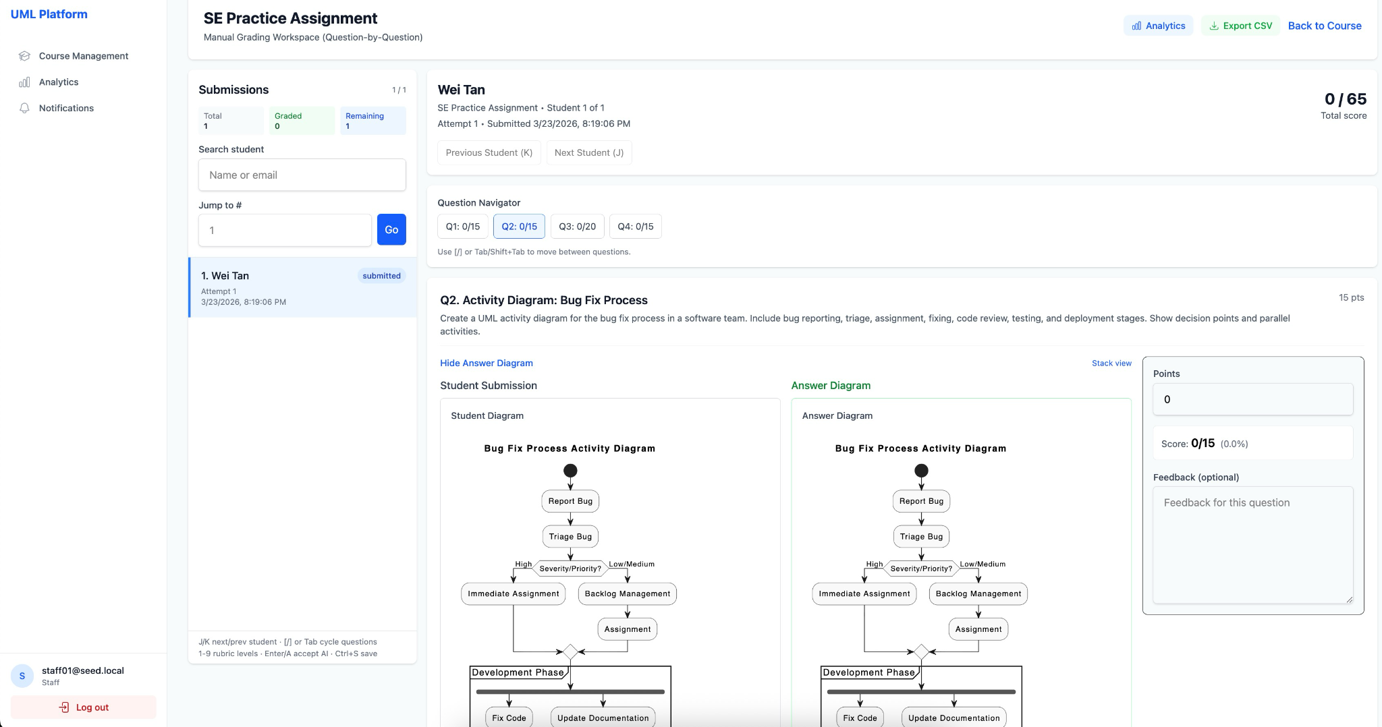
Human-in-the-Loop Review
01
Suggestions are staged
AI never writes to gradebook directly — separate from marks table.
02
Accept
Official mark recorded with source = ai_assisted; original suggestion preserved.
03
Reject
Suggestion cleared; staff grades manually.
04
Override
Mark changes recorded with optional written reason and previous-score audit.
05
Auditability
Figure 3.10 — Two-panel grading interface: AI suggestion (left) · official mark (right)
Every published grade has verifiable human oversight.
CCDS25-0233
21 / 35
Notes:
The most consequential design decision in the pipeline. AI suggestions live in a staging column, separate from the official marks table. Staff must explicitly accept or reject each one. Every grading action — including overrides of existing marks — is recorded with provenance metadata: who reviewed, whether AI-assisted, whether the AI suggestion was accepted as-is or modified. This audit trail is what makes AI grading defensible at the institution level.

Slide 22
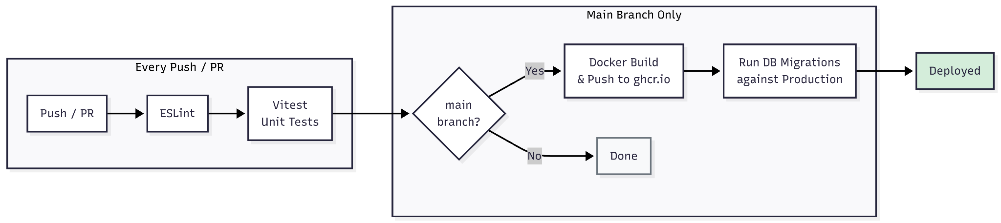
Production Deployment & CI/CD
Railway · two services from one Dockerfile
01
Two services, one image
web
Same Dockerfile, different startCommand for web vs worker.
Dockerfile
node dist/server/index.js
Supabase
multi-stage
Node 20 Alpine
Postgres + Auth
worker
(managed)
02
Healthcheck-gated rollout
node dist/server/worker.js
/api/health/ready returns 200 only when DB is reachable; Railway holds traffic until green.
preDeployCommand: node dist/db/migrate.js · healthcheck: /api/health/ready
03
Migration as preDeploy hook
node dist/db/migrate.js runs before the new web pod starts; rollout aborts if migration fails.
04
GitHub Actions pipeline
Figure 3.14 — GitHub Actions: lint · test · build · push · migrate
lint → vitest → build & push image to ghcr.io. Bridge to the on-prem path.
CCDS25-0233
22 / 35
Notes:
Production runs on Railway. Two services — web and worker — built from the same Dockerfile, distinguished only by their start command. The web service has a healthcheck on the readiness endpoint, so Railway holds traffic until database connectivity succeeds; if a migration breaks something, the new pod never gets traffic. Migrations run as a pre-deploy hook before the new web pod starts, gated on success — a bad migration can't take down a healthy version. The GitHub Actions pipeline is independent: it lints, tests, builds and publishes the image to ghcr.io. That image is the bridge to the on-prem story you'll see next.

Slide 23
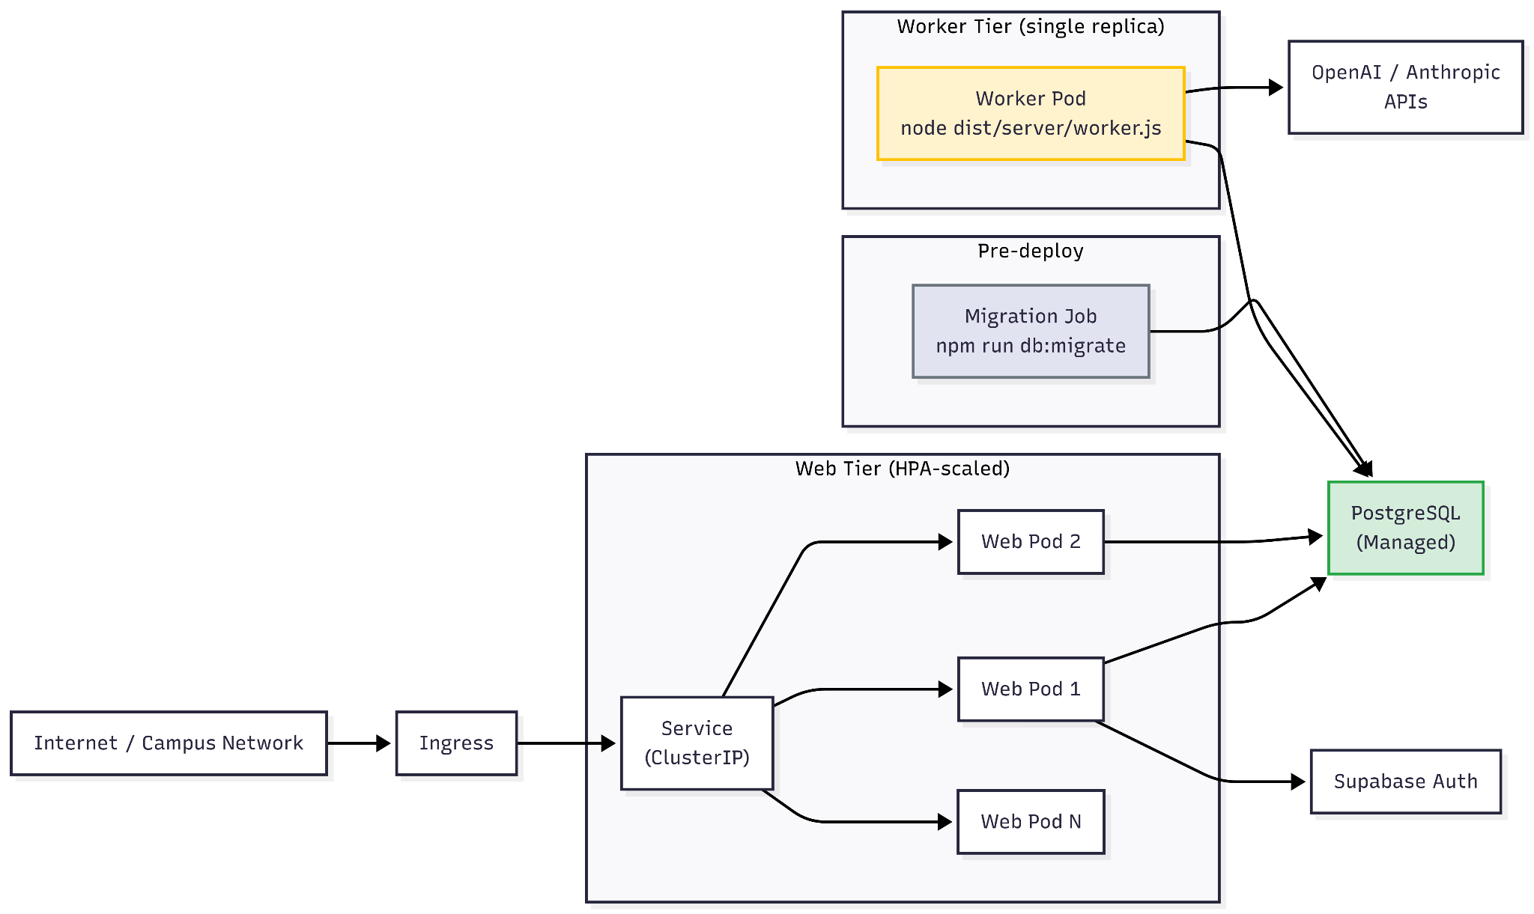
On-Premise Deployment Path
Why on-prem? Some institutions cannot use managed PaaS — outbound traffic policies, data sovereignty, or pre-existing on-prem clusters. The deployment artefact is reusable on Kubernetes.
01
Same image, k8s manifests
The CI/CD image is what the cluster pulls.
02
Web tier: HPA 2 → 6
CPU-based autoscale for exam bursts.
03
Worker tier: single replica
Advisory locks make scale-out safe if needed.
Figure 3.13 — Kubernetes topology: HPA-scaled web tier, single-replica worker, migration Job
04
Pre-deploy migration Job
kubectl apply + wait — pre-rollout gate.
Reference architecture; not deployed live. Fully air-gapped deployment (Ollama for LLM, self-hosted Postgres) is future work — see Section 05.
CCDS25-0233
23 / 35
Notes:
Some schools — especially ones with strict data-sovereignty policies or no outbound internet — can't use Railway or any managed PaaS. The same Docker image and Kubernetes manifests in the repository give them a self-hosted path. Pull the image from ghcr.io, apply the manifests, and you get a horizontally-scalable web tier with sequential worker processing. The migration Job mirrors Railway's preDeployCommand semantics — kubectl apply, kubectl wait, then rollout. Worth being explicit: this is the reference architecture. I haven't deployed it to a live cluster, and a fully air-gapped version with self-hosted Postgres and on-prem LLM serving is in the future-work section.

Slide 24

04
SECTION
Experiment & Evaluation
CCDS25-0233
24 / 35

Slide 25
Research Questions
RQ1
RQ2
Accuracy
Cost-performance
Which LLM achieves the highest grading accuracy compared to human experts?
What is the cost-performance tradeoff between flagship and baseline models across providers?
RQ3
RQ4
Consistency
Reliability
How consistent are LLM grades across multiple runs on the same submission?
Which model produces the most reliable structured output and useful qualitative feedback?
CCDS25-0233
25 / 35
Notes:
Four research questions. RQ1 is grading accuracy against human ground truth. RQ2 is the cost-performance trade-off — does the cheaper model in each provider's lineup hold up? RQ3 is inter-run consistency, since stochastic outputs would undermine reproducibility. RQ4 is structured output reliability — the format-compliance issue that Piscitelli et al. raised in 2025.

Slide 26
Experiment Setup
Models · Table 4.1
Dataset & Protocol
Model | Provider | Tier | $/1M in/out
Claude Opus 4.6 | Anthropic | Flagship | $5 / $25
Claude Sonnet 4.6 | Anthropic | Baseline | $3 / $15
GPT-5.4 | OpenAI | Flagship | $2.50 / $15
GPT-5.4 Mini | OpenAI | Baseline | $0.75 / $4.50
Gemini 3.1 Pro | Google | Flagship | $2 / $12
Gemini 3 Flash | Google | Baseline | $0.50 / $3
32
6
5
submissions
models
runs each
= 960 API calls
Submissions: 2 real (McGill UML repo) + 30 synthetic across 5 quality tiers
Domains: Library Management · E-Commerce · Hospital Management
Rubric: 5 criteria — class correctness · relationships · cardinality · naming · completeness
Protocol: temperature 0.0, exponential backoff, every call logged
5 synthetic-quality tiers
Excellent
Good
Average
Poor
Failing
CCDS25-0233
26 / 35
Notes:
Six models — one flagship and one baseline from each of three providers. Two real student submissions from the McGill repository and thirty synthetic submissions covering the full grade spectrum across three domains. Each submission graded five times by each model — nine hundred and sixty API calls total. Temperature zero where supported, exponential backoff on transient failures, every call logged with prompt, response, latency, and token usage.

Slide 27
Evaluation Metrics
Metric | Weight | Captures
Accuracy | 35% | Pearson r + MAE vs ground truth
Consistency | 25% | Std. dev. across 5 runs
Cost | 10% | USD per submission
Feedback quality | 15% | Parse success + structured-output compliance
Speed | 5% | Median latency
Rubric adherence | 10% | % rubric criteria addressed
W = 0.35·S_acc + 0.25·S_con + 0.10·S_cst + 0.15·S_fdb + 0.05·S_spd + 0.10·S_rub
Each sub-score normalised against an absolute reference ceiling (not min-max) — preserves stability when models are added or removed.
CCDS25-0233
27 / 35
Notes:
Six metrics, weighted toward accuracy (35%) and consistency (25%) since this is summative assessment — both account for sixty percent of the weighted score. Cost and speed are deliberately low-weighted because at the target scale of fifty to a hundred students, even the most expensive model costs under four cents per submission. Each metric is normalised against an absolute reference ceiling rather than min-max, so the rankings stay stable if more models are added later.

Slide 28
★ RQ1 — Grading Accuracy
the empirical headline
Model | Pearson r | MAE /10 | Mean Bias
Claude Opus 4.6 | 0.92 | 0.68 | −0.28
Claude Sonnet 4.6 | 0.89 | 0.78 | −0.42
GPT-5.4 | 0.86 | 0.90 | −0.55
Gemini 3.1 Pro | 0.85 | 0.95 | −0.52
GPT-5.4 Mini | 0.79 | 1.25 | −0.80
Gemini 3 Flash | 0.74 | 1.48 | −1.02
r = 0.92 improves on Bouali et al. (ICC = 0.76, earlier-gen models). All models show negative bias — systematic over-strictness, consistent with prior work.
CCDS25-0233
28 / 35
Notes:
(slow down — this is the headline) RQ1. Claude Opus 4.6 leads with Pearson 0.92 and mean absolute error of 0.68 out of 10 — clearly the best-performing model overall. Sonnet and GPT-5.4 form a competitive second tier with Pearson 0.89 and 0.86. The baseline models — GPT-5.4 Mini and Gemini 3 Flash — show a clear accuracy drop. Two takeaways. First, Pearson 0.92 is a notable improvement over Bouali et al.'s 0.76 with an earlier Claude generation, which directly addresses the gap from Section 01. Second, every model shows negative mean bias — they grade more strictly than the human grader. That's consistent with prior work and suggests a systematic LLM tendency, not a quirk of one provider.

Slide 29
RQ2 · Cost-Performance Tradeoff
01
$0.003 → $0.032
10× cost span across the lineup, all operationally affordable.
02
200-cohort total
Entire grading bill ranges $0.60 → $6.40 per assignment.
03
Sweet spot: Sonnet 4.6
$0.018 / r = 0.89 — half Opus's cost, near-equal accuracy.
04
Within-provider gap is tight
Institutions can choose by budget without sacrificing quality.
CCDS25-0233
29 / 35
Notes:
RQ2. Even the most expensive model costs under four cents per submission, so for a typical course the entire grading bill is under seven dollars per assignment. The interesting finding is the cost-accuracy ratio within a provider — Sonnet trails Opus by 0.03 on Pearson r at roughly half the cost. Institutions can choose based on budget without meaningfully compromising grading quality.

Slide 30
RQ3 · Consistency + RQ4 · Structured Output
RQ3 · Inter-run consistency
RQ4 · Structured-output parse rate
Model | Mean σ | Max σ
Claude Opus 4.6 | 0.16 | 0.50
Claude Sonnet 4.6 | 0.21 | 0.65
Gemini 3 Flash | 0.48 | 1.60
100%
Claude Opus / Sonnet
≥97.5%
all flagship models
94.4%
Gemini 3 Flash · truncated reasoning
Lower σ = more reliable across re-runs
Why both findings matter:
Opus's σ = 0.16 sits well below the 1.5-point ceiling that would mean two students could receive grades a full letter apart on the same submission. Combined with 100% parse rate, the API-level structured-output enforcement and temperature 0.0 protocol have effectively resolved the format-compliance problem flagged by Piscitelli et al. (2025).
CCDS25-0233
30 / 35
Notes:
Two RQs in one slide because they tell a single story. Claude Opus is the most consistent across runs at standard deviation 0.16, well below the 1.5-point ceiling that would mean two students could receive grades a full letter apart on the same submission. On structured output, both Claude models hit 100% parse rate — the API-level structured-output enforcement, combined with temperature zero, has effectively solved the format-compliance problem that Piscitelli et al. flagged earlier this year.

Slide 31
Aggregate Ranking & Recommendation
Rank | Model | Weighted Score | Recommendation
1 | Claude Opus 4.6 | 0.87 | Default for production deployment
2 | Claude Sonnet 4.6 | 0.87 | Cost-effective alternative
3 | GPT-5.4 | 0.84 | Fallback when Anthropic unavailable
4 | Gemini 3.1 Pro | 0.83 | Not recommended
5 | GPT-5.4 Mini | 0.80 | Not recommended
6 | Gemini 3 Flash | 0.77 | Not recommended
Tie at 0.87 — Opus leads by < 0.01 at full precision (driven by accuracy + consistency). Opus = production default; Sonnet = cost-effective alternative; GPT-5.4 = viable fallback.
CCDS25-0233
31 / 35
Notes:
Apply the weighting formula and Opus and Sonnet tie at 0.87 — Opus leads by less than 0.01 at full precision, driven by its accuracy and consistency advantage. Opus is the production recommendation when grading quality is paramount; Sonnet is the cost-effective alternative at roughly half the per-submission cost. GPT-5.4 is a viable fallback if the Anthropic API is unavailable. The baseline models — Mini and Flash — would be acceptable for formative feedback but their variance is too high for summative grading.

Slide 32
Threats to Validity
01
Synthetic-heavy dataset
02
Single-grader ground truth
03
Experiment scope
Only 2 of 32 submissions are real student work.
Most significant threat — no inter-rater reliability measured.
Empirical study covered class only. Sequence now supported in editor but unbenchmarked.
04
Conversion artefact
05
Model drift
McGill submissions required Umple → PlantUML conversion.
Providers update models over time; results are a snapshot.
Future work prioritises real student data with multi-grader ground truth — see Section 05.
CCDS25-0233
32 / 35
Notes:
I want to be explicit about the limits of these results. The dataset is small and predominantly synthetic — thirty of thirty-two submissions were author-generated. Ground truth came from a single grader, which is the most significant threat to internal validity. The empirical study evaluated class diagrams only — the editor now also supports sequence, but it wasn't part of the experiment, and activity and state remain future work. The McGill data required Umple-to-PlantUML conversion which may affect comparability. And model behaviour drifts as providers update their checkpoints. These are real limits — and they're exactly what Section 05's future work prioritises.

Slide 33

05
SECTION
Conclusion
CCDS25-0233
33 / 35

Slide 34
Summary & Future Work
Delivered
Future Work
✅
Full-stack platform with end-to-end assessment lifecycle [O1]
01
More diagram types
02
Real-student benchmark
Class + sequence shipped. Extend editor to activity, state, ER. Pipeline already type-agnostic.
Organic student work across multiple courses. Closes the Bouali et al. standardisation gap.
✅
Hybrid symbolic + neural grading (graph-diff + LLM); 100% parse rate on Claude [O2]
✅
Empirical: Claude Opus 4.6 wins (r = 0.92), Sonnet best cost-quality [O4]
03
Multi-grader validation
04
Air-gapped deployment
🔶
Two-panel grading UX — exact time saving pending user study [O3]
3+ graders, ICC metrics, recalibrate the −0.28 → −1.02 LLM bias estimates.
Ollama / vLLM for on-prem LLM serving; self-hosted PostgreSQL StatefulSet.
🔶
Containerised + k8s deployment — load-test under realistic exam load pending [O5]
CCDS25-0233
34 / 35
Notes:
Five objectives. Three were fully met — the platform, the AI grading pipeline with 100% parse rate on Claude, and the empirical evaluation. Two were substantially met with caveats: the grading UX was designed for time-saving but I haven't run a user study to quantify it, and the deployment was architecturally complete but I haven't load-tested it under realistic exam load. Future work in four directions — extend the editor to activity and state diagrams beyond the class and sequence support already shipped, build a real-student multi-grader benchmark to close the literature gap, validate with multiple human graders, and add air-gapped LLM serving for schools that can't permit outbound traffic.

Slide 35
Thank you
Q & A
Wang Yu Teng (U2122796L) · CCDS25-0233
Supervisor: Dr. Loke Yuan Ren · Examiner: Prof. Zhang Hanwang
College of Computing and Data Science · 2026
CCDS25-0233
35 / 35
Notes:
Thank you. Happy to take questions.

