Slide 1
Team 4
Members:Yue Wang, Kelsee Horrom, Essam Aljahmi, and Renjie Chen

Slide 2
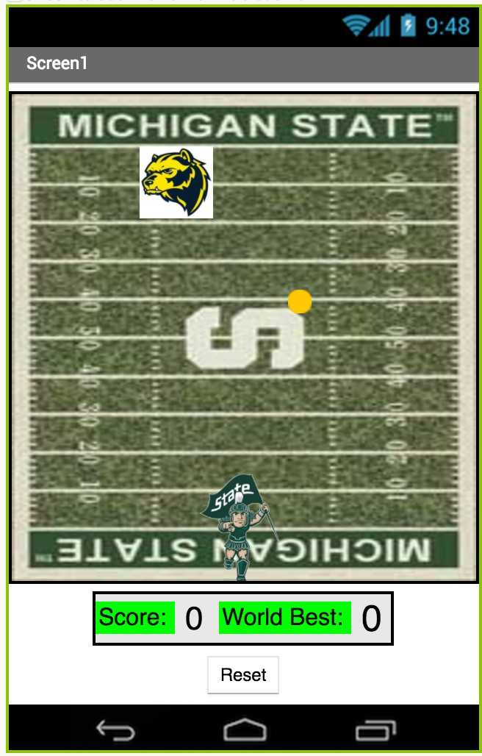
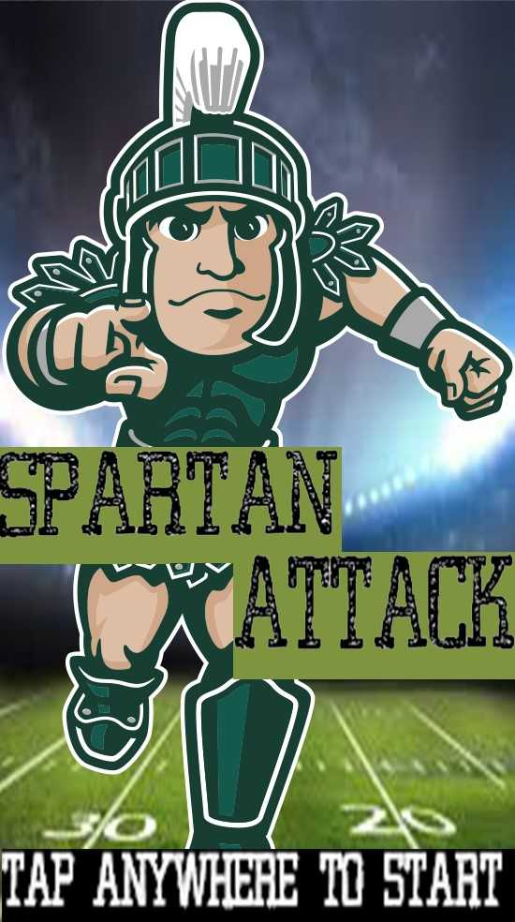
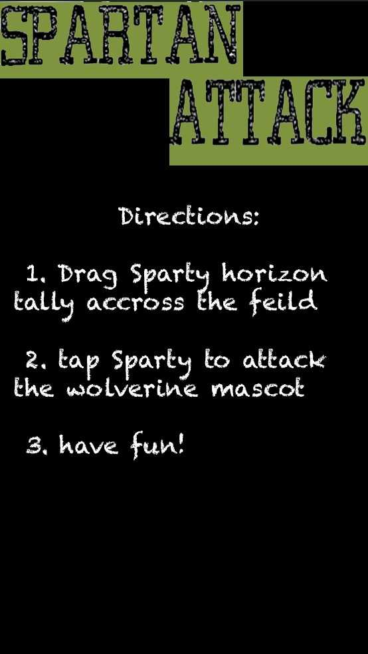
Completed work
Graphical user interface (GUI) with images and a professional appearance
Animation playback of user created animation
Outputs of sound
Full functionality and capable of running on the android phone
User survey
f
Figure 1: Main Screen of the Game Figure 2: Directions of the Game Figure 3: In-Game Screen with Best Score

Slide 3
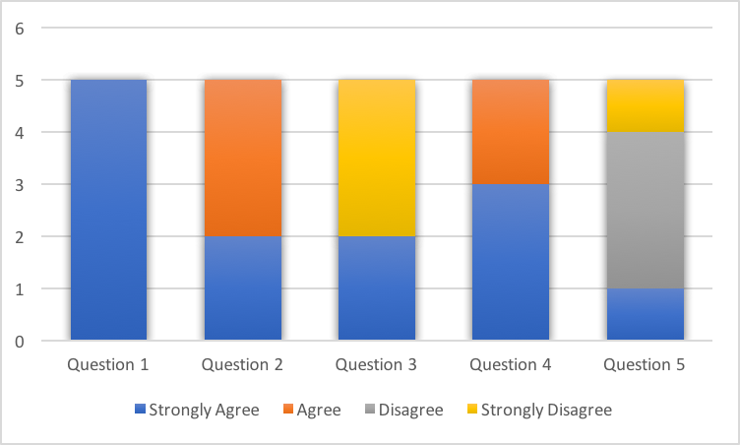
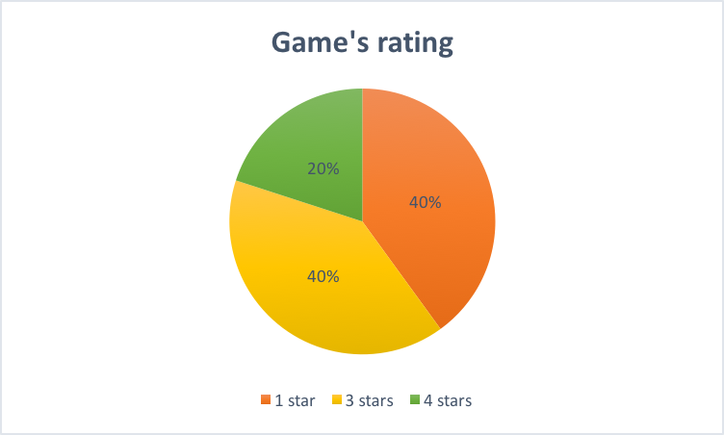
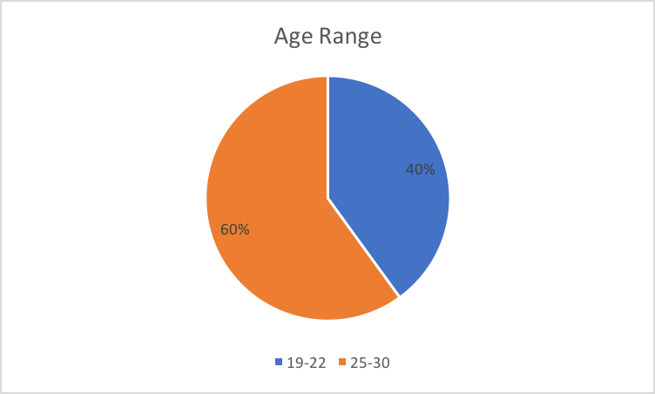
Results
The survey consisted of five main questions with the options-strongly agree, agree, disagree and strongly disagree. The questions asked was 1. Are the directions easy to follow? 2. Is it easy to play the game? 3. Do you like the other college’s mascot picture? 4. Do you like the sounds present? 5. Do you like the background of the game? Following that there was a question on how would you rate the game in stars with 1 being the lowest and 5 the highest. At the end of the survey it asks how old they are.
Table 1: Results of the Survey
Table 2: The Game’s Rating with Stars Table 3: Age Group of Participants

Slide 4
Future work
Make game easier for the users
Have clear instructions on how to play
The background picture will be changed to be realistic to the actual Spartan Stadium
Have different college’s mascots and different background of game
Include different sounds when the other mascot is hit or the user reaches a high score
Make Poster and final prototype

