Slide 1

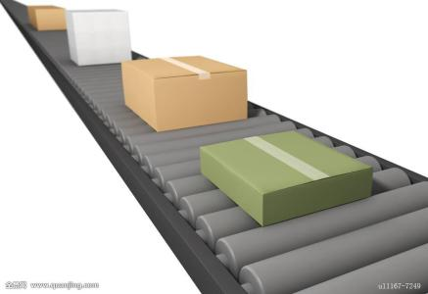
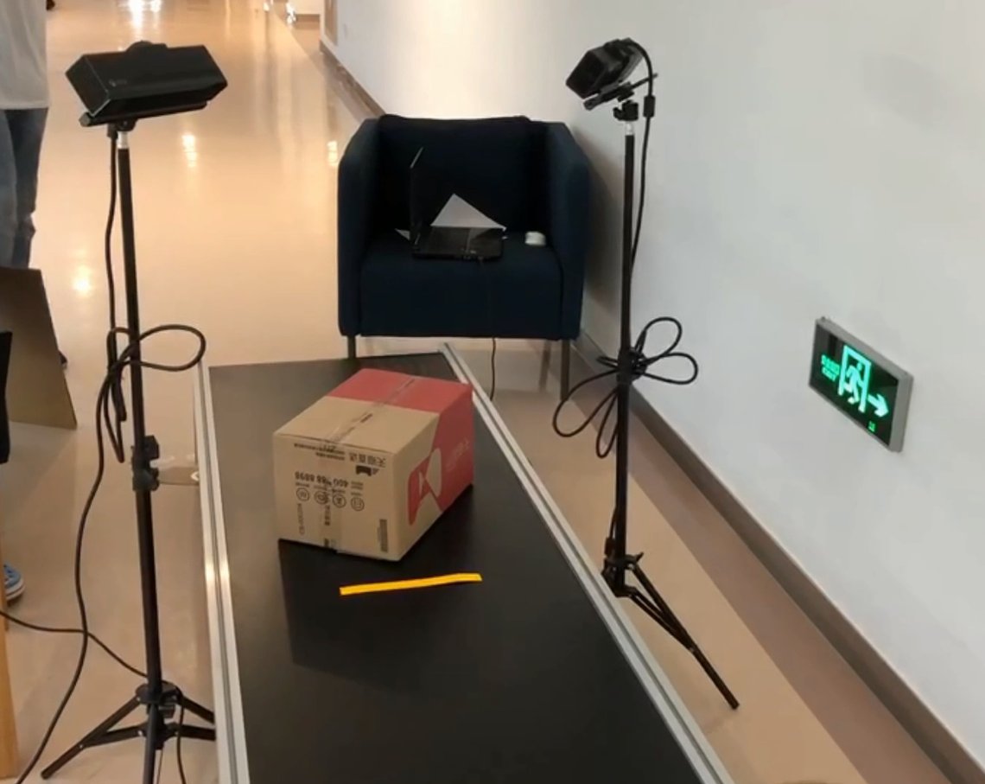
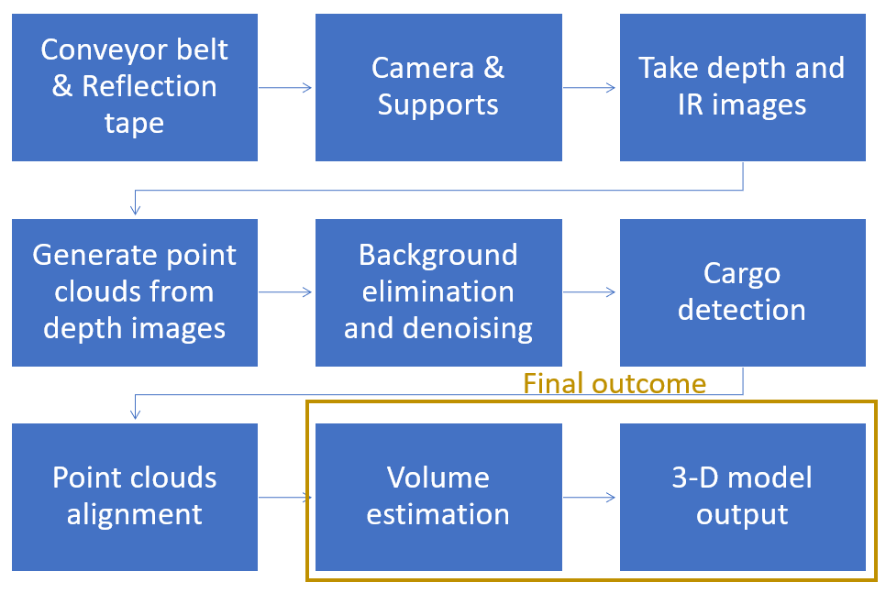
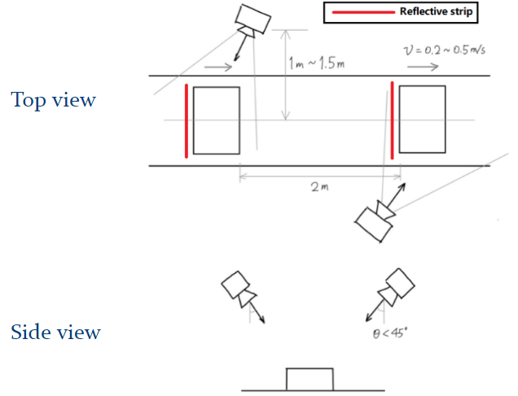
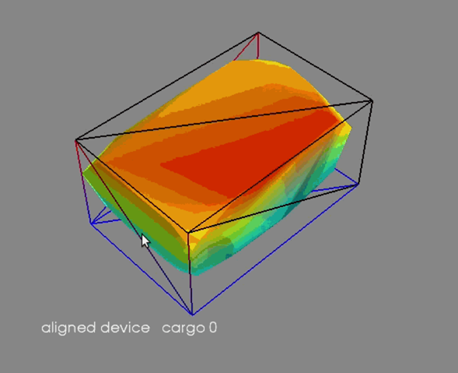
VM450 • Design and Manufacturing III
& VE450 • Major Design Experience
Automatic Measurement System for Cargo Volume
Sponsor: Zhuosi Zhang, Panasonic
Team Members: Zesen Wang, Xinyi Wu, Yier Zhang, Yetong Zhang, Zitao Zhang
Faculty Advisor: Dr. Mingjian Li Instructor: Prof. Chengbin Ma
Problem Statement
The growing e-market in China results in the quickly expanding demand of cargo delivery. Many companies have demands on fast packing and loading process, efficient usage of vehicle capacity, and accurate freight calculation. Our Customer, Panasonic, would like to improve the cargo delivery process. So our project is to build a system that can automatically estimate the volume and shape of cargos on a conveyor belt.
Fig. 1 Estimate cargo volume and shape on a conveyor belt[1]
Concept Generation
The concept is to take depth and IR images of the cargo along with the conveyor belt in different filming angles. We detect the cargo and generate point clouds. Then point clouds of different angles are aligned together to form the final model of the cargo. We then estimate the volume and shape of it from the point cloud model.
Fig. 2 Detailed Functional Decomposition
Fig. 3 Concept Diagram
Design Description
The design uses two depth cameras to take IR and depth images of the cargo. We use reflection tapes on the conveyor belt which are very obvious in IR images to determine the position of cargos. Then we generate point clouds out of the depth images. The point clouds are then denoised to eliminate irrelevant points. We first align the point clouds generated by each camera by referring to the moving direction and a feature point. Then we align the point clouds from two filming angle into one, and use convex hull construction to construct the 3D model of the cargo. Finally, we construct the smallest cuboid that encloses the cargo and then use its volume as the estimation.
Fig.4 The whole set-up system
Modeling and Analysis
A python script is written to visualize the 3D point cloud of reconstructed object, and display the bounding box of the object. The errors and offsets are evaluated by comparing the size of the bounding box to the size of the real object.
Fig. # 3D object visualization
Validation
Validation Process:
We conduct validation experiments on a real conveyor belt with 0.6m width and 3m length, with adjustable moving speed. Objects of various sizes are placed on the conveyor under different moving speeds. The volume estimation algorithm runs in real time to output the sizes and shapes of the cargos. The execution time and max unilateral error of size estimation are recorded.
Some other specifications are also verified using simple experiments and measurements
Validation Results:
According to validation part, most specifications can be met.
Max Unilateral error < 10%
Cargo Min Size 10⨉10⨉10 cm3
•Cargo Max Size 50⨉50⨉50 cm3
Process Time < 4s
Camera distance < 1.5m
Number of depth cameras <=2
Cost < 3500RMB
means having been satisfied and · means partially satisfied.
Conclusion
Depth cameras can be used to reconstruct the object shape and estimate the volume. The method can be applied in real-world conveyor belt settings to estimate cargo volumes at high accuracy and low cost.
Acknowledgement
Sponsor: Zhuosi Zhang from Panasonic
Advisor: Dr. Mingjian Li and Prof. Chengbin Ma from UM-SJTU Joint Institute
Reference
[1]https://ss0.bdstatic.com/70cFuHSh_Q1YnxGkpoWK1HF6hhy/it/u=3831402330,1049417822&fm=200&gp=0.jpg

