Slide 1
KijaniKiosk Capstone
Track A: Infrastructure-First Deployment Pipeline
Celine Wangare

Slide 2
Problem Statement
kk-payments had no way to validate changes in a production-like environment before deploying to production.
Before
Local test → Production
No safety net between a laptop and live traffic.
No staging namespace
No automated smoke test
No gated approval step
Deployments went straight from local testing to production

Slide 3
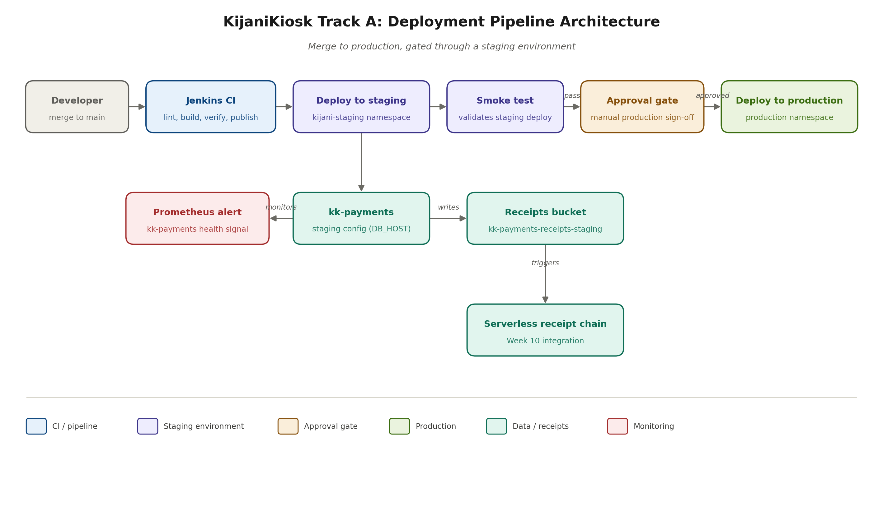
Architecture
Merge to production, gated through a staging environment

Slide 4
Pipeline Walkthrough
1
2
3
4
5
6
Lint / Build / Verify
Archive / Publish
Deploy to Staging
Smoke Test
Approval Gate
Deploy to Production
→
→
→
→
→
ESLint, Jest tests, npm audit (parallel)
Versioned tarball, published to Nexus
kijani-staging namespace
Confirms /health returns ok
Human approval, reason recorded
default namespace
A merge to develop triggers the pipeline automatically. Production is never touched without an explicit, recorded approval.

Slide 5
Key Decision
Deploy a known-working image tag, not a freshly built one
The trade-off
Why this was chosen
CI publishes an npm package, but there is no container build/push stage. Building and pushing a fresh image per run would close this gap, but requires registry credentials and a build stage this pipeline doesn't yet have.
Demonstrating a correct, working gate (staging deploy → smoke test → approval → production) mattered more under time pressure than a fully automated image pipeline. The gap is real and named explicitly, not hidden.

Slide 6
AI Tooling & Governance
Assistance used
What it got wrong
How it was verified / fixed
Jenkins deploy stages
Assumed kubectl + cluster network access existed in the build container; both were missing
--network flag added, kubectl installed in-stage
Terraform + Ansible
Committed .terraform/ provider cache and state file (52MB, potential sensitive data)
.gitignore added, files untracked
Prometheus alert
No governance gap - infra hiccup (slow image pull) verified before assuming failure
Confirmed via /api/v1/rules query
Full entries with checklist references in docs/ai-governance-log.md

Slide 7
Production Gaps
!
No container build/push stage
Pipeline deploys a fixed known-working tag instead of the artifact it just built
!
Serverless chain runs locally
No AWS account available; fs.watch simulates the S3-triggered Lambda
!
Broad Kubernetes credentials
Full kubeconfig copied into Jenkins rather than a scoped service account token

Slide 8
Reflection
What I'd get right earlier
Second pass
Assuming build-container tooling and network access instead of verifying it first cost real debugging time - checking kubectl and cluster reachability up front would have caught this before the first failed pipeline run.
Add a Docker build/push stage so the pipeline deploys the artifact it actually built. Move the serverless chain to a real cloud deploy. Replace the copied kubeconfig with a scoped service account.

Slide 9
Thank You
Repository: github.com/WangareCeline/KijaniKiosk_

