Slide 2

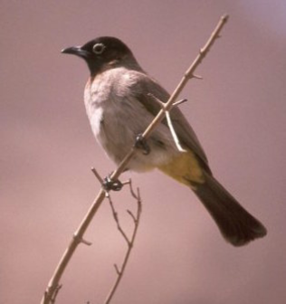
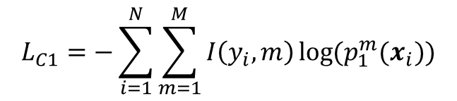


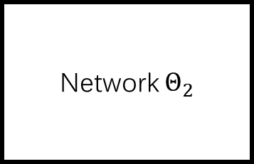

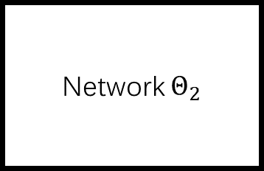
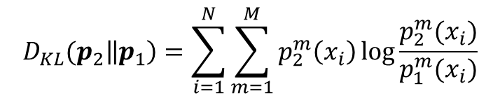
Deep Mutual Learning
softmax
logits
prediction
labels
Network $Θ_{2}$
z1
p1
$$L_{C1}$$
KL(p2||p1)
KL(p1||p2)
Network $Θ_{2}$
z2
p2
$$L_{Θ1} = L_{C1}+ D_{KL}(p_{2}‖p_{1}).$$
$$L_{C2}$$
$$L_{C1}=−\sum_{i=1}^{N}{\sum_{m=1}^{M}{I\left(y_{i},m\right)\log{(p_{1}^{m}(x_{i}))}}}$$
$$D_{KL}(p_{2}\left\|p_{1}\right)=\sum_{i=1}^{N}{\sum_{m=1}^{M}{p_{2}^{m}\left(x_{i}\right)\log{\frac{p_{2}^{m}(x_{i})}{p_{1}^{m}(x_{i})}}}}$$

Slide 3
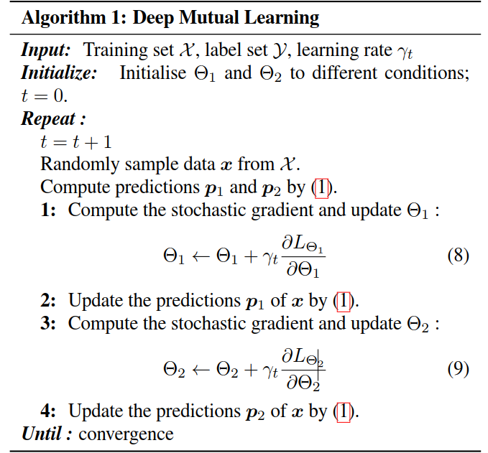

Slide 4
Extension to Larger Student Cohorts

