Slide 1
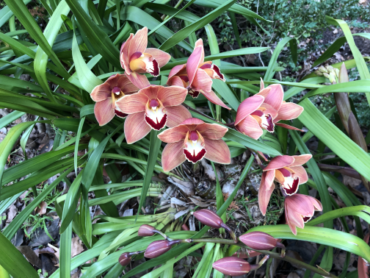

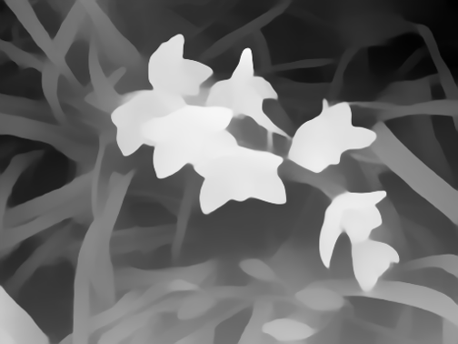
















1-minute quick start of SparseNeRF
Step 1
Rendered RGB image
GT RGB image
Reconstruct Color
Conventional NeRF
2
Volume
Rendering
Color
2
$$(\text{x},\text{d})$$
$$f_{θ}$$
$(\text{c},σ$)
$$ℒ_{nerf}$$
Distill Ranking
Depth
$$d_{a}^{′}>d_{b}^{′}$$
$$d_{a}>d_{b}$$
$$a$$
$$a$$
$$b$$
⬄
$$b$$
Rendered Depth map
$$d_{a}^{′}<d_{b}^{′}$$
$$ℛ_{rank}$$
Distill Continuity
Coarse depth map
Consistent neighbors
⬄
$$ℛ_{conti}$$

Slide 2
1-minute quick start of SparseNeRF
Rendered RGB image
GT RGB image
Reconstruct Color
2
Volume
Rendering
Color
2
$$(\text{x},\text{d})$$
$$f_{θ}$$
$(\text{c},σ$)
$$ℒ_{nerf}$$
Distill Ranking
Depth
$$d_{a}^{′}>d_{b}^{′}$$
$$d_{a}>d_{b}$$
$$a$$
$$a$$
$$b$$
⬄
$$b$$
Step 2
Rendered Depth map
$$d_{a}^{′}<d_{b}^{′}$$
$$ℛ_{rank}$$
Distill Continuity
Depth distillation
Coarse depth map
Consistent neighbors
⬄
$$ℛ_{conti}$$

Slide 3









Distill Ranking
Depth
$$d_{a}^{′}>d_{b}^{′}$$
$$d_{a}>d_{b}$$
$$a$$
$$a$$
$$b$$
⬄
$$b$$
Rendered Depth map
$$d_{a}^{′}<d_{b}^{′}$$
$$ℛ_{rank}$$
Distill Continuity
Coarse depth map
Consistent neighbors
Step 2
⬄
Depth distillation
$$ℛ_{conti}$$

Slide 4
Step 2.1
Distill Ranking
Depth
$$d_{a}^{′}>d_{b}^{′}$$
$$d_{a}>d_{b}$$
$$a$$
$$a$$
$$b$$
⬄
$$b$$
Rendered Depth map
$$d_{a}^{′}<d_{b}^{′}$$
$$ℛ_{rank}$$
Distill Continuity
Coarse depth map
Consistent neighbors
⬄
$$ℛ_{conti}$$

Slide 5







Distill Ranking
$${depth}_{a}^{′}>{depth}_{b}^{′}$$
$${depth}_{a}>{depth}_{b}$$
$$a$$
$$a$$
$$b$$
$$b$$
$$ℛ_{rank}$$
Rendered depth patch
coarse depth patch

Slide 6


Distill Ranking
$${depth}_{a}^{′}<{depth}_{b}^{′}$$
$${depth}_{a}>{depth}_{b}$$
$$a$$
$$a$$
$$b$$
$$b$$
$$ℛ_{rank}$$
Rendered depth patch
coarse depth patch

Slide 7
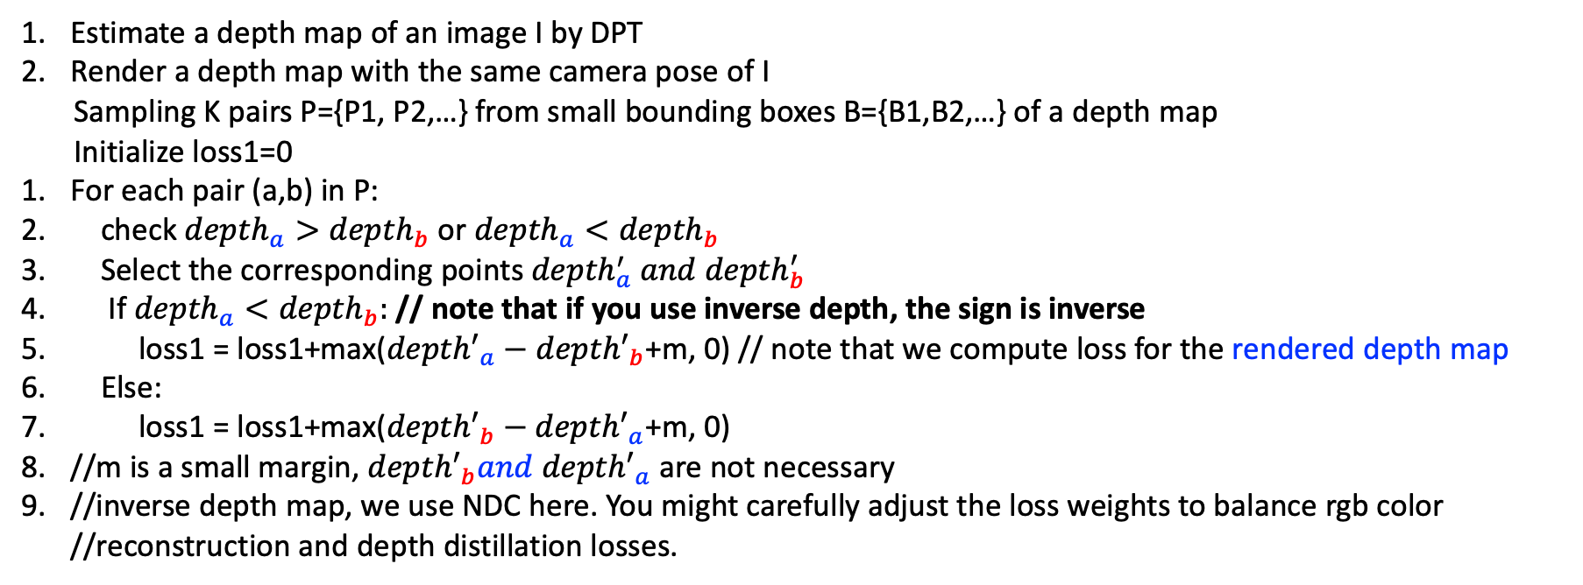
Algorithm 1:
Estimate a depth map of an image I by DPT
Render a depth map with the same camera pose of I
Sampling K pairs P={P1, P2,…} from small bounding boxes B={B1,B2,…} of a depth map
Initialize loss1=0
For each pair (a,b) in P:
check ${depth}_{a}>{depth}_{b}$ or ${depth}_{a}<{depth}_{b}$
Select the corresponding points${ depth}_{a}^{′} and {depth}_{b}^{′}$
If ${depth}_{a}<{depth}_{b}:$ // note that if you use inverse depth, the sign is inverse
loss1 = loss1+max(${depth′}_{a}−{depth′}_{b}$+m, 0) // note that we compute loss for the rendered depth map
Else:
loss1 = loss1+max(${{depth′}_{b}−depth′}_{a}$+m, 0)
//m is a small margin, ${{depth′}_{b}and depth′}_{a}$ are not necessary
//inverse depth map, we use NDC here. You might carefully adjust the loss weights to balance rgb color //reconstruction and depth distillation losses.

Slide 8
Distill Ranking
Depth
$$d_{a}^{′}>d_{b}^{′}$$
$$d_{a}>d_{b}$$
$$a$$
$$a$$
$$b$$
⬄
$$b$$
Rendered Depth map
$$d_{a}^{′}<d_{b}^{′}$$
$$ℛ_{rank}$$
Distill Continuity
Coarse depth map
Consistent neighbors
⬄
Step 2.2
$$ℛ_{conti}$$

Slide 9

Distill Continuty
$$ℛ_{conti}$$
Consistent
K-nearest neighbors

Slide 10
Sampled points in Algorithm 1, anchor, centers of the box
Algorithm 2:
BB1
B1
Suppose we sample a bounding box set B={B1, B2,…} in Algorithm 1, then we further sample smaller bounding boxes BB={BB1, BB2, …} from B (see below), where BB1 is the corresponding smaller box sampled from B1.
Loss2=0
For each smaller bounding box BBi in BB:
Compute the k-nearest neighbors of the anchor A on the depth map of DPT
Record the corresponding pixel position
Encourage these neighbors on the rendered depth of NeRF to be continuous. We randomly select one neighbor A_i, and construct pairs (A,A_i)
we compute the loss2= loss2+ max(|depth’_A-depth’_A_i|-m’, 0)
BB1
In Algorithm 1, we sample K pairs of points. Now, we use these points as anchors (centers). We further crop smaller boxes BB.
k-nearest neighbors
anchor A
Here, the anchor A is from the sampling points of P in Algorithm 1.

