Slide 1



DailyCost
Gachon University
Integrated Project
Team2
2021.09.06

Slide 2
Project Description
This project is a personal accounting tool based on the Android development platform.
Basic functions include recording the income and expense of the day, calculating the total income and expense of the day and the current month, being able to view historical bills, perform chart analysis and percentage analysis of the monthly income and expense.

Slide 3
App function objectives.
1.Bookkeeping
2. Display bill specific information
3. Analyze the bill situation (chart

Slide 4
development environment
Development platform：
Android Studio
Development Language:
Java

Slide 5
Include pages: (may be modified later)
1.Today's income and expenditure list and data page
2. Recording the details of each income or expense page
3. History of bills page
4.Monthly bill details chart page
5. Search screen
6. Settings screen
7. "About" screen

Slide 6
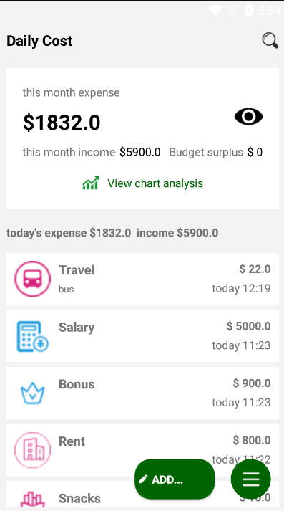
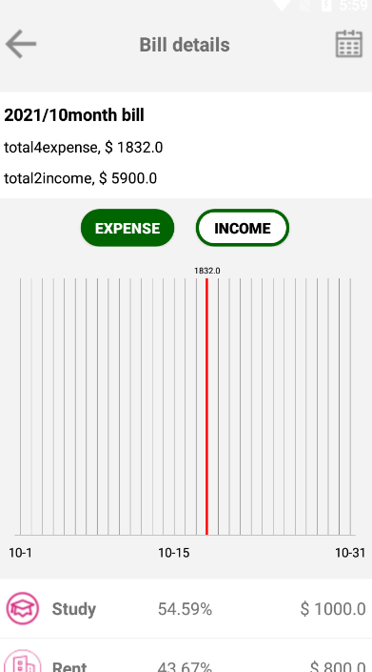
final page display

Slide 7
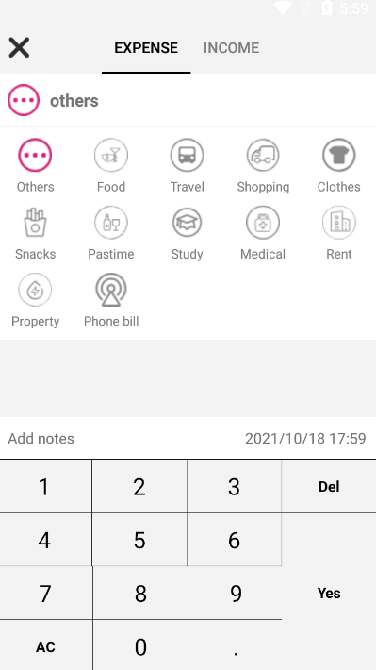
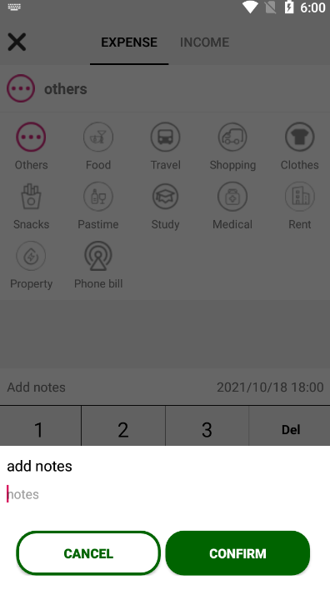
final page display

Slide 8
Technical points of the project
Important technical points of the project：
1. drawing layout, using the properties and functions of the Android basic view control
2. use "Activity" to load page information
(including life cycle, jumping, passing values and other operations)
3. use "Fragment" to load the page
(viewpager nested fragment loading data, fragment switching)
4. Custom Dialog

Slide 9
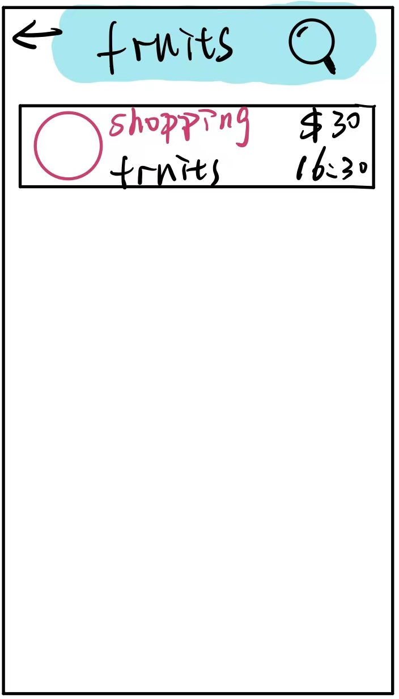
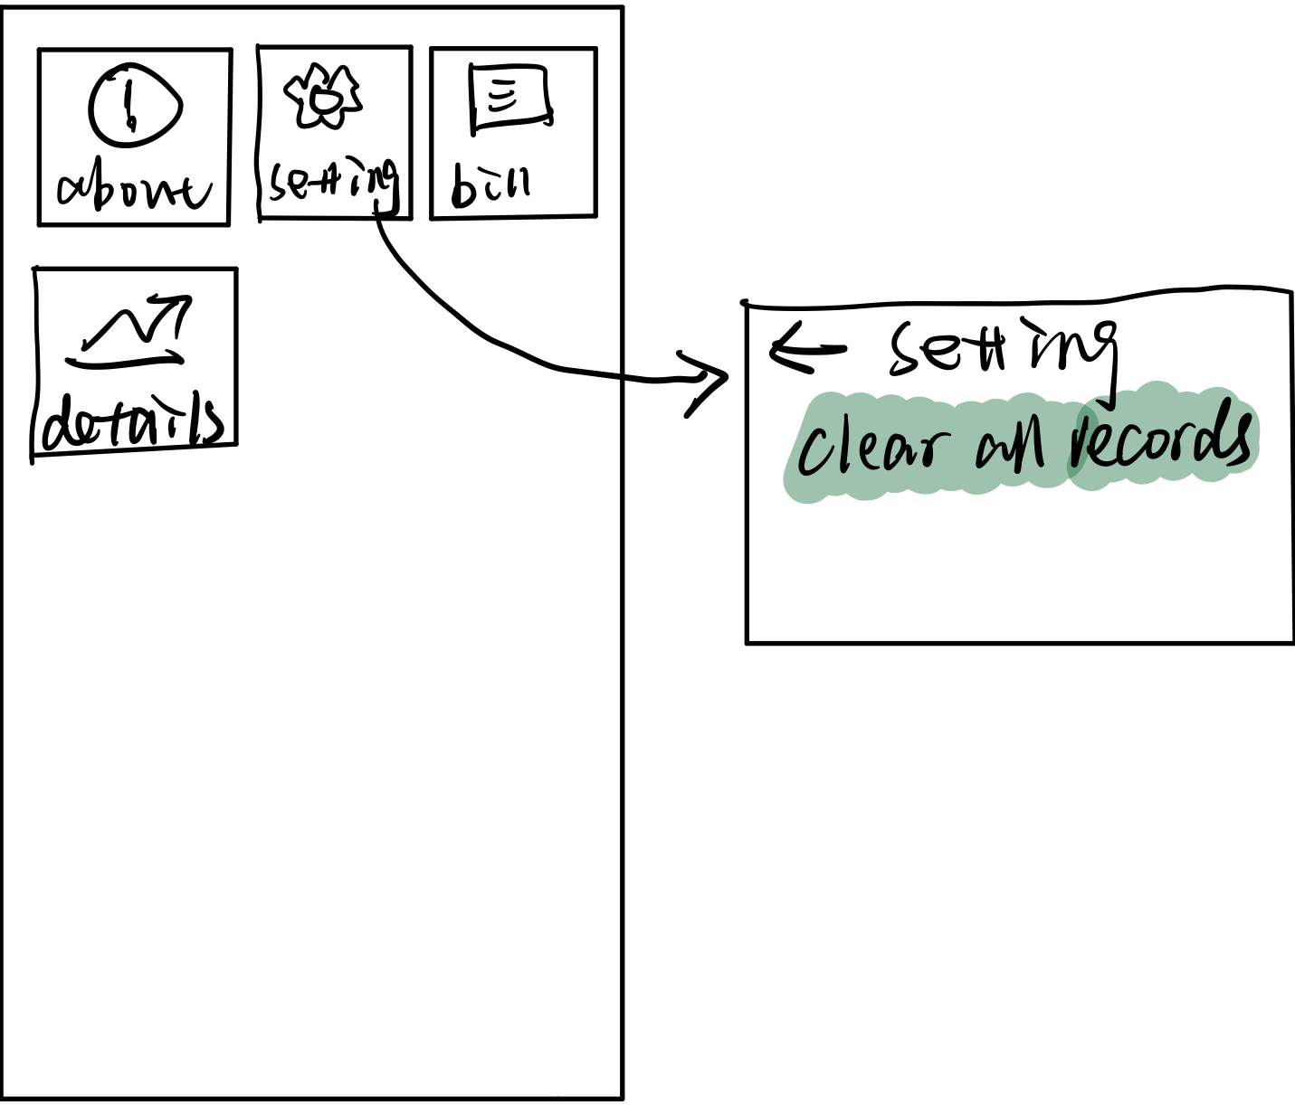
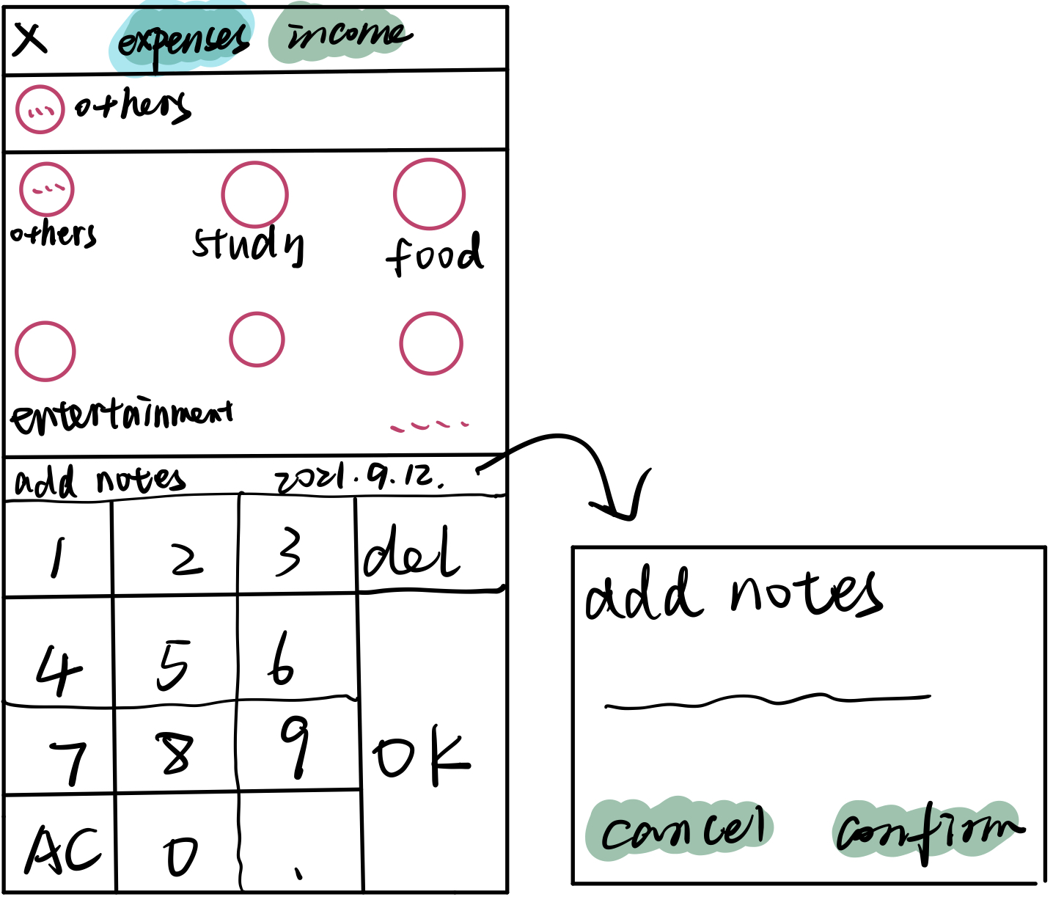
Technical points of the project

Slide 10
Technical points of the project
5. Custom Soft Keyboard
(Draw soft keyboard display, bind with the specified EditText to use)
6. Use of ListView adapter
(ListView, GridView --->BaseAdapter)
(ViewPager-->FragmentPagerAdapter/PagerAdapter)
7. Use of SQLite database

Slide 11
Technical points of the project
8. Define Drawable file, set style and some details
9. Use Android chart control "MPAndroidChart" to draw bar chart

Slide 12
The
TEAM 2
Team Information
Team leader
Wang Qing
Project Manager
Zhao JiaMing

Slide 13
Roles for us
Leader：
WangQing
Design style
draw the page layout
logic code writing
Project manager：
Zhao Jiaming
PPT preparation
Project conception requirement analysis database construction chart drawing
test function
MODERN 2.0

Slide 14
Summary

Slide 15
THANK YOU

