Slide 1

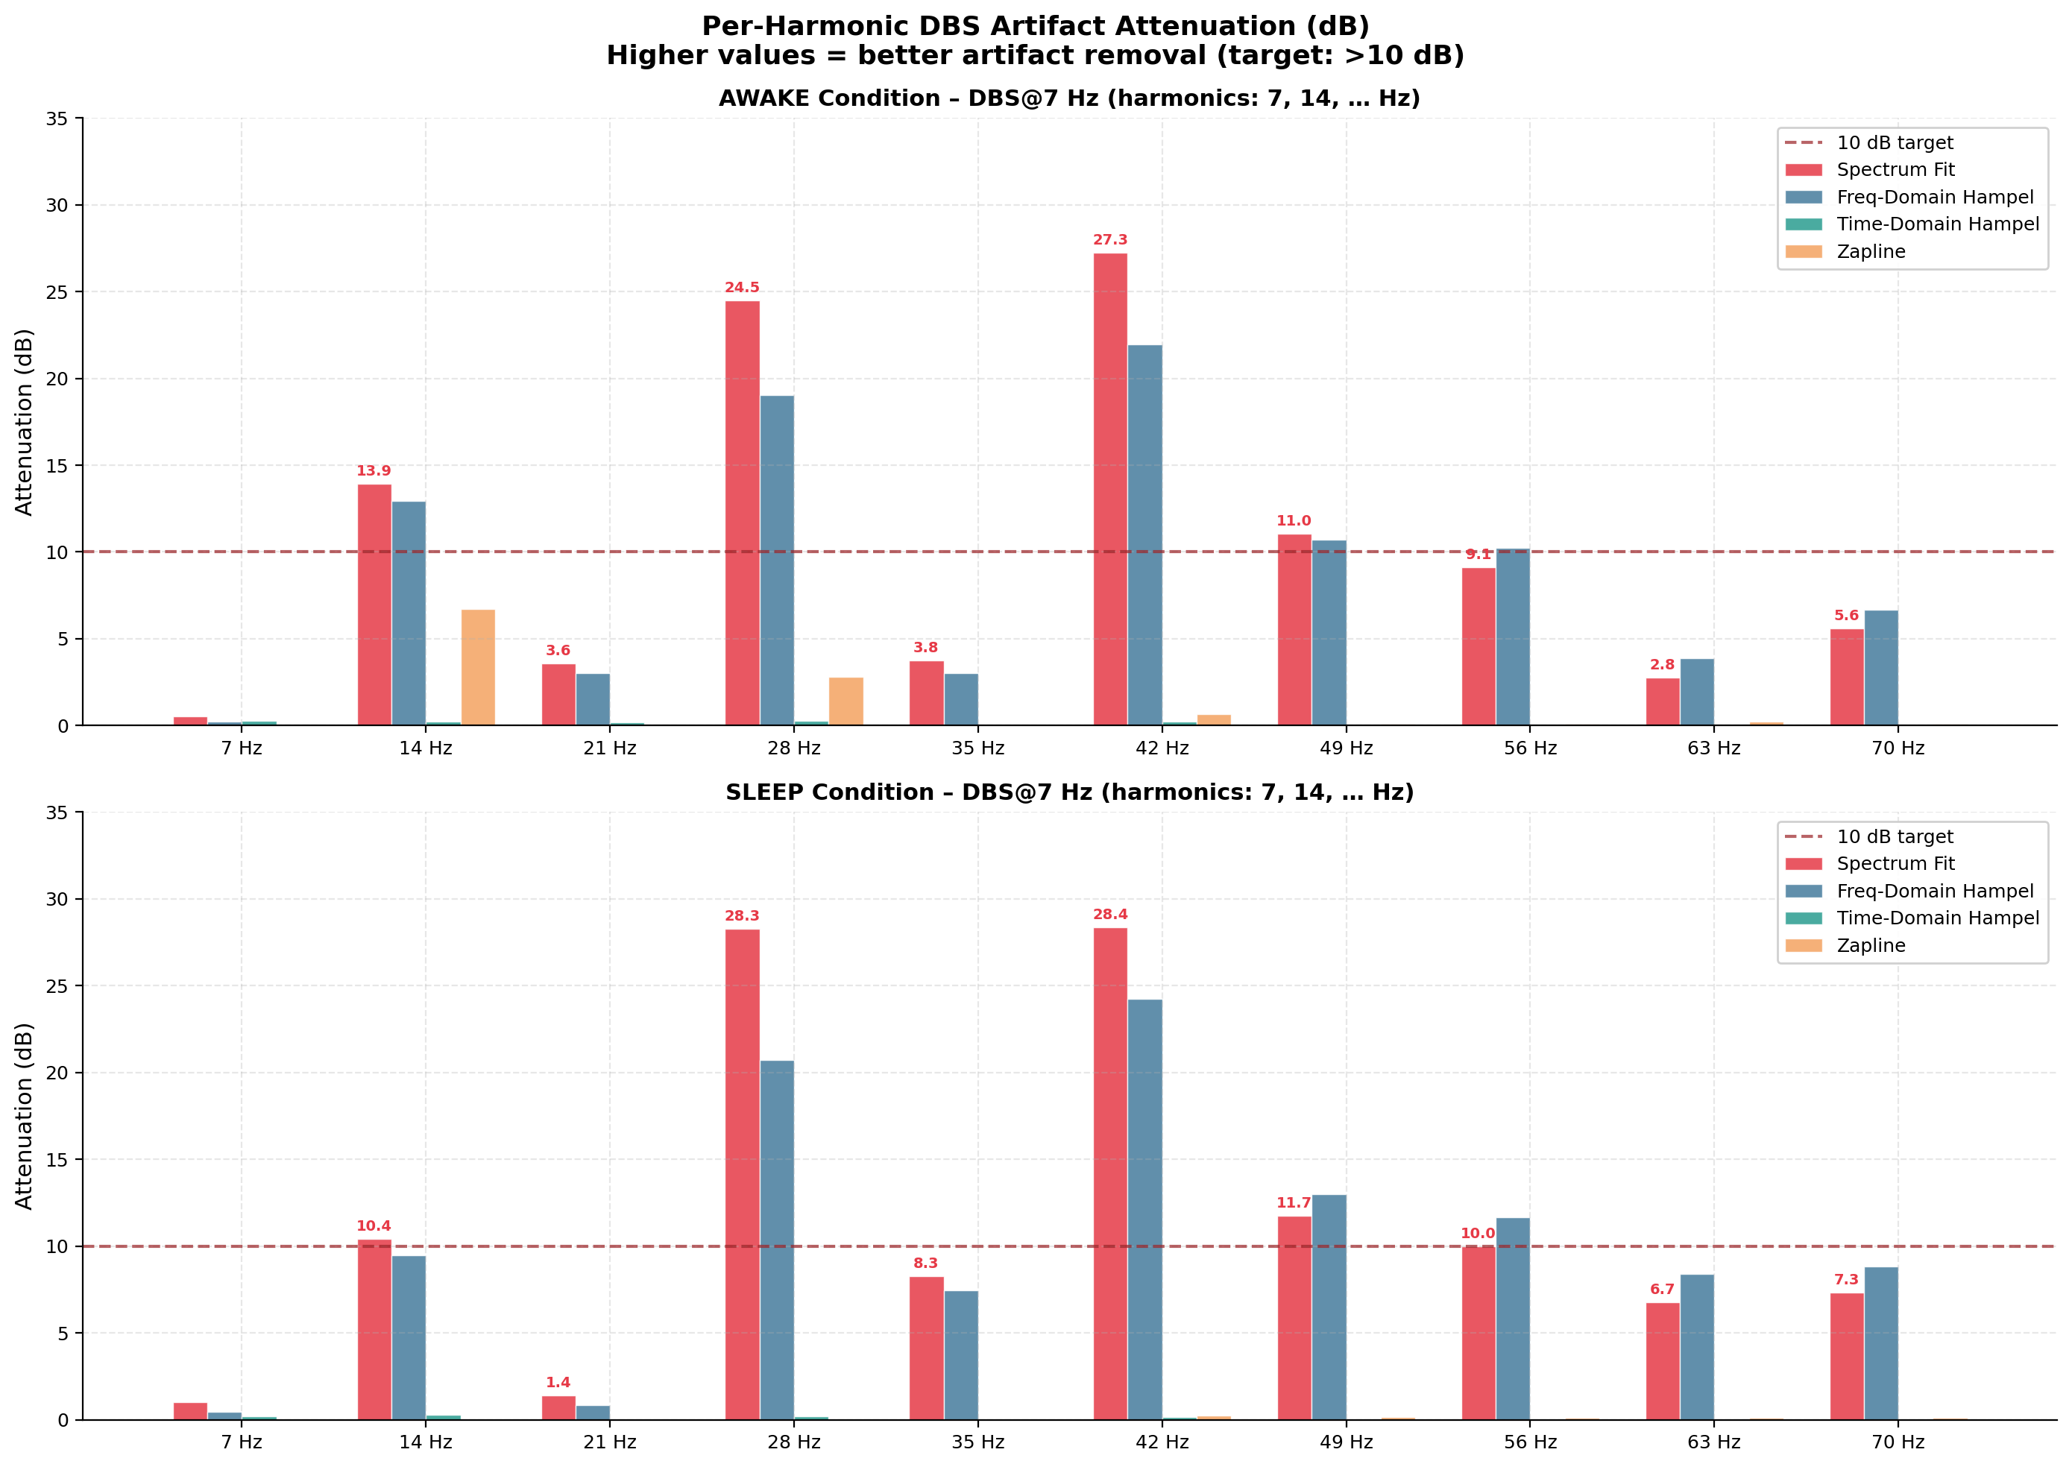
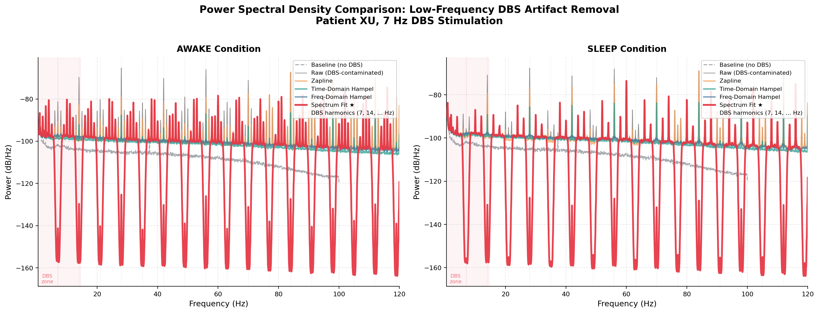
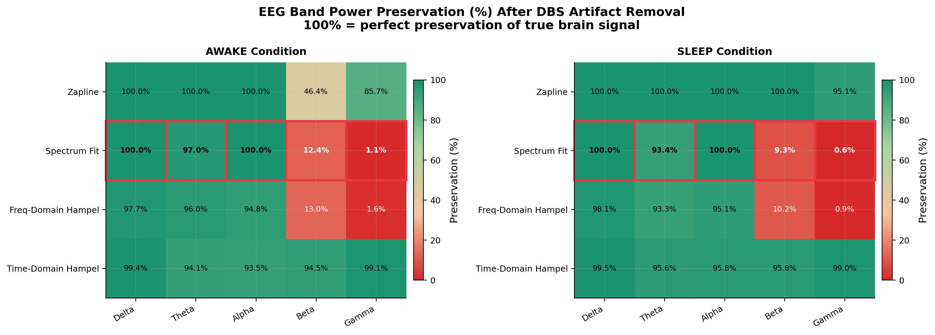
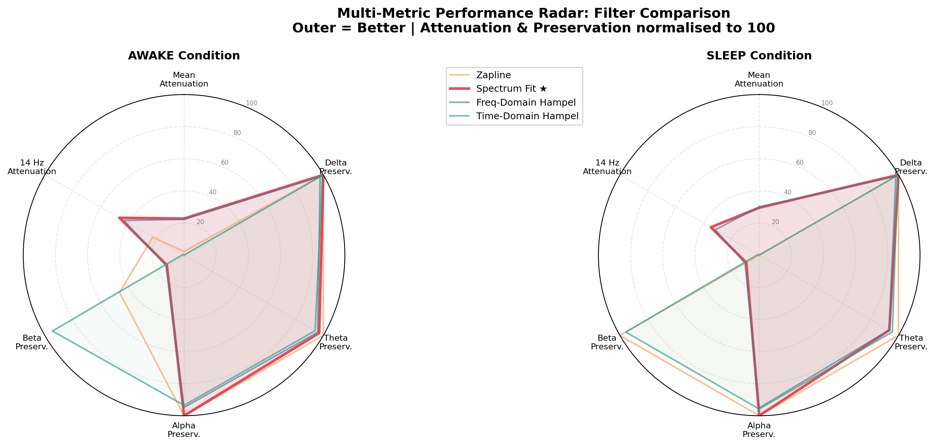
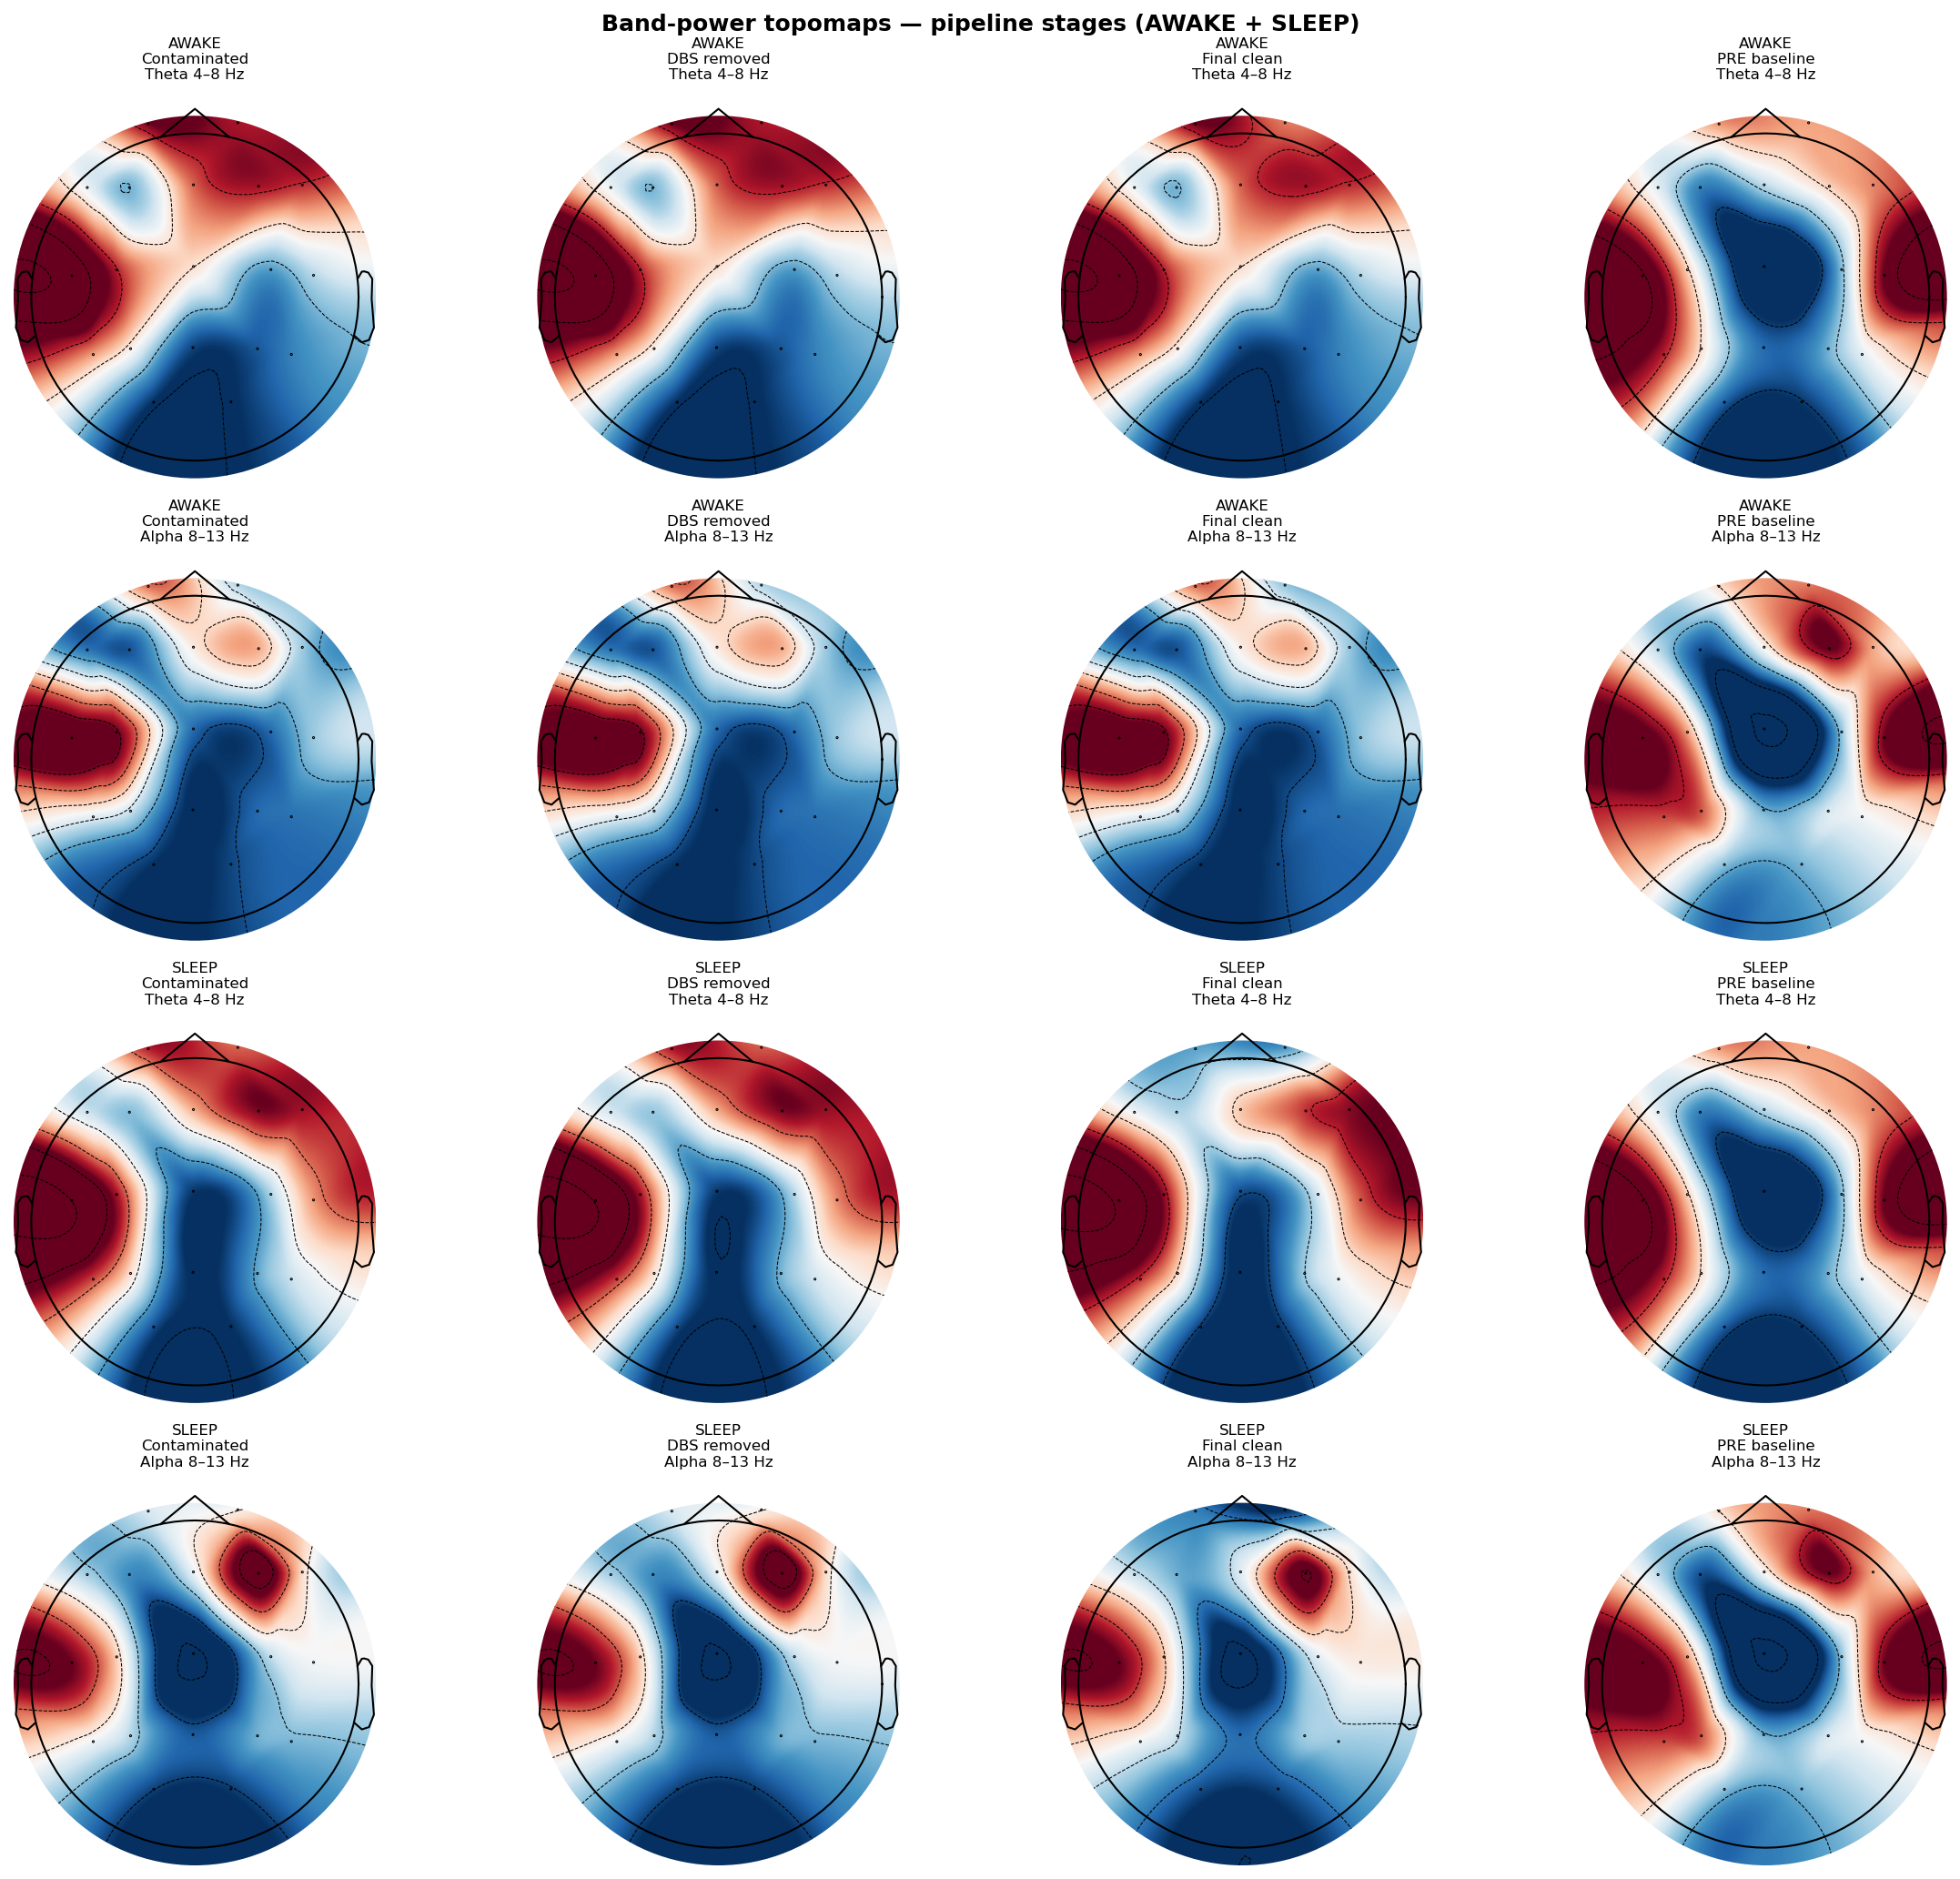
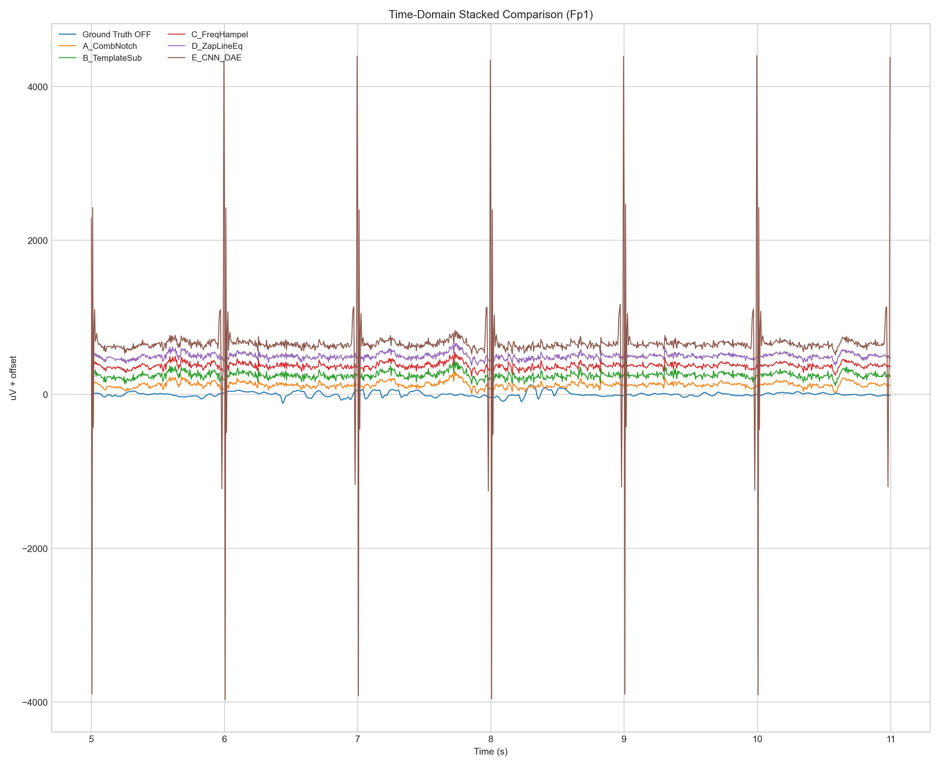
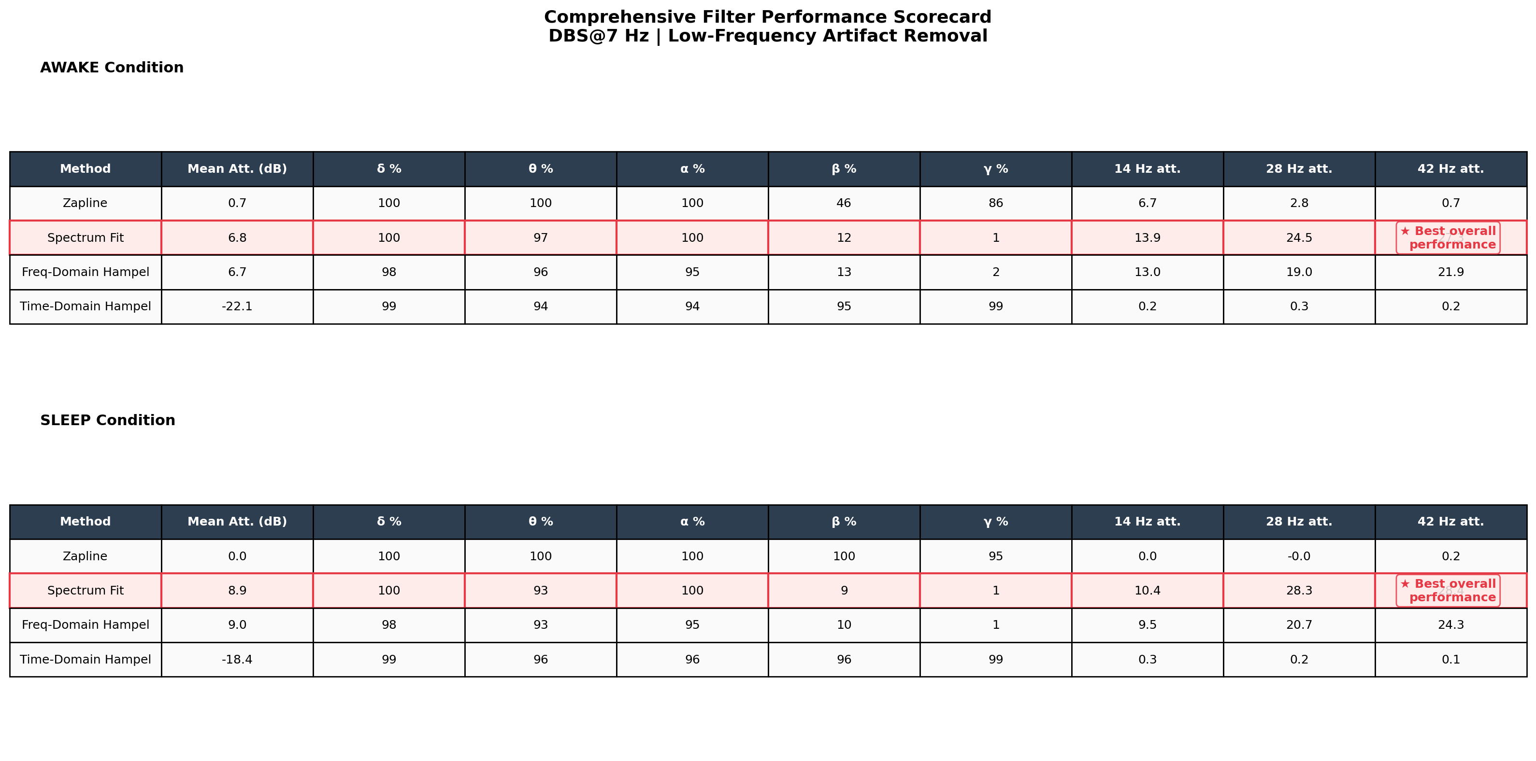
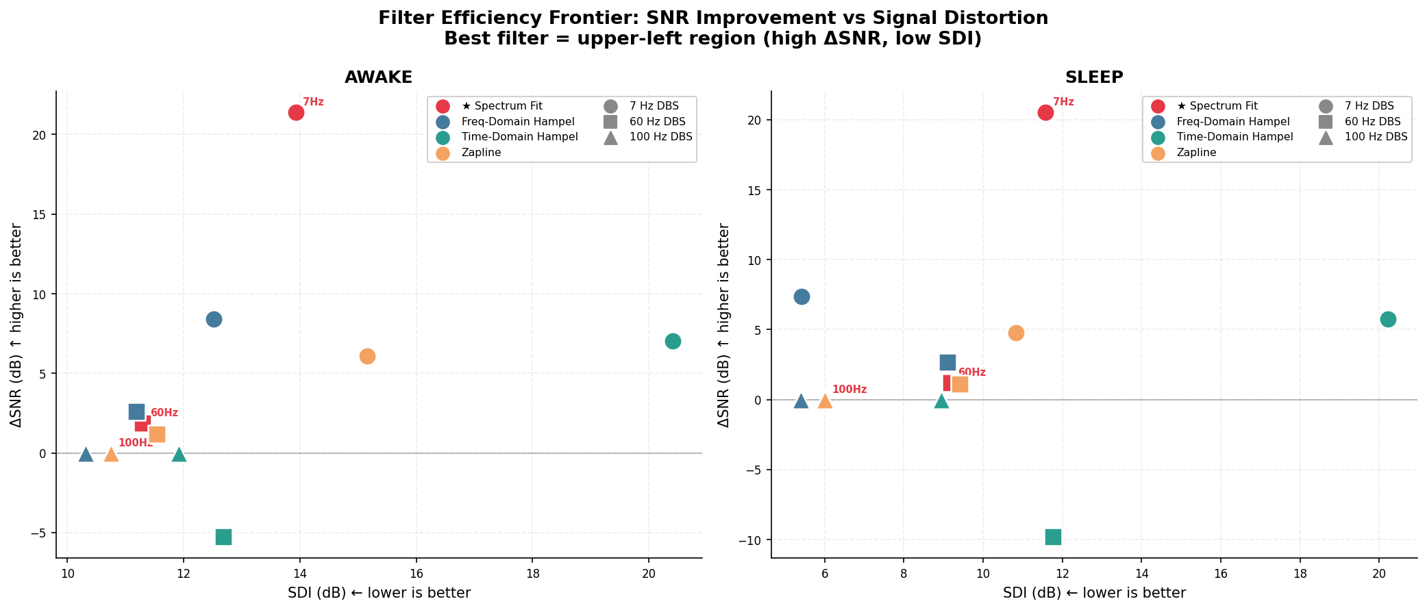
ML-Driven EEG Biomarker Extraction via Multi-Method DBS Artifact Removal
Wanghley Soares Martins | Department of Electrical & Computer Engineering, Pratt School of Engineering, Duke University | Senior Thesis, Spring 2026
Introduction
Processing Pipeline
Results
Deep Brain Stimulation (DBS) generates powerful oscillatory artifacts at its stimulation frequency and harmonics, contaminating concurrently recorded EEG signals. These artifacts — spanning Delta through Gamma bands — obscure clinically relevant biomarkers, making accurate neurological state classification impossible without rigorous preprocessing.
Core Challenge: Standard notch filters provide only ~10–20 dB attenuation and irrecoverably destroy endogenous brain oscillations co-located with DBS harmonics (e.g., theta at 7 Hz, beta at 14 Hz).
This Work: We benchmark 5 advanced artifact-removal methods and extract spectral biomarkers (PSD, band power, topomaps) from de-identified clinical EDF recordings (DBS at 7 Hz, 60 Hz, 100 Hz) using a modular MNE-Python pipeline with Dagster orchestration.
1. DATA INGESTION | EDF/EDF+ → mne.io.read_raw_edf | 10-20 montage standardization
−8.9 dB
Spectrum-Fit mean attenuation (sleep)
98.6%
Zapline broadband preservation (sleep)
2. CLINICAL FILTERING | Zero-phase FIR bandpass: 1–110 Hz | Nyquist-limited cutoff
★ 3. DBS ARTIFACT REMOVAL ★ Spectrum-Fit | Zapline+ | Hampel-Freq | Hampel-Time | Wiener
97.1%
Time-Hampel broadband pres. (awake)
5
Artifact removal methods benchmarked (3 DBS freqs)
Objectives
4. ICA OCULAR/MUSCLE REJECTION | EOG-correlated component removal | 19-channel 10-20 system
Fig. 3 — Per-Harmonic Attenuation (dB) Across Methods
Quantify attenuation of DBS harmonics (7/14/21... Hz) across 5 methods, targeting ≥40 dB suppression
Preserve broadband neural content (Delta, Theta, Alpha, Beta, Gamma) via band-power retention (%)
Extract spectral biomarkers (PSD via Welch, topographic band-power maps) distinguishing awake vs. sleep states
Benchmark runtime vs. quality trade-offs to recommend a clinically deployable pipeline configuration
5. BIOMARKER EXTRACTION PSD (Welch) | Band Power (Simpson) | Topomaps
6. ML CLASSIFICATION (Future) EEGNet / RandomForest | Awake vs. Sleep detection
Methods: DBS Artifact Removal
Fig. 1 — PSD Full Spectrum: All Methods vs. Raw (Awake, 7 Hz DBS)
1. Spectrum-Fit Multi-Harmonic Removal
STFT-based frequency-domain gain mask with cosine taper at harmonic band edges. Tunable attenuation: −30 to −100 dB. Bandwidth: 2.0 Hz; f₀ auto-detected from filename.
2. Zapline+ (Chen et al., 2022)
Spectro-spatial decomposition via eigendecomposition of per-harmonic covariance matrix across channels. Projects and scales artifact subspace. n_harmonics=10; threshold_percentile=95.
3. Freq-Domain Hampel (Allen et al., 2010)
Rolling-median MAD outlier detection on FFT magnitude spectrum. Scales peak magnitudes to target attenuation while preserving phase. window=2 Hz; nσ=3; attenuation=−60 dB.
4. Time-Domain Hampel (Allen et al., 2010)
Rolling median + MAD in time domain; replaces outlier samples (>3σ) with local median. Excellent broadband preservation. window=0.2 s; multi-pass via attenuation_factor.
5. Baseline-Referenced Wiener Filter
Frequency-dependent Wiener gain mask built from pre-DBS baseline PSD. Removes only excess power above baseline; optimal brain-activity preservation. α=1.5; floor=−40 dB.
Fig. 4 — Band-Power Preservation Heatmap (% retained vs. clean reference)
Fig. 5 — Multi-Metric Radar: Attenuation, Preservation, Speed, Broadband
Fig. 2 — Topographic Band-Power Maps: Delta/Theta/Alpha/Beta/Gamma (Real Data)
Conclusions
No single method dominates all dimensions. Spectrum-Fit achieves the strongest harmonic suppression; Zapline+ and Time-Hampel preserve broadband neural content best.
Recommended clinical pipeline: Spectrum-Fit (−60 dB) followed by Freq-Hampel refinement for residual peaks; Wiener filter when pre-DBS baseline is available.
Biomarker validity confirmed: topographic Delta/Theta/Alpha power clearly differentiates awake vs. sleep states after artifact removal.
Future work: EEGNet / RandomForest classification on extracted band-power feature vectors; adaptive DBS frequency tracking for long-term recordings.
References: Allen DP et al. (2010) IEEE Trans Neurosci. | Chen X et al. (2022) NeuroImage [Zapline+]. | Wiener N. (1949) MIT Press. | MNE-Python v1.10 | Gramfort A et al. (2013) Front. Neurosci.
Contact: wanghleys@gmail.com | GitHub: github.com/wanghley/ml-driven-eeg-biomarkers | Duke University, Pratt School of Engineering | Spring 2026

