Slide 1
JVM

Slide 2
Java Object
Clone/finalize
  JVM
  Garbage collection
Wait/notify
  Java threading
HashCode/equal
  JCF

Slide 3
JVM Features
Stack based
Symbolic Reference
Guarantee platform independent
Garbage collection
Network byte order

Slide 4
Java byte code
[Opcode][operand]
VISS
Invokevirtual (own method)
Invokeinterface
Invokestatic
invokespecial(init/super/private)
jsr (Jump to SubRoutine) jsr_w
goto goto_w

Slide 5
Type signature
Byte code | type | description
B | byte | Signed byte
C | char | Unicode character
D | double | Double precision value
F | float | Single precision value
I | int | Integer
J | long | Long integer
L | reference | An instance of class
S | short | Singed short
Z | bool | True or false
[ | reference | One dimension array
double d3[][][] | [[[D
Object m(int i, double d, Thread t) | (IDLjava/lang/Thread;)Ljava/lang/Object;

Slide 6
Class File Format
U4 Magic
U2 Major version
U2 Minor version
U2 Constant pool count
cp_info constant_pool[cp_count]
Access flag(private/final)
This class
Super class
Interface count
interface_info[interface_count]
Method count
method_info[method_count]
Field count
field_info[field_count]
Attribute count
attribute_info[attribute_count]

Slide 7
Class loader
Delegated model
Hierarchy
Visibility
Unloadable
Bootstrap
Ext class loader
System class loader (CLASSPATH)
User defined class loader

Slide 8
Class loading process
Load
Linking(PVR)
  Prepare
  Verify(most heavy)
  Resolve
Initialize

Slide 9
Memory layout
Per thread
  PC (program counter)
  Java stack
    Local variable array
    Operand stack
    Constant pool reference
  Native stack
Shared between thread
  Heap (heap tuning)
  Method area
  Constant pool

Slide 10
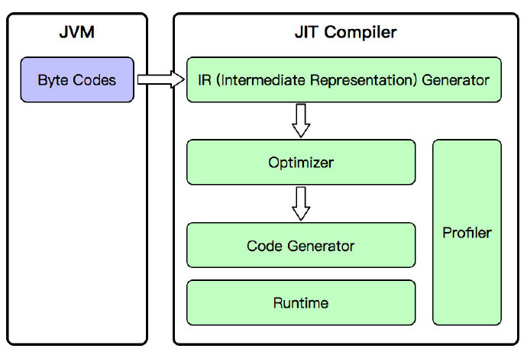
Execute engine
JIT
Interpreter

Slide 11
Hotspot client/server JVM
Client Hotspot JVM
  Simple JIT Compiler
Server Hotspot JVM
  Advance dynamic optimizing compiler
Analysis Java 7 switch

Slide 12
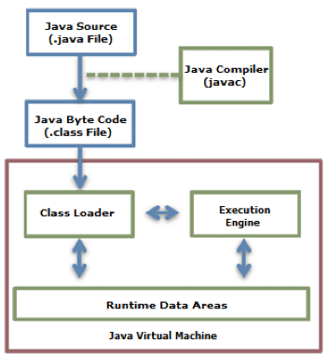
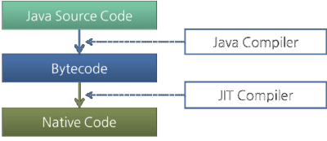
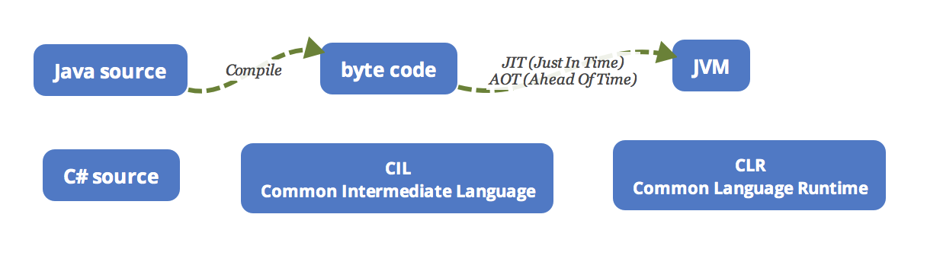
JVM compiling

Slide 13
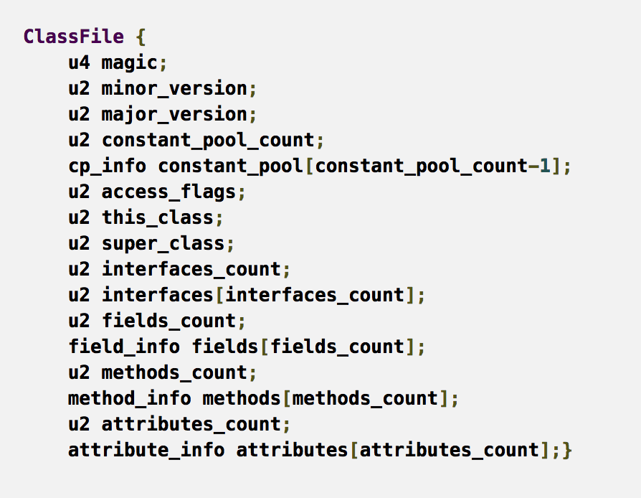
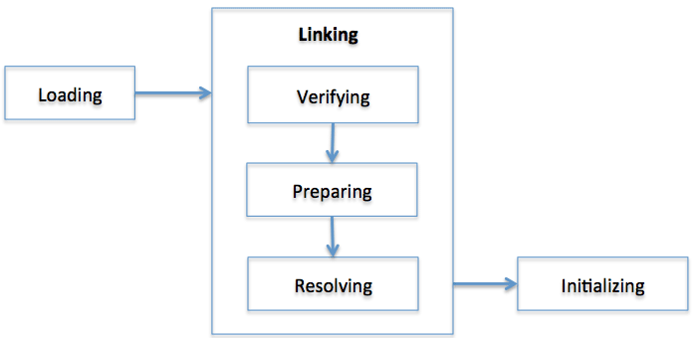
JVM class file

Slide 14
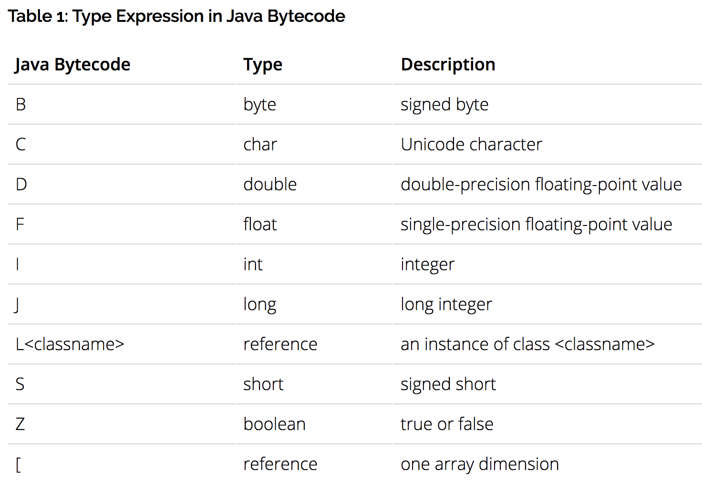
JVM bytecode

Slide 15
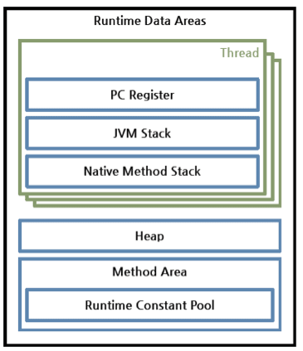
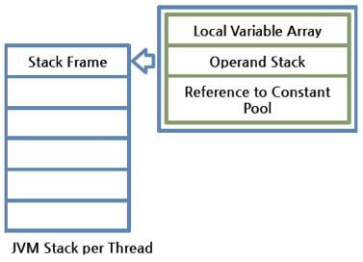
JVM Memory

Slide 16
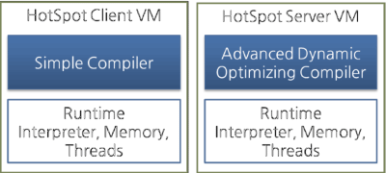
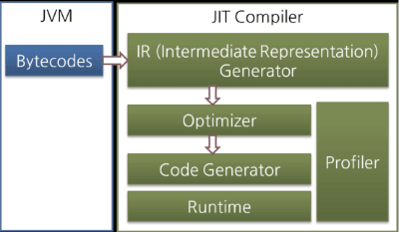
JVM Engine

Slide 17
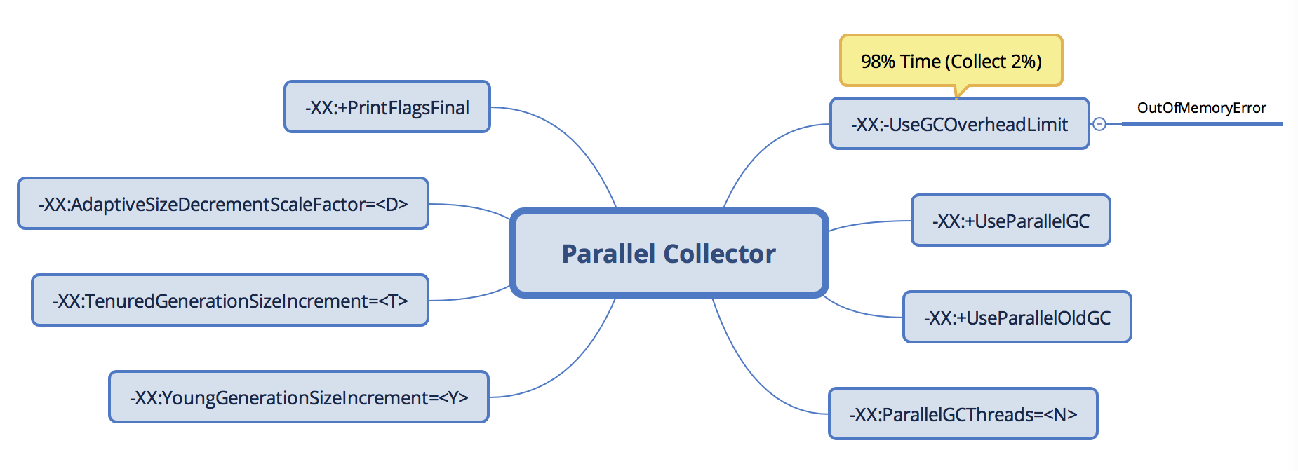
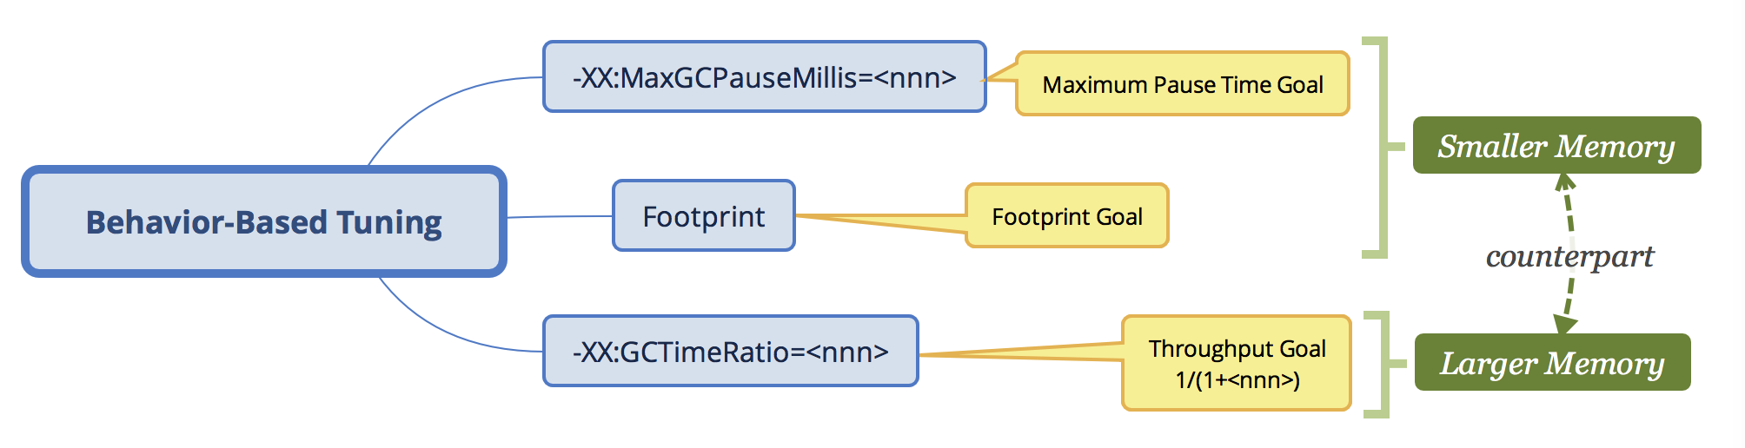
JVM Tunning

Slide 18
Java Threading
ReentrantLock
  Single lock per lock instance
  newCondition
  General purpose locking
ReadWriteLock
  Separate R/W locks per lock instance
  Allow W owner also require R
  newCondition only W
  Frequent R and infrequent W
  Performant for right use case

Slide 19
Java Threading
FixThreadPool
SingleTreadPool
  LinkedBlockingQueue
  Limited thread
  Unbounded Queue store tasks
CachedThreadPool
  Unbounded threads
  SynchronousQueue
ScheduledThreadPool
  DelayedWordQueue
Customed
  ArrayBlockingQueue

Slide 20
Java threading
CPU Intensive
  CPU core count
  How many other tasks run on same CPU
IO intensive
  High pool size
  More threads consume more memory

Slide 21
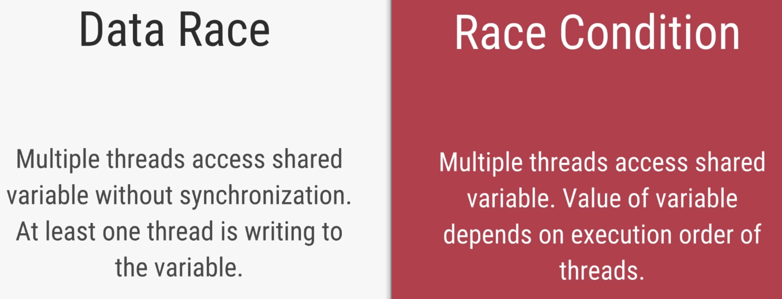
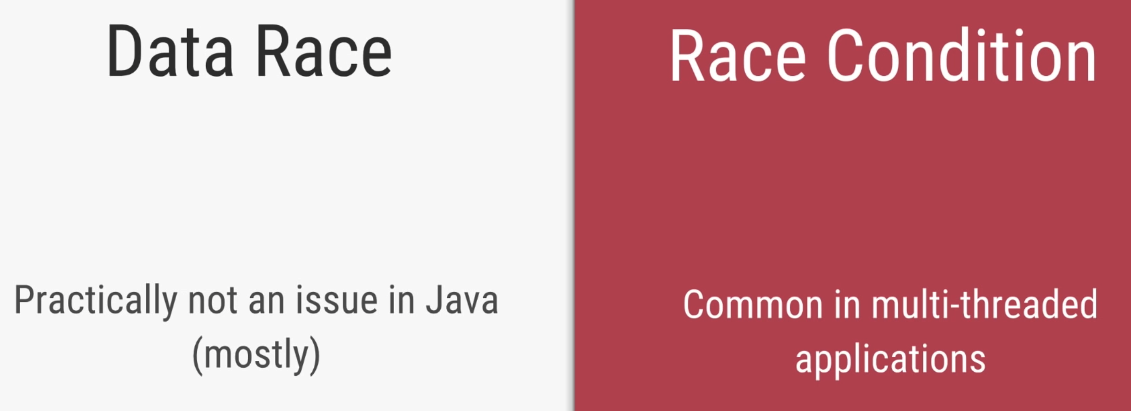

Java Threading

Slide 22
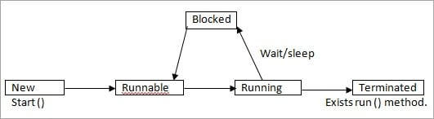
Java threading

Slide 23
Kotlin
PCs
Property and field
Class and inheritance
SAM(Functional interface)
GIVE
Generic
Interface
Visibility
Extensions

Slide 24
Kotlin vocabulary
Denis
Data class
Enum class
Nested class
Inline class
Sealed class
Todd
Type alias
Objects
Delegate property
Delegate field

