Slide 1
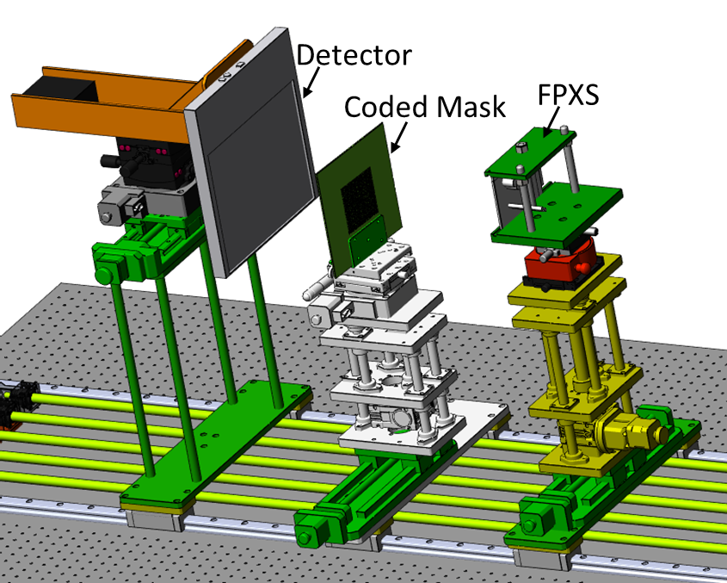
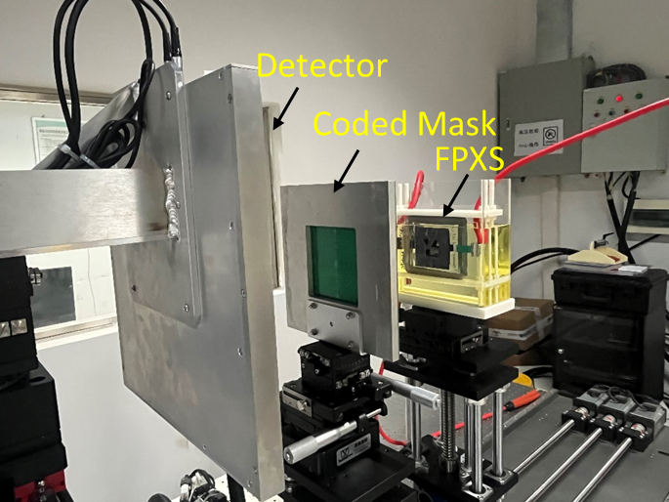
(a)
(b)
Fig. Decoding the spatial distribution of the Cold-Cathode Flat-Panel X-ray Source (FPXS) by using coded aperture imaging (CAI)

Slide 2
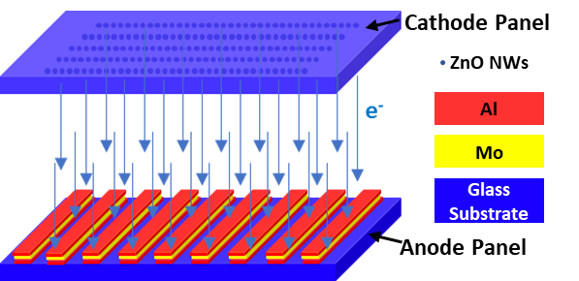
(a)
(b)

