Slide 1
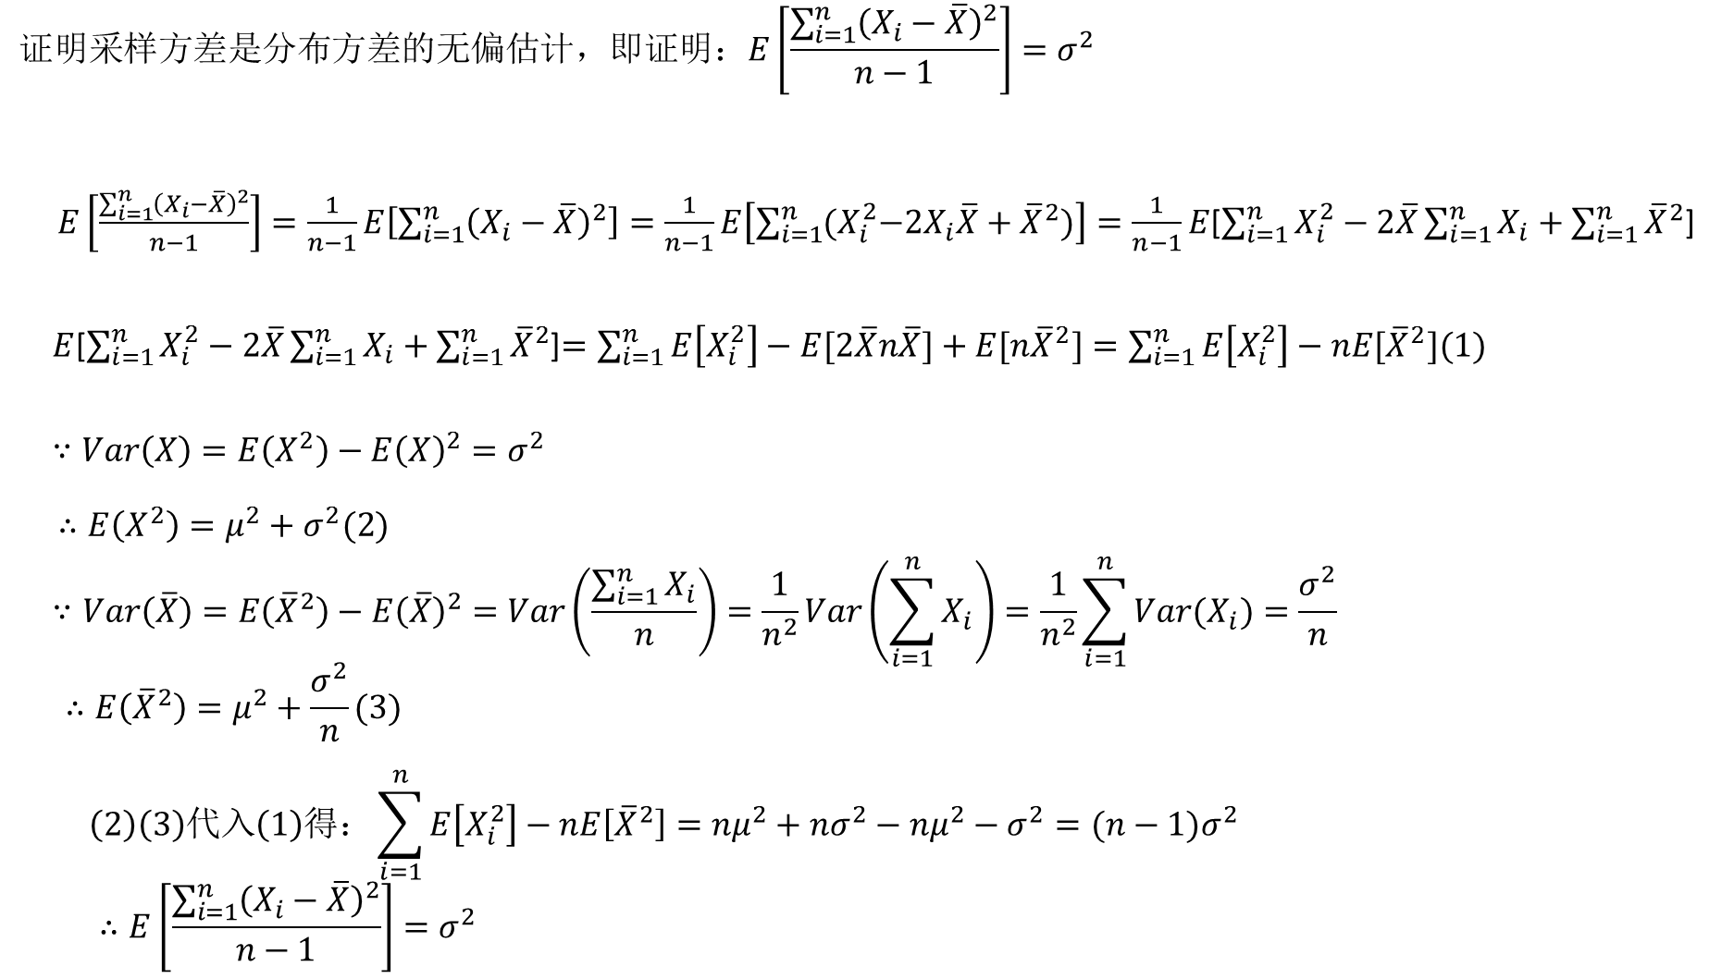

Slide 2

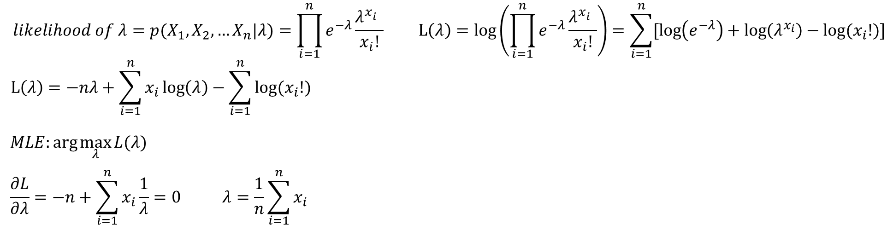
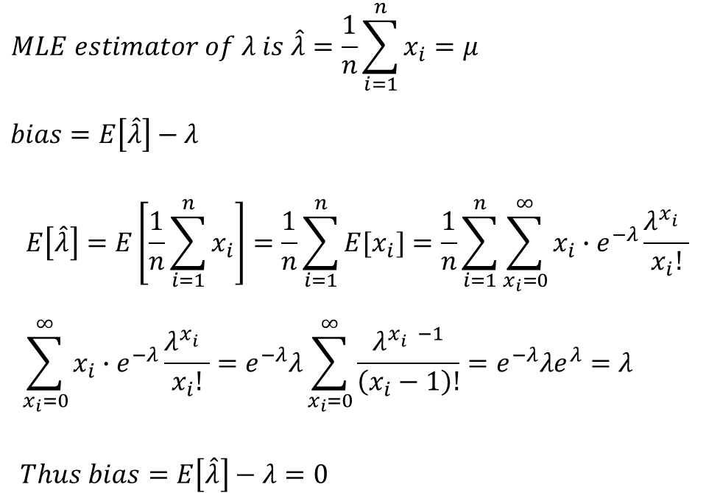
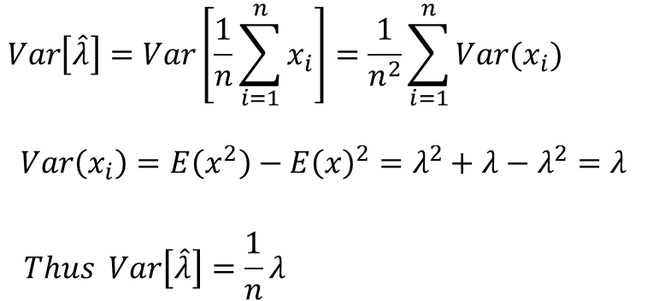

$$p(λ|X_{1},X_{2}…X_{n})$$

Slide 3
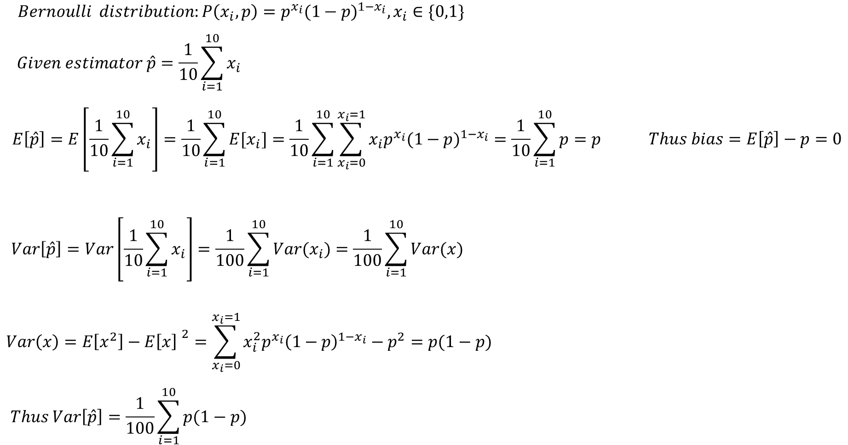

Slide 4
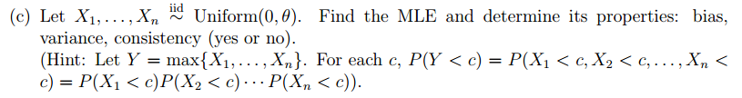
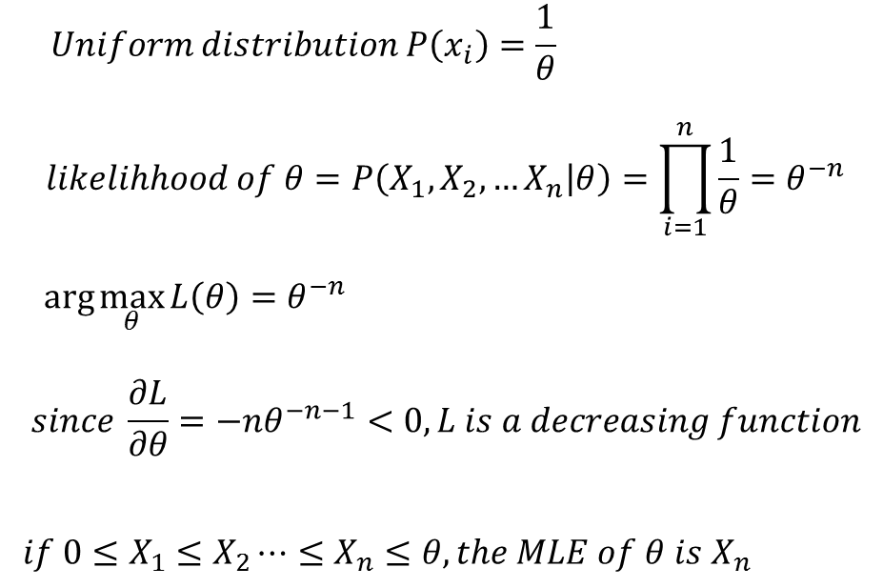
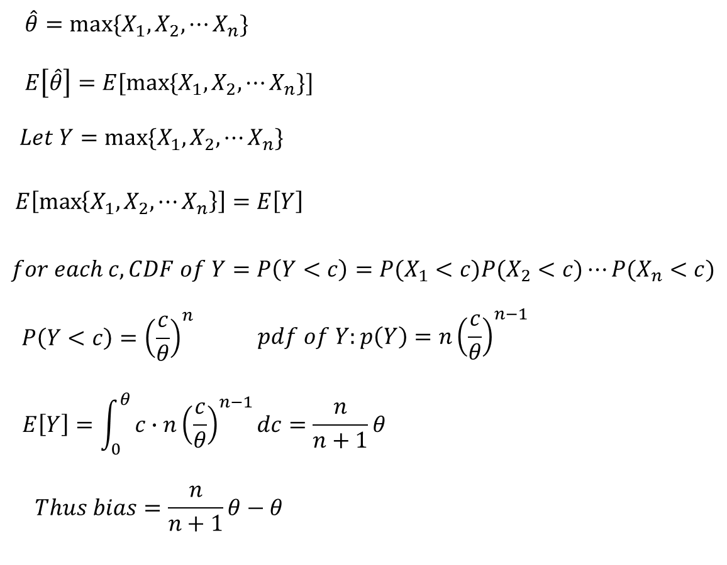
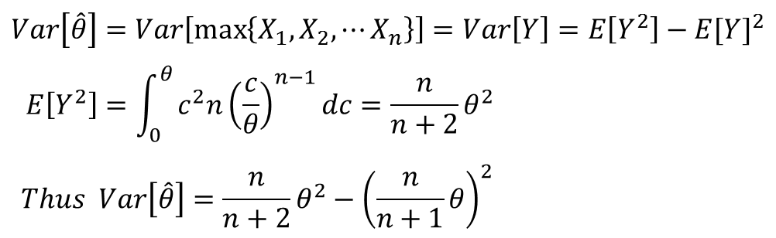

Slide 5
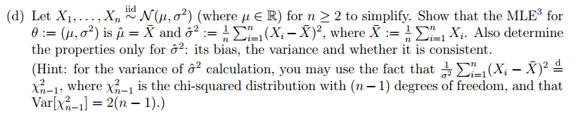
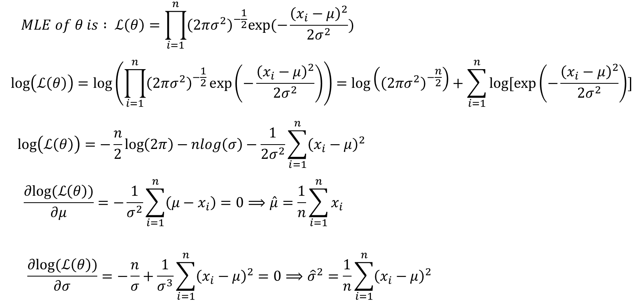

Slide 6
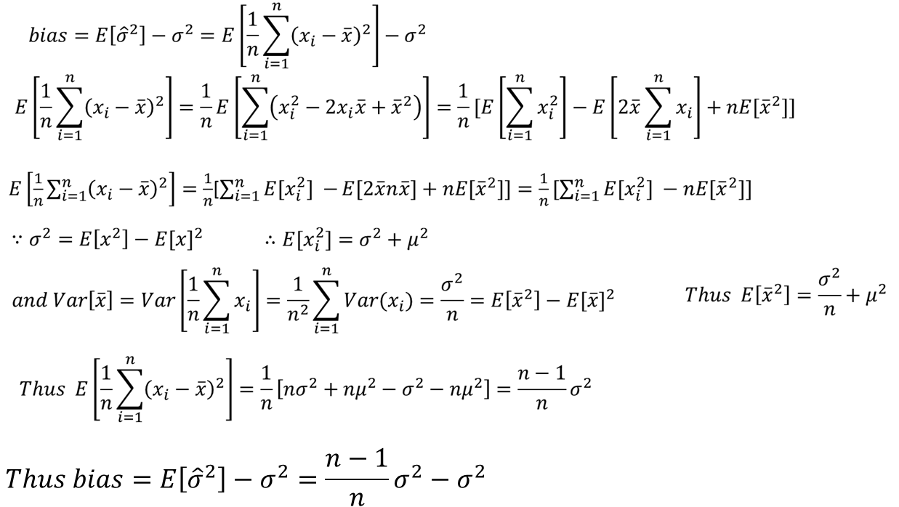

Slide 7
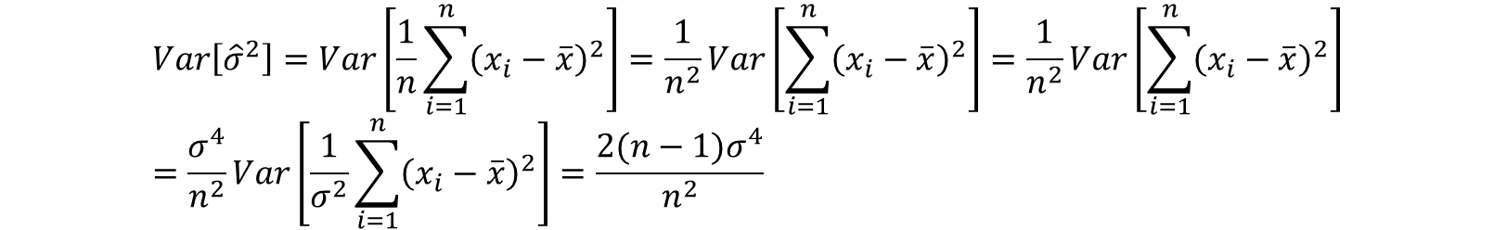

Slide 8
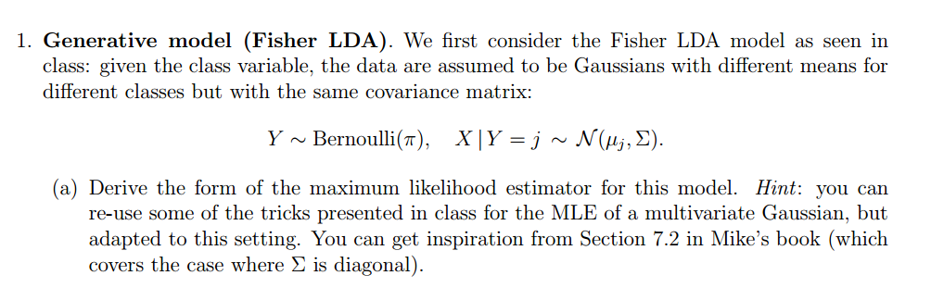
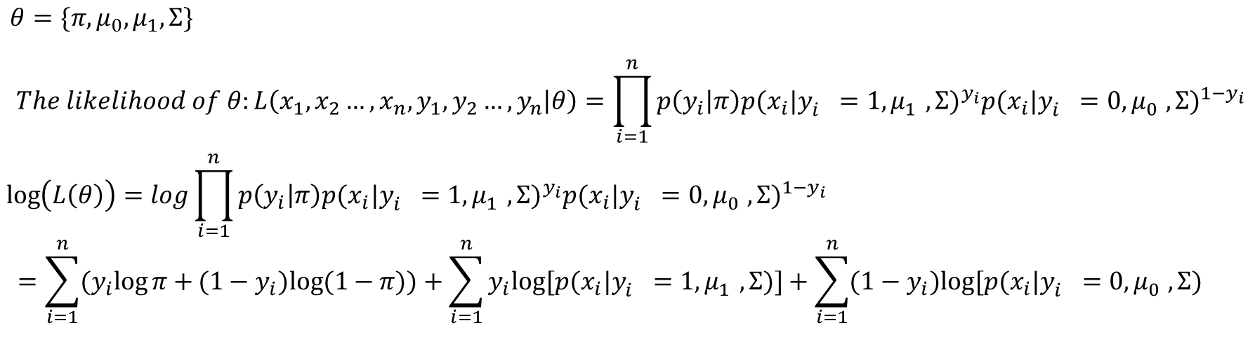
https://zh.wikipedia.org/wiki/%E7%B7%9A%E6%80%A7%E5%88%A4%E5%88%A5%E5%88%86%E6%9E%90
Notes:
Statistical decision theory

Slide 9
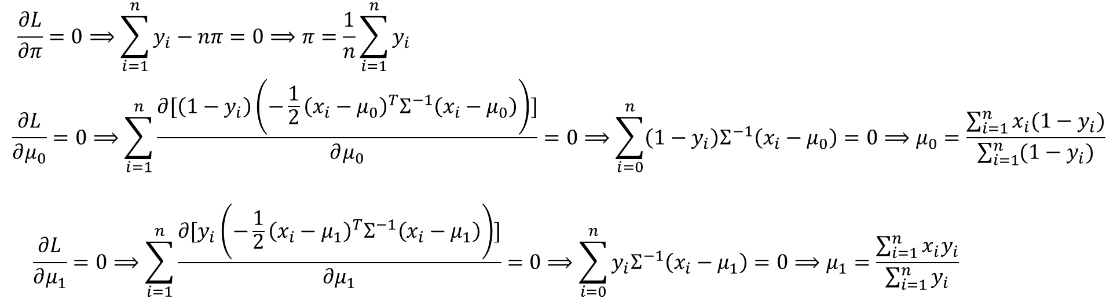
https://zh.wikipedia.org/wiki/%E7%B7%9A%E6%80%A7%E5%88%A4%E5%88%A5%E5%88%86%E6%9E%90
Notes:
Statistical decision theory

Slide 10
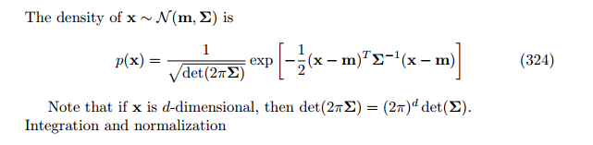
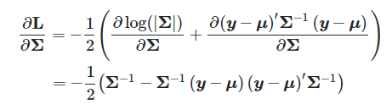
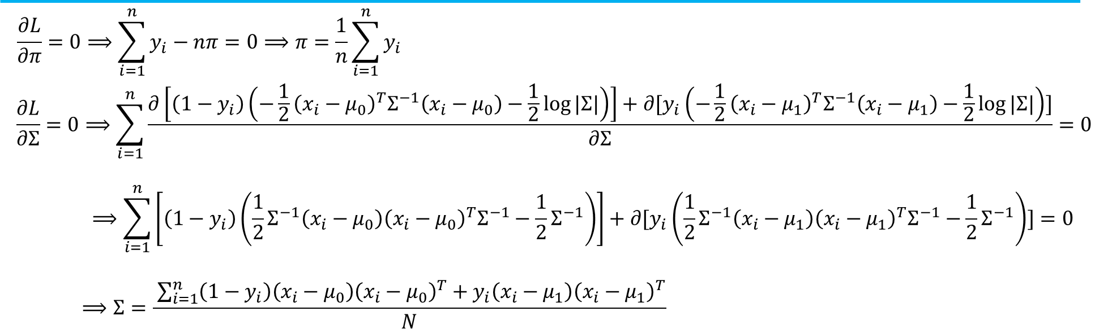
Notes:
Statistical decision theory

Slide 11

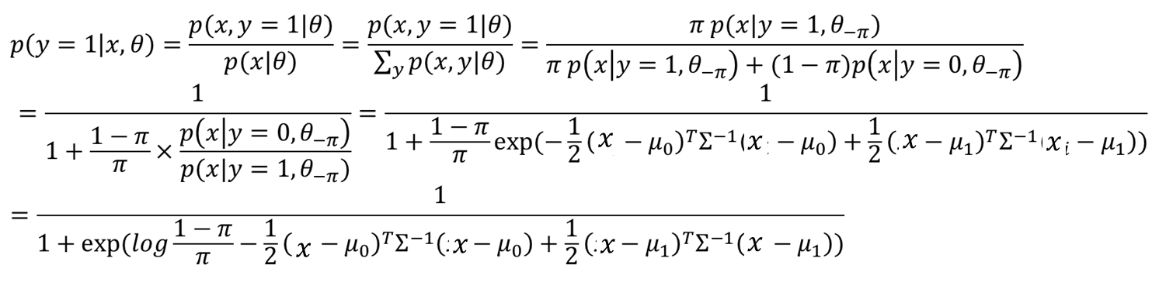
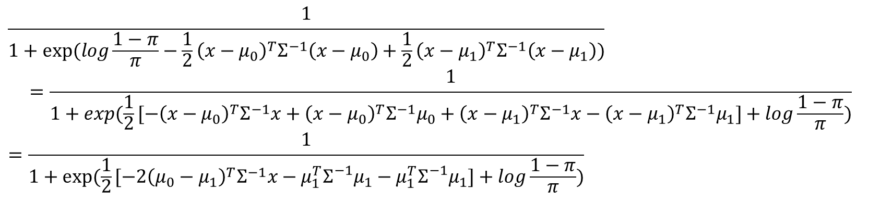




$$μ_{0}^{T}$$
$$μ_{0}$$
$$w$$
$$b$$

Slide 12
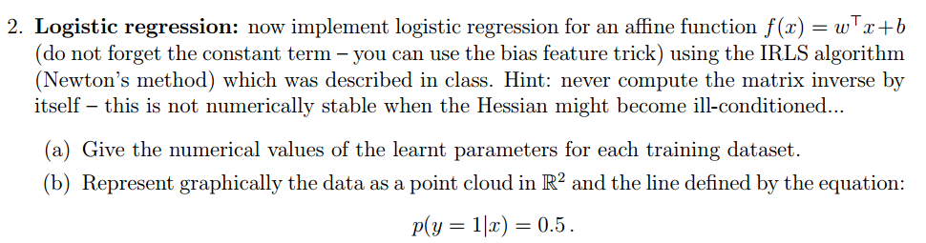
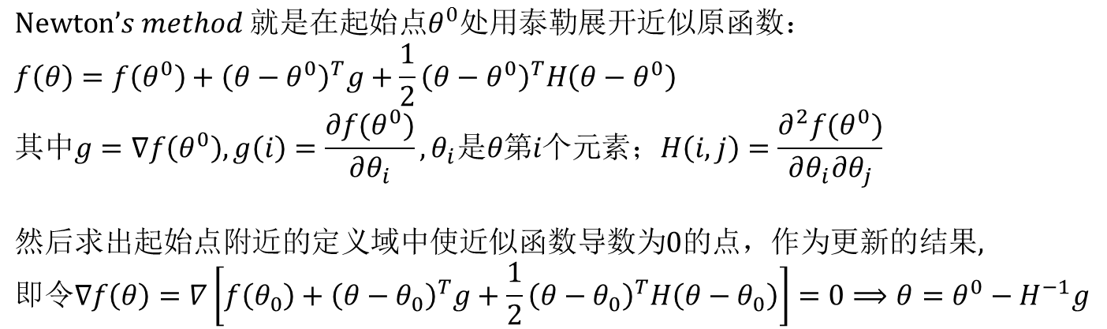

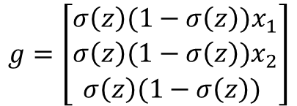

$$\hat{y}=\frac{1}{1+exp⁡(−z)}=σ\left(z\right), z=θ_{1}x_{1}+θ_{2}x_{2}+θ_{3}$$
$$L=−(y\hat{y}+(1−y)(1−\hat{y}))$$
$$g=\left[\begin{matrix}σ\left(z\right)(1−σ\left(z\right))x_{1} \\ σ\left(z\right)(1−σ\left(z\right))x_{2} \\ σ\left(z\right)(1−σ\left(z\right)) \end{matrix}\right]$$
$$H=\left[\begin{matrix}\left[σ\left(z\right){\left(1−σ\left(z\right)\right)}^{2}−{σ\left(z\right)}^{2}\left(1−σ\left(z\right)\right)\right]x_{1}x_{1}+σ\left(z\right)(1−σ\left(z\right)) & [σ\left(z\right){\left(1−σ\left(z\right)\right)}^{2}−{σ(z)}^{2}\left(1−σ\left(z\right)\right)]x_{1}x_{2} & [σ\left(z\right){\left(1−σ\left(z\right)\right)}^{2}−{σ(z)}^{2}\left(1−σ\left(z\right)\right)]x_{1} \\ [σ\left(z\right){\left(1−σ\left(z\right)\right)}^{2}−{σ(z)}^{2}\left(1−σ\left(z\right)\right)]x_{1}x_{2} & \left[σ\left(z\right){\left(1−σ\left(z\right)\right)}^{2}−{σ\left(z\right)}^{2}\left(1−σ\left(z\right)\right)\right]x_{2}x_{2}+σ\left(z\right)(1−σ\left(z\right)) & [σ\left(z\right){\left(1−σ\left(z\right)\right)}^{2}−{σ(z)}^{2}\left(1−σ\left(z\right)\right)]x_{2} \\ [σ\left(z\right){\left(1−σ\left(z\right)\right)}^{2}−{σ(z)}^{2}\left(1−σ\left(z\right)\right)]x_{1} & [σ\left(z\right){\left(1−σ\left(z\right)\right)}^{2}−{σ(z)}^{2}\left(1−σ\left(z\right)\right)]x_{2} & \left[σ\left(z\right){\left(1−σ\left(z\right)\right)}^{2}−{σ\left(z\right)}^{2}\left(1−σ\left(z\right)\right)\right]\end{matrix}\right]$$

Slide 13
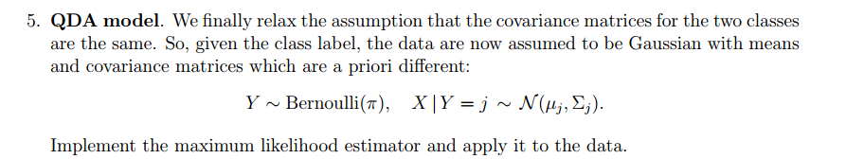

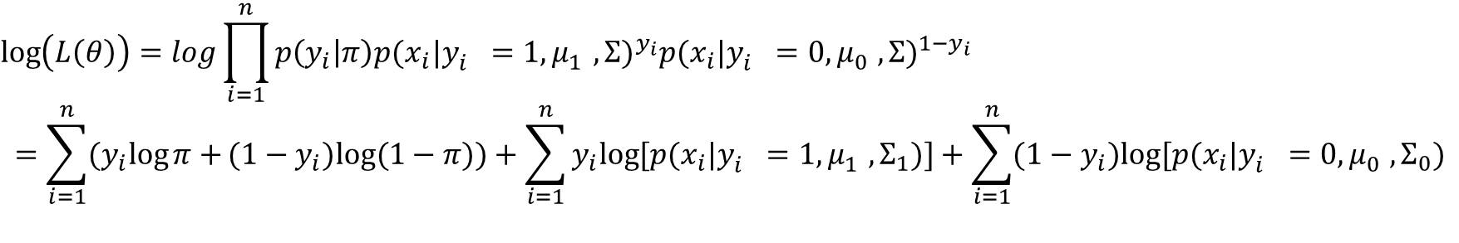
$$θ=\{π,μ_{0},μ_{1},Σ_{0},Σ_{1}\}$$
$$The likelihood of θ:L\left(x_{1},x_{2}…,x_{n},y_{1},y_{2}…,y_{n} | θ\right)=\prod_{i=1}^{n}{p\left(y_{i} | π\right){p(x_{i}|y_{i}^{}=1,μ_{1}^{},Σ)}^{y_{i}}{p(x_{i}|y_{i}^{}=0,μ_{0}^{},Σ)}^{1−y_{i}}}$$
$$\log\left(L\left(θ\right)\right)=log\prod_{i=1}^{n}{p\left(y_{i} | π\right){p(x_{i}|y_{i}^{}=1,μ_{1}^{},Σ)}^{y_{i}}{p(x_{i}|y_{i}^{}=0,μ_{0}^{},Σ)}^{1−y_{i}}}$$
$$=\sum_{i=1}^{n}{(y_{i}log{π}+}(1−y_{i})log⁡(1−π))+\sum_{i=1}^{n}{y_{i}log⁡[p(x_{i}|y_{i}^{}=1,μ_{1}^{},Σ_{1})}]+\sum_{i=1}^{n}{({1−y}_{i})log⁡[p(x_{i}|y_{i}^{}=0,μ_{0}^{},Σ_{0})}$$

Slide 14
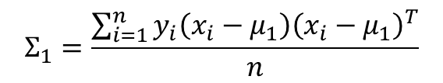
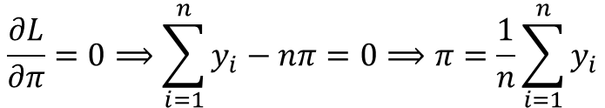
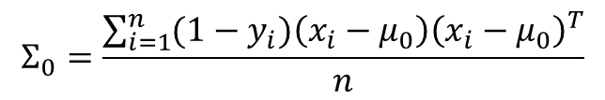
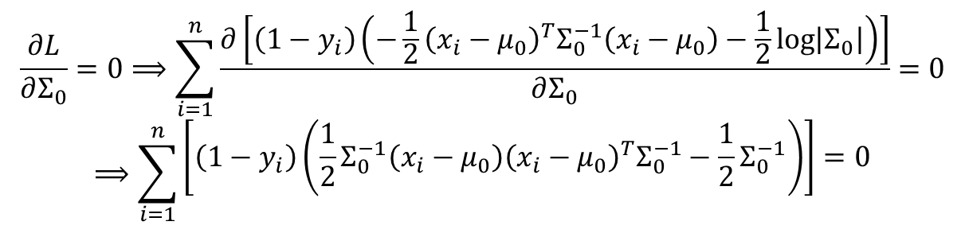
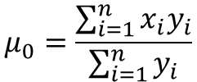
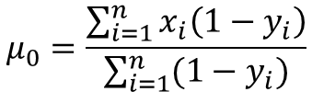
$$\frac{∂L}{∂π}=0⟹\sum_{i=1}^{n}{y_{i}−nπ}=0⟹π=\frac{1}{n}\sum_{i=1}^{n}{y_{i}}$$
$$μ_{0}=\frac{\sum_{i=1}^{n}{x_{i}y_{i}}}{\sum_{i=1}^{n}{y_{i}}}$$
$$μ_{0}=\frac{\sum_{i=1}^{n}{x_{i}\left(1−y_{i}\right)}}{\sum_{i=1}^{n}{(1−y_{i})}}$$
$$\frac{∂L}{∂Σ_{0}}=0⟹\sum_{i=1}^{n}{\frac{∂\left[\left({1−y}_{i}\right)\left(−\frac{1}{2}{\left(x_{i}−μ_{0}\right)}^{T}Σ_{0}^{−1}\left(x_{i}−μ_{0}\right)−\frac{1}{2}\log\left|Σ_{0}\right|\right)\right]}{∂Σ_{0}}}=0$$
$$⟹\sum_{i=1}^{n}{\begin{aligned}\left[\left({1−y}_{i}\right)\left(\frac{1}{2}Σ_{0}^{−1}{\left(x_{i}−μ_{0}\right)\left(x_{i}−μ_{0}\right)}^{T}Σ_{0}^{−1}−\frac{1}{2}Σ_{0}^{−1}\right)\right]=0 \\ \end{aligned}}$$
$$Σ_{0}=\frac{\sum_{i=1}^{n}{(1−y_{i}){\left(x_{i}−μ_{0}\right)\left(x_{i}−μ_{0}\right)}^{T}}}{n}$$
$$Σ_{1}=\frac{\sum_{i=1}^{n}{y_{i}{\left(x_{i}−μ_{1}\right)\left(x_{i}−μ_{1}\right)}^{T}}}{n}$$

Slide 15
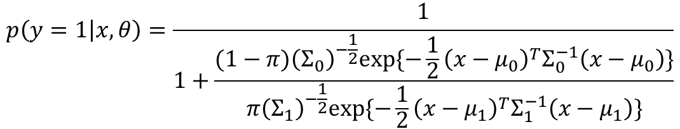
$$p\left(y=1 | x,θ\right)=\frac{1}{1+\frac{(1−π){\left(Σ_{0}\right)}^{−\frac{1}{2}}exp⁡\{−\frac{1}{2}{\left(x−μ_{0}\right)}^{T}Σ_{0}^{−1}\left(x−μ_{0}\right)\}}{π{\left(Σ_{1}\right)}^{−\frac{1}{2}}exp⁡\{−\frac{1}{2}{\left(x−μ_{1}\right)}^{T}Σ_{1}^{−1}\left(x−μ_{1}\right)\}}}$$

Slide 16




$$Derivation of multivariate gaussian$$
$$Negative\log{−likelihood}:−l\left(μ,Σ\right)=−\sum_{i=1}^{n}{p_{μ,Σ}\left(x_{i}\right)}=\frac{nd}{2}\log\left(2π\right)+\frac{n}{2}log⁡(\det{Σ})+\frac{1}{2}\sum_{i=1}^{n}{{\left(x_{i}−μ\right)}^{T}Σ^{−1}(x_{i}−μ)}$$
$$令A=Σ^{−1}，则有：$$
$$∵\det{AB}=\det{A}\det{B}$$
$$\frac{n}{2}\log\left(\det{Σ}\right)=−\frac{n}{2}log⁡(\det{A})$$
$$\sum_{i=1}^{n}{{\left(x_{i}−μ\right)}^{T}Σ^{−1}(x_{i}−μ)}=\sum_{i=1}^{n}{{\left(x_{i}−μ\right)}^{T}A (x_{i}−μ)}=\frac{n}{2}Tr\left(A\tilde{Σ}\right), 其中\tilde{Σ}=\frac{1}{2}\sum_{i=1}^{n}{{\left(x_{i}−μ\right)}^{T} (x_{i}−μ)}$$

Slide 17
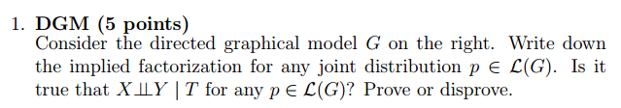
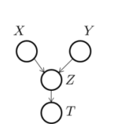
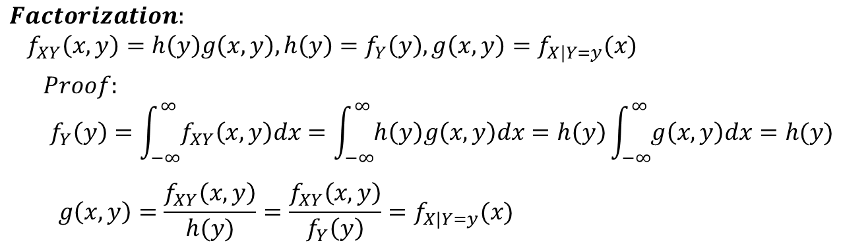


$$Disprove$$
$$ℒ\left(G\right)=p\left(X\right)p\left(Y\right)p\left(Z | X,Y\right)P(T|Z)$$

Slide 18
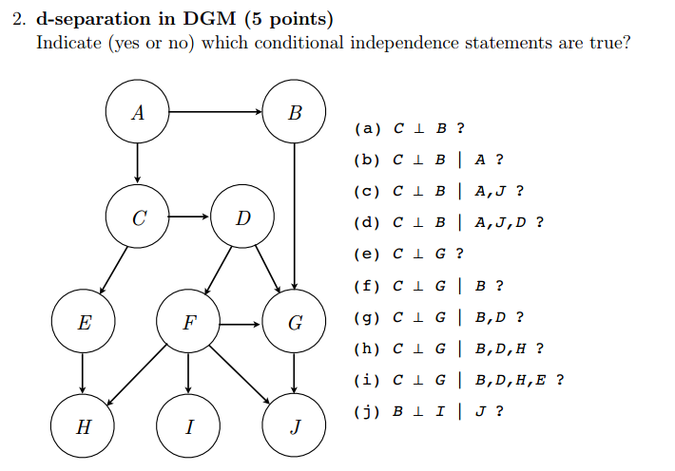
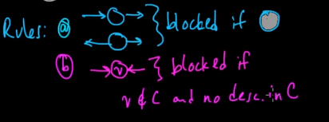










$$A and B is d−separated with respect to C if all paths(unnecessary directed) from A to B is blocked given C$$
$$A is descedent of B if there is a directed route from B to A$$
$$No$$
$$Yes$$
$$No$$
$$Yes$$
$$No$$
$$No$$
$$Yes$$
$$No$$
$$Yes$$
$$No$$

Slide 19





$$1. Ansectral Graph for B⊥I| J$$
$$2.Moralize$$
A
B
A
B
C
D
C
D
F
G
F
G
I
J
I
J
$$3. Disorient$$
$$4.Delete Givens$$
A
B
A
B
C
D
C
D
F
G
F
G
I
J
I
$$Not conditionally independent$$

Slide 20
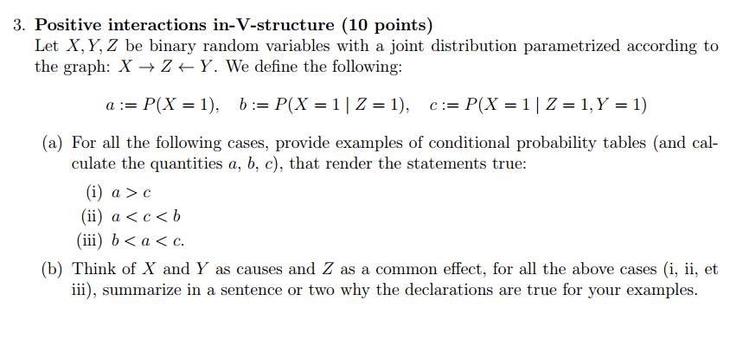
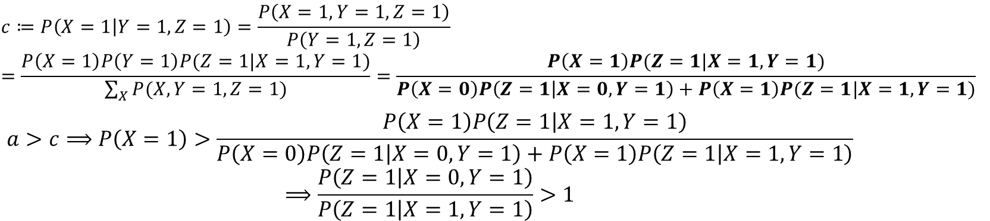

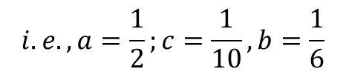














$$X=0,Y=0$$
$X=0,Y=$1
$$X=1,Y=0$$
$X=1,Y=$1
$$\frac{1}{12}$$
$$\frac{1}{12}$$
$$\frac{1}{12}$$
$$\frac{1}{12}$$
$$Z=0$$
$$\frac{1}{18}$$
$$\frac{1}{2}$$
$$\frac{1}{18}$$
$$\frac{1}{18}$$
$Z=$1
$$i.e.,a=\frac{1}{2};c=\frac{1}{10},b=\frac{1}{6}$$
$$ℒ\left(G\right)=p\left(x\right)p\left(y\right)p(z|x,y)$$
$$Z=1 is more likely to be a result from X=0, thus Z=1 will reduce the probability of X=1$$

Slide 21
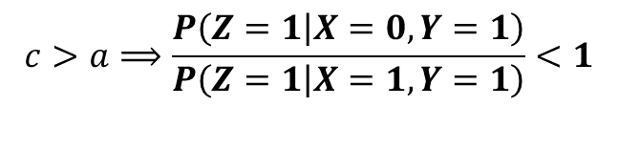











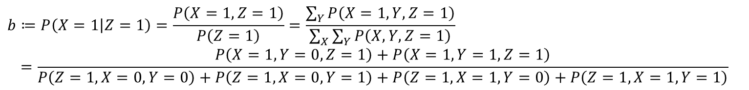



$$X=0,Y=0$$
$X=0,Y=$1
$$X=1,Y=0$$
$X=1,Y=$1
$$Z=0$$
$$\frac{3}{24}$$
$$\frac{4}{24}$$
$$\frac{4}{24}$$
$$\frac{1}{24}$$
$Z=$1
$$\frac{3}{24}$$
$$\frac{3}{24}$$
$$\frac{1}{24}$$
$$\frac{5}{24}$$
$$b≔P\left(X=1 | Z=1\right)=\frac{P\left(X=1,Z=1\right)}{P\left(Z=1\right)}=\frac{\sum_{Y}{P\left(X=1,Y,Z=1\right)}}{\sum_{X}{\sum_{Y}{P\left(X,Y,Z=1\right)}}}$$
$$=\frac{P\left(X=1,Y=0,Z=1\right)+P\left(X=1,Y=1,Z=1\right)}{P\left(Z=1,X=0,Y=0\right)+P\left(Z=1,X=0,Y=1\right)+P\left(Z=1,X=1,Y=0\right)+P\left(Z=1,X=1,Y=1\right)}$$
$$b>c⟹\frac{P\left(X=1,Z=1\right)}{P\left(Z=1\right)}>\frac{P\left(X=1,Y=1,Z=1\right)}{P\left(Y=1,Z=1\right)}$$
$$i.e.,P\left(Y\right)=\frac{1}{2},a=\frac{1}{2}, b=\frac{2}{3},c=\frac{8}{13}$$

Slide 22
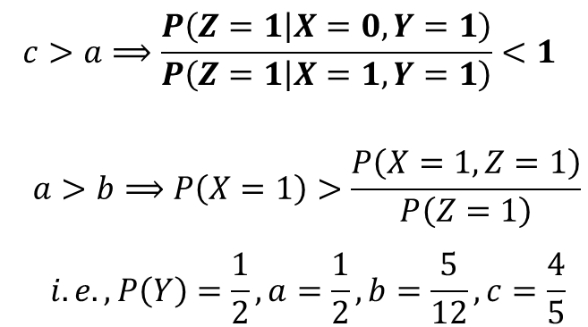









$$ℒ\left(G\right)=p\left(x\right)p\left(y\right)p(z|x,y)$$
$$X=0,Y=0$$
$X=0,Y=$1
$$X=1,Y=0$$
$X=1,Y=$1
$$Z=0$$
$$\frac{3}{24}$$
$$\frac{4}{24}$$
$$\frac{4}{24}$$
$$\frac{1}{24}$$
$Z=$1
$$\frac{3}{24}$$
$$\frac{4}{24}$$
$$\frac{1}{24}$$
$$\frac{4}{24}$$
$$X=1 amd Y=1 has high probability on resulting in Z=1 while Z=1 is not necessarily related to X=1$$

Slide 23

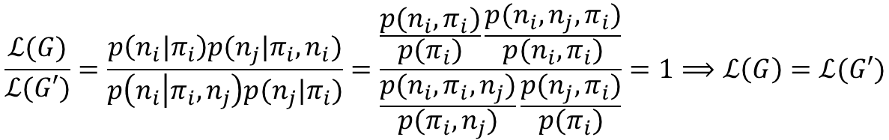
$$Given covered edge \left(i,j\right), suppose the end of the edge is n_{i},n_{j}$$

Slide 24
The undirected models offer a different and often simpler perspective on directed models, in terms of both the independence structure and the inference task.

Slide 25
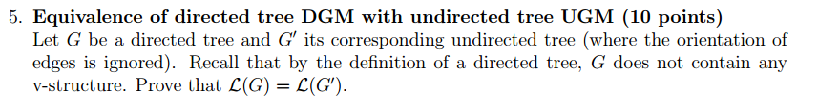
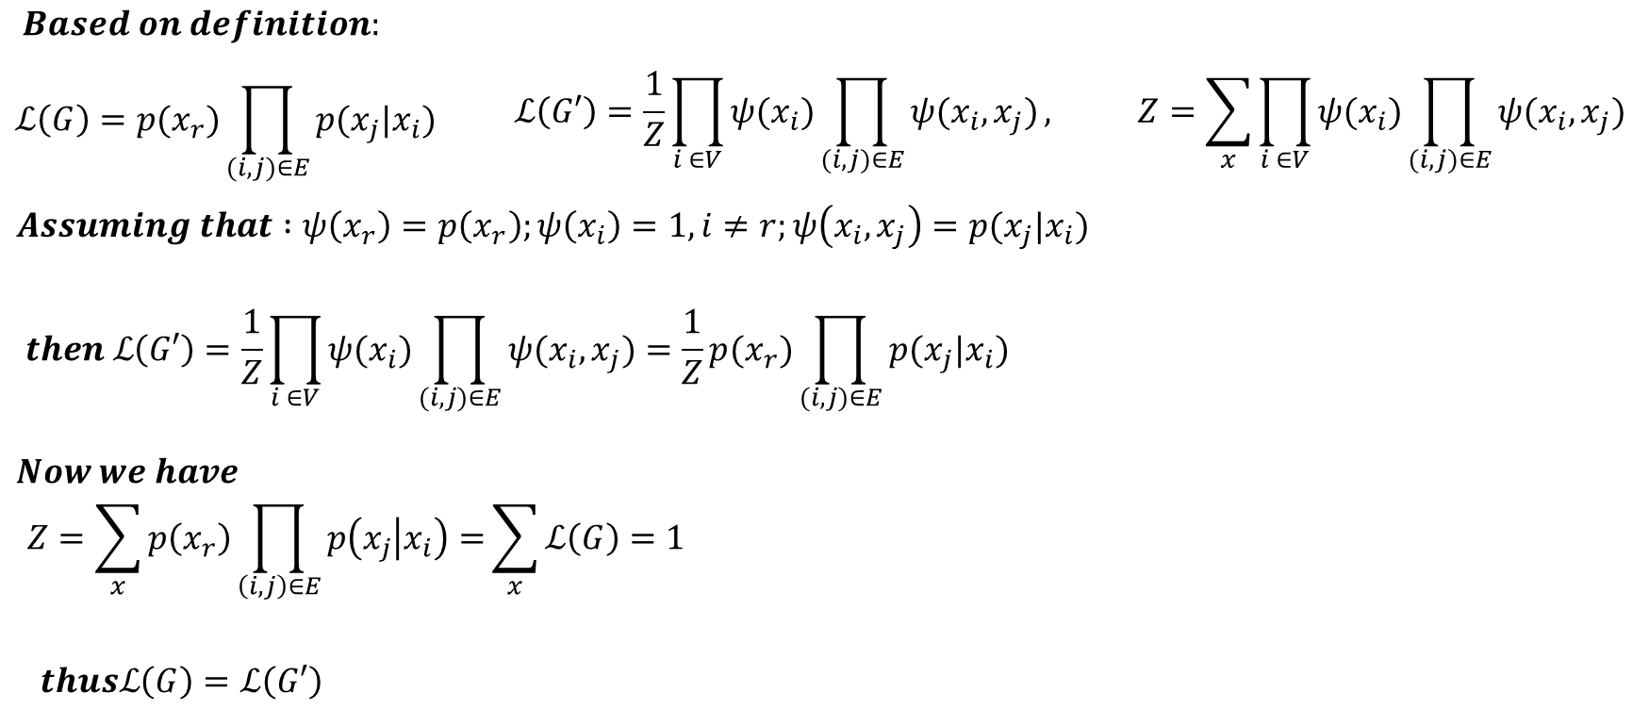
Directed tree: All nodes except the root have one parent.
Any undirected tree can be converted to directed tree by choosing a root and directing all edges away from it.
A directed tree and corresponding undirected tree make the same conditional assertion.

Slide 26
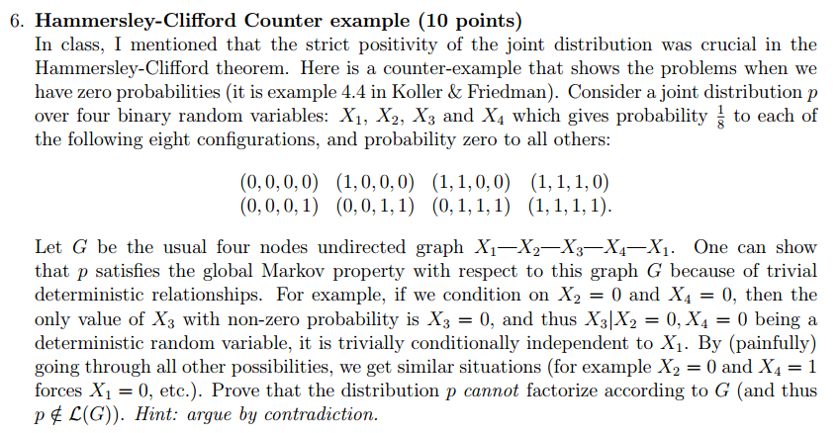
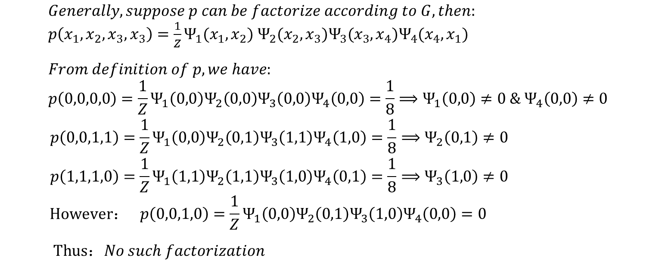
即证明：某联合分布满足全局马尔科夫性，但不能进行因子分解。

Slide 27
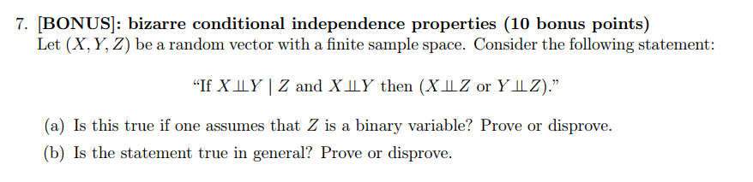

$$p\left(X,Y | Z\right)=\frac{p(X,Y,Z)}{p(Z)}=\frac{p\left(X\right)p\left(Y | X\right)p(Z|X,Y)}{p(Z)}=\frac{p\left(X\right)p\left(Y\right)p(Z|X,Y)}{p(Z)}=p\left(X | Z\right)p(Y|Z)$$
$$\frac{p\left(X\right)p\left(Y\right)p(Z|X,Y)}{p(Z)}=p\left(X | Z\right)p\left(Y | Z\right)$$
$$⟹ p\left(X\right)p\left(Y\right)p\left(Z\right)p\left(Z | X,Y\right)=p\left(X,Z\right)p\left(Y,Z\right)⟹p\left(Z\right)p\left(Z | X,Y\right)=p\left(Z | X\right)p(Z|Y)$$
不会做

Slide 28


EM
The Expectation-maximization algorithm is an iterative method for finding maximum likelihood estimates of parameters in statistical models, where the model depends on unobserved latent or hidden variables.
Jensen’s Inequality
$E_{x}\left[f\left(x\right)\right]≥f\left(E_{x}\left(x\right)\right), f\left(x\right) is convex$
$E_{x}\left[f\left(x\right)\right]=f\left(E_{x}\left(x\right)\right), f\left(x\right) is strictly convex, if and only if x=constant$

Slide 29


Slide 30




$$q(z)$$

Slide 31





$$q\left(z\right)=p(z|x)$$
$$M−step:given ξ_{j}^{t},j=1,2…k, \underset{θ}{arg max}{l\left(θ\right)=\sum_{i=1}^{n}{\sum_{j=1}^{k}{ξ_{j}^{i}\log{𝒩\left(x_{i} | μ_{j}, Σ_{j}\right)}}}+\sum_{i=1}^{n}{\sum_{j=1}^{k}{ξ_{j}^{i}\log{a_{j}}}}}$$
$$\frac{∂l}{∂μ_{j}}=0⟹μ_{j}=\frac{\sum_{i=1}^{n}{ξ_{j}^{i}}x_{i}}{\sum_{i=1}^{n}{ξ_{j}^{i}}}$$

Slide 32




信息消除的不确定性=信息包含的实际信息量
$$x bit=\log_{2}{uncertainty}, where uncertainty is the inverse of possibility for the event$$
衡量某事件的不确定性 =计算某分布包含的期望信息量
$$Entropy:H\left(p\right)=−\sum_{j}{p_{j}\log_{2}{p_{j}}}$$
$p_{j}$：事件第$j$种情况发生的(先验)概率
$−\log_{2}{p_{j}}：$事件第$j$种情况包含的有价值的信息量
衡量另一个分布与实际分布的差异
用另一个分布描述实际分布所需的期望信息量
$$KL divergence=Cross entropy−Entropy$$
$$Cross entropy:H\left(p,q\right)=−\sum_{j}{p_{j}\log_{2}{q_{j}}}$$
$$p−实际分布$$
$$q−猜测分布$$

Slide 33




$$H\left(x\right)−D(p|\left|q\right)=$$

Slide 34


Slide 35

HMM
计算观测序列概率$P(O|λ)$
前向算法
后向算法

Slide 36



HMM 前向算法
$$p\left(o_{1},o_{2}⋯o_{T} | λ\right)=\sum_{j=1}^{N}{p(o_{1},o_{2}⋯o_{T},s_{T}=q_{j}|λ) }=\sum_{j=1}^{N}{α_{T}\left(j\right)}$$

Slide 37

HMM 后向算法

Slide 38


Slide 39


Slide 40
HMM
学习问题
已知观测序列，估计模型参数

Slide 41






HMM 学习算法
$$\log{P(O|λ)}=\log{\sum_{s_{1}}{\sum_{s_{2}}{⋯\sum_{s_{T}}{P(O,I|λ)}}}}=\log{\sum_{I}{P(O,I|λ)}}$$
$$I=(s_{1},s_{2},⋯s_{T})$$
简化后的目标函数
$$arg\max_{λ}{\sum_{I}{\log{(P\left(O,I | λ\right))q(I)}}}$$
进一步化简

Slide 42


由于$P\left(O | \overline{λ}\right)对λ$而言为常数，故$q\left(I\right)=P(I,O|\overline{λ})$

Slide 43




$$\sum_{I}{\log{(P\left(O | λ,I\right))q(I)}}=\sum_{I}{P(I,O|\overline{λ})[\sum_{t=1}^{T}{\log{b_{t}(o_{t})}}}]$$
$$\sum_{I}{\log{(P\left(I | λ\right))q(I)}}=\sum_{I}{P(I,O|\overline{λ})[\sum_{t=1}^{T−1}{\log{a_{s_{t}s_{t+1}}}}}]+\sum_{I}{\log{(π_{s_{1}})P(I,O|\overline{λ})}}$$
优化参数包括观测概率、转移概率、初始状态分布，三者位于上述表达式独立项中，故分别进行优化：
$$① \underset{π}{arg max}{\sum_{I}{\log{(π_{s_{1}})P(I,O|\overline{λ})}}}$$
$$②\underset{a}{arg max}\sum_{I}{P(I,O|\overline{λ})[\sum_{t=1}^{T−1}{\log{a_{s_{t}s_{t+1}}}}}]$$
$$③\underset{b}{arg max}\sum_{I}{P(I,O|\overline{λ})[\sum_{t=1}^{T}{\log{b_{t}(o_{t})}}}]$$

Slide 44



$$① \underset{π}{arg max}{\sum_{I}{\log{(π_{s_{1}})P(I,O|\overline{λ})}}}$$
$$\sum_{I}{\log{(π_{s_{1}})P(I,O|\overline{λ})}}=\sum_{s_{1}}{\log{(π_{s_{1}})}\sum_{s_{2}}{⋯\sum_{s_{T}}{P(O,s_{1},s_{2},⋯s_{T}|\overline{λ})}}}=\sum_{s_{1}}{\log{(π_{s_{1}})}P(O,s_{1}|\overline{λ})}$$
$$\sum_{s_{1}}{\log{(π_{s_{1}})}P(O,s_{1}|\overline{λ})}$$
$$s.t. \sum_{s_{1}}{π_{s_{1}}}=1$$
由拉格朗日乘子法可得:

Slide 45





$$②\underset{a}{arg max}\sum_{I}{P(I,O|\overline{λ})[\sum_{t=1}^{T−1}{\log{a_{s_{t}s_{t+1}}}}}]$$
由拉格朗日乘子法可得:

Slide 46




$$③\underset{b}{arg max}\sum_{I}{P(I,O|\overline{λ})[\sum_{t=1}^{T}{\log{b_{t}(o_{t})}}}]$$
$$\sum_{I}{P(I,O|\overline{λ})[\sum_{t=1}^{T}{\log{b_{t}(o_{t})}}}]=\sum_{s_{t}}{[\sum_{t=1}^{T}{\log{b_{t}(o_{t})}}}]P(s_{t},O|\overline{λ})$$

Slide 47

HMM
预测问题
已知模型和观测序列
求给定观测序列下条件概率$P(I|O)$最大的状态序列

Slide 48





HMM 预测算法
近似算法，割裂计算每一步最可能的隐状态，但每步单独求出的状态所组成的状态序列有可能不会发生，因为只考虑了当前时刻的状态，没有考虑该状态之后的转移状态
维特比算法，从$t=1$开始,对于每个状态$s_{t}=i$，通过递归，可以找到最可能通往$s_{t}$的序列，直至$t=T，$可以获得在终点时到达每个状态的最优路径，在这些最优路径中选取最优(概率最大)的，即得到最优的状态序列
给定$t个观测，$在$t$时刻状态$i$观测到$o_{t}$的最大概率，可以找出该概率对应的$t$时刻前的状态序列$s_{1},s_{2}…s_{t−1}$
$$δ_{t}\left(i\right)=\max_{s_{1}s_{2}…s_{t−1}}{P(s_{1},s_{2}…s_{t−1},o_{1},o_{2}…o_{t},s_{t}=i|λ)}$$
$$δ_{t+1}\left(i\right)=\max_{s_{1}s_{2}…s_{t}}{P\left(s_{1},s_{2}…s_{t−1},{s_{t},o}_{1},o_{2}…o_{t},{o_{t+1},s}_{t+1}=i | λ\right)}$$
$$=[\max_{1≤j≤N}{δ_{t}\left(i\right)a_{ji}]}b_{i}(o_{t+1})$$
在状态$i$观测到$o_{t+1}$的概率
$t+1$时刻到达状态$i$的路径最大概率

Slide 49





How to sample from a specific distribution
When inverse of CDF is easy to calculate
Probability Density Function
$$f(x)$$
Cumulative Distribution Function
$$F\left(k\right)=\int_{−∞}^{k}{f\left(x\right)dx}$$

Slide 50

Otherwise,
Rejection Sampling
Usually not practical since the q and k is hard to determine
Important Sampling

Slide 51



Slide 52




Slide 53

后验分布与先验共轭：
分布参数的后验
分布参数的先验

Slide 54



Slide 55




s
s
i
s
s
i
$$p\left(x_{i}^{(t+1)}=1|x_{1}^{\left(t+1\right)},x_{2}^{\left(t+1\right)}…x_{i−1}^{\left(t+1\right)},x_{i+1}^{\left(t\right)}…\right)$$
$$=\frac{1}{\exp\left(−((−{1)}^{i}+\sum_{\left\{i,t\right\}∈E}{\frac{1}{2}x_{t}^{(t+1 if t>i else t)}})\right)+1}$$

Slide 56

Variational Inference
通过构造$q\left(z\right)=\prod_{i=1}^{m}{{q_{i}(z}_{i})} 估计 p(z|x)$,
$${{{ 其中待估计的各个独立分布更新：q}^{∗}}_{i}(z}_{i})=E_{\backslash q_{i}}[p(z,x)]$$

Slide 57


$$\log{q_{i}\left(x_{i}\right)∝E_{q\backslash i}[\log{p(x)}]}$$
$$KL(q|\left|p\right)−\log{Z_{p}}=−E_{q}\left[\log{p}\right]+E_{q}\left[\log{q}\right]−\log{Z_{p}}=−\left(\sum_{s∈V}{η_{s}ℸ_{s}}+\sum_{\left\{s,t\right\}∈E}{η_{st}ℸ_{s}ℸ_{t}}\right)+\prod_{s∈V}{ℸ_{s}}$$

