Slide 1
Multi-Agent Actor-Critic for Mixed Cooperative-Competitive Environments
Literature review 04

Slide 2
Contents
1
Motivation
2
Methodology

Slide 3
1 Motivation
Challenges in RL for multi-agent case
Q-learning
Policy of each agent keeps changing (environment is non-stationary)
Policy gradient
Frequent coordination of multiple agents (high training variance)
Notes:
environment is non-stationary in view of each individual agent = in a way that is not explainable by changes in the agent’s own policy

Slide 4
1 Motivation
Challenges in RL for multi-agent case
Q-learning
Policy of each agent keeps changing (environment is non-stationary)
Policy gradient
Frequent coordination of multiple agents (high training variance)
General-purpose multi-agent learning algorithm:
Learning policy based on local information
Not assuming a differentiable model of the environment dynamics.
Not assuming any structure on the communication method between agents.
Applicable in cooperative interaction, competitive interaction as well as mixed cooperative- competitive interaction environments.
Notes:
environment is non-stationary in view of each individual agent = in a way that is not explainable by changes in the agent’s own policy

Slide 5
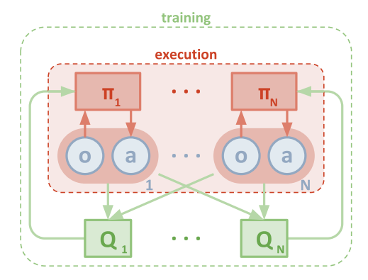
2 Methodology
Basic Idea
Decentralized:
Actor only has access to local information
Test with Actor acting in decentralized manner
Centralized:
Critic is augmented with extra information of every agents’ policy
Test without critic

Slide 6
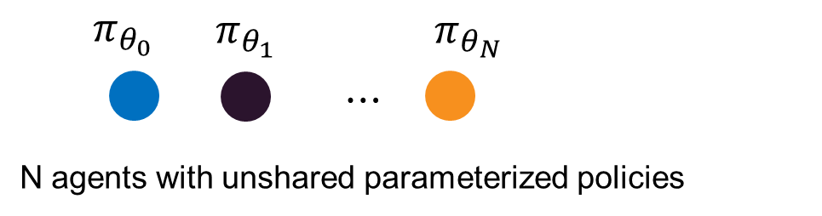
2 Methodology
Algorithmic Detail
Policy gradient

Slide 7
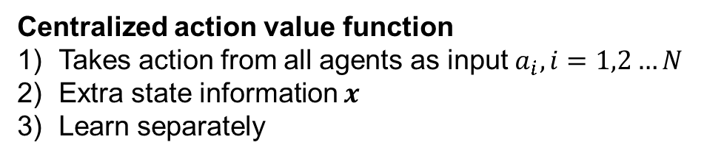
2 Methodology
Algorithmic Detail
Policy gradient
Centralized action value function
Takes action from all agents as input${ a}_{i},i=1,2…N$
Extra state information $x$
Learn separately

Slide 8
2 Methodology
Algorithmic Detail
Policy gradient
Deterministic Policy gradient

Slide 9
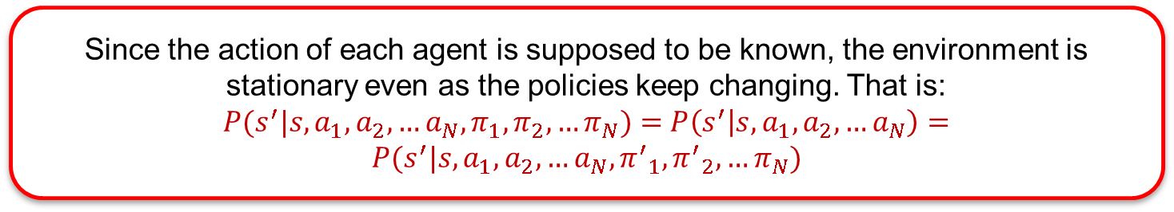
2 Methodology
Algorithmic Detail
Since the action of each agent is supposed to be known, the environment is stationary even as the policies keep changing. That is:
$P(s^{′}|s,a_{1},a_{2},…a_{N},π_{1},π_{2},…π_{N})=$ $P\left(s^{′} | s,a_{1},a_{2},…a_{N}\right)=P(s^{′}|s,a_{1},a_{2},…a_{N},{π^{′}}_{1},{π^{′}}_{2},…π_{N})$
Policy gradient
Deterministic Policy gradient

Slide 10

2 Methodology
Algorithmic Detail
Update actor
Update critic
Notes:
Similarily

Slide 11
2 Methodology
Algorithmic Detail
Update actor
Update critic
How can agent i derive agent j’s action?
Notes:
Similarily

Slide 12



2 Methodology
Algorithmic Detail
Update actor
Update critic
Policy approximate by maximizing log probability
$$φ is parameters for agent i to approximate policy of agent j$$
$${\hat{μ}}_{i}^{j} is policy that agent i imitate agent j$$
$$H is entropy for regularization$$
Notes:
Similarily

Slide 13

2 Methodology
Algorithmic Detail
Update actor
Update critic
Policy approximate by maximizing log probability
Online update with one single step with latest policy samples from agent j
$$φ is parameters for agent i to approximate policy of agent j$$
$${\hat{μ}}_{i}^{j} is policy that agent i imitate agent j$$
$$H is entropy for regularization$$
Notes:
Similarily

Slide 14
Thank you for attention !

