Slide 1
IG-RL: Inductive Graph Reinforcement Learning for Massive-Scale Traffic Signal Control
Literature review

Slide 2
Contents
1
Motivation
2
Methodology
3
Experiment

Slide 3
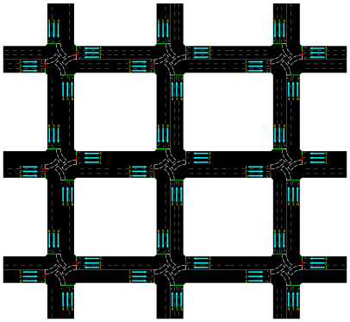
1 Motivation

Slide 4
1 Motivation
Fixed network structure

Slide 5
1 Motivation
Fixed network structure
Reinforcement learning to traffic control has strong specification, which hinders transferability and generalization

Slide 6
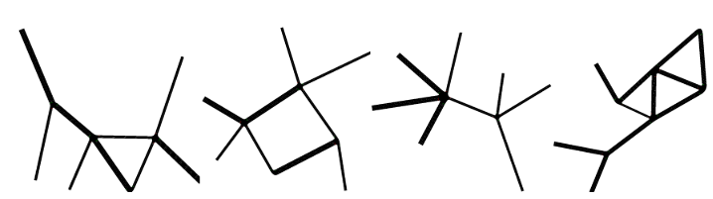
1 Motivation
1
Train a ubiquitous policy which can adapt to new road networks, including topologies and traffic never experienced during training.

Slide 7

1 Motivation
Lack of careful exploitation on dynamic traffic entities (i.e., vehicle), but limit the idea on fixed upstream-downstream consideration.

Slide 8
1 Motivation
2
Exploit the vehicular data at its finest granularity.

Slide 9
2 Methodology
Basic Idea
Deep Q learning to learn control policy.
Graph convolution network to introduce consideration on dynamic entities appearing during the control period.

Slide 10
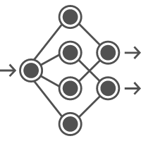

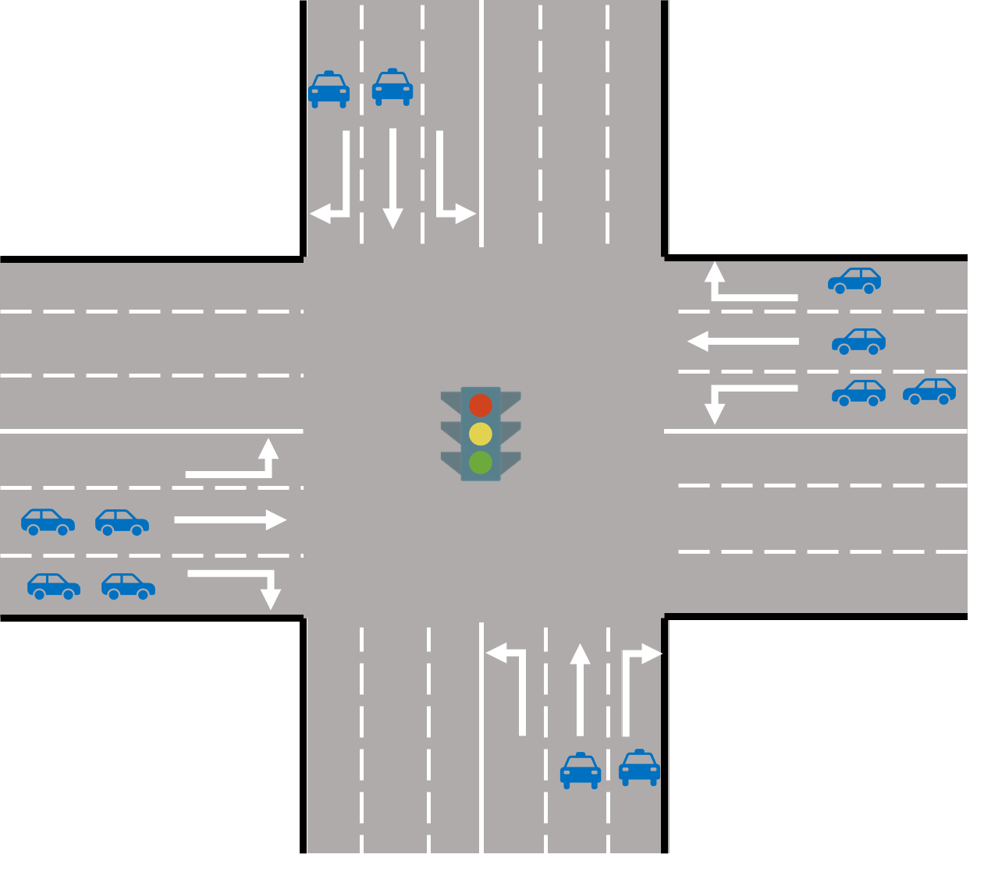
2 Methodology
Basic Idea
Deep Q learning to learn control policy.
Graph convolution network to introduce consideration on dynamic entities appearing during the control period.
Action:
switch to next phase or not
State features
Reward: Queue length of different inflow lanes

Slide 11
2 Methodology
Basic Idea
Deep Q learning to learn control policy.
Graph convolution network to introduce consideration on dynamic entities appearing during the control period.

Slide 12
2 Methodology
Basic Idea
Deep Q learning to learn control policy.
Graph convolution network to introduce consideration on dynamic entities appearing during the control period.
An intersection together with its possible traffic flow dynamic can be represented as nodes in a graph

Slide 13
2 Methodology
Basic Idea
Deep Q learning to learn control policy.
Graph convolution network to introduce consideration on dynamic entities appearing during the control period.
Traffic signal controller node

Slide 14
2 Methodology
Basic Idea
Deep Q learning to learn control policy.
Graph convolution network to introduce consideration on dynamic entities appearing during the control period.
Time elapse since last signal control (switch the signal phase)
Traffic signal controller node

Slide 15
2 Methodology
Basic Idea
Deep Q learning to learn control policy.
Graph convolution network to introduce consideration on dynamic entities appearing during the control period.
Is open
Its current open priority
Next open priority
Connection node

Slide 16
2 Methodology
Basic Idea
Deep Q learning to learn control policy.
Graph convolution network to introduce consideration on dynamic entities appearing during the control period.
Lane
Number of vehicles
Average speed
Lane node

Slide 17
2 Methodology
Basic Idea
Deep Q learning to learn control policy.
Graph convolution network to introduce consideration on dynamic entities appearing during the control period.
Vehicle node
Current speed
Position on lane

Slide 18
2 Methodology
Basic Idea
Deep Q learning to learn control policy.
Graph convolution network to introduce consideration on dynamic entities appearing during the control period.
Traffic signal controller node
Vehicle node
Connection node
Lane node

Slide 19
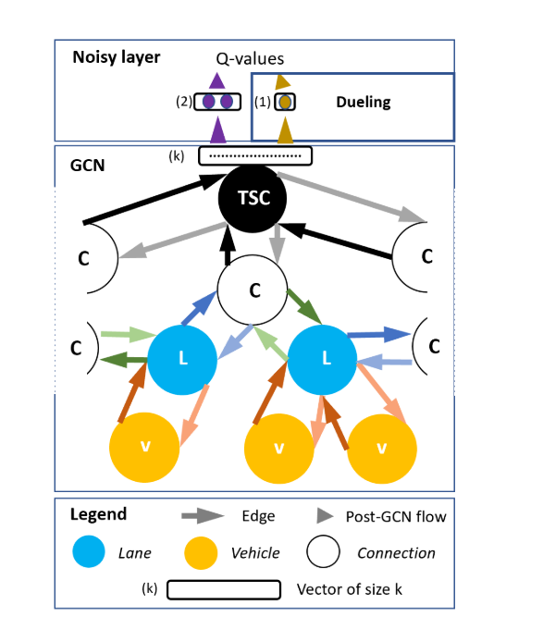
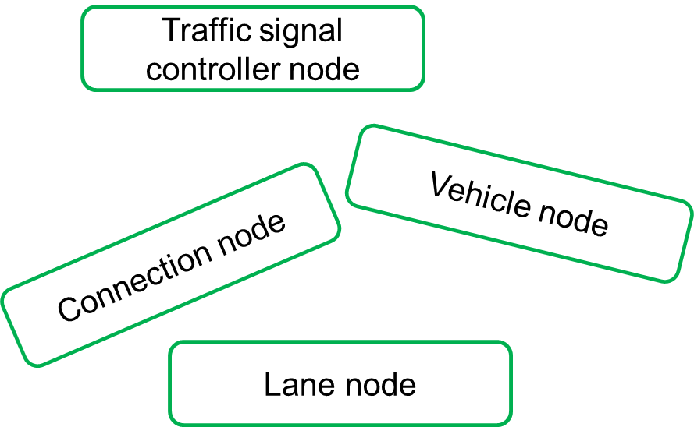
2 Methodology
Basic Idea
Deep Q learning to learn control policy.
Graph convolution network to introduce consideration on dynamic entities appearing during the control period.

Slide 20
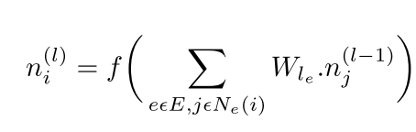
2 Methodology
Basic Idea
Deep Q learning to learn control policy.
Graph convolution network to introduce consideration on dynamic entities appearing during the control period.
Multiple GCN layer to produce node embedding.
For each node, its neighboring nodes can belong to different types.
Different type of node corresponds to different parameter set.
The number and feature dimension of the neighboring node is free.

Slide 21
2 Methodology
Basic Idea
Deep Q learning to learn control policy.
Graph convolution network to introduce consideration on dynamic entities appearing during the control period.
There is no additional setting (i.e. Weighted adjacency matrix) to distinguish nodes from the same category, but the feature itself.

Slide 22
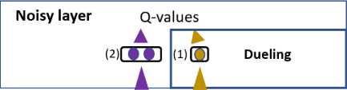
2 Methodology
Basic Idea
Deep Q learning to learn control policy.
Graph convolution network to introduce consideration on dynamic entities appearing during the control period.
Add independent gaussian noise to the parameters of network, in order to favor consistent and state-independent policy exploration.

Slide 23
3 Experiment
Set up (Train setting)
Models
S-IG-RL-L : Specialized (Train in the scenario for test)
G-IG-RL-L: General (Train in random scenario)
G-IG-RL-V: vehicle node considered while ignore lane

Slide 24
3 Experiment
Set up (Train setting)
Models
S-IG-RL-L : Specialized (Train in the scenario for test)
G-IG-RL-L: General (Train in random scenario)
G-IG-RL-V: vehicle node considered while ignore lane
Why do not consider both the vehicle and lane node?

Slide 25
3 Experiment
Set up (Train setting)
Random network structure
Number of intersections
Number of edges for each intersection
Number of lanes per route
Random traffic flow
Vehicle trajectory (start lane-immediate lanes-final lane)
Random training set
Train in parallel with different random seeds

Slide 26
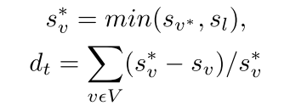
3 Experiment
Set up (Test setting)
Same network structure
Identical demand
Vehicle trajectory (start lane-immediate lanes-final lane)
Evaluation
Baselines
Fixed time (predefined and constant phases)
Max moving car heuristic (Switch phases if there are more stopped vehicles than moving vehicles in inbound lanes )
MARL-IQL (Naïve independent DQN)
Maximum speed of vehicle
Total instantaneous delay at timestep t

Slide 27
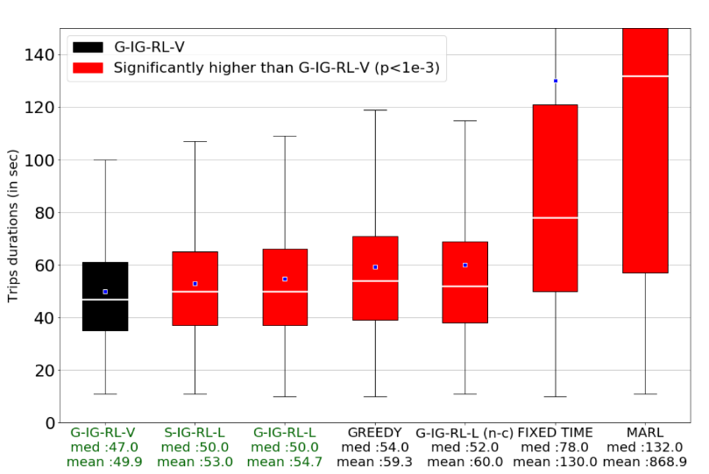
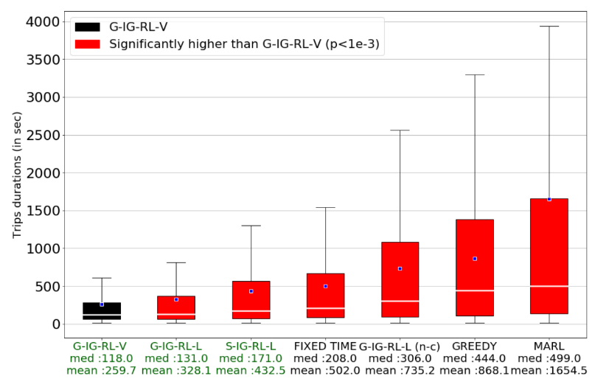
3 Experiment
Transferability and Flexibility
Trip duration
Default traffic regime (used in training)
Heavy traffic regime

Slide 28
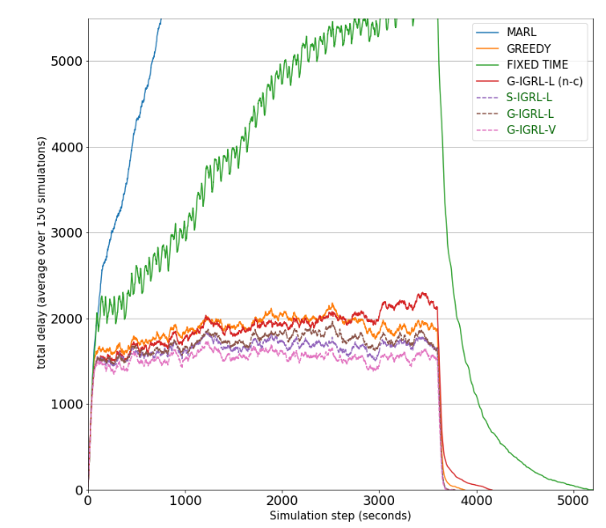
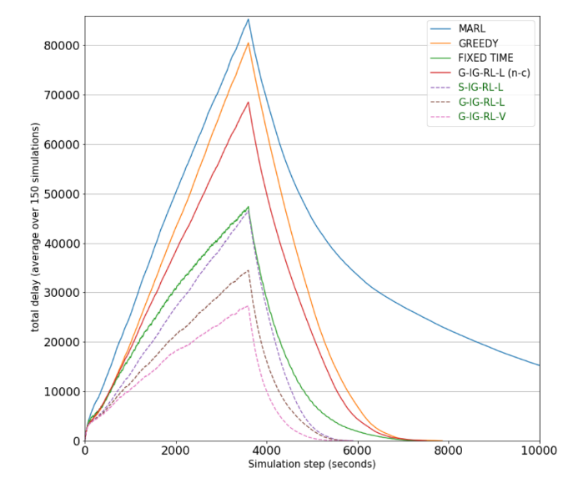
3 Experiment
Transferability and Flexibility
Total delay evolution
Default traffic regime (used in training)
Heavy traffic regime

Slide 29
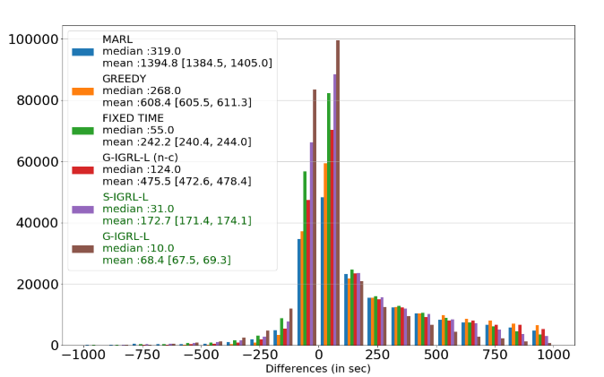
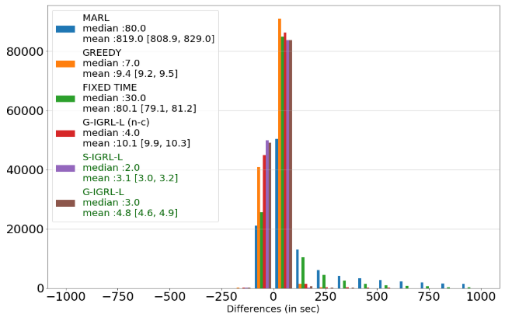
3 Experiment
Transferability and Flexibility
Differences of Paired Trips Durations (compared to IG-RL-V)
Default traffic regime (used in training)
Heavy traffic regime

Slide 30
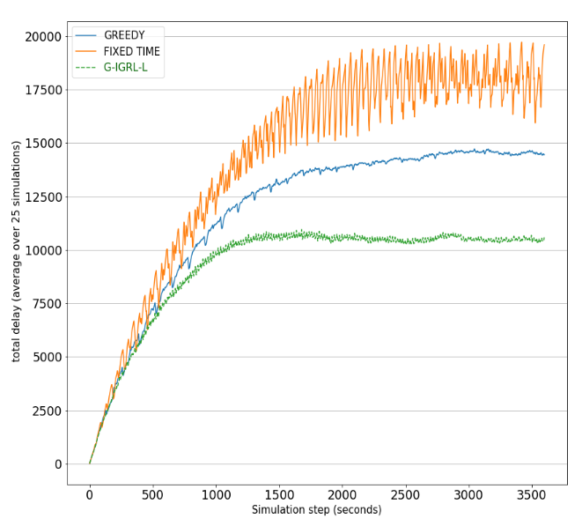
3 Experiment
Transfer and scaling (3971 intersections in Manhattan Island)

Slide 31
Thank you for watching !

