Slide 1

CIKM 2019 Paper Review
Intelligent Transportation System, Urban Computing
Presented by Fuqiang Liu (aka. Fu)
$8^{th}$-Nov-2019

Slide 2
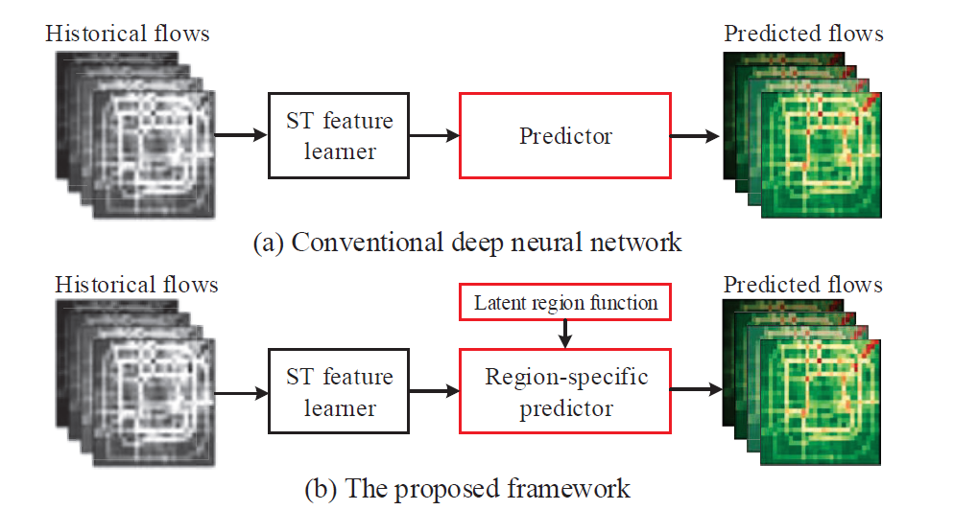
CIKM2019 Paper Review-2
Presented by Fuqiang LIU, 11/8/2019
Matrix Factorization for Spatio-Temporal Neural Networks with Applications to Urban Flow Prediction
Motivation:
Previous deep learning models for traffic flow prediction overlook latent region functions that impact ST correlations greatly;
A framework to assist deep models in tackling the region function issue is valuable.
Methodology:
Propose Matrix factorization for spatio-temporal neural networks (MF-STN), capable of enhancing the deep ST models.
A ST feature learner obtains features of ST correlations from all regions by the corresponding sub-networks;
A region-specific predictor leverages the learned ST features to make region specific predictions (MF is employed to decompose the region-specific parameters).

Slide 3
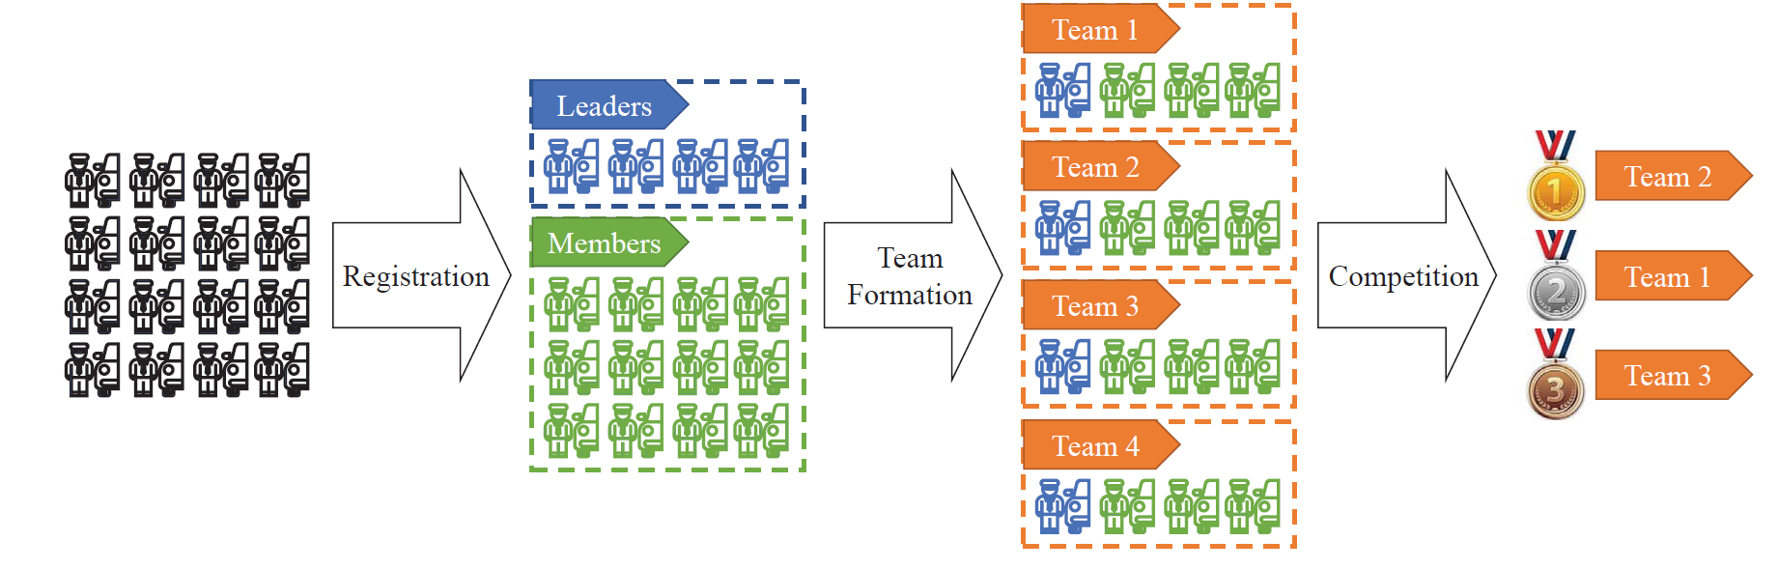
CIKM2019 Paper Review-2
Presented by Fuqiang LIU, 11/8/2019
Recommendation-based Team Formation for On-demand Taxi-calling Platforms
Motivation:
Attracting and motivating drivers is essential for the success of on-demand taxi-calling platforms
On-demand taxi-calling platforms often ignore the social engagement of individual drivers
The lack of social incentives impairs the work enthusiasms of drivers and will affect the quality of service
Methodology:
Define Recommendation-based Team Formation problem (need accurate recommendation and coordination among recommendations);
Propose Recommendation-Matrix-Based Framework (RMBF) to solve the problem;
Estimate the acceptance probability of recommendations and then derive a recommendation matrix to maximize the number of formed teams from a global view.

Slide 4
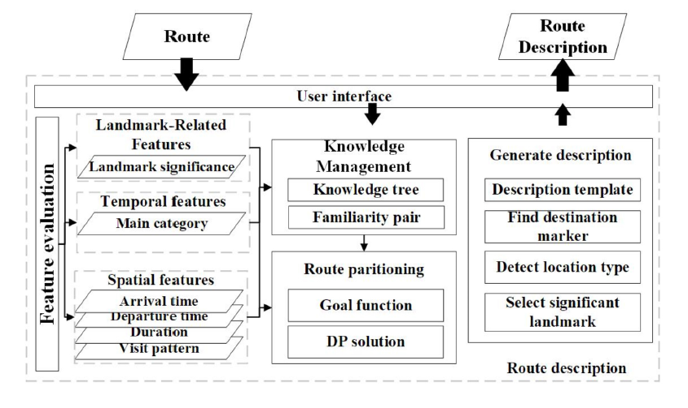
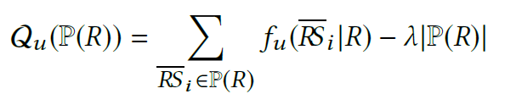
CIKM2019 Paper Review-2
Presented by Fuqiang LIU, 11/8/2019
Personalized Route Description Based On Historical Trajectories
Motivation:
The turn-by-turn route descriptions are exclusively derived from underlying road network topology information;
Such translation that ignores human cognition of the geographic space, is frequently verbose and redundant for the drivers who have knowledge of the geographical areas.
Methodology:
Formalize the task as a problem of finding the optimal partition for a given route that maximizes the familiarity while minimizing the number of partitions;
Find a proper sentence to describe each partition.
familiarity score

Slide 5
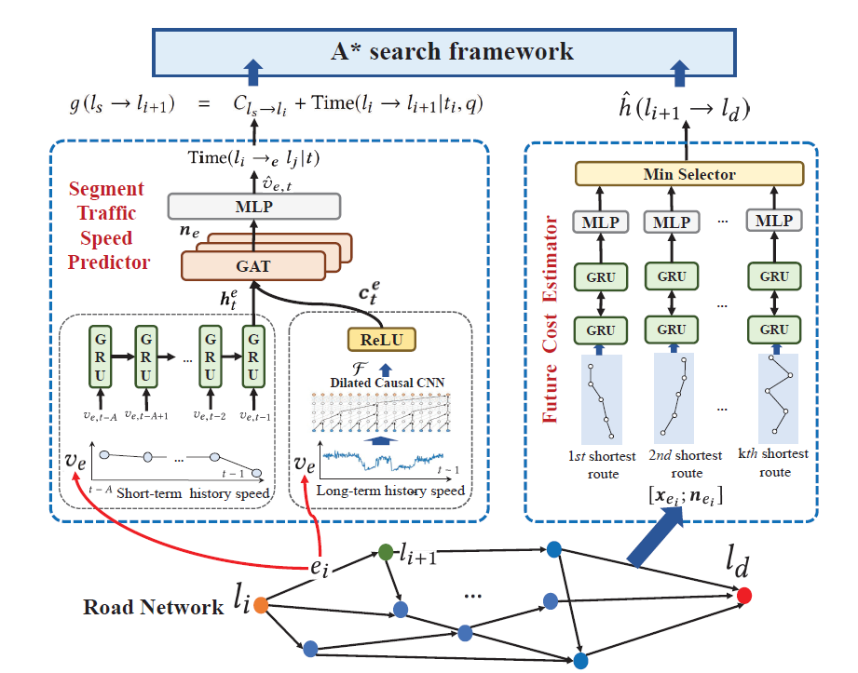

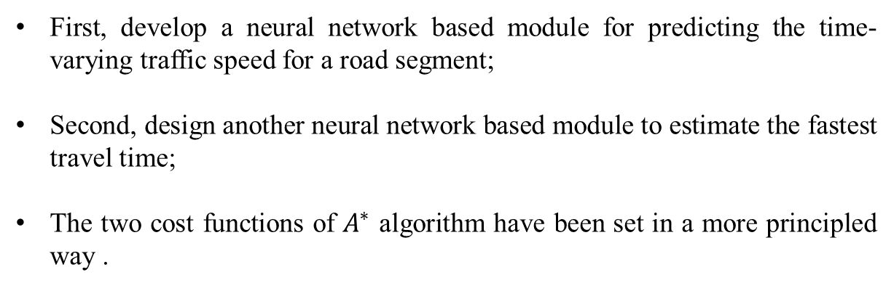
CIKM2019 Paper Review-2
Presented by Fuqiang LIU, 11/8/2019
Learning to Effectively Estimate the Travel Time for Fastest Route Recommendation
Motivation:
Early studies cast the Fastest Route Recommendation (FRR) task as a pathfinding problem on graphs and adopt heuristic algorithms as the major solution;
Heuristic function is usually empirically set with simple methods, which is difficult to model other useful factors.
Methodology:
First, develop a neural network based module for predicting the time-varying traffic speed for a road segment;
Second, design another neural network based module to estimate the fastest travel time;
The two cost functions of $A^{∗}$ algorithm have been set in a more principled way .
observation cost
estimation cost

Slide 6
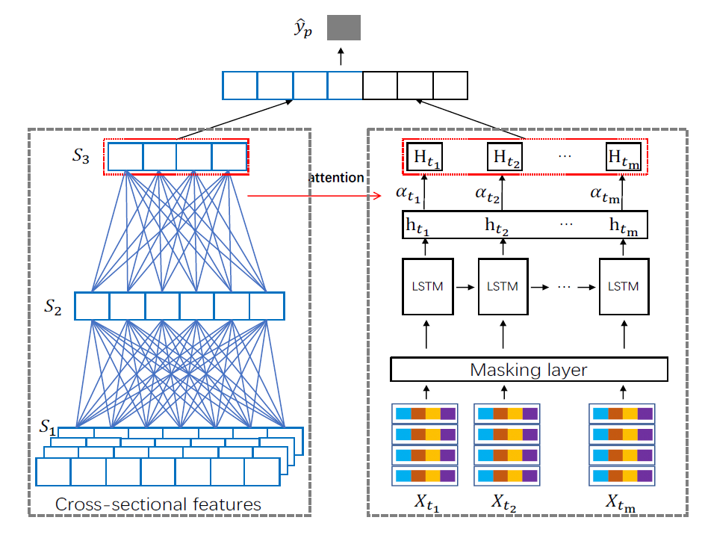
CIKM2019 Paper Review-2
Presented by Fuqiang LIU, 11/8/2019
Forecasting Pavement Performance with a Feature Fusion LSTM-BPNN Model
Motivation:
Accurate prediction of International Roughness Index (IRI) becomes a key tasks for the pavement management system
Existing models are proposed on top of small datasets and consider no time-series information
Methodology:
Propose a novel feature fusion LSTM-BPNN model to better capture the latent relationship between the cross-sectional and time-series features;
Features learned by two neural networks are fused via an attention mechanism.

Slide 7
CIKM2019 Paper Review-2
Presented by Fuqiang LIU, 11/8/2019
Deep Dynamic Fusion Network for Traffic Accident Forecasting
Motivation:
Traffic accident forecasting is a vital part of intelligent transportation systems
There are two key challenges:
The complexities of external factors which are presented with heterogeneous data structures
The complex sequential transition regularities exhibited with time-dependent and high-order inter-correlations
Methodology:
Incorporate the POI information into the hidden representation generation of the geographical region (generate embedding matrix);
Propose a GRU-based model to encode the sequential patterns of traffic accidents as well as the correlations between traffic accidents and external factors;
Design the temporal aggregation mechanism to refer back to the input sequence.

Slide 8
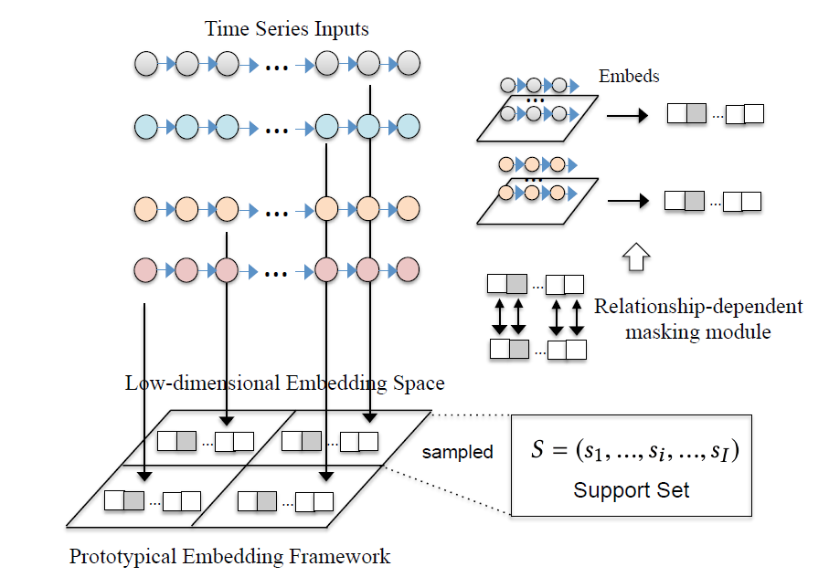
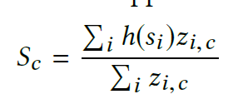

CIKM2019 Paper Review-2
Presented by Fuqiang LIU, 11/8/2019
Deep Prototypical Networks for Imbalanced Time Series Classification under Data Scarcity
Motivation:
Time series classification is a key problem in diverse domains, ranging from human activity recognition to financial pattern identification;
Previous methods relies on data sufficiency, and may not be effective when training instances are scarce and highly imbalance across classes.
Methodology:
Propose a prototype embedding framework-Deep Prototypical Networks (DPN), which leverages a main embedding space to capture the discrepancies of different time series classes.
embedding function
prototype

Slide 9
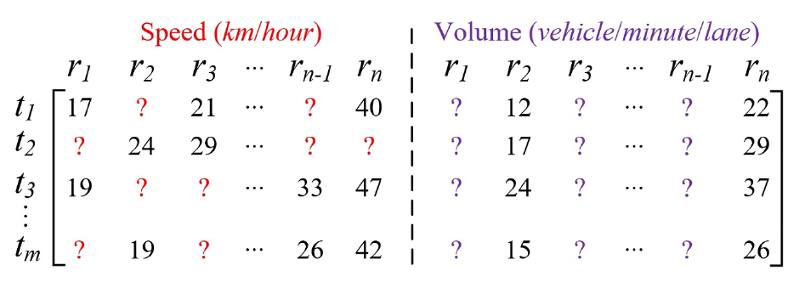



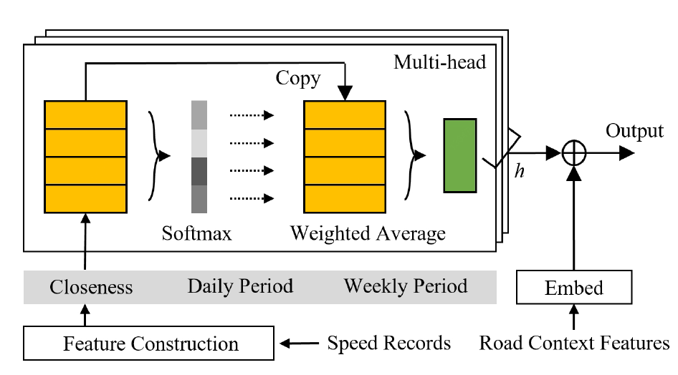

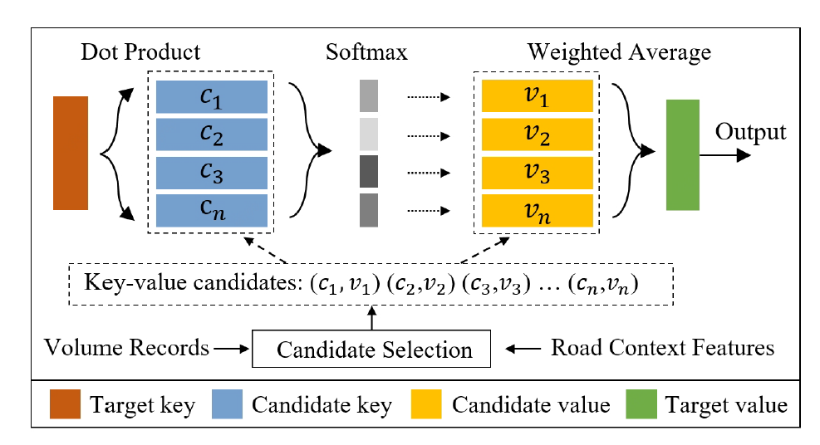
CIKM2019 Paper Review-2
Presented by Fuqiang LIU, 11/8/2019
CityTraffic: Modeling Citywide Traffic via Neural Memorization and Generalization Approach
Motivation:
Sensing citywide traffic is of great benefit to the government’s policy-making and people’s decision making;
Speed and volume information suffer from serious data missing problem;
Methodology:
Propose a self –attention-based memorization module for speed inference (GPS trajectories);
Propose a key-value-attention-network-based generalization module for volume inference (volume sense).
FC-nn

Slide 10
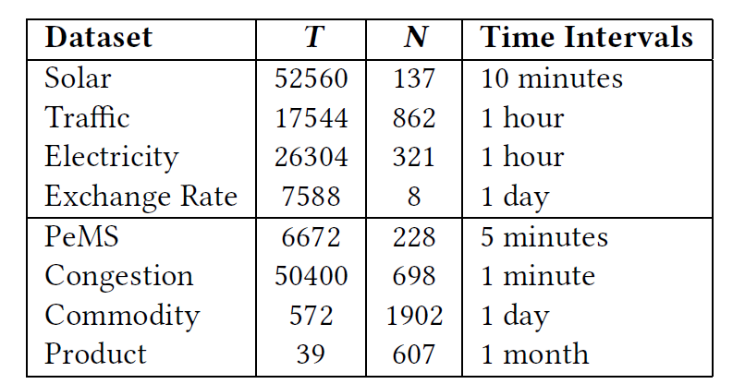
CIKM2019 Paper Review-2
Presented by Fuqiang LIU, 11/8/2019
Experimental Study of Multivariate Time Series Forecasting Models
Motivation:
Multivariate time series forecasting is important for wide applications;
There is a lack of comprehensive performance comparison of these models on different tasks.
Methodology:
Conduct a systematic evaluation of eight representative forecasting models over eight multivariate time series datasets.
Models: ARIMA, Ridge, SVR, KNN, CNN, RNN, LSTNet, STGCN
Conclusion:
When the datasets exhibit strong periodic patterns, deep learning models perform best;
When the datasets in a non-periodic manner, the statistical models such as ARIMA perform best;
When multivariate time series involving graphic inter-dependencies among multi-variates like road network, Graph convolution network is the best.

Slide 11
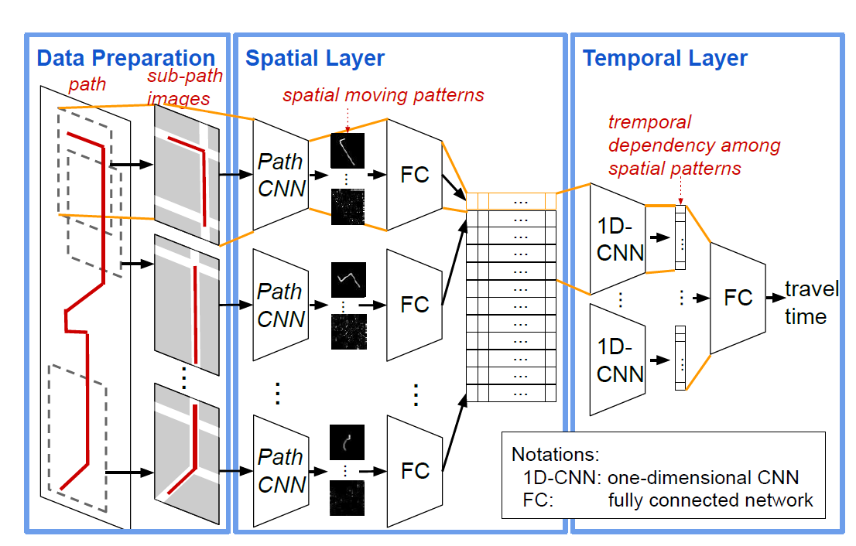
CIKM2019 Paper Review-2
Presented by Fuqiang LIU, 11/8/2019
DeepIST: Deep Image-based Spatio-Temporal Network for Travel Time Estimation
Motivation:
Estimating the travel time for a given path is a fundamental problem in many urban transportation systems;
Prior works fail to well capture moving behaviors embedded in paths and thus do not estimate the travel time accurately.
Methodology:
Propose to plot a path as a sequence of “generalized images” which include sub-paths along with additional information, such as traffic conditions, road network and traffic signals;
Design a novel two-dimensional CNN (PathCNN) to extract spatial patterns for lines in images by regularization and adopting multiple pooling methods;
Apply a one-dimensional CNN to capture temporal patterns.

