Slide 1

Graph U-Nets
Literature review

Slide 2
Contents
1
Motivation
2
Methodology
3
Empirical study

Slide 3
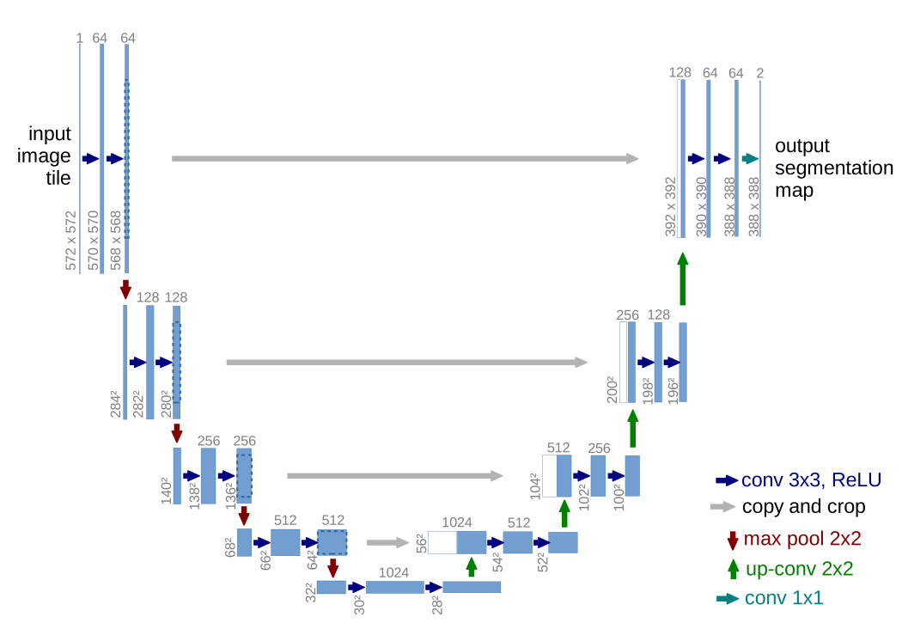
1 Motivation
U-Net
Contracting path to capture context
Expansive path for precise localization

Slide 4
1 Motivation
U-Net
Pooling and Unpooling for graph data is another story

Slide 5
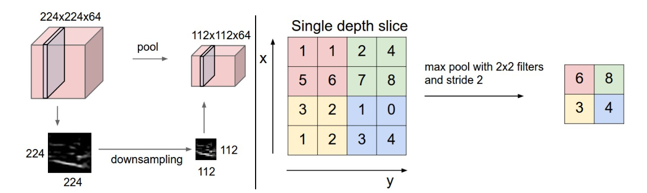
1 Motivation
Source: https://cs231n.github.io/convolutional-networks/#pool
Pooling progressively reduce the spatial size of the representation to reduce the amount of parameters and computation in the network

Slide 6
1 Motivation
Source: https://cs231n.github.io/convolutional-networks/#pool
The goal of the pooling operation is to bring a level of invariance to changes in position and scale as well as to aggregate responses within and across feature maps

Slide 7
1 Motivation
Source: https://cs231n.github.io/convolutional-networks/#pool
Highlight similar information in local area and therefore reduce the size of feature map
The goal of the pooling operation is to bring a level of invariance to changes in position and scale as well as to aggregate responses within and across feature maps

Slide 8
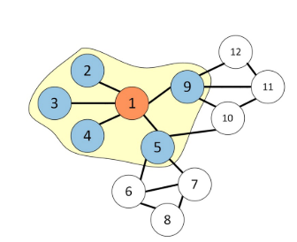
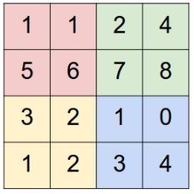
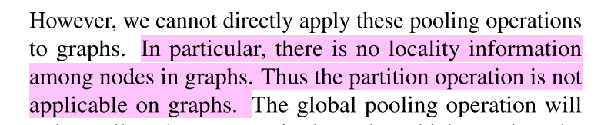
1 Motivation
Source: Zhao, L., et al. T-GCN : A Temporal Graph Convolutional Network for Traffic Prediction. 14(8), 1–11.
Pooling can not distinguish the local information among feature vectors

Slide 9
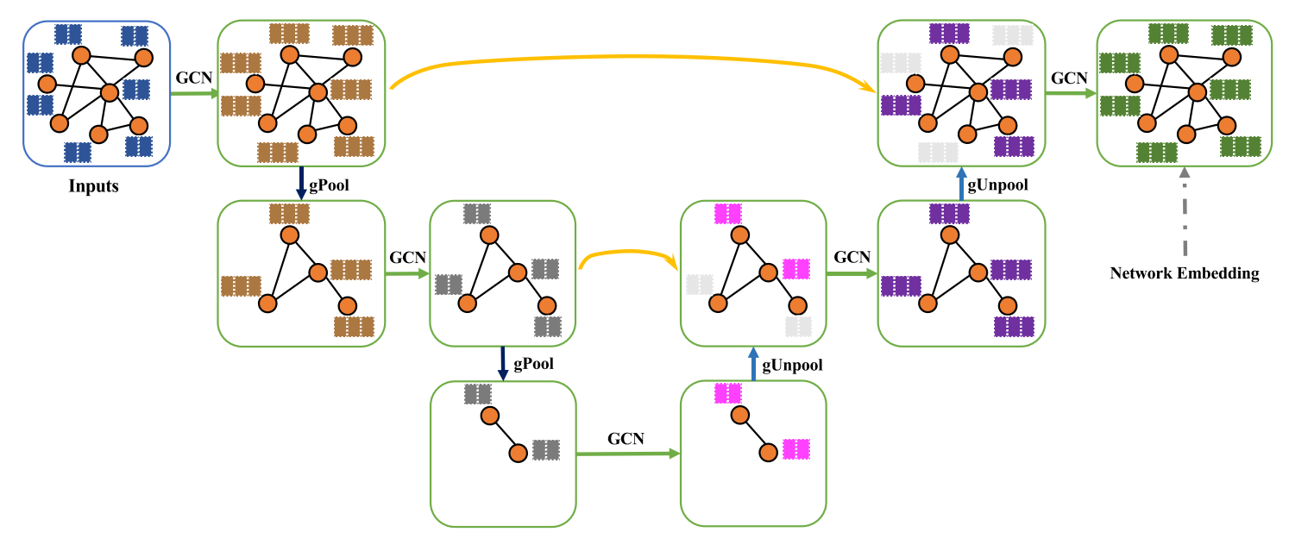
2 Methodology
Graph U-Net
Graph embedding

Slide 10

2 Methodology
Aggregate neighbor information
Reduce graph size
Graph U-Net
GCN -> gPool -> GCN…… -> gPool -> GCN
Block
Encoder

Slide 11
2 Methodology
Aggregate neighbor information
Restore graph into higher resolution
Graph U-Net
gUnpool -> GCN…… -> gUnpool -> GCN
Block
Decoder

Slide 12
2 Methodology
For blocks in the same level, encoder block uses skip connection to fuse the low-level spatial features from the encoder block
Graph U-Net

Slide 13
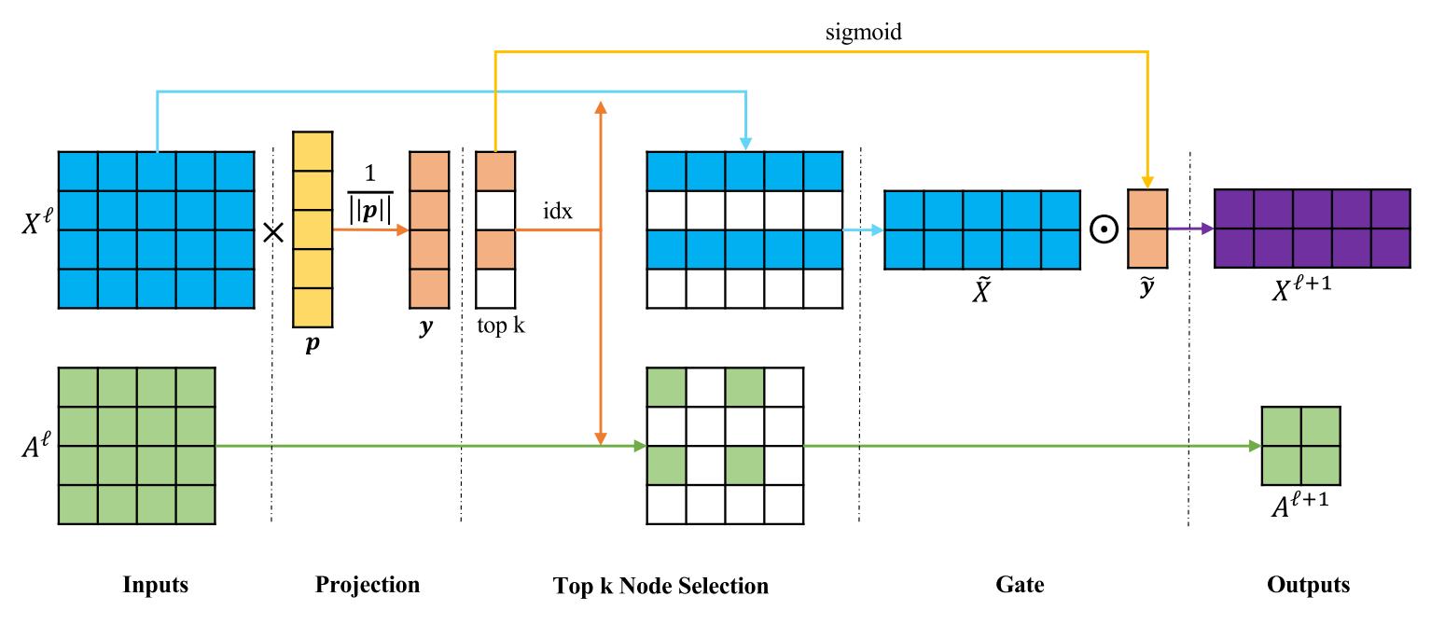
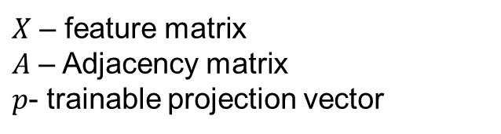
2 Methodology
$X$ – feature matrix
$A$ – Adjacency matrix
$p$- trainable projection vector
Graph Pooling
GCN

Slide 14

2 Methodology
$X$ – feature matrix
$A$ – Adjacency matrix
$p$- trainable projection vector
Graph Pooling
GCN
Measure feature of each node along projection vector
Select nodes with top-k largest projection value

Slide 15
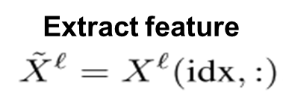
2 Methodology
$X$ – feature matrix
$A$ – Adjacency matrix
$p$- trainable projection vector
Graph Pooling
GCN

Slide 16
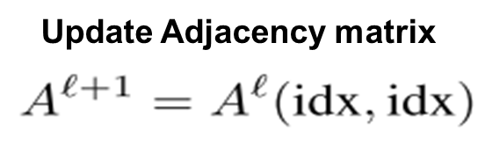
2 Methodology
$X$ – feature matrix
$A$ – Adjacency matrix
$p$- trainable projection vector
Graph Pooling
GCN

Slide 17
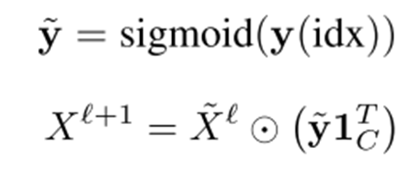
2 Methodology
$X$ – feature matrix
$A$ – Adjacency matrix
$p$- trainable projection vector
Graph Pooling
Control information flow
GCN

Slide 18
2 Methodology
$X$ – feature matrix
$A$ – Adjacency matrix
$p$- trainable projection vector
Graph Pooling
Control information flow
Allow gradient propagation to train the projection vector
GCN

Slide 19

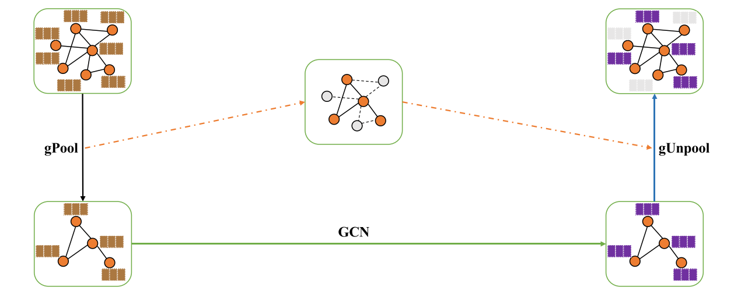
2 Methodology
Graph Unpooling
Fill 0 feature vector for Unselected node
Too coarse ?

Slide 20


2 Methodology
Tricks
Use 2-order adjacency matrix to avoid too sparse connectivity after gPooling
Emphasize each node’s own feature

Slide 21
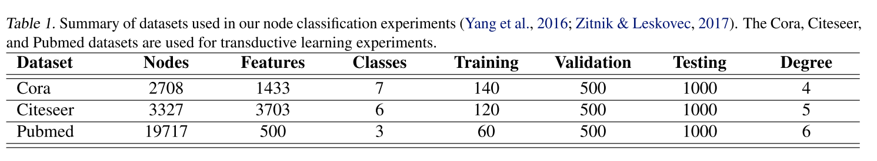
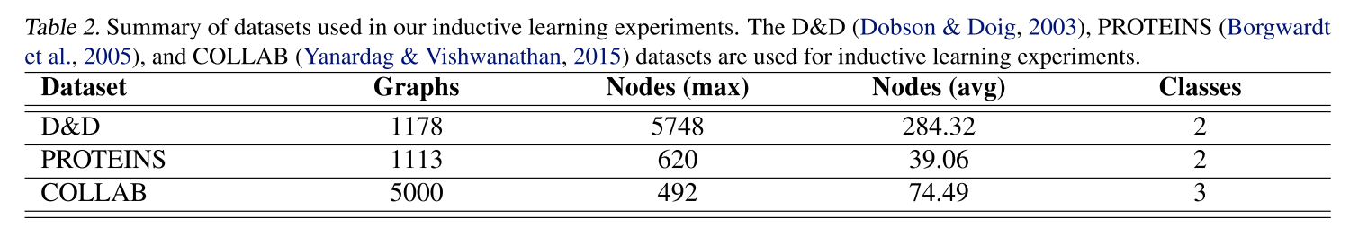
3 Experiments
Datasets
Node classification (under inductive learning setting)
)

Slide 22
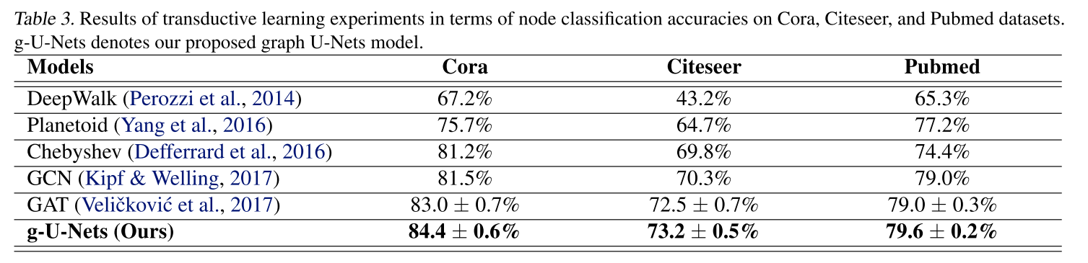
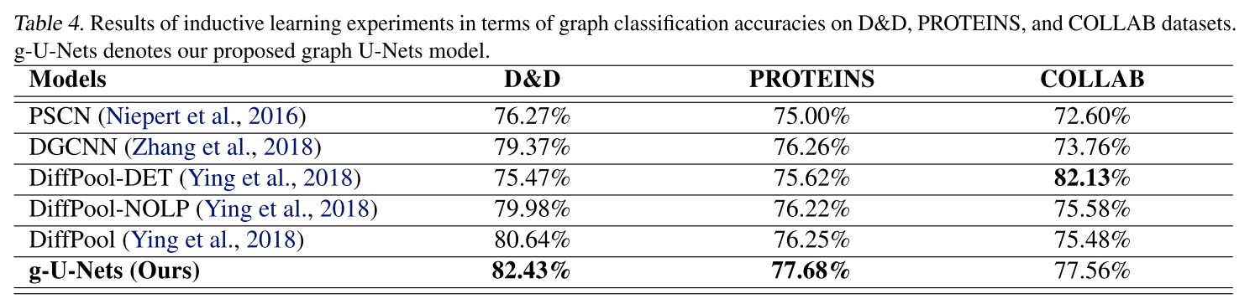
3 Experiments
Performance

Slide 23
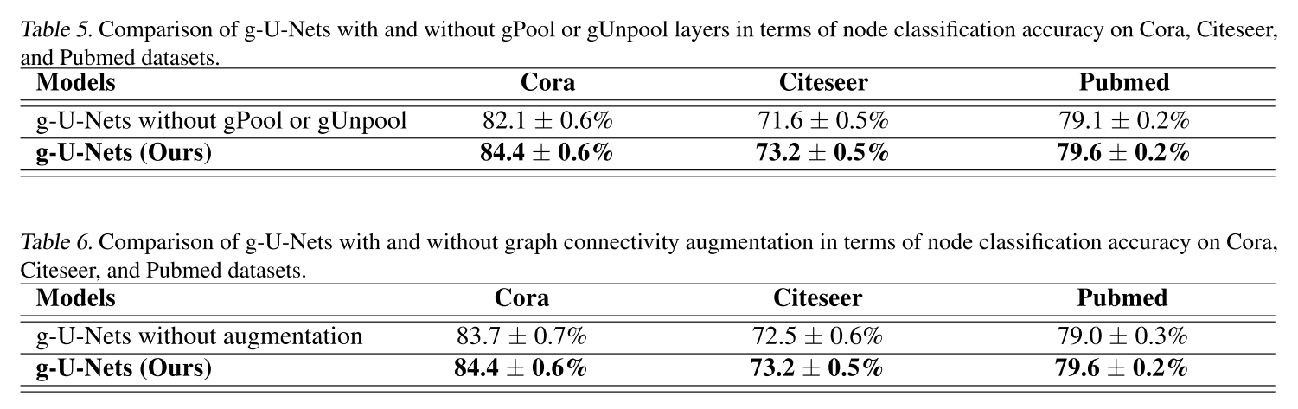
3 Experiments
Ablation study (gPool and gUnpool do work)

Slide 24
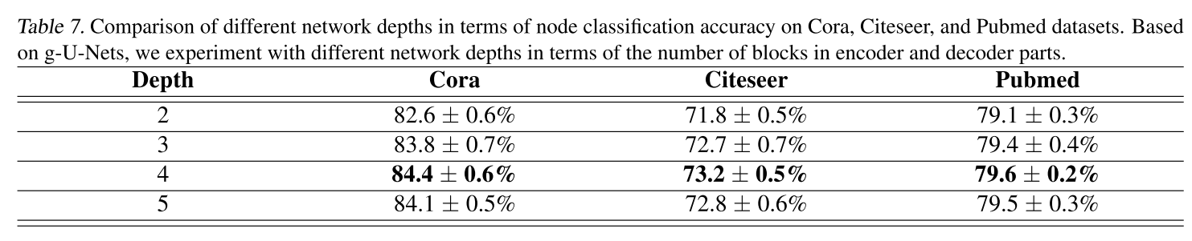
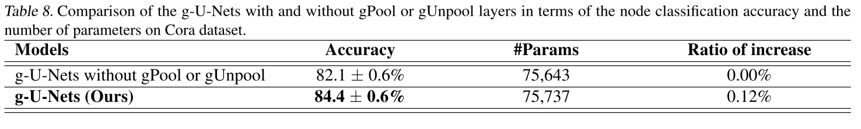
3 Experiments
Network structure study
Network depth (Works for shallow network and consistent with U-net)
Parameter number (Add small parameters for large improvement)

Slide 25
Thank you !

