Slide 1
Efficient Evolution of Neural Network Topologies
Literature review

Slide 2
Contents
1
Motivation
2
Methodology
3
Empirical study

Slide 3
1 Motivation
Multilinear decomposition methods can not capture complex, non-linear relationships in data

Slide 4
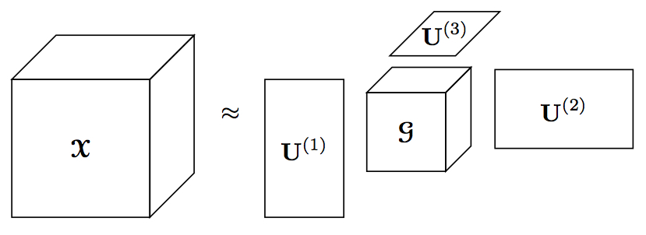
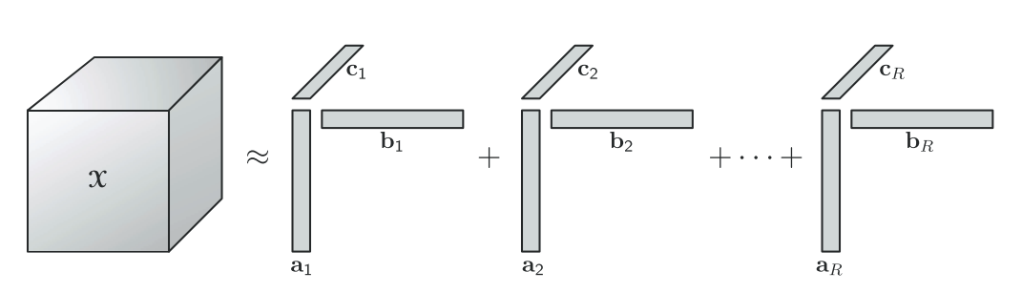
1 Motivation
Multilinear decomposition methods can not capture complex, non-linear relationships in data
Lack of efficient NN based factorization methods for streaming data.
Remove the structure assumption: Bayesian Deep Tensor Factorization
Increasingly update posterior:
Streaming Posterior Inference
New coming data

Slide 5



2 Methodology
Bayesian Deep Tensor Factorization
$$d_{3}$$
$$d_{1}$$
$$d_{2}$$

Slide 6
3 Experiments
4 real world datasets
Binary tensor about bibliography relationships(author, conference, keyword)
10000x20x10000 with 0.001% nonzero entries
Binary tensor (user, anime) depict user preference
25838x4066 with 1300160 observed entries
Continuous tensor about interaction (user, action, file)
3000x150x30000 with 0.9% nonzero entries
Continuous tensor about movie rating(user, movie)
6040x3706 with 100209 observed values

Slide 7
3 Experiments
5 Baselines
POST: streaming tensor decomposition algorithm based on a probabilistic CP model
SVB-DTF: SVB based deep tensor factorization
SVB-GPTF : SVB based tensor factorization with Gaussian process to encode nonlinear
SS-GPTF: Gaussian process factorization with the recent streaming sparse GP approximations
CP-WOPT: statistic CP model

Slide 8
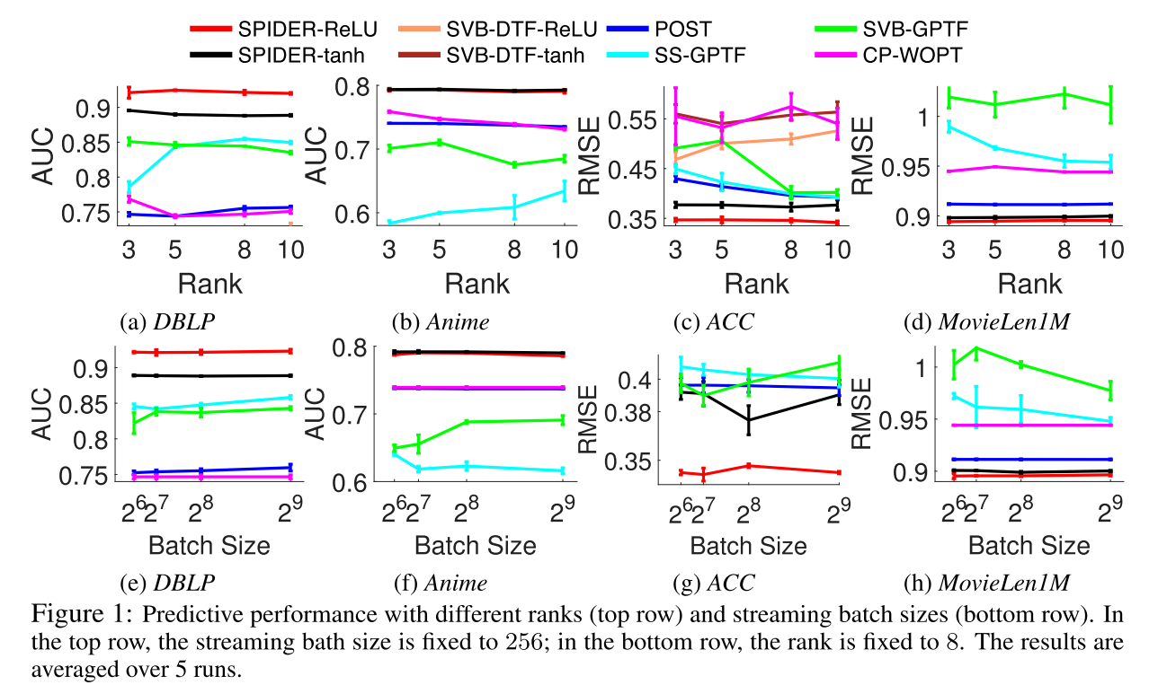
3 Experiments
Evaluate the prediction accuracy after all the (accessible) entries are processed in sequential batches
▪ Poor performance for CP based methods:
Multilinear assumption is limited to data.
▪ Poor performance for SVB based methods:
Optimize posterior based on SGD is unreliable
Notes:
Area Under the ROC Curve, receiver operating characteristic curve
AUC:The expectation that a uniformly drawn random positive is ranked before a uniformly drawn random negative

Slide 9
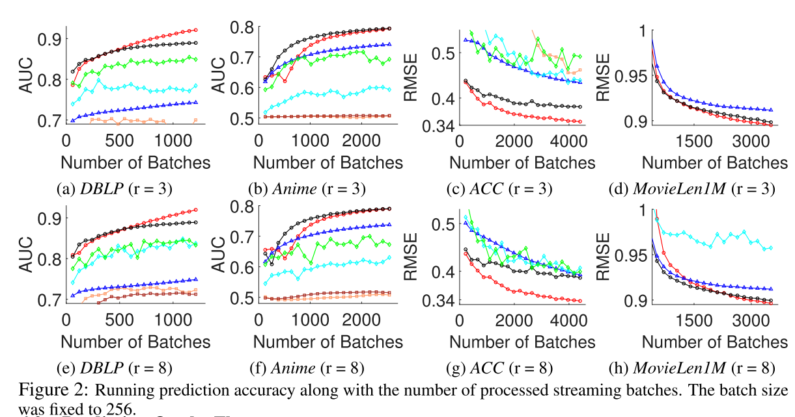
3 Experiments
Evaluate the dynamic performance. (generate a stream of batches and test after train on each batch)

Slide 10
Thank you !

