Slide 1
Diffusion Convolutional Recurrent Neural Network: Data-Driven Traffic Forecasting
Literature review

Slide 2
Contents
1
Motivation
2
Methodology
3
Empirical study

Slide 3
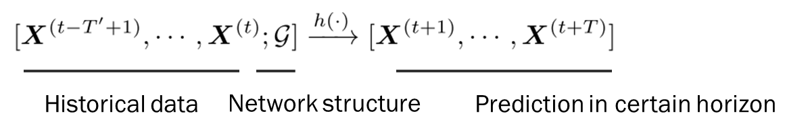
1 Motivation
Problem setting:

Slide 4
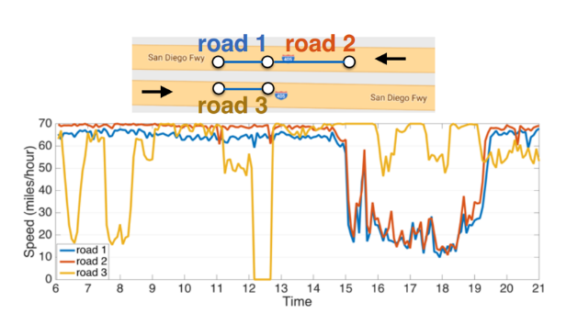
1 Motivation
Problem setting:
Challenges:
1) Complex spatial dependency
i.e. Traffic pattern among road segments with close euclidean distance seem to vary.

Slide 5
1 Motivation
Problem setting:
Challenges:
2) Non-linear temporal dependency
i.e. Rush hours or incident can cause non-stationarity.

Slide 6
1 Motivation
Problem setting:
Challenges:
3) Difficult long-term forecasting
Traffic speed fluctuates severely in long horizon

Slide 7
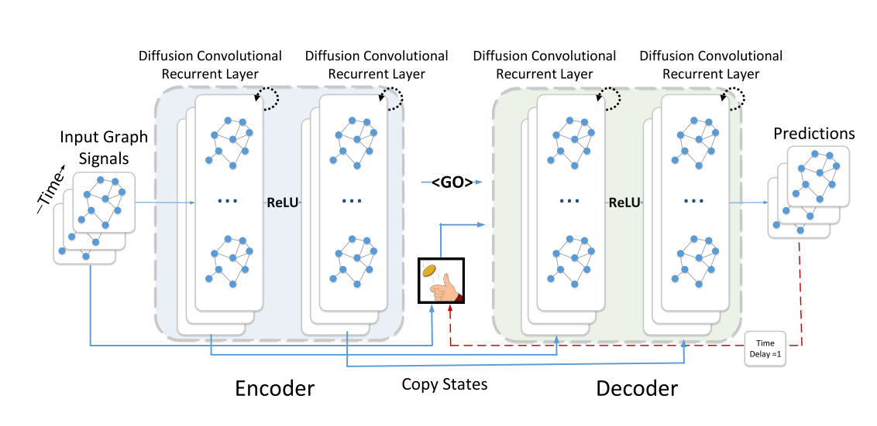
2 Methodology
Overall Structure
Complex spatial dependency Diffusional convolution
Non-linear temporal dynamics Recurrent neural network
Difficult long term prediction Encoder-Decoder architecture

Slide 8
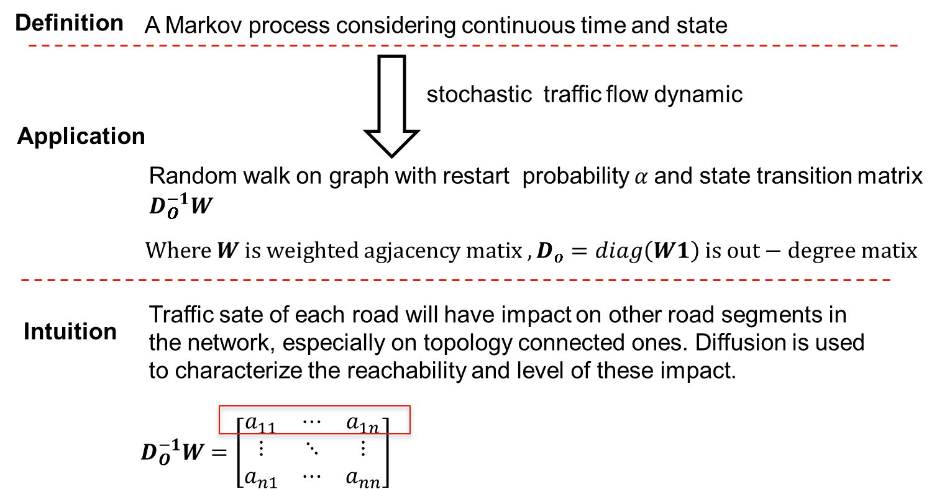
2 Methodology
Diffusion convolution
Diffusion process
Notes:
Apply to traffic flow

Slide 9
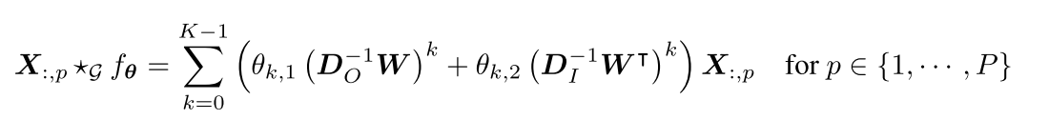
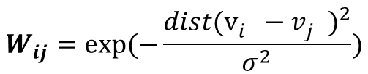
2 Methodology
Diffusion convolution
$X ∈ℝ^{N×P}, N for number of nodes, P for feature dimesnsion of each node$

Slide 10

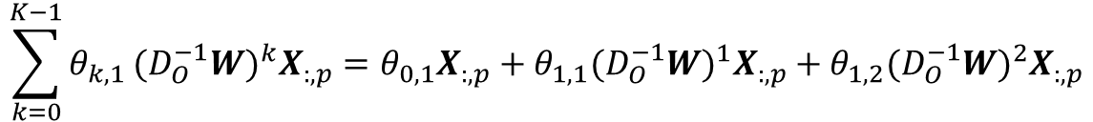
2 Methodology
Diffusion convolution
$$\sum_{k=0}^{K−1}{θ_{k,1}}{(D_{O}^{−1}W)}^{k}X_{:,p}=θ_{0,1}X_{:,p}+θ_{1,1}{(D_{O}^{−1}W)}^{1}X_{:,p}+θ_{1,2}{(D_{O}^{−1}W)}^{2}X_{:,p}$$

Slide 11














2 Methodology
Diffusion convolution
$$\sum_{k=0}^{K−1}{θ_{k,1}}{(D_{O}^{−1}W)}^{k}X_{:,p}=θ_{0,1}X_{:,p}+θ_{1,1}{(D_{O}^{−1}W)}^{1}X_{:,p}+θ_{1,2}{(D_{O}^{−1}W)}^{2}X_{:,p}$$
$$R_{1}$$
$$R_{2}$$
$$R_{3}$$
$$R_{4}$$
$$R_{5}$$
$$⋯$$
$$R_{1}$$
If we mainly consider nearest downstream neighbor of target road, what is the level of influence any other segments have on it?
$$R_{5}$$
$$R_{2}$$
$$R_{target}$$
$$×$$
$$R_{4}$$
$$R_{3}$$
$$X$$

Slide 12
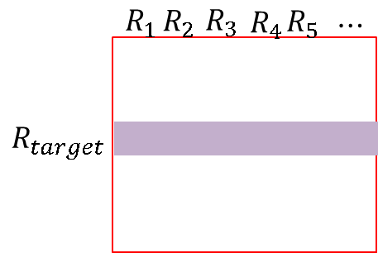
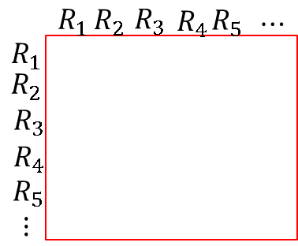




2 Methodology
Diffusion convolution
$$\sum_{k=0}^{K−1}{θ_{k,1}}{(D_{O}^{−1}W)}^{k}X_{:,p}=θ_{0,1}X_{:,p}+θ_{1,1}{(D_{O}^{−1}W)}^{1}X_{:,p}+θ_{1,2}{(D_{O}^{−1}W)}^{2}X_{:,p}$$
$$×$$
$$×$$
$$X$$

Slide 13
2 Methodology
Diffusion convolution
$$\sum_{k=0}^{K−1}{θ_{k,1}}{(D_{O}^{−1}W)}^{k}X_{:,p}=θ_{0,1}X_{:,p}+θ_{1,1}{(D_{O}^{−1}W)}^{1}X_{:,p}+θ_{1,2}{(D_{O}^{−1}W)}^{2}X_{:,p}$$
Noted: Information from downstream of the target segment is incorporated according to the topology distance (i.e. transition probability)

Slide 14


2 Methodology
Diffusion convolution
$$\sum_{k=0}^{K−1}{θ_{k,1}}{(D_{O}^{−1}W)}^{k}X_{:,p}$$
$$\sum_{k=0}^{K−1}{θ_{k,1}}{(D_{I}^{−1}W)}^{k}X_{:,p}$$
Downstream 3-neighborhood information is considered
Upstream 3-neighborhood information is considered

Slide 15
2 Methodology
Diffusion convolution
Relationship with spectral graph convolution
First to propose graph convolution with DNN:
[1] Bruna,et al(2013). Spectral Networks and Locally Connected Networks on Graphs.
Increase computation efficiency of graph convolution:
[2] Michaël Defferrard, et al(2016). Convolutional Neural Networks on Graphs with Fast Localized Spectral Filtering.
Graph convolution in traffic prediction：
[3] Cui, Z.,et al(2018). High-Order Graph Convolutional Recurrent Neural Network: A Deep Learning Framework for Network-Scale Traffic Learning and Forecasting.

Slide 16
2 Methodology
Diffusion convolution
Relationship with spectral graph convolution
Spectral graph convolution
$$Given degree matrix D, adjacency matrix W$$
$$Normalized graph Laplacian:L=D^{−\frac{1}{2}}(D−W)D^{−\frac{1}{2}}$$
$$eigen value decomposition on L:L=ΦΛΦ^{T}$$

Slide 17




2 Methodology
Diffusion convolution
Relationship with spectral graph convolution
Spectral graph convolution
$$Given degree matrix D, adjacency matrix W$$
$$Normalized graph Laplacian:L=D^{−\frac{1}{2}}(D−W)D^{−\frac{1}{2}}$$
$$eigen value decomposition on L:L=ΦΛΦ^{T}$$
$$Graph convolution for two signal on graph G with graph fourier transform:$$
$${(f∗h)}_{G}=Φ({(Φ}^{T}h)⊙(Φ^{T}f))$$
$$⊙:element−wise multiplication$$
$$GFT for h$$
$$GFT for f$$

Slide 18






2 Methodology
Diffusion convolution
Relationship with spectral graph convolution
Spectral graph convolution
$$Given degree matrix D, adjacency matrix W$$
$$Normalized graph Laplacian:L=D^{−\frac{1}{2}}(D−W)D^{−\frac{1}{2}}$$
$$eigen value decomposition on L:L=ΦΛΦ^{T}$$
$$Graph convolution for two signal on graph G with graph fourier transform:$$
$${(f∗h)}_{G}=Φ({(Φ}^{T}h)⊙(Φ^{T}f))$$
$$⊙:element−wise multiplication$$
$$GFT for filter$$
$$GFT for input feature on G$$
$$Graph convolution neural network:$$
$${(f∗h)}_{G}=Φ(diag(θ) (Φ^{T}f))$$
$$filter to train$$

Slide 19
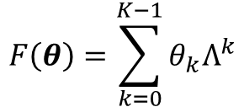


2 Methodology
Diffusion convolution
Relationship with spectral graph convolution
Spectral graph convolution

Slide 20
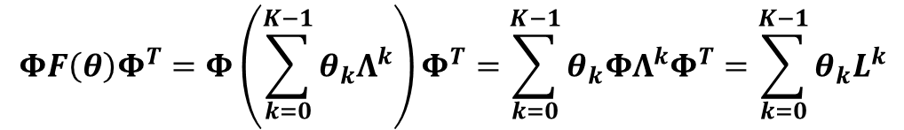
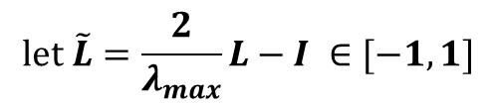
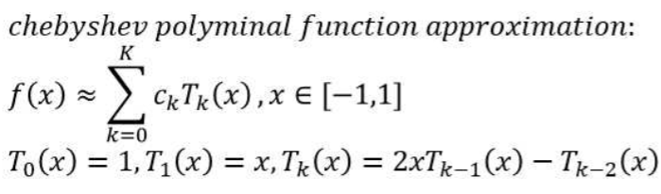
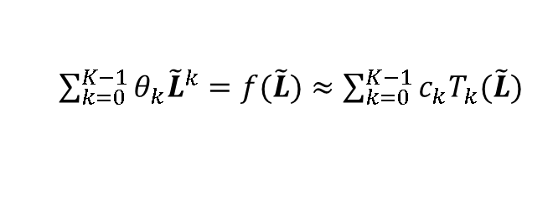
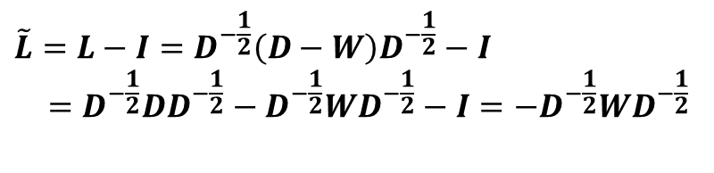

2 Methodology
Diffusion convolution
Relationship with spectral graph convolution
From spectral graph convolution to diffusion process
$$λ_{max}=2$$

Slide 21


2 Methodology
Diffusion convolution
Relationship with spectral graph convolution
From spectral graph convolution to diffusion process
$$ΦF\left(θ\right)Φ^{T}≈c_{0}1+c_{1}\left(−D^{−\frac{1}{2}}WD^{−\frac{1}{2}}\right)+…$$
Noted: Spectral graph convolution is similar to diffusion convolution on undirected graph

Slide 22
2 Methodology
Recurrent neural network
Noted: Embed diffusion convolutional layer to traditional GRU unit.

Slide 23
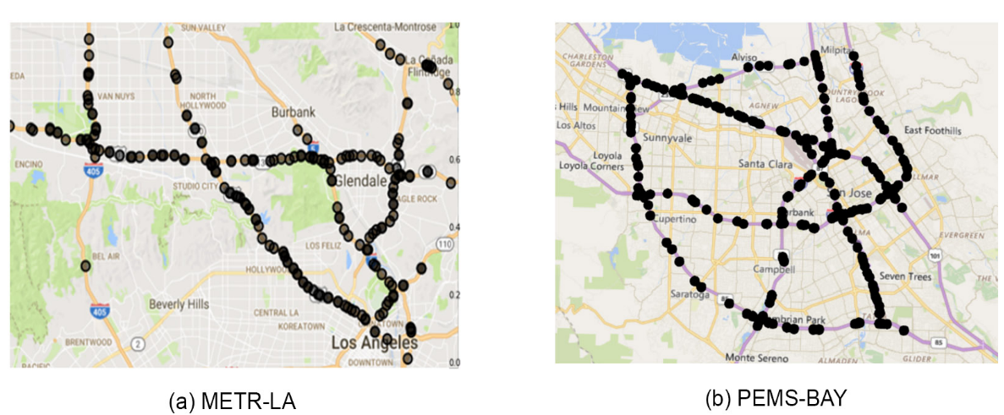
3 Empirical study
Validation
3 evaluation metrics
MAE, MAPE, RMSE
2 real-world large scale dataset:
6 baseline in prediction horizon
15min, 30min, 1 hour. (5min/step)
2 specific model validation:
DCRNN(No specific spatial consideration)
DCNN(No specific temporal consideration)

Slide 24
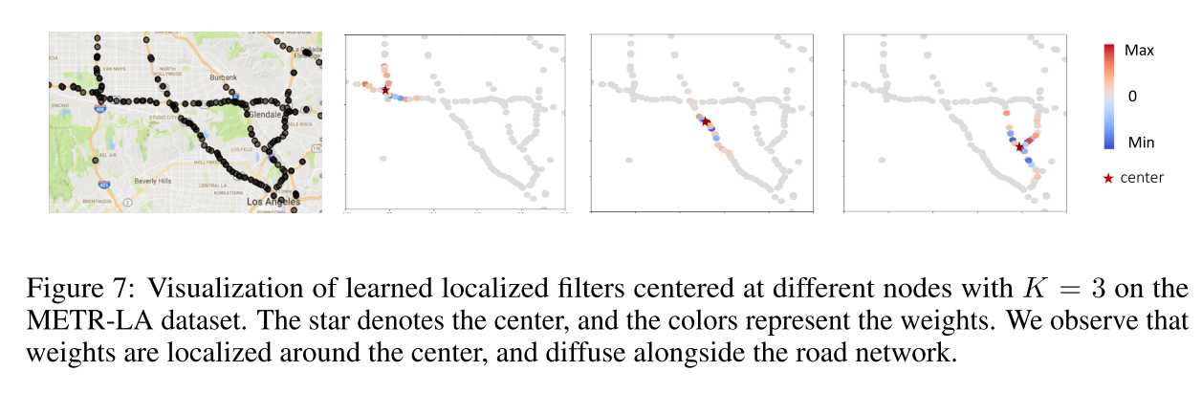

3 Empirical study
Interpretation of the model
$$\left[\begin{matrix}a_{11} & ⋯ & a_{1n} \\ ⋮ & ⋱ & ⋮ \\ a_{n1} & ⋯ & a_{nn}\end{matrix}\right]$$

Slide 25
Thank you for attention !

Slide 26
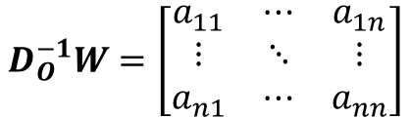
Definition
A Markov process considering continuous time and state
stochastic traffic flow dynamic
Application
Random walk on graph with restart probability $α$and state transition matrix $D_{O}^{−1}W$
$$Where W is weighted agjacency matix , D_{o}=diag\left(W1\right) is out−degree matix$$
Traffic sate of each road will have impact on other road segments in the network, especially on topology connected ones. Diffusion is used to characterize the reachability and level of these impact.
Intuition
$$D_{O}^{−1}W=\left[\begin{matrix}a_{11} & ⋯ & a_{1n} \\ ⋮ & ⋱ & ⋮ \\ a_{n1} & ⋯ & a_{nn}\end{matrix}\right]$$

