Slide 1
T-GCN: A Temporal Graph Convolutioal Neural Network for Traffic Prediction
Literature review

Slide 2
Contents
1
Motivation
2
Methodology
3
Experimental study

Slide 3
1 Motivation
To capture the spatial and temporal dependencies simultaneously for prediction

Slide 4
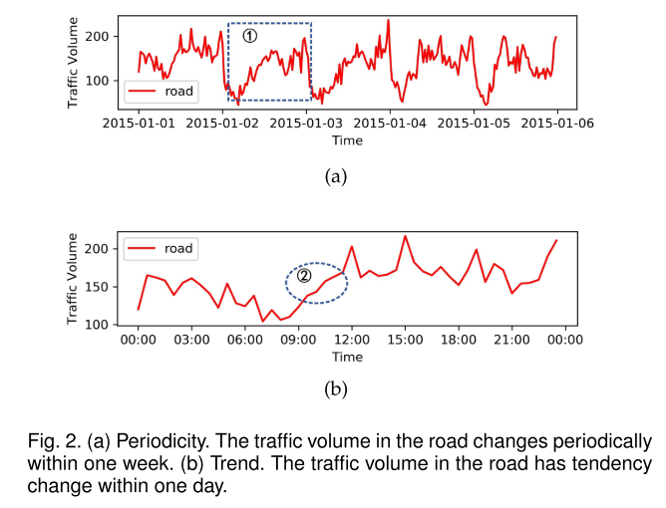
1 Motivation
To capture the spatial and temporal dependencies simultaneously for prediction
temporal dependencies

Slide 5
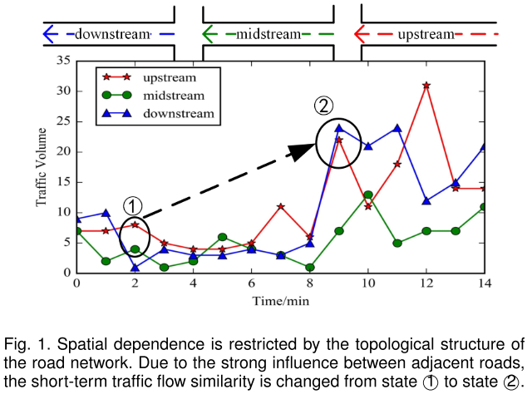
1 Motivation
To capture the spatial and temporal dependencies simultaneously for prediction
Spatial dependencies
Later similarity appears between midstream and downstream
At first similarity appears between upstream and midstream

Slide 6
1 Motivation
To capture the spatial and temporal dependencies simultaneously for prediction
Spatial dependencies
Limitations
Not consider spatial dependency (i.e., ARIMA, Kalman Filter)
Not match the context of network topology (i.e., model only suitable for Euclidean data)

Slide 7
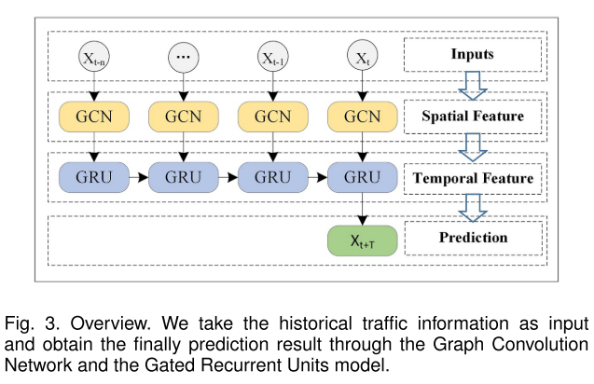
2 Methodology
Framework

Slide 8
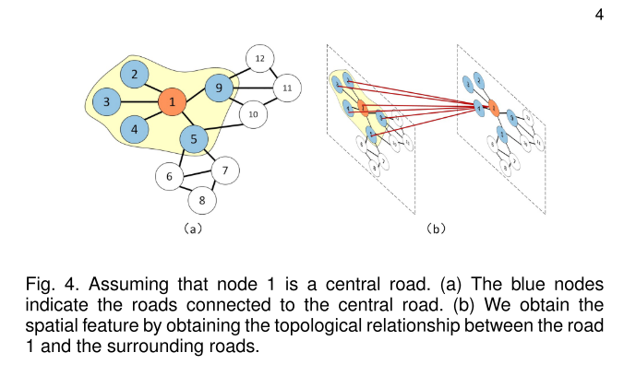
2 Methodology
Spatial dependency modelling
Learn from basic feature
Learn from topology

Slide 9

2 Methodology
Spatial dependency modelling
Learn from basic feature
Feature corresponds to node
(i.e., $X∈ℝ^{n×T}, n nodes, T feature dimension$)
Learn from topology
Adjacency Matrix (i.e., $A∈ℝ^{n×n}$ )
$$H^{(l+1)}=f\left(H^{\left(l\right)},A\right)=σ(AH^{\left(l\right)}W^{\left(l\right)})$$

Slide 10
2 Methodology
Spatial dependency modelling
Learn from basic feature
Feature corresponds to node
(i.e., $X∈ℝ^{n×T}, n nodes, T feature dimension$)
Learn from topology
Adjacency Matrix (i.e., $A∈ℝ^{n×n}$ )
$$H^{(l+1)}=f\left(H^{\left(l\right)},A\right)=σ(AH^{\left(l\right)}W^{\left(l\right)})$$
Feature output of layer l+1
Feature output of layer l

Slide 11
2 Methodology
Spatial dependency modelling
Learn from basic feature
Feature corresponds to node
(i.e., $X∈ℝ^{n×T}, n nodes, T feature dimension$)
Learn from topology
Adjacency Matrix (i.e., $A∈ℝ^{n×n}$ )
$$H^{(l+1)}=f\left(H^{\left(l\right)},A\right)=σ(AH^{\left(l\right)}W^{\left(l\right)})$$
Weight matrix of layer l

Slide 12
2 Methodology
Spatial dependency modelling
Learn from basic feature
Feature corresponds to node
(i.e., $X∈ℝ^{n×T}, n nodes, T feature dimension$)
Learn from topology
Adjacency Matrix (i.e., $A∈ℝ^{n×n}$ )
$$H^{(l+1)}=f\left(H^{\left(l\right)},A\right)=σ(AH^{\left(l\right)}W^{\left(l\right)})$$
For each node, accumulate feature of its neighbor node.

Slide 13


2 Methodology
Spatial dependency modelling
Learn from basic feature
Feature corresponds to node
(i.e., $X∈ℝ^{n×T}, n nodes, T feature dimension$)
Learn from topology
Adjacency Matrix (i.e., $A∈ℝ^{n×n}$ )
$$H^{(l+1)}=f\left(H^{\left(l\right)},A\right)=σ(AH^{\left(l\right)}W^{\left(l\right)})$$
Problem 1: Diagonal entries are zero, which means ignorance of its own feature
$$\tilde{A}=I+A$$
Problem 2: The node with more neighbor nodes tends to occupy higher feature.
$$\hat{A}={\tilde{D}}^{−\frac{1}{2}}\tilde{A}{\tilde{D}}^{−\frac{1}{2}}$$

Slide 14
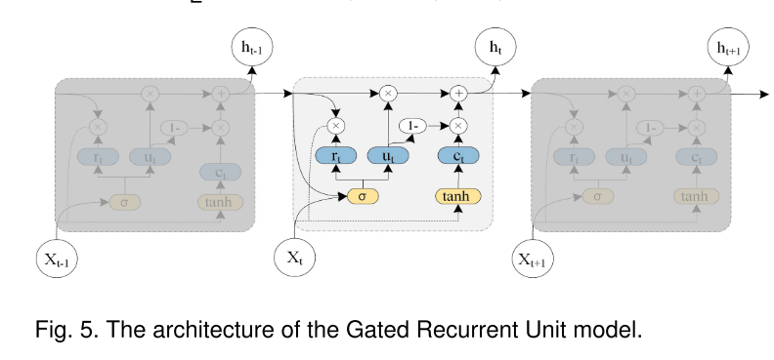
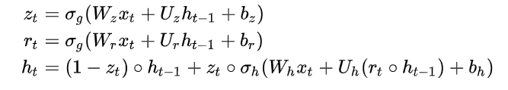
2 Methodology
Temporal dependency modelling
Update gate vector
Reset gate vector

Slide 15
3 Empirical study
Dataset
SZ Taxi
156 major roads
2015-1-1 ~ 2015-1-31
Traffic speed in 15min
Los-loop
207 sensors
2012-5-1 ~ 2012-5-31
Traffic speed in 5min

Slide 16
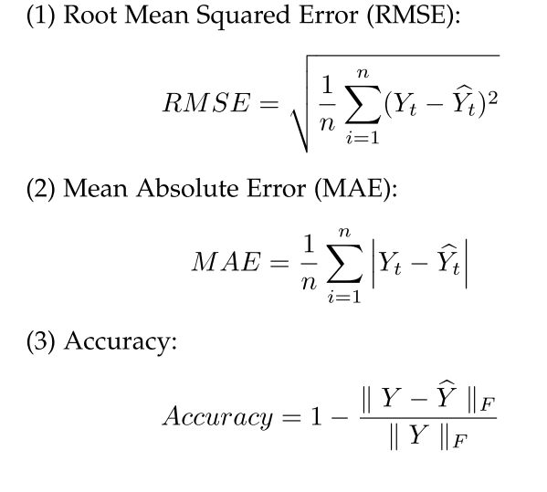
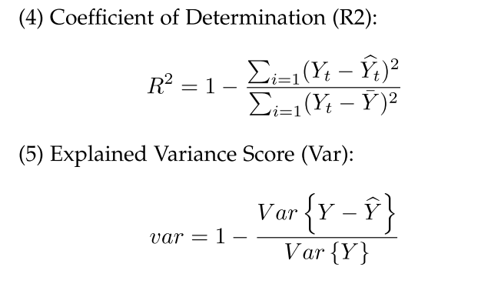
3 Empirical study
Metric

Slide 17
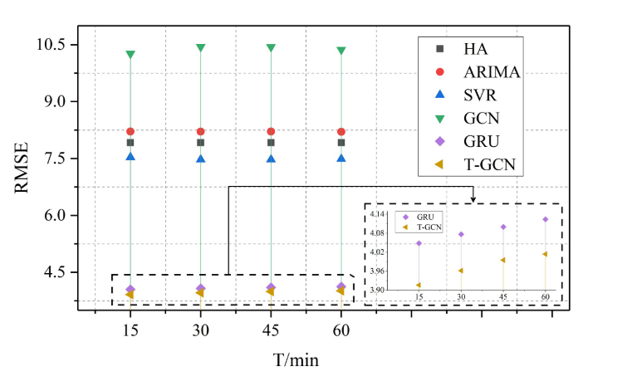
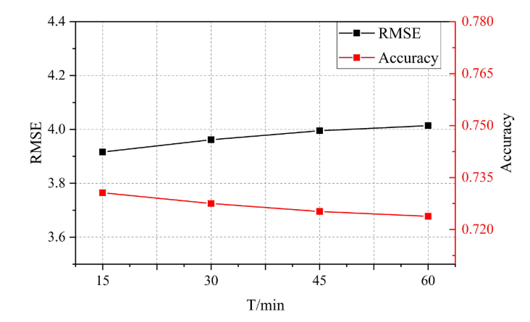
3 Empirical study
Prediction performance

Slide 18
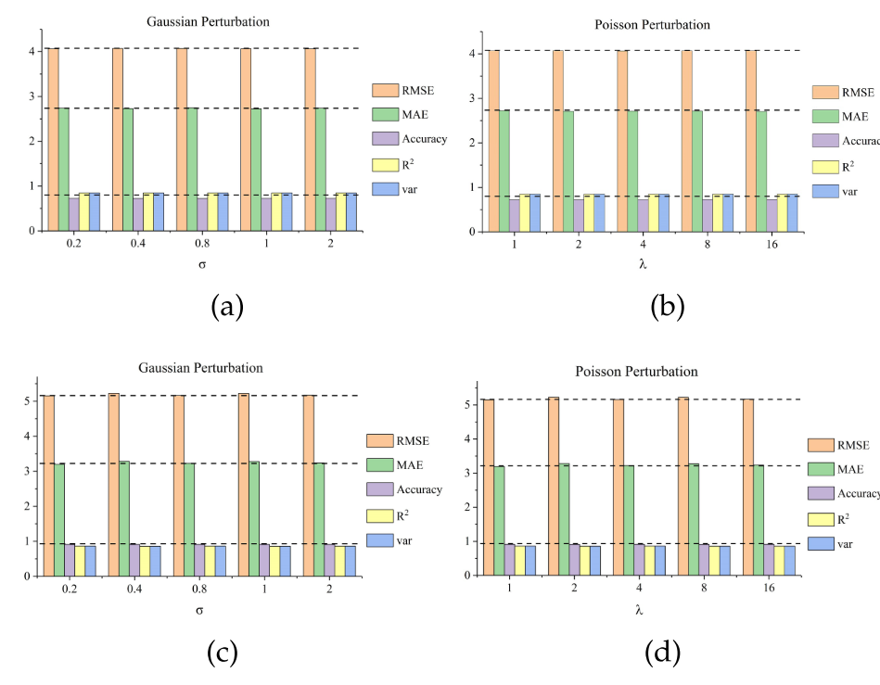
3 Empirical study
Perturbation Analysis and Robustness
Add Gaussian or Poisson noise to test the model
SZ-Test
Metrics change little
Los_Loop

Slide 19
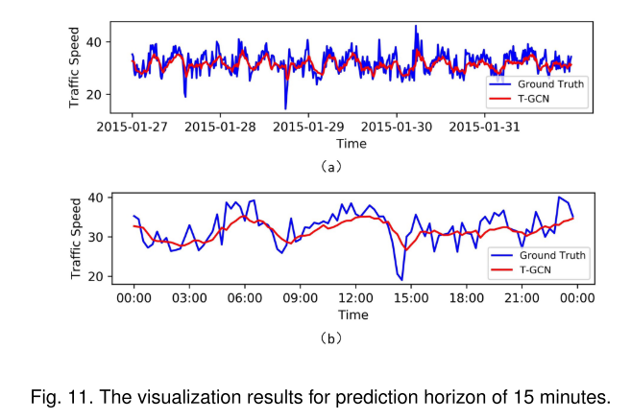
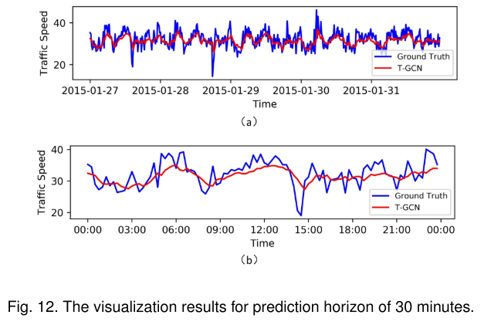
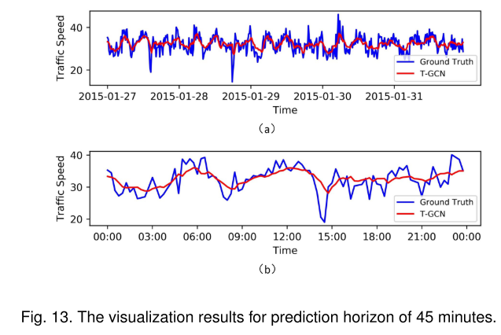
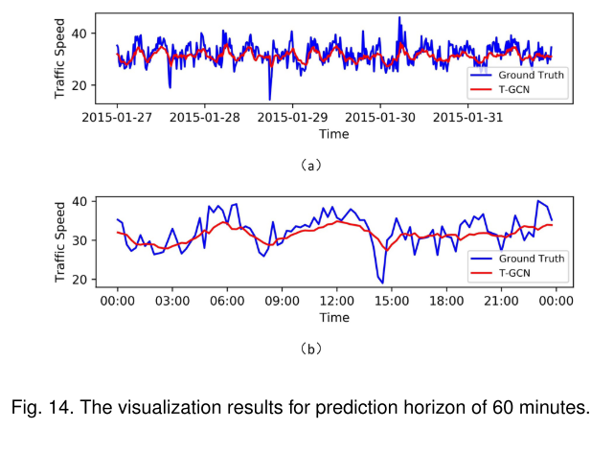
3 Empirical study
Predict poorly in peak : the spatial filter smooths the change
Model interpretation

Slide 20
Thank you for watching !

