Slide 1
Brief review on proceedings for CIKM
Literature review

Slide 2
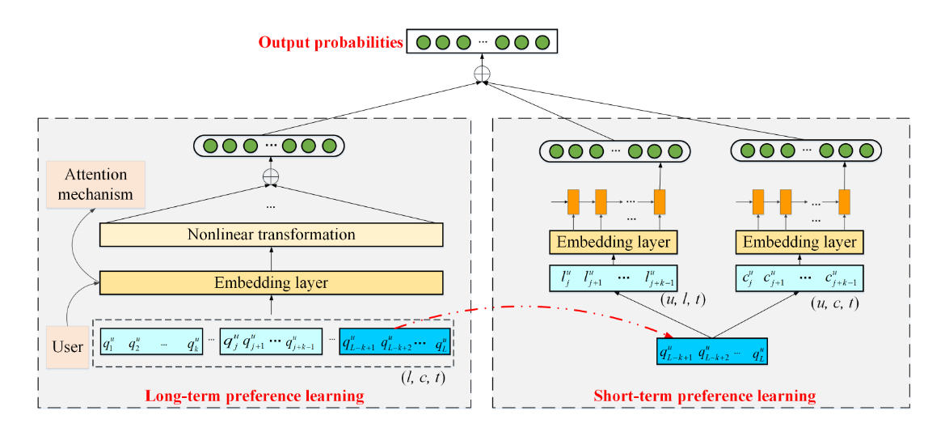
01 Long- and Short-term Preference Learning for Next POI Recommendation
Problem
How to model the user’s general taste and recent sequential behavior as well as context information to capture user preference for next POI
Contribution
Model general state by long term preference
Model recent preference by short-term behaviors
Establish connection to unify two model

Slide 3
01 Long- and Short-term Preference Learning for Next POI Recommendation
Methodology
Connect by weighted summation
Long term learning: Input each user’s record in the form of (location, location category, time)
Short term learning: Input each user’s latest location information

Slide 4
02 Multi-scale Trajectory Clustering to Identify Corridor in Mobile Networks
Problem
Find common mobility human patterns in mobile networks.
Mobile trajectories are coarse, and their granularity varies due to the inconsistent density of cell towers. (related to noise data from FCD)
Contribution
Multi-level trajectory clustering.
Methodology
Trajectories
segments
Group similar segment.
Group similar journey
Data process
Trajectory segmentation
First level clustering
Second level clustering
√ Movement direction
√ Stay time at start and end.
Modified Hausdorff Distance
Hierarchical clustering with grid based strategy

Slide 5
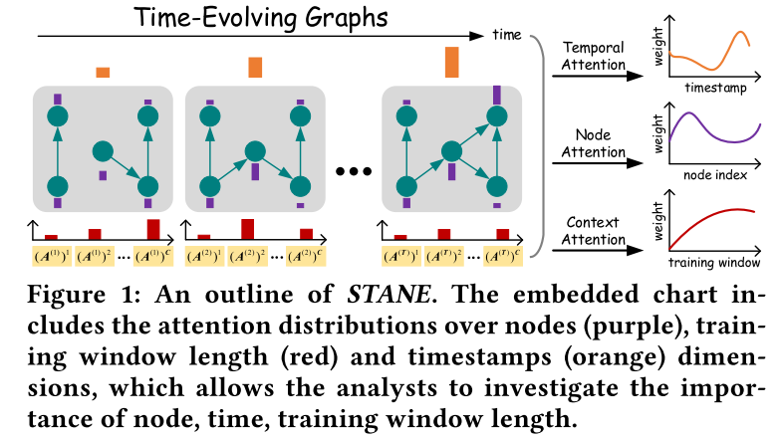
03 Towards Explainable Representation of Time-Evolving Graphs via Spatial-Temporal Graph Attention Networks
Problem
How we can jointly model the spatial and temporal context information and learn a unique network representation, while being able to provide interpretable inference over the observed data.
Contribution
Learn a generic network embedding for time-evolving graphs

Slide 6
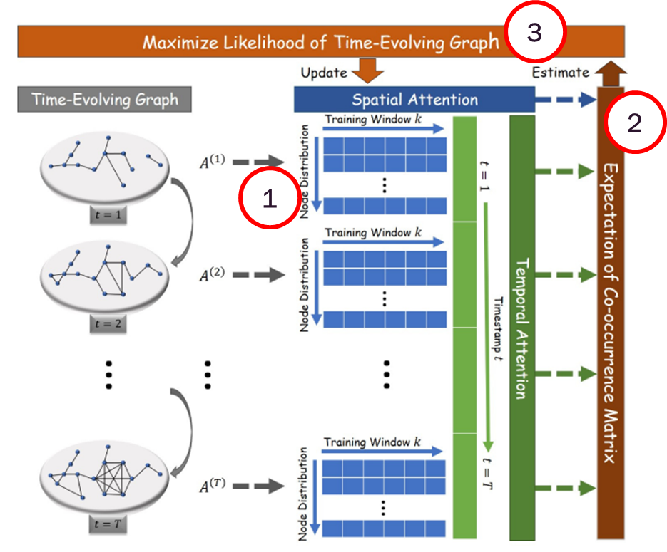
03 Towards Explainable Representation of Time-Evolving Graphs via Spatial-Temporal Graph Attention Networks
Methodology
1
Model time evolving graph in the form of adjacency matrix in different time step
2
Model transition probability matrix with adjacency matrix as input, and utilize attention model to estimate co-occurrence matrix
3
Use co-occurrence matrix as weight to construct MLE problem, then update the attention model and graph representation(latent factors).

Slide 7
04 Time Series Prediction with Interpretable Data Reconstruction
Problem
Most of the prior works fail to identify the most effective frequency components of time series before passing through the prediction.
Contribution
Sequence-to-sequence + LSTM + frequency regulator based on DFT
Major contribution

Slide 8
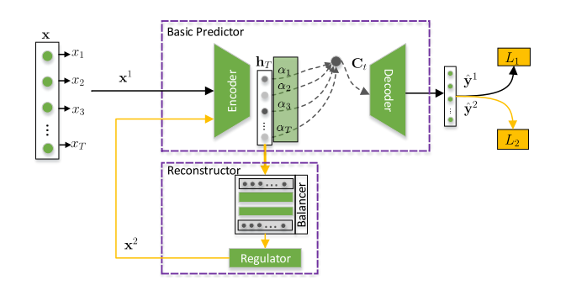
04 Time Series Prediction with Interpretable Data Reconstruction
Methodology
1
1
BPSM: Produce prediction based on seq2seq model with LSTM module. Also use attention module.
Input : raw time series $x^{1}$or reconstructed time series $x^{2}$ (obtain later)

Slide 9




04 Time Series Prediction with Interpretable Data Reconstruction
Methodology
1
2
Regulate raw data with hidden feature from step 1 as input in fourier domain
2
IPR
DFT
IDFT
$$x^{1}$$
$${\tilde{x}}^{1}$$
$${\tilde{x}}^{2}$$
$$x^{2}$$
raw time series
reconstructed time series

Slide 10



04 Time Series Prediction with Interpretable Data Reconstruction
Methodology
Update BPSM based on $L_{1}$
1
2
Update the whole model based on $L_{2}$

Slide 11
05 Path Travel Time Estimation using Attribute-related Hybrid Trajectories Network
Problem
Large-scale data for single trajectory source is not always attainable
Path travel time estimation can be improved with external data.
Contribution
A network model that utilize different trajectory sources and addition attributes (vehicle ID, rainfall level etc.)

Slide 12
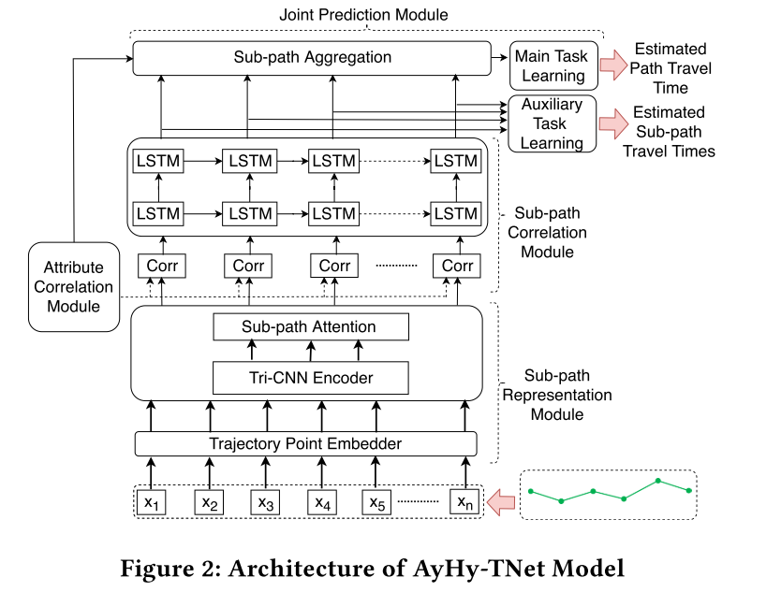
05 Path Travel Time Estimation using Attribute-related Hybrid Trajectories Network
Improve train performance with auxiliary task on sub-path
Methodology
Major contribution
Encode input trajectory from different source
Consider addition attributes (Vehicle ID…)

Slide 13
06 DSANet: Dual Self-Attention Network for Multivariate Time Series Forecasting
Problem
There is complicated non-linear dependencies between time steps and between multiple time series.
Current models can not fit well dynamic-period patterns or nonperiodic patterns.
Contribution
Design dual self-attention network structure
Embed AR in Deep Learning model

Slide 14
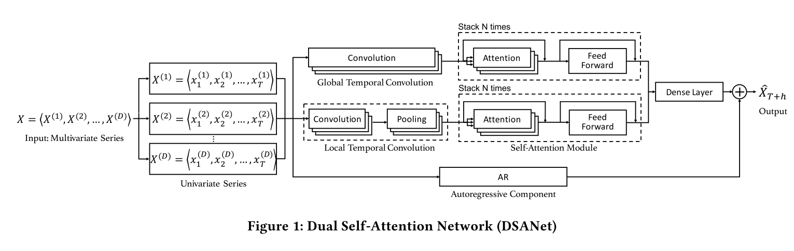
06 DSANet: Dual Self-Attention Network for Multivariate Time Series Forecasting
Methodology
For each univariate time series, implement 1-D convolution on the whole time horizon
1-D convolution on local horizon
AR act as linear part of the prediction while neural network as non-linear part.

Slide 15
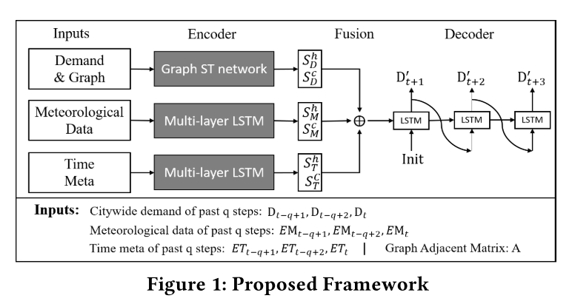
07 Spatio-Temporal Graph Convolutional and Recurrent Networks for Citywide Passenger Demand Prediction
Problem
Predicting multi-step passenger demand is challenging due to its high dynamicity, complex dependencies along spatial and temporal dimensions, and sensitivity to external factors.
Contribution
End-to-end deep learning model
Methodology

Slide 16
08 Learning Traffic Signal Control from Demonstrations
Problem
Reinforcement learning suffers from the prominent exploration problem and even fail to converge in traffic signal control
Contribution
Leverage demonstrations collected from classic methods as expert knowledge to accelerate learning procedure.
Methodology
Basic Actor-critic framework
Train Actor from demonstration
Pretrain policy with demo action
Train Critic from demonstration
Impose the Q value be larger for demo action-state pair

Slide 17
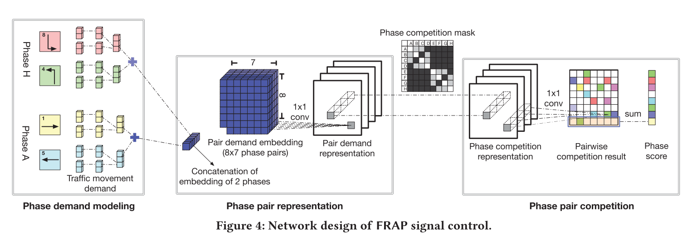
09 Learning Phase Competition for Traffic Signal Control
Problem
In traffic signal control, existing RL methods typically take a long time to converge and the learned models may fail to adapt to new scenarios.
Contribution
Define constraints to limit action space in RL.
Define a Q function to model competition among agents.
Methodology
Phase with higher corresponding current demand should have higher priority

Slide 18
09 Learning Phase Competition for Traffic Signal Control
Problem
In traffic signal control, existing RL methods typically take a long time to converge and the learned models may fail to adapt to new scenarios.
Contribution
Define constraints to limit action space in RL.
Define a Q function to model competition among agents.
Methodology
Q value of each phase depends on other phase, a competitive scheme.

Slide 19
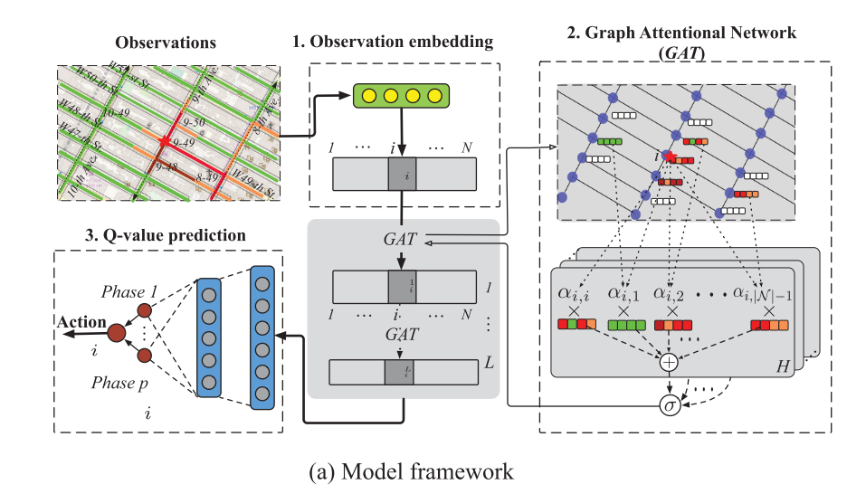
10 CoLight: Learning Network-level Cooperation for Traffic Signal Control
Problem
Conventional method is not suitable for cooperation among the traffic signals given dynamic traffic movements.
Contribution
MARL with graph-attention network to facilitate communication among agents
Methodology

Slide 20
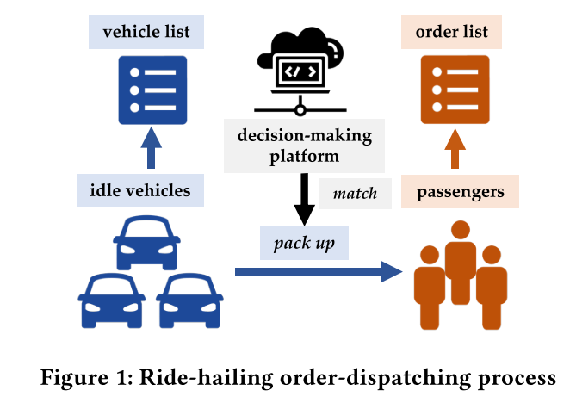
11 Multi-Agent Reinforcement Learning for Order-dispatching via Order-Vehicle Distribution Matching
Problem
For large-scale ride-sharing platforms, there are thousands of vehicles and orders to be matched at every second which is of very high computational cost.
Contribution
Decentralized execution order-dispatching method based on multi-agent reinforcement learning
Define optimization function for the problem considering accumulated driver Income (ADI) and Order response rate (ORR) per day.

Slide 21
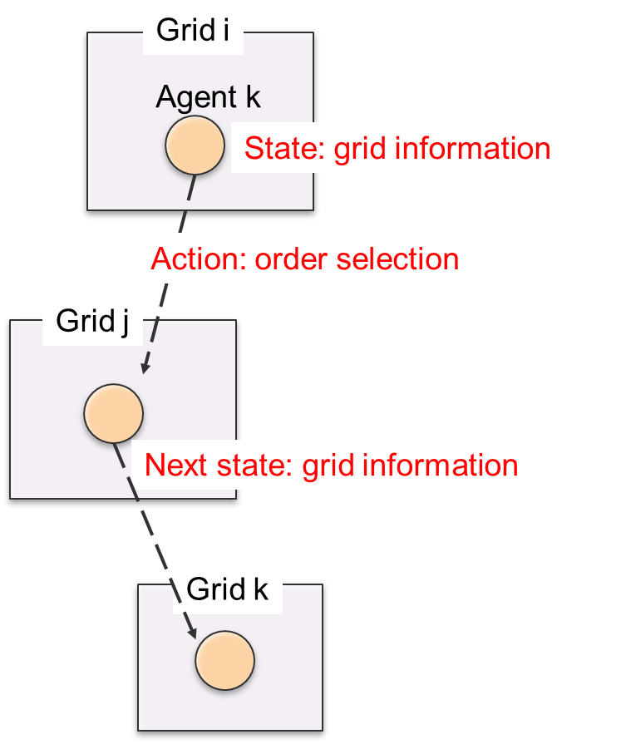
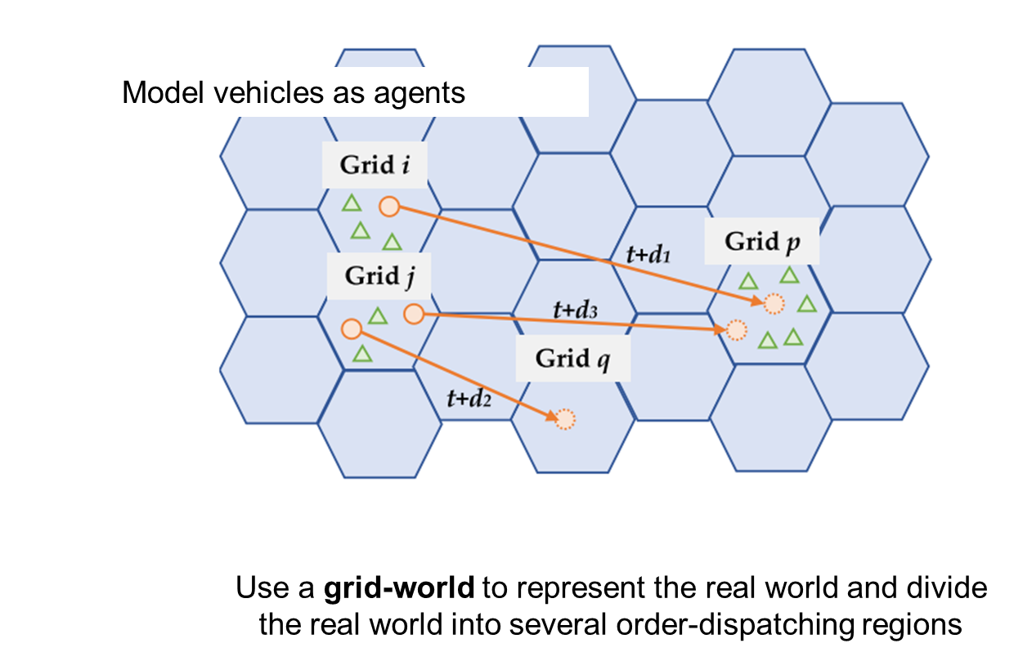
11 Multi-Agent Reinforcement Learning for Order-dispatching via Order-Vehicle Distribution Matching
Methodology

Slide 22
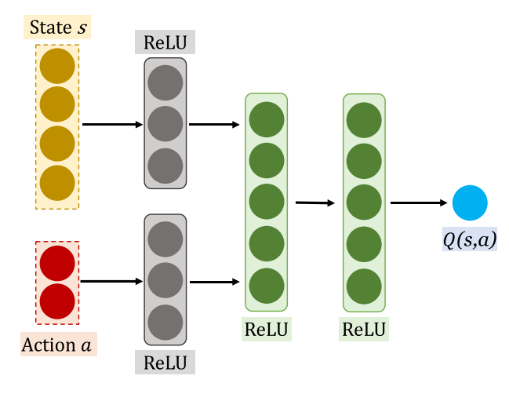
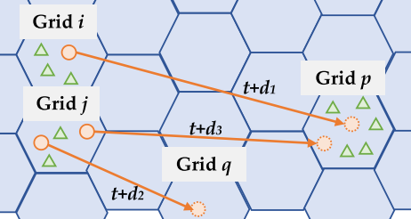
11 Multi-Agent Reinforcement Learning for Order-dispatching via Order-Vehicle Distribution Matching
Methodology
Major contribution
Design Q-value approximator for unfixed action space
Consider agents’ interaction inexplicitly by introducing a centralized optimization from domain knowledge

Slide 23
Thank you for attention !

