Slide 1
Bus bunching and related research
Literature review 04
Notes:
、

Slide 2
Contents
1
Background
2
Traditional methods
3
Advanced methods

Slide 3
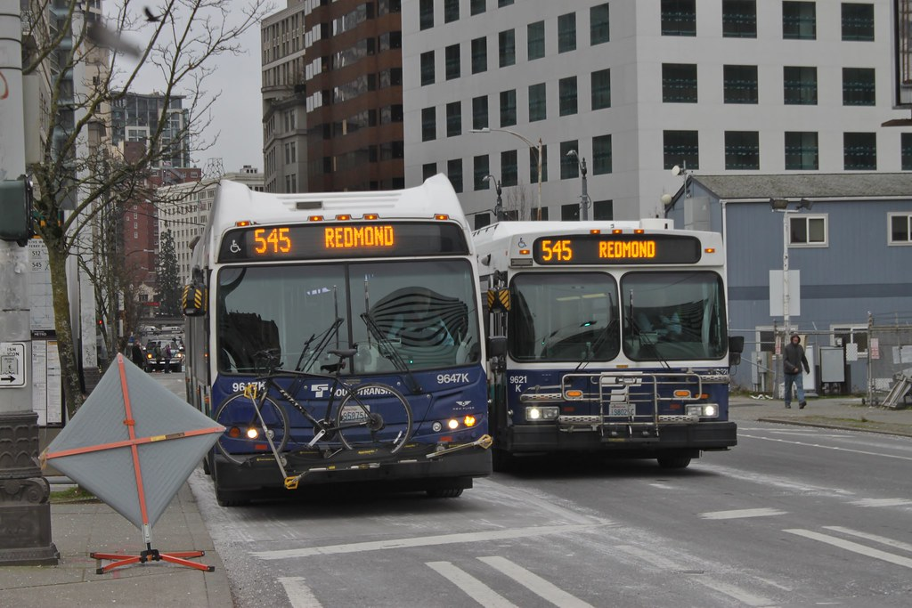
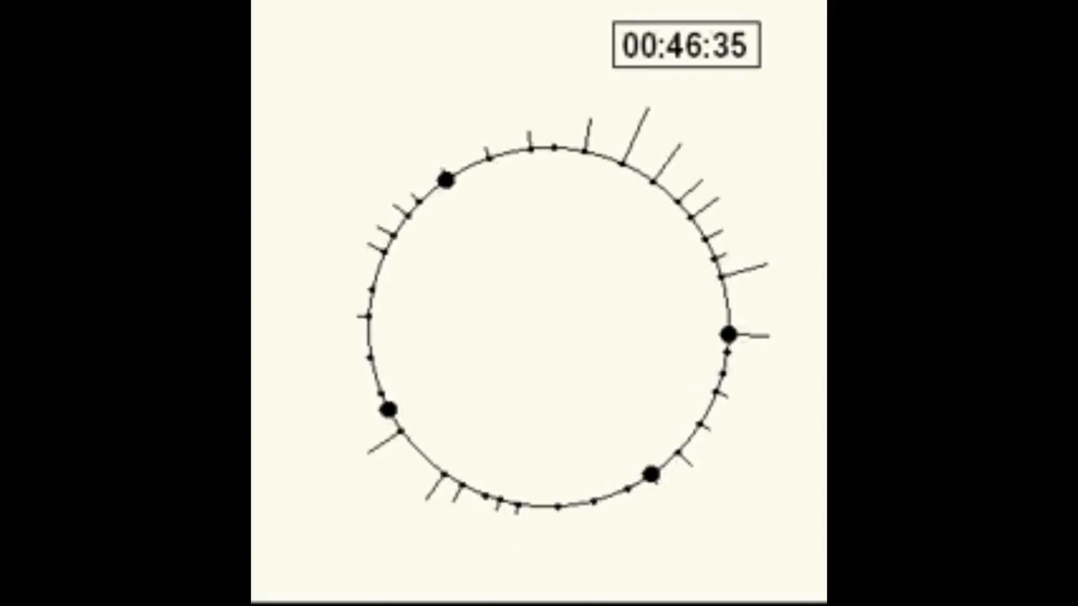
1 Background
What is bus bunching?
What causes bus bunching?
Variability in travel time between stops.
Variability in passenger demands
Notes:
参考文献
Bus bunching original:
Newell G F, Potts R B. Maintaining a bus schedule[C]//Australian Road Research Board (ARRB) Conference, 2nd, 1964, Melbourne. 1964, 2(1).
How much can holding and/or limiting boarding improve transit performance?

Slide 4
1 Background
What is bus bunching?
What causes bus bunching?
Variability in travel time between stops.
Variability in passenger demands
positive feedback mechanism

Slide 5
1 Background
What is bus bunching?
What causes bus bunching?
Variability in travel time between stops.
Variability in passenger demands
What is the result of bus bunching?
Waste bus capacity and causes unevenness in public transportation resource
Worsen both the magnitude and variability of average waiting times
positive feedback mechanism

Slide 6
1 Background
What is bus bunching?
What causes bus bunching?
Variability in travel time between stops.
Variability in passenger demands
What is the result of bus bunching?
Waste bus capacity and causes unevenness in public transportation resource
Worsen both the magnitude and variability of average waiting times
positive feedback mechanism
Impact the level of service & Undermine the reliability of bus system

Slide 7
1 Traditional methods
Strategies
Skipping stops
Holding buses
Adjust cruising speed
Boarding limits
Solutions:
Control
the control approach can systematically account for the uncertainties due to traffic and demand while reducing the commercial speed only slightly.
Optimization
Notes:
各自文献
The real-time stop-skipping problem
An analysis of consumer preferences for a public transportation system

Slide 8
1 Traditional methods
Skipping stops
The formulations of Li, Rousseau, and Gendreau (1991), Lin
et al. (1995), Eberlein (1995), and Fu and Liu (2003) all formulated the real-time stop-skipping problem as a decision problem solved during vehicle dispatch from the terminal. In those studies, the underlying assumption is that, as soon as the vehicle is dispatched from the terminal, the prescribed skipping stops (or skipped segment) cannot be changed.
Sun(2005) moves a step further to investigate the possibility of implementing stop-skipping control in a real-time manner. The proposed control policy allows the control vehicle to drop off the onboard passengers at the same stops as they planned to alight, even when their destination stops are already prescribed to be skipped by the control vehicle.
Notes:
Li,Y., Rousseau, J.-M., and Gendreau, M. (1991). Real-time scheduling on a transit bus route: A 0–1 stochastic programming model, Pro- ceedings of the Thirty-Third Annual Meeting, Transportation Re- search Forum, 157–166.
Lin, G., Liang, P., Schonfeld, P., and Larson, R. (1995). Adaptive Con- trol of Transit Operations, Final Report for Project MD–26–7002, US
Eberlein, X.-J. (1995). Real-time control strategies in transit operations: Models and analysis, Ph.D. Dissertation, Department of Civil and Environmental Engineering, Massachusetts Institute of Technology
Fu, L. and Liu, Q. (2003). A real-time optimization model for dynamic scheduling of transit operations, 82nd Annual Meeting of the Trans- portation Research Board, Washington, DC.
Sun, A., & Hickman, M. (2005). The real-time stop-skipping problem. Journal of Intelligent Transportation Systems, 9(2), 91–109. https://doi.org/10.1080/15472450590934642
.

Slide 9
1 Traditional methods
Adjusting cruising speed
Daganzo(2011) yields regular headway with faster bus travel by adjusting cruising speed:
1) Model the bus dynamic to illustrate the fact that more passenger arrival results in lower cruising speed.
Notes:
Daganzo, C. F., & Pilachowski, J. (2011). Reducing bunching with bus-to-bus cooperation. Transportation Research Part B: Methodological, 45(1), 267–277. https://doi.org/10.1016/j.trb.2010.06.005

Slide 10
1 Traditional methods
Holding buses
Basic implementation: transit agencies insert slack into their schedules, and require buses (or transit vehicles) to depart on time at predefined control points along the route. The slack is calculated so buses can make up time lost due to random recurrent travel disruptions between control points, but slack reduces the commercial speed of the buses, so it cannot be too big. To limit the total amount of bus delay, control points are spaced widely so that typical routes include only a few. Analytical
Notes:
, C. F. (2009). A headway-based approach to eliminate bus bunching: Systematic analysis and comparisons. Transportation Research Part B: Methodological, 43(10), 913–921. https://doi.org/10.1016/j.trb.2009.04.002

Slide 11
1 Traditional methods
Holding buses
Single point control:
Pioneer work: Osuna and Newell (1972), Barnett (1974), Newell (1974), Ignall and Kolesar (1974)
Most recently: Hickman (2001) ,Zhao et al. (2006), Daganzo(2009), Bartholdi and Eisentein (2012)
single-point control cannot suc-ceed for long routes with frequent service and a strong bunching tendency.
Notes:
Osuna, E.E., Newell, G.F., 1972. Control strategies for an idealized bus system. Transportation Science 6 (1), 52–71
Barnett, A., 1974. On controlling randomness in transit operations. Transportation Science 8 (2), 102–116.
Newell, G.F., 1974. Control of pairing of vehicles on a public transportation route, two vehicles, one control point. Transportation Science 8 (3), 248–264. Newell,
Ignall, E., Kolesar, P., 1974. Optimal dispatching of an infinite capacity shuttle: Control at a single terminal. Operations Research 22 (5), 1008–1024.
Hickman, M.D., 2001. An analytic stochastic model for the transit vehicle holding problem. Transportation Science 35 (3), 215–237.
Zhao, J., Dessouky, M., Bukkapatnam, S., 2006. Optimal slack time for schedule-based transit operations. Transportation Science 40 (4), 529–539
Daganzo, C. F. (2009). A headway-based approach to eliminate bus bunching: Systematic analysis and comparisons. Transportation Research Part B: Methodological, 43(10), 913–921. https://doi.org/10.1016/j.trb.2009.04.002
Bartholdi, J. J., & Eisenstein, D. D. (2012). A self-coördinating bus route to resist bus bunching. Transportation Research Part B: Methodological, 46(4), 481–491. https://doi.org/10.1016/j.trb.2011.11.001

Slide 12
1 Traditional methods
Holding buses
Schedule based: Zhao et al. (2006) ,Wu et al(2016)
Headway based:Xuan et al (2011) proposed a set of control strategies by integrating both the forward headway and backward headway information. It was found that the headway regularity can be further improved compared to the previous headway-based methods. The work is extended by Argote-Cabanero et al. (2016) to be scalable for multi-line systems, taking into account the interaction among different bus lines.
Both target schedules and target headways attempt to realize a pre-specified static value of headway. We consider this a technical weakness in both approaches, because the ideal achievable headway is not static and not even knowable in advance
Notes:
Zhao, J., Dessouky, M., Bukkapatnam, S., 2006. Optimal slack time for schedule-based transit operations. Transportation Science 40 (4), 529–539
Wu, W., Liu, R. Jin, W., 2016. Designing robust schedule coordination scheme for transit networks with safety control margins. Transportation Research Part B, 93, 495-519.
Xuan, Y.G., Arogte, J., Daganzo, C.F., 2012. Dynamic bus holding strategies for schedule reliability: optimal linear control and performance analysis. Transportation Research Part B, 45(10), 1831-1845.
Argote-Cabanero, J., Daganzo, C.F., Lynn, J.W., 2015. Dynamic control of complex transit systems. Transportation Research Part B, 81, 146-160.

Slide 13
1 Traditional methods
Holding buses
Schedule free: Zhao et al. (2006) Bartholdi(2012) Deigado(2009)
Zhao, J., Dessouky, M., Bukkapatnam, S., 2006. Optimal slack time for schedule-based transit operations. Transportation Science 40 (4), 529–539
Bartholdi, J. J., & Eisenstein, D. D. (2012). A self-coördinating bus route to resist bus bunching. Transportation Research Part B: Methodological, 46(4), 481–491. https://doi.org/10.1016/j.trb.2011.11.001
Delgado, F., Muñoz, J. C., Giesen, R., & Cipriano, A. (2009). Real-time control of buses in a transit corridor based on vehicle holding and boarding limits. Transportation Research Record, (2090), 59–67. https://doi.org/10.3141/2090-07
Notes:
各自文献
The real-time stop-skipping problem
An analysis of consumer preferences for a public transportation system

Slide 14
1 Traditional methods
Holding buses
Optimization based: Sánchez-Martínez et al. (2016) formulated an effective dynamic holding optimization model that can reflect dynamic running times and demand.
Notes:
Sánchez-Martínez, G. E., Koutsopoulos, H. N., & Wilson, N. H. M. (2016). Real-time holding control for high-frequency transit with dynamics. Transportation Research Part B: Methodological, 83, 1–19. https://doi.org/10.1016/j.trb.2015.11.013

Slide 15
1 Traditional methods
Boarding limits
Zhao(2016) abandons the idea of target headway or schedule. Proposed passenger rejection based control scheme. The scheme is basically equalize two adjacent headway at control point, with such scheme, bus drivers need not pay much attention to the schedule and there is no addition wasting time for buses.
Delgado(2009,2012) come up with a optimzation problem exploring how to combine both the holding strategy and boarding limits to avoid bus bunching, with the objective to minimize the sum of individual travel times of all passengers.
Notes:
Zhao, S., Lu, C., Liang, S., & Liu, H. (2016). A Self-Adjusting Method to Resist Bus Bunching Based on Boarding Limits. Mathematical Problems in Engineering, 2016. https://doi.org/10.1155/2016/8950209
Delgado, F., Munoz, J. C., & Giesen, R. (2012). How much can holding and/or limiting boarding improve transit performance? Transportation Research Part B: Methodological, 46(9), 1202–1217. https://doi.org/10.1016/j.trb.2012.04.005
Delgado, F., Muñoz, J. C., Giesen, R., & Cipriano, A. (2009). Real-time control of buses in a transit corridor based on vehicle holding and boarding limits. Transportation Research Record, (2090), 59–67. https://doi.org/10.3141/2090-07

Slide 16
1 Traditional methods
Bus subsititution
Petit A(2019) suggests a dynamic bus substitution strategy for multiple bus lines, where standby buses are dispatched to take over service from late/early buses.
Petit, A., Lei, C., & Ouyang, Y. (2019). Multiline Bus Bunching Control via Vehicle Substitution. Transportation Research Part B: Methodological, 126, 68–86. https://doi.org/10.1016/j.trb.2019.05.009
Notes:
综合

Slide 17
References:
[1] Xuan, Y., Argote, J., & Daganzo, C. F. (2011). Dynamic bus holding strategies for schedule reliability: Optimal linear control and performance analysis. Transportation Research Part B: Methodological, 45(10), 1831–1845. https://doi.org/10.1016/j.trb.2011.07.009
[2] Daganzo, C. F., & Pilachowski, J. (2011). Reducing bunching with bus-to-bus cooperation. Transportation Research Part B: Methodological, 45(1), 267–277. https://doi.org/10.1016/j.trb.2010.06.005
[3] Chen, W., Zhou, K., & Chen, C. (2016). Real-Time bus holding control on a transit corridor based on multi-Agent reinforcement learning. IEEE Conference on Intelligent Transportation Systems, Proceedings, ITSC, 0, 100–106. https://doi.org/10.1109/ITSC.2016.7795538
[4] Pilachowski, J. M. (2013). An Approach to Reducing Bus Bunching Permalink. Ensemble, 15(4), 250–260. https://doi.org/10.11436/mssj.15.250
[5] Andres, M., & Nair, R. (2017). A predictive-control framework to address bus bunching. Transportation Research Part B: Methodological, 104, 123–148. https://doi.org/10.1016/j.trb.2017.06.013
[6] Delgado, F., Munoz, J. C., & Giesen, R. (2012). How much can holding and/or limiting boarding improve transit performance? Transportation Research Part B: Methodological, 46(9), 1202–1217. https://doi.org/10.1016/j.trb.2012.04.005
[7] Newell G F, Potts R B. Maintaining a bus schedule[C]//Australian Road Research Board (ARRB) Conference, 2nd, 1964, Melbourne. 1964, 2(1).
[8] Golob, T. F., Canty, E. T., Gustafson, R. L., & Vitt, J. E. (1972). An analysis of consumer preferences for a public transportation system. Transportation Research, 6(1), 81–102. https://doi.org/10.1016/0041-1647(72)90113-X
[9] Sun, A., & Hickman, M. (2005). The real-time stop-skipping problem. Journal of Intelligent Transportation Systems, 9(2), 91–109. https://doi.org/10.1080/15472450590934642

Slide 18
References:
[1] Xuan, Y., Argote, J., & Daganzo, C. F. (2011). Dynamic bus holding strategies for schedule reliability: Optimal linear control and perform

Slide 19
Thank you for attention !

Slide 20
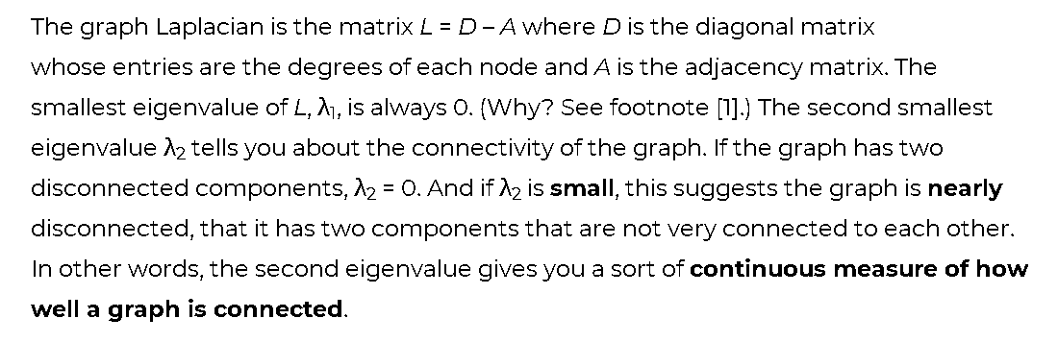
2 Kernels and Regularization on Graph
Notes:
Now we go back to regularization on graph
Here r(˜L) is understood as applying the scalar valued function r(λ) to the eigen- values of ˜L, that is,

