Slide 1
Multiline bus control with asynchronous multiagent reinforcement learning
Research progress
Jiawei Wang
6/19/2020

Slide 2
Contents
1
Background
2
Methodology
3
Eexperimental progress

Slide 3
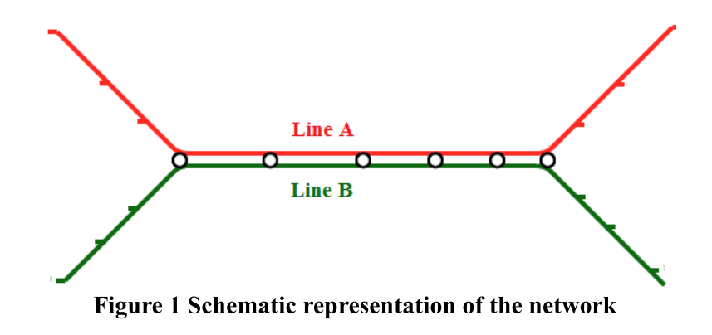
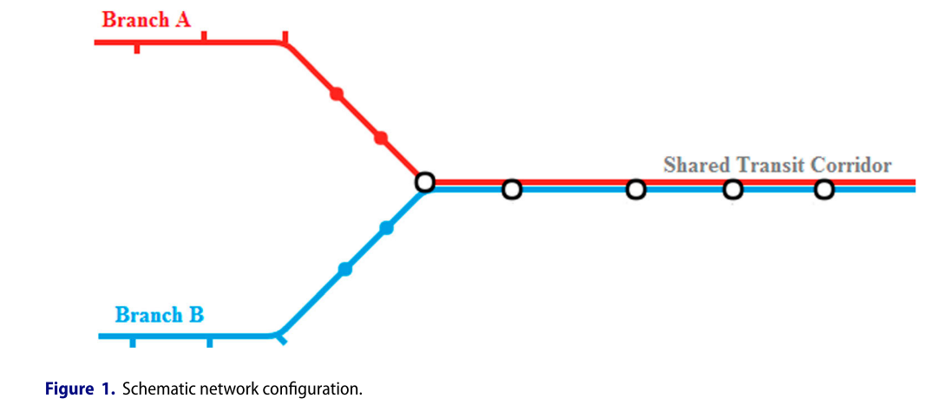
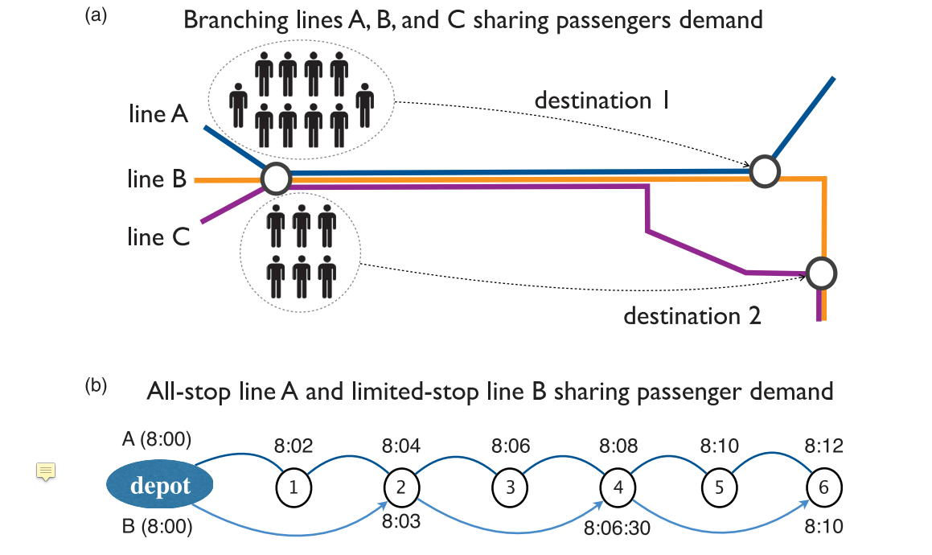
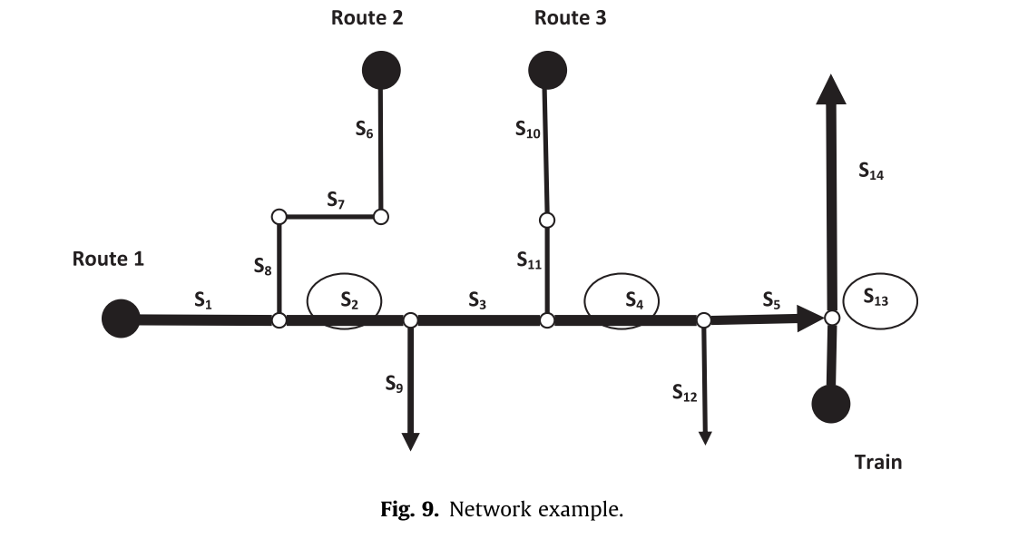
1 Background
Problem statement
In transit network, multiple bus lines usually share the same corridor along their routes.

Slide 4
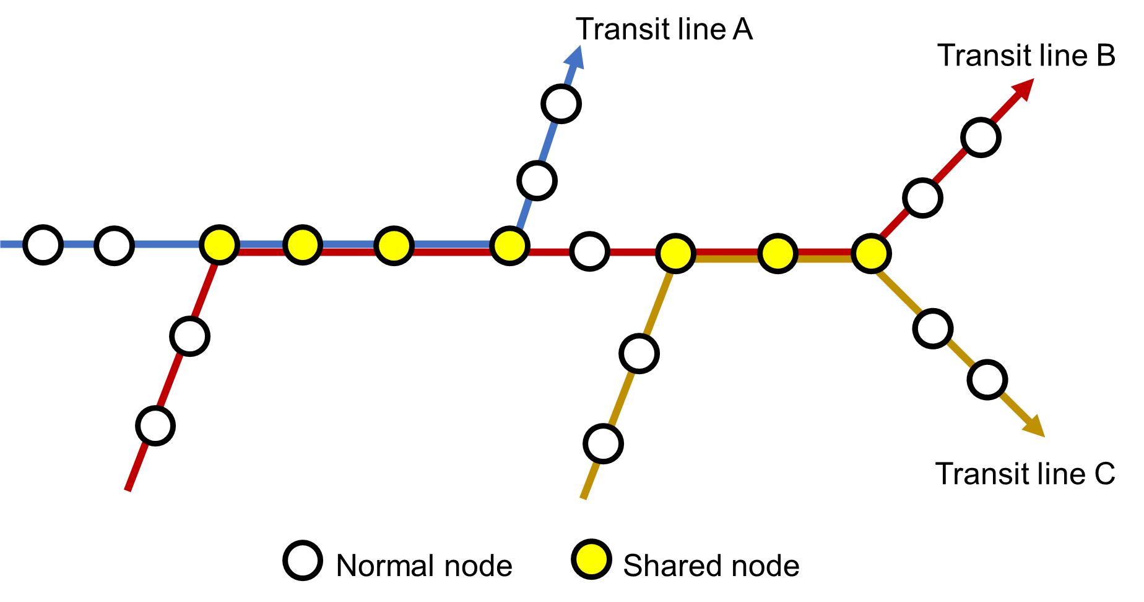


1 Background
Problem statement

Slide 5
1 Background
Problem statement
How to regularize buses from the same route to avoid bus bunching?
regularize

Slide 6
1 Background
Problem statement
How to regularize buses from the same route to avoid bus bunching?
How to synchronize buses from different routes on the shared corridor to reduce transfer cost?
regularize
synchronize

Slide 7
1 Background
Past studies
Polices
Holding control
Bus substitution
Stop skipping
On-road speed control
Boarding limits
Combined based some rules…

Slide 8
1 Background
Past studies
Polices
Holding control
Flexible and less frustrated for passengers
Bus substitution
Stop skipping
On-road speed control
Boarding limits
Combined based some rules…

Slide 9
1 Background
Past studies
Polices
Holding control
Bus substitution
Stop skipping
On-road speed control
Boarding limits
Combined based some rules…
Solutions
Approaches
Objectives
Analytical optimization
Waiting time minimization
Global optimal but onerous
Heuristic optimization
Headway regularization
Local optimal but quick

Slide 10
1 Background
Past studies
Require an explicit dynamic model for the environment
Can not learn from past

Slide 11
1 Background
Past studies
MDRL
Require an explicit dynamic model for the environment
Can not learn from past
Model-free
Learn to explore more efficient and viable cooperation

Slide 12








2 Methodology
Model
Agents
$$⋯$$
Route 1 section 1
Bus stop
$$⋮$$
$$⋯$$
Route 1 section k
$$⋮$$
$$⋯$$
Route n section 1
$$⋮$$
Route n section k
$$⋯$$

Slide 13
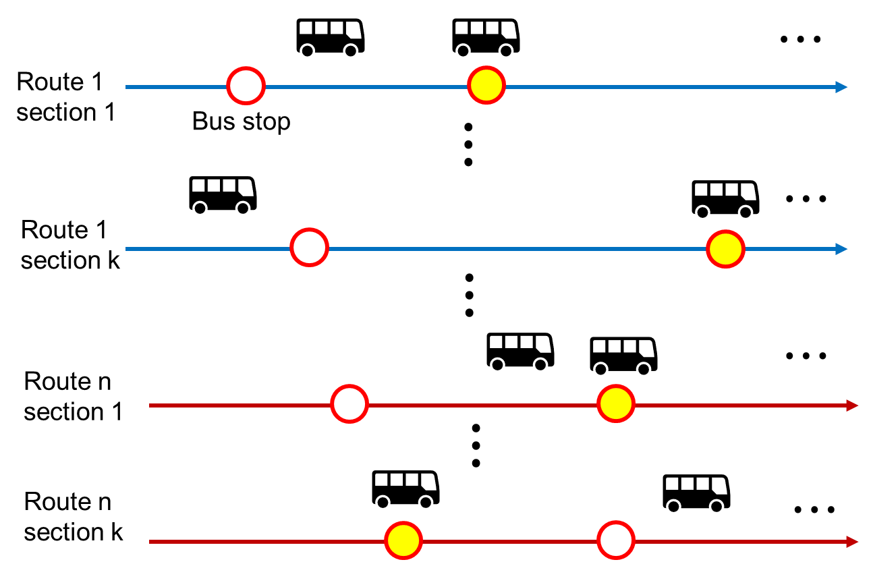
2 Methodology
At time step t
Challenges
Each agent acts asynchronously because of different arrival period
How to achieve stable and cooperative control in asynchronous setting?

Slide 14
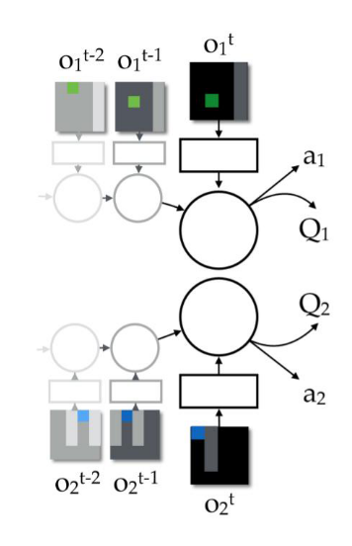
2 Methodology
Related studies
Independent Q learning
Solution: Each agent independently learns its own policy, treating other agents as part of the environment.
Problem: In general, each agent is faced with a non-stationary learning problem because the dynamics of its environment effectively changes as teammates change their behaviors through learning.

Slide 15
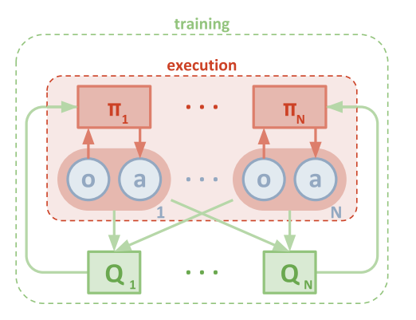
2 Methodology
Related studies
Policy based
[1] Multi-Agent Actor-Critic for Mixed Cooperative-Competitive Environments
Solution: Estimate actions of other agent for critic to evaluate current policy
Problem: In asynchronous setting, action estimation is less necessary since less agents act simultaneously .

Slide 16
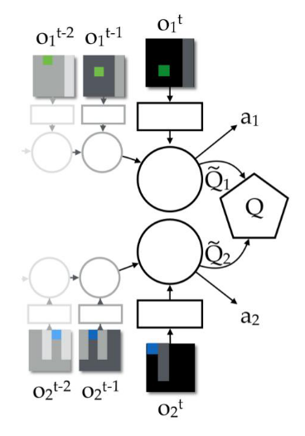


2 Methodology
Related studies
Value based
[2] Value-Decomposition Networks For Cooperative Multi-Agent Learning Based On Team Reward Extended
[3] QMIX: Monotonic Value Function Factorization for Deep Multi-Agent Reinforcement Learning
Solution: Estimate joint action-value function for the system can be additively decomposed into value functions across agents.
Problem:
They do not consider asynchronous problem
Limited to local observation and discrete action.
Strong assumption on joint value and local value.
Less flexible with centralized setting
Notes:
1

Slide 17
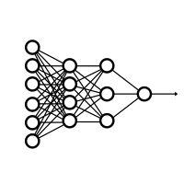

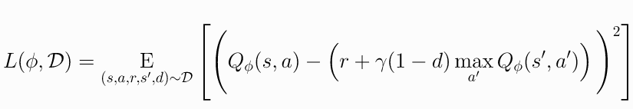


2 Methodology
Proposed method
DDPG actor-critic framework to model continuous action
Incorporate asynchronous actions to conduct credit assignment
Action $μ_{θ}(s)$
State s
Q value $Q_{φ}(s,a)$
State s
Actor
Critic
Traditional setting of ddpg

Slide 18
2 Methodology
Proposed method
DDPG actor-critic framework to model continuous action
Incorporate asynchronous actions to conduct credit assignment
In multi-agent case, the Q is ambiguous
Action $μ_{θ}(s)$
State s
Q value $Q_{φ}(s,a)$
State s
Actor
Critic
Traditional setting of ddpg

Slide 19
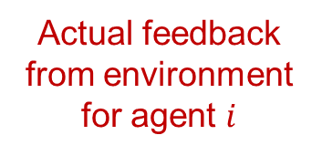

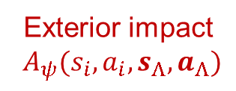


2 Methodology
Proposed method
DDPG actor-critic framework to model continuous action
Incorporate asynchronous actions to conduct credit assignment
Action $μ_{θ}(s_{i})$
State s
Q value $Q_{φ}(s_{i},a_{i})$
State s
Actual feedback from environment for agent $i$
Actor
Ego Critic
$$G_{i}$$
Exterior impact
$A_{ψ}(s_{i},a_{i},s_{Λ},a_{Λ})$
Exterior Critic
Proposed asynchronous framework

Slide 20
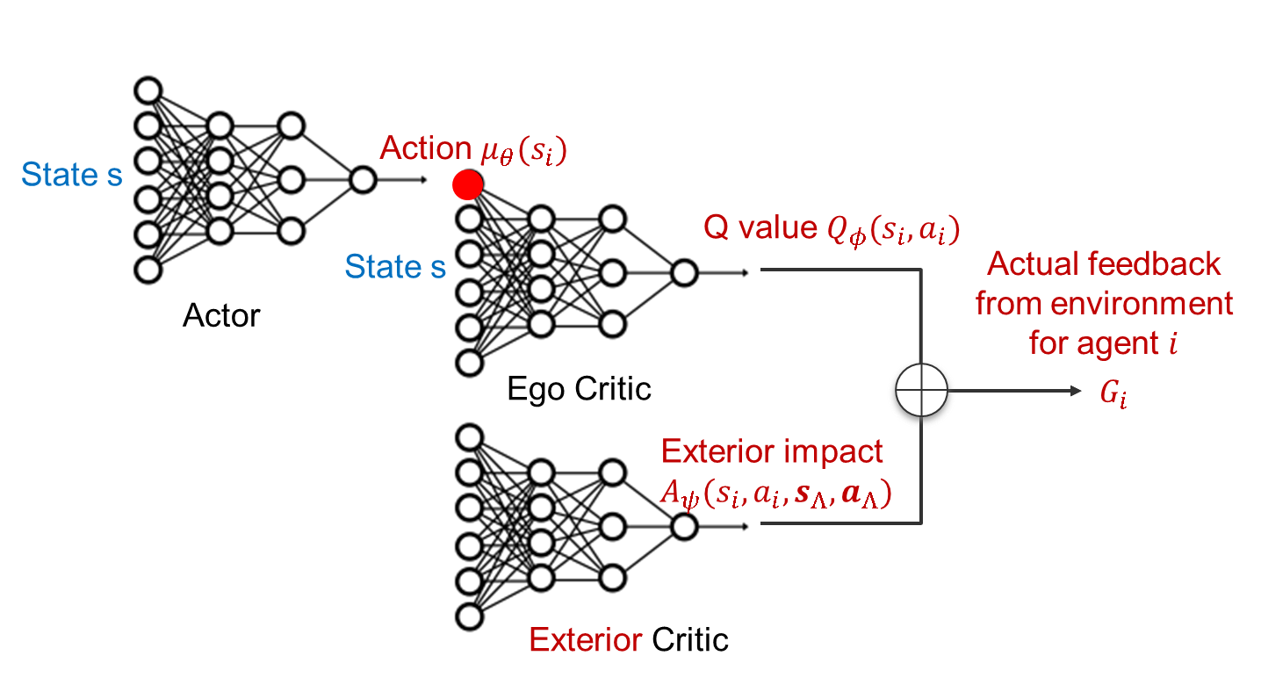
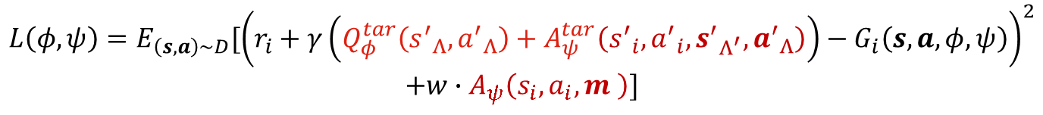
2 Methodology
Proposed method
DDPG actor-critic framework to model continuous action
Incorporate asynchronous actions to conduct credit assignment
$$L\left(φ,ψ\right)=E_{\left(s,a\right)\sim D}[{\left(r_{i}+γ\left(Q_{φ}^{tar}\left({s^{′}}_{Λ},{a^{′}}_{Λ}\right)+A_{ψ}^{tar}\left({s^{′}}_{i},{a^{′}}_{i},{s^{′}}_{Λ^{′}},{a^{′}}_{Λ}\right)\right)−G_{i}\left(s,a,φ,ψ\right)\right)}^{2}$$
$$+w∙A_{ψ}\left(s_{i},a_{i},m \right)]$$

Slide 21
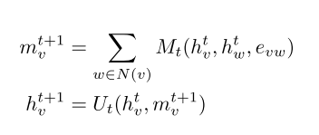
2 Methodology
Proposed method
DDPG actor-critic framework to model continuous action
Incorporate asynchronous actions to conduct credit assignment
Message Passing Neural Networks

Slide 22




2 Methodology
Control and learning
For each bus $i$, a piece of experience is collected every 3 consecutive arrivals
Experience k
Bus $i$
$$⋯$$
k arrival
k+1 arrival
k+2 arrival
State $s_{i}=[s_{i}^{local},s_{i}^{global} ]$
Local observation $s_{i}^{local}$
1. Forward headway from the bus on the same route
2. Backward headway from the bus on the same route
3. Backward headway from the bus on different route in transfer stop
4. Waiting passengers / capacity
5. Transfer stop one-hot indicator
Global observation $s_{i}^{global}$
Snap shot of all stops (Waiting passengers,Transferring passengers)
Historical arrival rate

Slide 23


2 Methodology
Control and learning
For each bus $i$, a piece of experience is collected every 3 consecutive arrivals
Experience k
Bus $i$
$$⋯$$
k arrival
k+1 arrival
k+2 arrival
State $s_{i}=[s_{i}^{local},s_{i}^{global} ]$
Local observation $s_{i}^{local}$
1. Forward headway from the bus on the same route
2. Backward headway from the bus on the same route
3. Backward headway from the bus on different route in transfer stop
4. Waiting passengers / capacity
5. Transfer stop one-hot indicator
Global observation $s_{i}^{global}$
Snap shot of all stops (Waiting passengers,Transferring passengers)
Historical arrival rate
$$s_{i}^{global}=A_{i}O_{t}$$

Slide 24

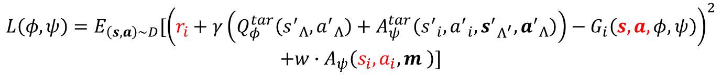
2 Methodology
Control and learning
For each bus $i$, a piece of experience is collected every 3 consecutive arrivals
Experience k (current asynchronous situation organization)
Bus $i$
$$⋯$$
k arrival
k+1 arrival
k+2 arrival
Impact collection: Collect information on stops where arrivals occur
$$L\left(φ,ψ\right)=E_{\left(s,a\right)\sim D}[{\left(r_{i}+γ\left(Q_{φ}^{tar}\left({s^{′}}_{Λ},{a^{′}}_{Λ}\right)+A_{ψ}^{tar}\left({s^{′}}_{i},{a^{′}}_{i},{s^{′}}_{Λ^{′}},{a^{′}}_{Λ}\right)\right)−G_{i}\left(s,a,φ,ψ\right)\right)}^{2}$$
$$+w∙A_{ψ}\left(s_{i},a_{i},m \right)]$$
Experience for formulating objective function

Slide 25


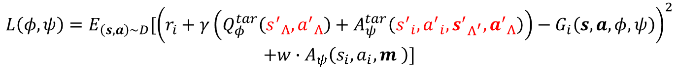
2 Methodology
Control and learning
For each bus $i$, a piece of experience is collected every 3 consecutive arrivals
Experience k (next asynchronous situation organization)
Bus $i$
$$⋯$$
k arrival
k+1 arrival
k+2 arrival
Impact collection: Collect information on stops where arrivals occur
$$L\left(φ,ψ\right)=E_{\left(s,a\right)\sim D}[{\left(r_{i}+γ\left(Q_{φ}^{tar}\left({s^{′}}_{Λ},{a^{′}}_{Λ}\right)+A_{ψ}^{tar}\left({s^{′}}_{i},{a^{′}}_{i},{s^{′}}_{Λ^{′}},{a^{′}}_{Λ}\right)\right)−G_{i}\left(s,a,φ,ψ\right)\right)}^{2}$$
$$+w∙A_{ψ}\left(s_{i},a_{i},m \right)]$$
Experience for formulating objective function

Slide 26
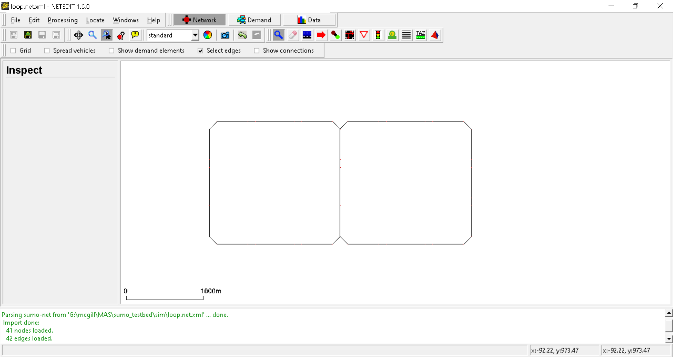
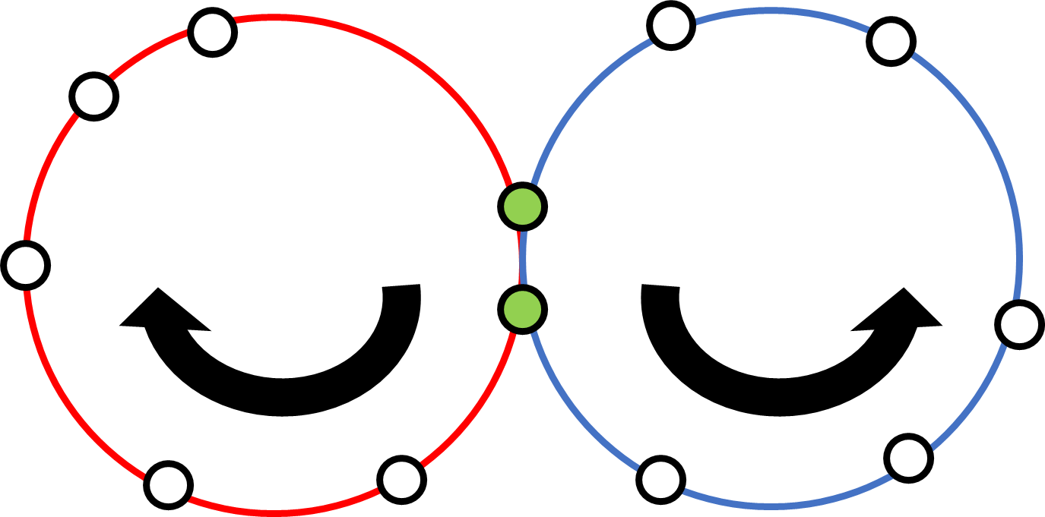
3 Experimental progress
Work have done so far
Experiment setting
Testbed
Simulation engine: sumo 1.6.0
Algorithm: pytorch 10.2
Scenario
20 bus stops with 2 shared stops (passenger can transfer at shared stops)
Two bus routes with 8 buses for each
Transfer rate: 0.1 (10% passengers need to transfer)
Simulation network

Slide 27
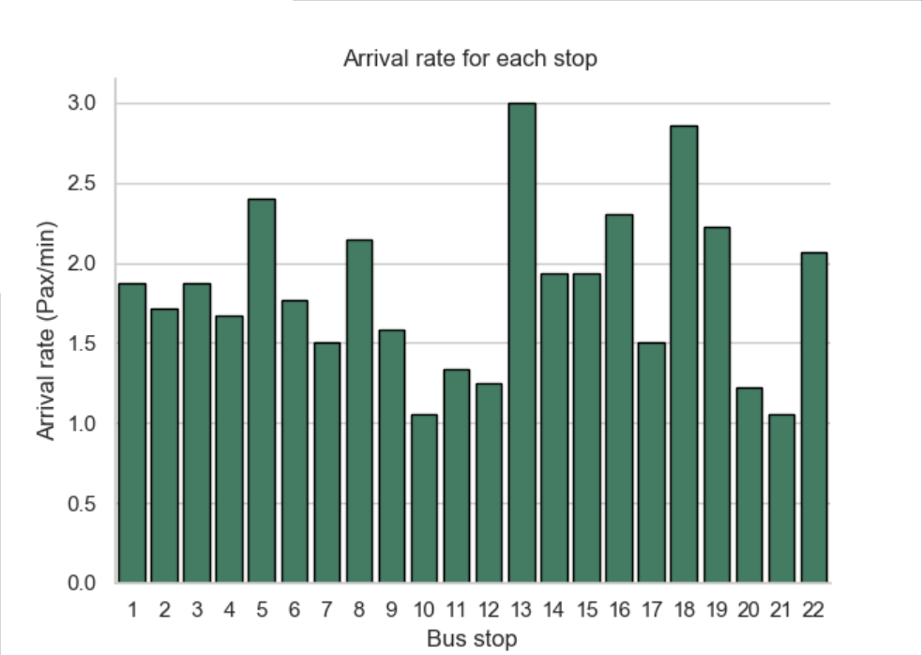
3 Experimental progress
Work have done so far
Experiment setting
SUMO api for python for simulation testbed & torch for learning algorithm
Two ring road network with shared corridor
20 bus stops with 2 shared stops (passenger can transfer at shared stops)
Two bus routes with 8 buses for each
Transfer rate: 0.1 (10% passengers need to transfer)
Simulation network

Slide 28
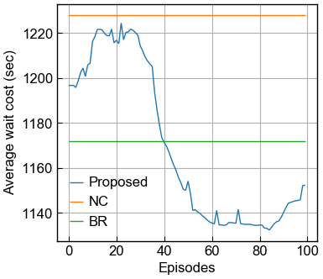
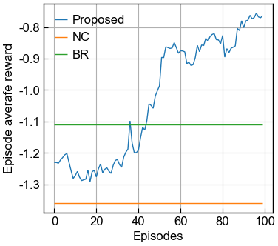
3 Experimental progress
Work have done so far
Results

Slide 29
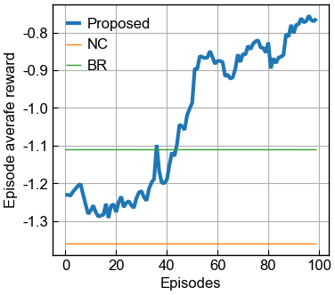
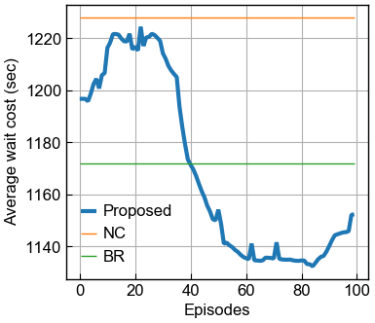
3 Experimental progress
Work have done so far
Results
The reward function can not ensure the improvement.
There is no explicit consideration on transfer process.
$$r=\exp\left(−\left|forwrd headway−backward headway\right|\right)−w∗forwrd headway.$$

Slide 30
3 Experimental progress
Next step
Design reward function
Baseline comparisons
Complex network (i.e., more overlapped ring roads)
Random speed setting
Different transfer rate
Field data

Slide 31
Thank you ! And Any suggestions?

