Slide 1
Unithree

Slide 2
Immigration Security

Slide 3
18 Billion Dollars
Only in the US

Slide 4

UNIFY THE CRIMINAL RECORDS AROUND THE WORLD.

Slide 5
Benefits of using blockchain technology
Encrypt data
Only selected companies or government entities may use it
Limited access
Protect Personal Data

Slide 6
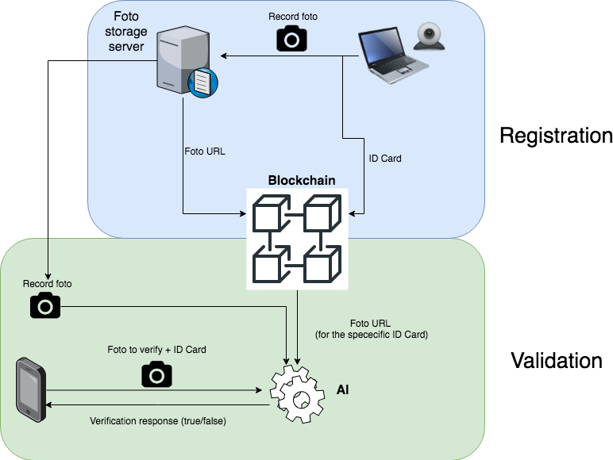

Slide 7

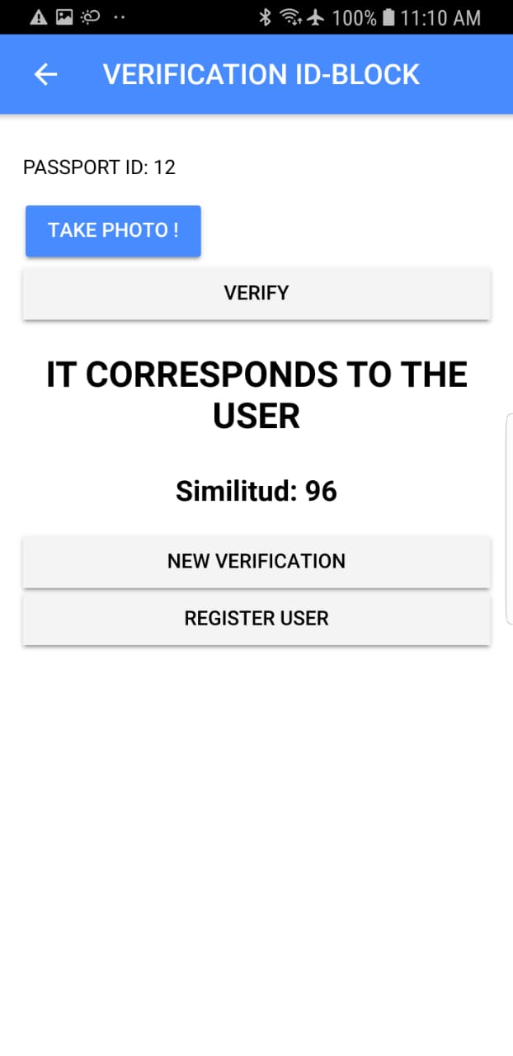
Unithree
Dapp

