Slide 1
Custom HDL for USRP Prototyping
Winston Wang

Slide 2
So what are USRP’s?
The USRP’s are primarily used as software defined radios. The intended use case is that consumers either
Implement their algorithms on their PC (host) to post process data (GNU Radio)
(very slow, underutilizes fpga, bottlenecked by the transport of samples from USRP to PC)
Connect predefined hardware (dsp) blocks on the USRP FPGA together using the RFNOC library (RFNOC)
Faster, but becomes significantly more complicated to integrate custom modules
This can lead to very fast development/prototyping of wireless systems/signal processing, since you can connect different processing blocks together like LEGOs
Notes:
https://wiki.gnuradio.org/index.php/Main_Page
https://drive.google.com/file/d/0B6ccrJyAZaq3MTRDbmVUR0gwVU0/view?resourcekey=0-jXgCyj_rLFC8Bk699QjBiw
https://kb.ettus.com/images/e/eb/RFNoC_Wireless_at_VirginiaTech_2014_Intro.pdf

Slide 3
So why work at the HDL level?
For some research, we want to create custom digital signal processing hardware blocks to use on the FPGAs
Time constraints, data size constraints …
Ettus has a way for us to create our own RFNOC blocks which we could then use from the GRC flowgraphs!
Well, do we really need the flowgraph interactivity? What’s the cost?
Need to look under the hood

Slide 4
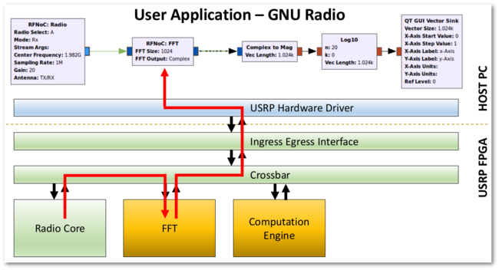
How does RFNOC work?
To achieve this host side re-programmability while using digital hardware blocks, the RFNOC system specifies a communication protocol between all the blocks, handles switching and connections, and handles interfacing between RFNOC blocks and the USRP Hardware Driver (UHD)
Notes:
https://kb.ettus.com/RFNoC_(UHD_3.0)

Slide 5
Custom RFNOC?
The problem with RFNOC is that it requires wrappers for all blocks so that they can be reconfigurable. This introduces a packet based interface between blocks that is taken care by the RFNOC wrapper, but requires our modules to use an AXI interface
This introduces complexity as well as ambiguity for the engineer (how does the CHDR work? What is the latency? etc.)
If we are prototyping a device, do we need this reconfigurability? Are we OK just flashing a design to the FGPA and using it?
A: Probably more work than its worth
Notes:
https://kb.ettus.com/images/7/78/RFNoC_Wireless_at_VirginiaTech_2014_FPGA.pdf

Slide 6
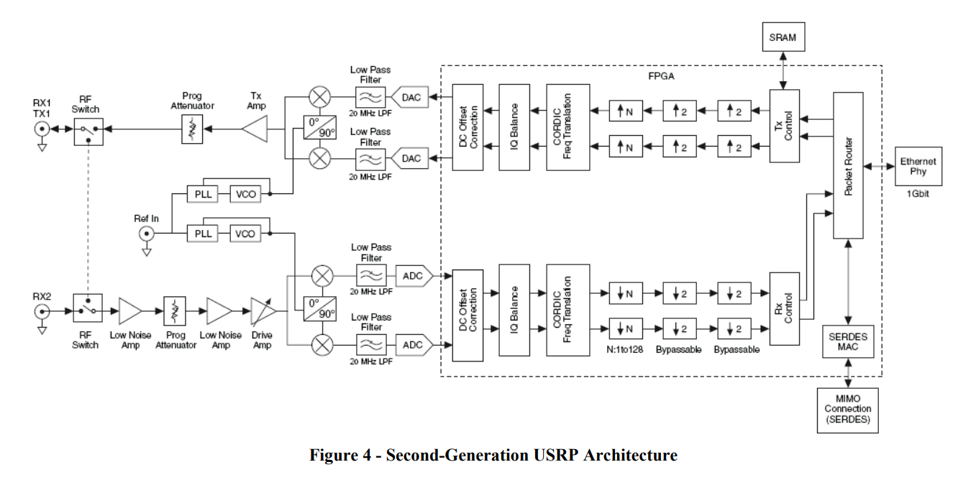
What we want
What the minimum amount of stuff we must deal with to make a prototype?
We want an Analog front end/data converters, an FGPA, and a way to interface with a host device.
Some radio nonideality corrections would be nice as well

Slide 7
Towards our AFE + DC + FPGA goal
There is no customer-friendly “supported” way to get what we want.
Fortunately, the USRP host and FGPA code is all open source. We can edit the FPGA code ourselves and “hijack” the system for our goals.
This requires learning about important subsystems of the USRP and many hours of code reading/searching
Hopefully, we can condense this by explaining some major parts, and establish a framework for projects to start off of.
Notes:
https://github.com/EttusResearch/uhd

Slide 8
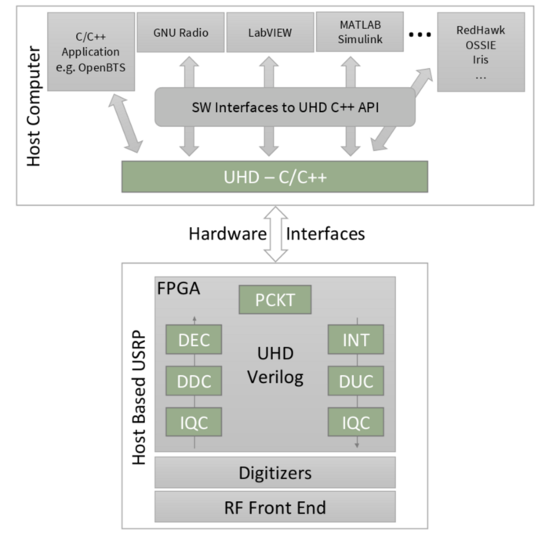
What is UHD?
Verilog code to handle outputs from ADC/DAC
Processing, transport, control
C++ code to communicate with the USRP
Transport, processing, control (again)
Notes:
https://kb.ettus.com/UHD

Slide 9
Project setup

Slide 10
Verilog file structure
First focus on implementing the signal datapath of your modules.
They should have a clk, reset, start signal, and data you want to read
Recommended file structure
Make a github repo
ex: your_project_name = OSLA
Then make an rtl folder
mkdir OSLA/rtl
Make subfolders for sources
mkdir OSLA/rtl/sources

Slide 11
rtl/Sources
Each module has a folder
ex: source, dest, utils,…
each folder contains
module hdl
testbench
wcfg
Makefile.srcs (more on this later)
TODO: try using packages instead of #include
Advice: Don’t use global params because the sys_defs.svh file will cause a lot of compilation heartache

Slide 12
Some Verilog advice
https://nandland.com/coding-style-guidelines-for-vhdl-verilog/
https://projectf.io/posts/multiplication-fpga-dsps/
https://docs.xilinx.com/r/en-US/ug901-vivado-synthesis/Multipliers-Coding-Examples

Slide 13
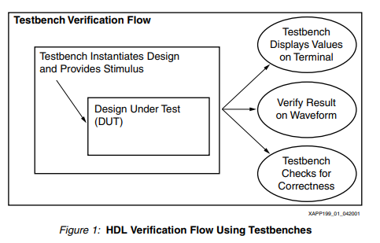
Matlab sim
in OSLA, make a matlab folder
Should have a subfolder testvectors, as well as your sim
testvectors will have subfolders with all of your various simulations
This is stimulus-based verification, as opposed to formal verification
Why not formal? A: I don’t know how to
Notes:
https://docs.xilinx.com/v/u/en-US/xapp199

Slide 14
Testbench
Make a testbench (how to do this…)
To access test vectors
$readmemb("/afs/eecs.umich.edu/spvlsi/users/wangston/OSLA/bpsk/matlab/testvectors/esn0_1/source_input.mem", tb_input);

Slide 15

Now add UHD
I recommend making UHD a submodule of your project
Others have made their project a submodule of UHD, but that doesn’t make sense. Your project contains UHD, not the other way around. Especially if you do more than prototyping (e.g. algorithm research)
In the uhd submodule, I add branches named wangstonn/setup1, etc
Much easier to differentiate your branches from UHD branches
git remote –v should return
Now set uhd to be the upstream
git remote add upstream git@github.com:EttusResearch/uhd.git
This essentially adds another repository we can pull from.
(next slide explains why)

Slide 16
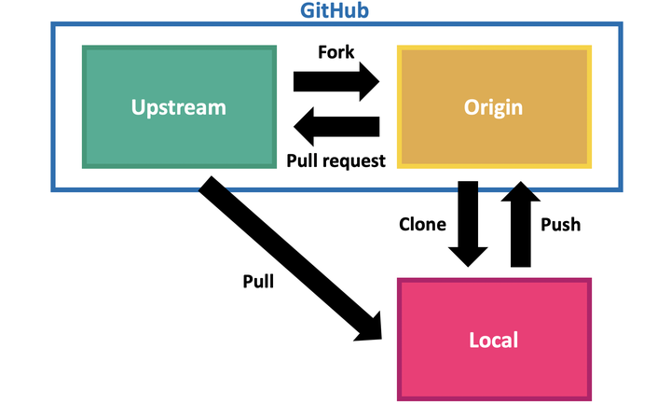
UHD git setup continued
Ettus periodically releases UHD updates with bugfixes. (UHD 4.4, 4.5,etc)
While they do keep branches with stable releases, it is very hard to upgrade to the next release from these branches (lots of merge conflicts due to hotfixes post release).
On the other hand, master seems to be continuously updated and contains each release in its history
Because of this, we want to develop on top of upstream/master.
to start: Git checkout –b <mybranch> upstream/master
to update: fetch then merge upstream/master with <mybranch>
Notes:
https://stackoverflow.com/questions/57272453/how-can-i-copy-commits-from-one-branch-to-another

Slide 17
Cherry-picking
What if we developed on a stable release branch?
We want to selectively apply all of our changes from our current branch to the upstream/master branch
go to your history and find the range of all commits you want
git cherry-pick <oldest commit>^..<latest commit>
This is a one-off trick! Not a permanent solution! Do this to transition to the uhd master branch.
Notes:
https://stackoverflow.com/questions/46109211/cherry-picking-few-commits-from-another-branch

Slide 18
to do:
cpp file setup
/host/examples/txrx_loopback_to_file.cpp
simulation makefile
https://files.ettus.com/manual/md_usrp3_sim_writing_sim_makefile.html
https://github.com/Wangstonn/ww_uhd/tree/master/fpga/usrp3/lib/dsp

Slide 19
General useful information
https://www.youtube.com/watch?app=desktop&v=PNMOwhEHE6w
https://www.youtube.com/watch?v=wqKNUXDdIvU&t=1811s https://en.wikipedia.org/wiki/Stochastic_resonance
https://www.youtube.com/watch?v=FxciG7nW-J0

Slide 20
Nonideality correction
fe_control sits between x300 and adc (CHECK)
https://github.com/Wangstonn/ww_uhd/blob/master/fpga/usrp3/lib/control/fe_control.v#L14
Performs DC offset correction, etc
https://github.com/Wangstonn/ww_uhd/blob/master/fpga/usrp3/lib/rfnoc/blocks/rfnoc_block_radio/tx_frontend_gen3.v#L8

Slide 21
Debug advice
(* dont_touch = "true" , mark_debug = "true" *) logic fb_o_ctr_r
(* DONT_TOUCH = "yes" *) dest dest_dut( )
Notes:
https://docs.xilinx.com/r/2021.1-English/ug1387-acap-hardware-ip-platform-dev-methodology/Synthesis-Attributes
https://docs.xilinx.com/r/en-US/ug901-vivado-synthesis/DONT_TOUCH

Slide 22
Repo overview
uhd/fpga contains the Verilog used on the USRPs
https://github.com/EttusResearch/uhd/tree/master/fpga/usrp3/top/x300
All the action happens in x300_core
handles communication with PC, gpio, adc/dac, nonideality correction
We will insert our module here
However, there are nuances! There are many signals that we need to go through

Slide 23
Makefile setup
To compile the HDL, the makefile needs to know which files are needed. This is done by reading makefile.srcs files, which contain a list of all hdl code we use.
In each module folder, add a Makefile.srcs file that
Adds all utility files
Adds the full paths to each of the hdl files
In the top module folder Makefile, add all the files that are being used. To add this Makefile, include the path to the Makefile.srcs and append the path string to DESIGN_SRCS
https://github.com/Wangstonn/ww_uhd/blob/osla-bpsk-4.5/fpga/usrp3/top/x300/Makefile.x300.inc
Notes:
https://github.com/EttusResearch/uhd/blob/master/fpga/usrp3/top/x300/Makefile.x300.inc

Slide 24
Compilation/bitfile generation
module load python/3.8.5
. ./setupenv.sh --vivado-path /usr/caen/xilinx/2021.1/Vivado/
make X310_HG
vivado path will change based on uhd version
https://github.com/Wangstonn/ww_uhd/blob/osla-bpsk-4.5/fpga/usrp3/top/x300/vlsi_make.sh
To record bitfile in github commit
mv build/usrp_x310_fpga_HG.bit ./usrp_x310_fpga_HG.bit
To load onto USRP: go to lab compuer
uhd_image_loader --args type=x300 addr=192.168.110.2 --fpga-path usrp_x310_fpga_HG.bit
Notes:
https://github.com/Wangstonn/ww_uhd/blob/osla-bpsk-4.5/fpga/usrp3/top/x300/vlsi_make.sh
usrp_load.sh
mv_bitfile.sh

Slide 25
USRP CPP code
To build
cd uhd/host/<folder for cpp code>
mkdir build
cd build
cmake ..
make

Slide 26
USRP Processing Delay
USRP Loopback Test
USRP Processing Delay must be accounted for in implementation for timing
Get USRP TX and RX processing delay
Processing Delay contains ADC, DAC, and Analog Frontend processing times.
An estimated constant delay was measured from USRP. Similar results from an additional USRPS with same wire.
Wired Cable used to connect. Wire Length is about 8 inches.
TX
RX
USRP

Slide 27
USRP Processing Delay
Estimated Processing Delay = 119 samples at 200M = 0.595 us
Processing includes TX path, RX path and Wire length.
Wire Length = 8 inches

