Slide 1
Custom HDL for USRP Prototyping
Winston Wang

Slide 2
So what are USRP’s?
The USRP’s are primarily used as software defined radios. The intended use case is that consumers either
Implement their algorithms on their PC (host) to post process data (GNU Radio)
(very slow, underutilizes fpga, bottlenecked by the transport of samples from USRP to PC)
Connect predefined hardware (dsp) blocks on the USRP FPGA together using the RFNOC library (RFNOC)
Faster, but becomes significantly more complicated to integrate custom modules
This can lead to very fast development/prototyping of wireless systems/signal processing, since you can connect different processing blocks together like LEGOs
Notes:
https://wiki.gnuradio.org/index.php/Main_Page
https://drive.google.com/file/d/0B6ccrJyAZaq3MTRDbmVUR0gwVU0/view?resourcekey=0-jXgCyj_rLFC8Bk699QjBiw
https://kb.ettus.com/images/e/eb/RFNoC_Wireless_at_VirginiaTech_2014_Intro.pdf

Slide 3
So why work at the HDL level?
For some research, we want to create custom digital signal processing hardware blocks to use on the FPGAs
Time constraints, data size constraints …
Ettus has a way for us to create our own RFNOC blocks which we could then use from the GRC flowgraphs!
Well, do we really need the flowgraph interactivity? What’s the cost?
Need to look under the hood

Slide 4
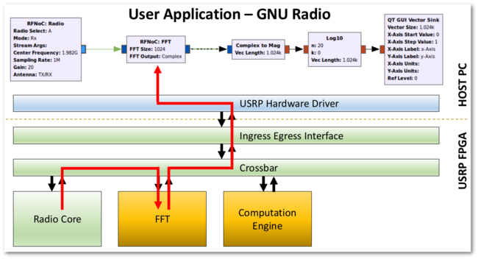
How does RFNOC work?
To achieve this host side re-programmability while using digital hardware blocks, the RFNOC system specifies a communication protocol between all the blocks, handles switching and connections, and handles interfacing between RFNOC blocks and the USRP Hardware Driver (UHD)
Notes:
https://kb.ettus.com/RFNoC_(UHD_3.0)

Slide 5
Custom RFNOC?
The problem with RFNOC is that it requires wrappers for all blocks so that they can be reconfigurable. This introduces a packet based interface between blocks that is taken care by the RFNOC wrapper, but requires our modules to use an AXI interface
This introduces complexity as well as ambiguity for the engineer (how does the CHDR work? What is the latency? etc.)
If we are prototyping a device, do we need this reconfigurability? Are we OK just flashing a design to the FGPA and using it?
A: Probably more work than its worth
Notes:
https://kb.ettus.com/images/7/78/RFNoC_Wireless_at_VirginiaTech_2014_FPGA.pdf
https://www.gnuradio.org/grcon/grcon17/presentations/applications_and_extensions_of_gnuradio_at_APL/Jarriel-Cook-Measured-Latency-Introduced-by-RFNoC-Architecture.pdf

Slide 6
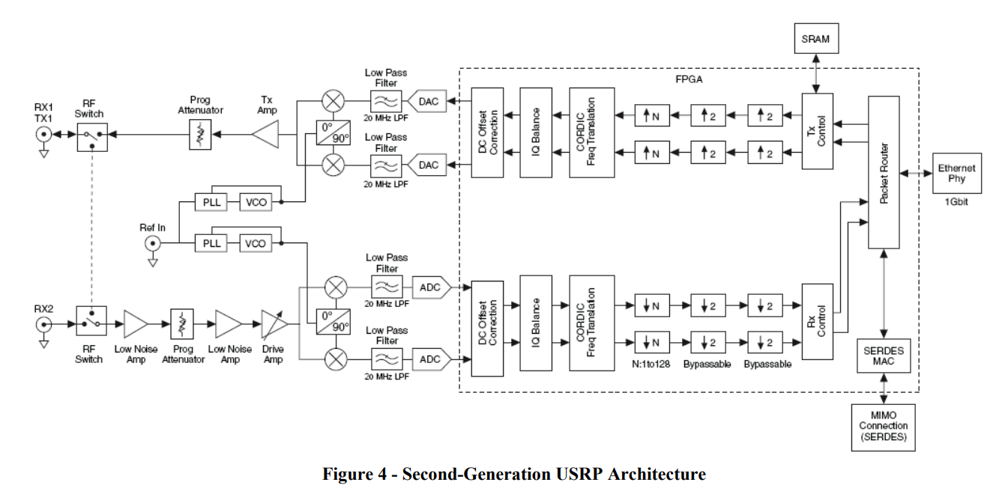
What we want
What the minimum amount of stuff we must deal with to make a prototype?
We want an Analog front end/data converters, an FGPA, and a way to interface with a host device.
Some radio nonideality corrections would be nice as well

Slide 7
Towards our AFE + DC + FPGA goal
There is no customer-friendly “supported” way to get what we want.
Fortunately, the USRP host and FGPA code is all open source. We can edit the FPGA code ourselves and “hijack” the system for our goals.
This requires learning about important subsystems of the USRP and many hours of code reading/searching
Hopefully, we can condense this by explaining some major parts, and establish a framework for projects to start from.
Notes:
https://github.com/EttusResearch/uhd

Slide 8
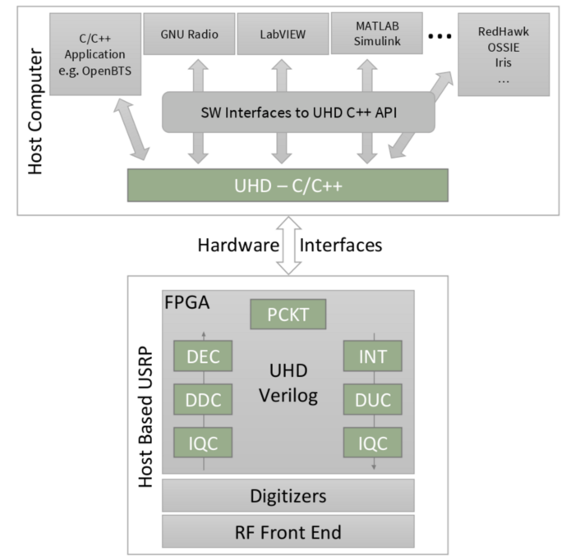
What is UHD?
Verilog code to handle outputs from ADC/DAC
Processing, transport, control
C++ code to communicate with the USRP
Transport, processing, control (again)
Notes:
https://kb.ettus.com/UHD

Slide 9
Step one: understanding the USRP architecture
Before designing any USRP system, you need to first understand the channel characteristics you are dealing with.
The USRP X310 is a motherboard that takes an analog signal, converts it, and interfaces with a computer
They connect to an RF daughterboard that handles up conversion and amplification.
This signal goes into an antenna and transmitted

Slide 10
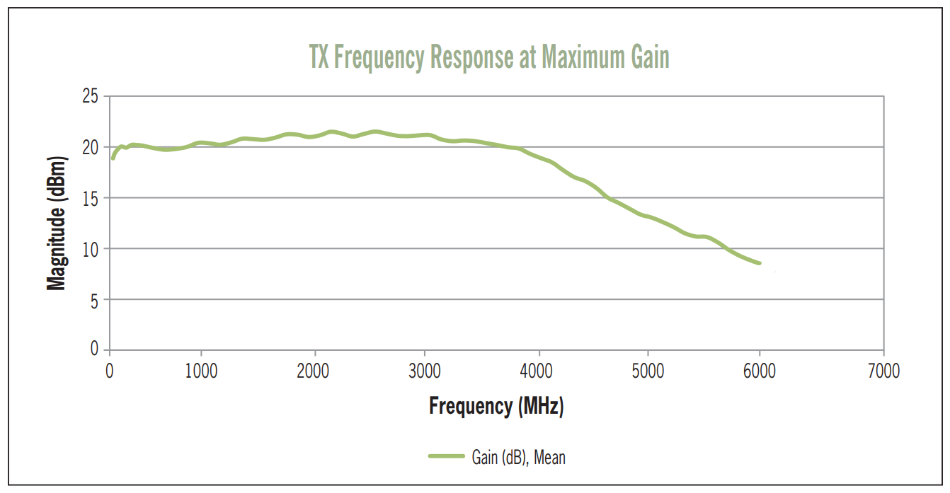
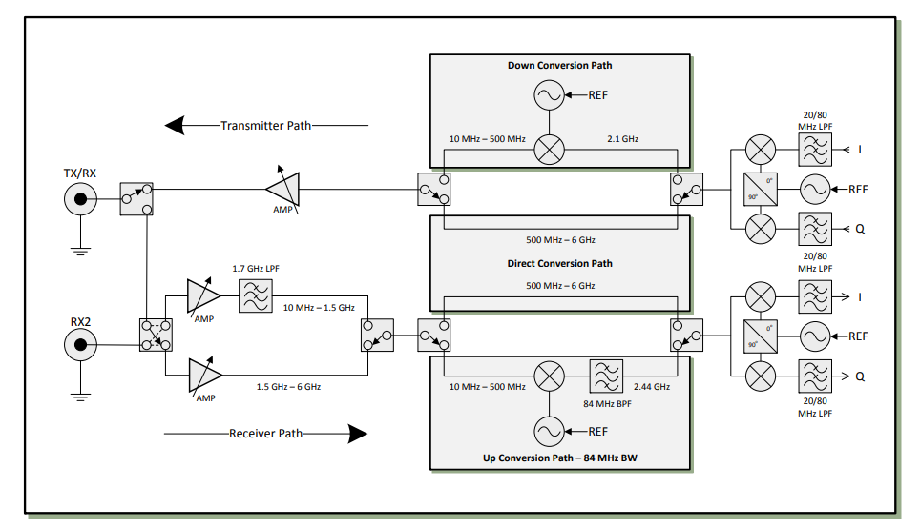
Daughterboards
DAC is on motherboard
Notes:
https://kb.ettus.com/UBX

Slide 11
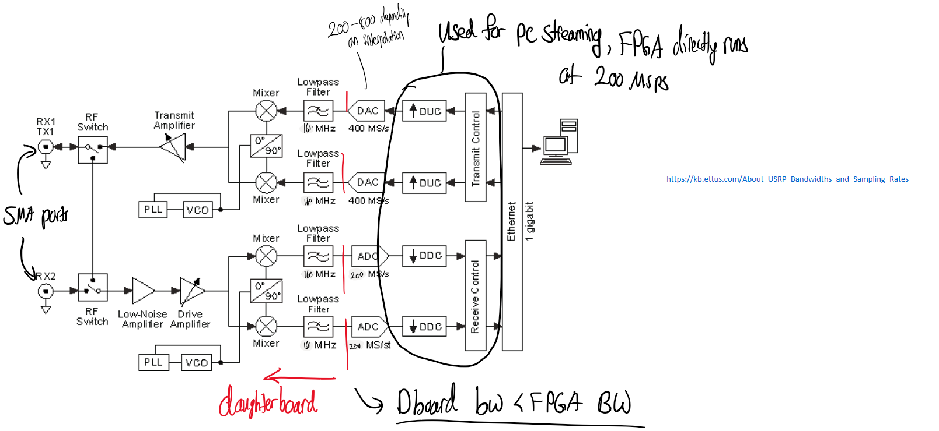
Bandwidth
https://kb.ettus.com/About_USRP_Bandwidths_and_Sampling_Rates
In the X310+UBX160 setup, the daughterboard bandwidth is lower than the fpga bandwidth

Slide 12
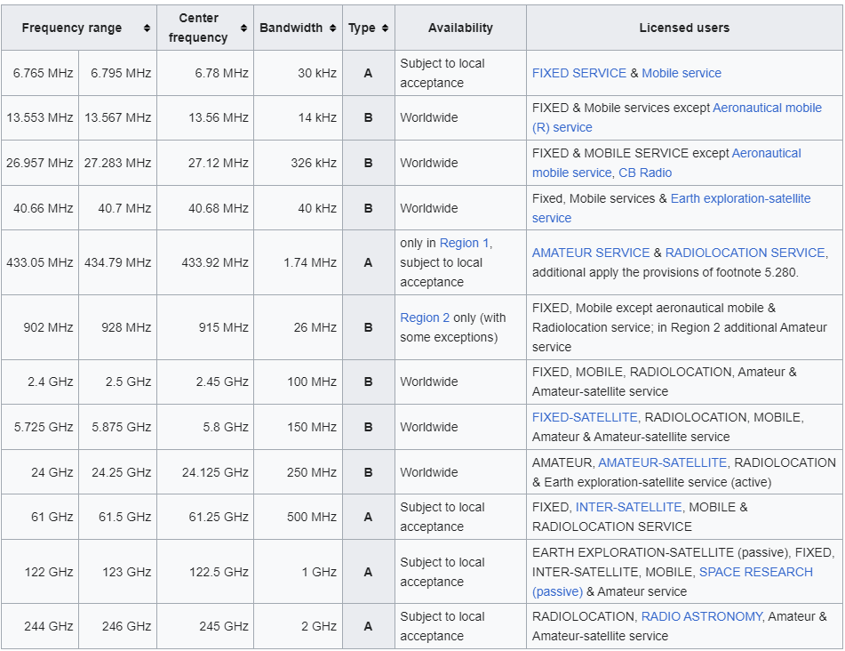
About frequencies
What should our tx and rx frequencies be?
Legally, must be in the ISM band (reserved for research
2.4 GHz is attenuated by water and subject to WiFi interference
Notes:
https://en.wikipedia.org/wiki/ISM_radio_band

Slide 13
USRP Processing Delay
USRP Loopback Test
USRP Processing Delay must be accounted for in implementation for timing
Get USRP TX and RX processing delay
Processing Delay contains ADC, DAC, and Analog Frontend processing times.
An estimated constant delay was measured from USRP. Similar results from an additional USRPS with same wire.
Wired Cable used to connect. Wire Length is about 8 inches.
TX
RX
USRP

Slide 14
USRP Processing Delay
Estimated Processing Delay = 119 samples at 200M = 0.595 us
Processing includes TX path, RX path and Wire length.
Wire Length = 8 inches
Notes:
https://forums.ni.com/t5/USRP-Software-Radio/Why-is-the-latency-of-my-USRP-repeater-550-nsec/td-p/3301858

Slide 15
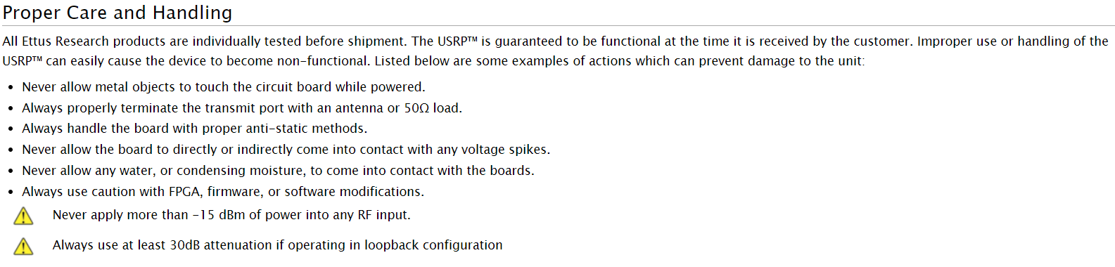
Safety
https://kb.ettus.com/X300/X310_Getting_Started_Guides

Slide 16
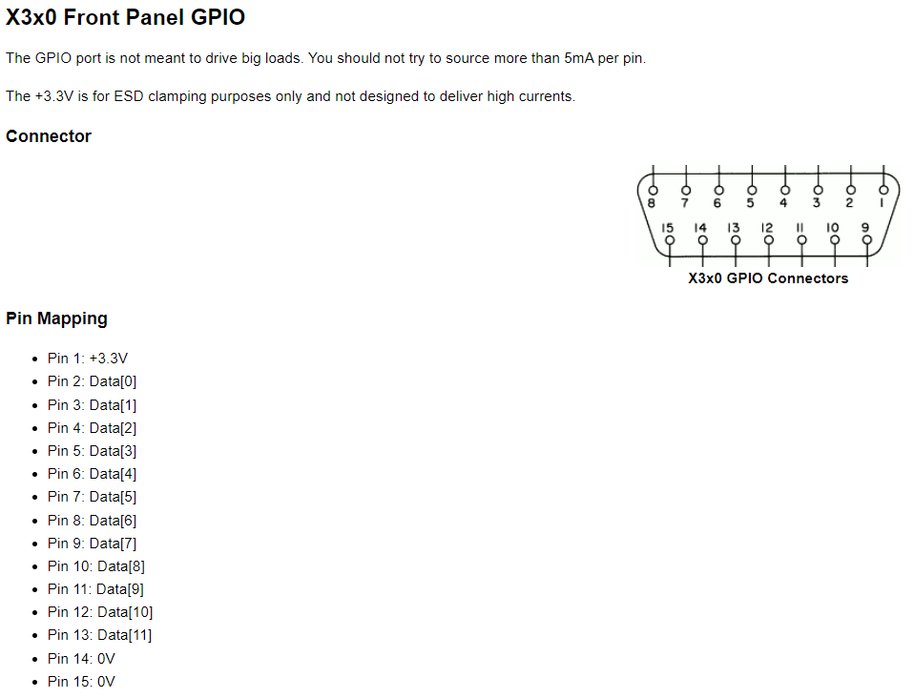
GPIO
Notes:
https://files.ettus.com/manual/page_gpio_api.html

Slide 17
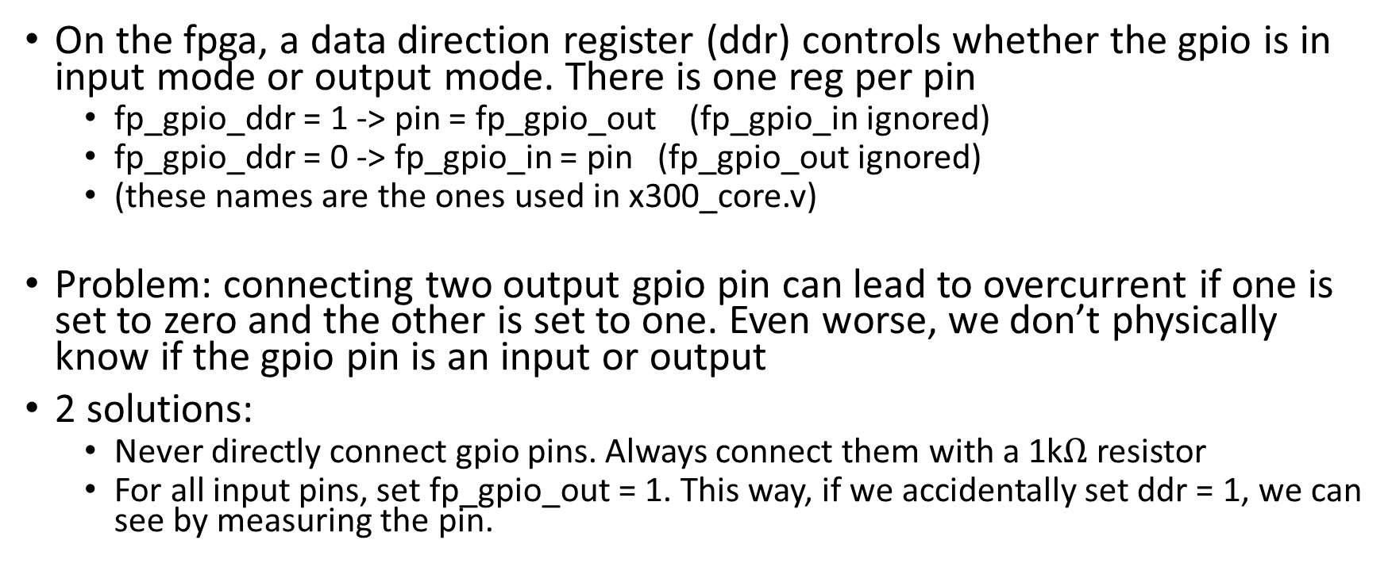
GPIO safety
On the fpga, a data direction register (ddr) controls whether the gpio is in input mode or output mode. There is one reg per pin
fp_gpio_ddr = 1 -> pin = fp_gpio_out (fp_gpio_in ignored)
fp_gpio_ddr = 0 -> fp_gpio_in = pin (fp_gpio_out ignored)
(these names are the ones used in x300_core.v)
Problem: connecting two output gpio pin can lead to overcurrent if one is set to zero and the other is set to one. Even worse, we don’t physically know if the gpio pin is an input or output
2 solutions:
Never directly connect gpio pins. Always connect them with a 1k$Ω$ resistor
For all input pins, set fp_gpio_out = 1. This way, if we accidentally set ddr = 1, we can see by measuring the pin.

Slide 18
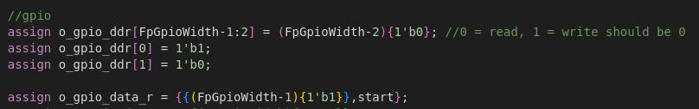
Verilog reminder
‘b1 will set the first bit to one, not all of them
Use the replication operator to set a group of bits to one

Slide 19
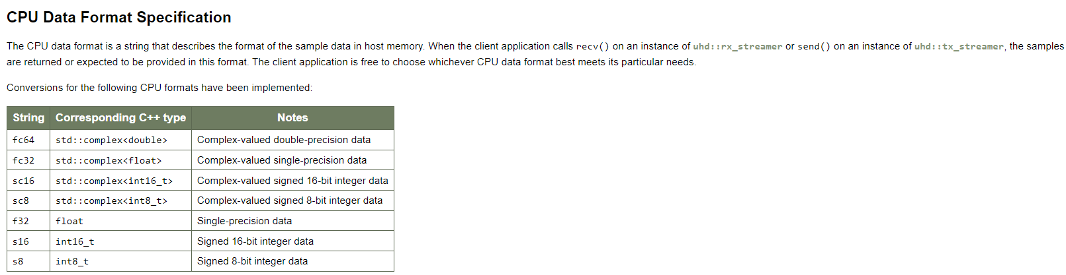
Streaming
Notes:
https://files.ettus.com/manual/page_configuration.html

Slide 20
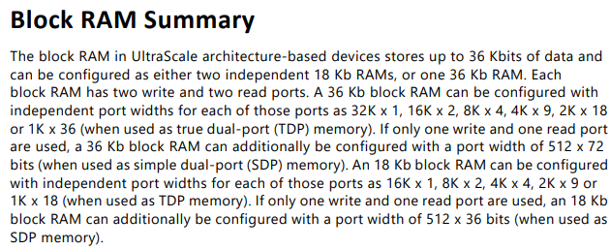
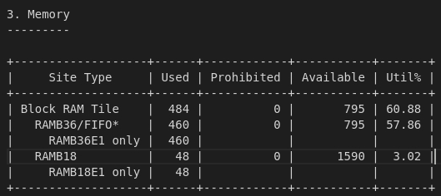



MMIO maximum memory
Each BRAM is 36 kb
Can’t set it to run at a data width of 32 bits – can only set it as 36 bit width
Total available (unused) memory is 311,000 32 bit samples

Slide 21
Useful references
https://files.ettus.com/schematics/x300/x3xx.pdf
NI documentation
https://kb.ettus.com/Mapping_Between_ER-USRP_and_NI-USRP_Product_Numbers
https://www.ni.com/docs/en-US/bundle/usrp-2940-features/page/usrp-2940-feature.html
FPGA features
https://docs.xilinx.com/v/u/en-US/7-series-product-selection-guide
https://docs.xilinx.com/v/u/en-US/ug473_7Series_Memory_Resources
A components list:
https://kb.ettus.com/X300/X310#Choosing_USRP_X310_vs_USRP_X300
https://www.analog.com/media/en/technical-documentation/data-sheets/AD9146.PDF
https://www.ti.com/lit/ds/symlink/ads62p48.pdf?ts=1697824892672&ref_url=https%253A%252F%252Fwww.google.com%252F

Slide 22
Project setup

Slide 23
vlsipool

Slide 24
Verilog file structure
First focus on implementing the signal datapath of your modules.
They should have a clk, reset, start signal, and data you want to read
Recommended file structure
Make a github repo
ex: your_project_name = OSLA
Then make an rtl folder
mkdir OSLA/rtl
Make subfolders for sources
mkdir OSLA/rtl/sources

Slide 25
rtl/Sources
Each module has a folder
ex: source, dest, utils,…
each folder contains
module hdl
testbench
wcfg
Makefile.srcs (more on this later)
TODO: try using packages instead of #include (see fpga/usrp3/<any folder>
Advice: Don’t use global params because the sys_defs.svh file will cause a lot of compilation heartache

Slide 26
Vivado Project
Vivado will create a TON of logs that make it hard to checkout different branches.
Create your vivado project outside of your git repo and have it linked to sources in the repo

Slide 27
Notes
Typically we use a sys_defs.svh file to hold the global variables. This typically doesn’t work well with usrp HDL compilation, so I’d advise using packages or parameterized values instead
Warning about parameterized modules: I once ran into a bug where the default parameter was NOT overridden by the parameter values given at instantiation. This can lead to very cryptic bugs.

Slide 28
FSM
https://web.engr.oregonstate.edu/~traylor/ece474/beamer_lectures/

Slide 29
Some Verilog advice
https://nandland.com/coding-style-guidelines-for-vhdl-verilog/
https://projectf.io/posts/multiplication-fpga-dsps/
https://docs.xilinx.com/r/en-US/ug901-vivado-synthesis/Multipliers-Coding-Examples

Slide 30
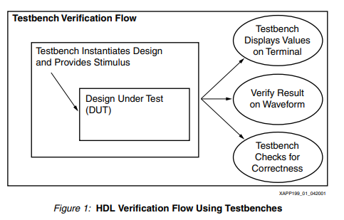
Matlab sim
in OSLA, make a matlab folder
Should have a subfolder testvectors, as well as your sim
testvectors will have subfolders with all of your various simulations
This is stimulus-based verification, as opposed to formal verification
Why not formal? A: I don’t know how to
Notes:
https://docs.xilinx.com/v/u/en-US/xapp199

Slide 31
Testbench
Make a testbench (how to do this…)
To access test vectors
$readmemb("/afs/eecs.umich.edu/spvlsi/users/wangston/OSLA/bpsk/matlab/testvectors/esn0_1/source_input.mem", tb_input);

Slide 32
Synthesis vs Implementation
Synthesis reports are only a ballpark estimate. Don’t worry about timing from these reports. Implementation is what matters.
When simulating and Implementation, there will be a 100ns delay before the device is operational due to global set reset (GSR)
Each time after booting up, SRAM based FPGA devices take time to load FPGA settings before operation
Notes:
https://support.xilinx.com/s/question/0D52E00006hpZBtSAM/100ns-delay-when-using-ise-isim-why?language=en_US

Slide 33
Inferring memory
Use templates
https://docs.amd.com/r/en-US/ug901-vivado-synthesis/RAM-HDL-Coding-Guidelines

Slide 34
Arithmetic
Don’t implement your own multiplication
https://projectf.io/posts/multiplication-fpga-dsps/

Slide 35

Now add UHD
I recommend making UHD a submodule of your project
Others have made their project a submodule of UHD, but that doesn’t make sense. Your project contains UHD, not the other way around. Especially if you do more than prototyping (e.g. algorithm research)
In the uhd submodule, I add branches named wangstonn/setup1, etc
Much easier to differentiate your branches from UHD branches
git remote –v should return
Now set uhd to be the upstream
git remote add upstream git@github.com:EttusResearch/uhd.git
This essentially adds another repository we can pull from.
(next slide explains why)

Slide 36
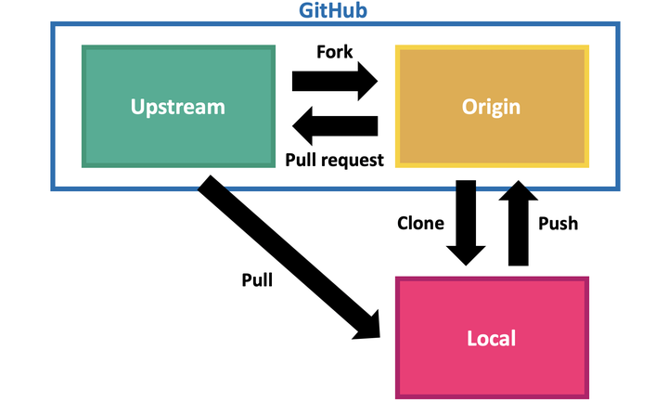
UHD git setup continued
Ettus periodically releases UHD updates with bugfixes. (UHD 4.4, 4.5,etc)
While they do keep branches with stable releases, it is very hard to upgrade to the next release from these branches (lots of merge conflicts due to hotfixes post release).
On the other hand, master seems to be continuously updated and contains each release in its history
Because of this, we want to develop on top of upstream/master.
to start: Git checkout –b <mybranch> upstream/master
to update: fetch then merge upstream/master with <mybranch>
Notes:
https://stackoverflow.com/questions/57272453/how-can-i-copy-commits-from-one-branch-to-another

Slide 37
Cherry-picking
What if we developed on a stable release branch?
We want to selectively apply all of our changes from our current branch to the upstream/master branch
go to your history and find the range of all commits you want
git cherry-pick <oldest commit>^..<latest commit>
This is a one-off trick! Not a permanent solution! Do this to transition to the uhd master branch.
Notes:
https://stackoverflow.com/questions/46109211/cherry-picking-few-commits-from-another-branch

Slide 38
General useful information
https://www.youtube.com/watch?app=desktop&v=PNMOwhEHE6w
https://www.youtube.com/watch?v=wqKNUXDdIvU&t=1811s https://en.wikipedia.org/wiki/Stochastic_resonance
https://www.youtube.com/watch?v=FxciG7nW-J0

Slide 39
Nonideality correction
fe_control sits between x300 and adc (CHECK)
https://github.com/Wangstonn/ww_uhd/blob/master/fpga/usrp3/lib/control/fe_control.v#L14
Performs DC offset correction, etc
https://github.com/Wangstonn/ww_uhd/blob/master/fpga/usrp3/lib/rfnoc/blocks/rfnoc_block_radio/tx_frontend_gen3.v#L8

Slide 40
Debug advice
(* dont_touch = "true" , mark_debug = "true" *) logic fb_o_ctr_r
(* DONT_TOUCH = "yes" *) dest dest_dut( )
Notes:
https://docs.xilinx.com/r/2021.1-English/ug1387-acap-hardware-ip-platform-dev-methodology/Synthesis-Attributes
https://docs.xilinx.com/r/en-US/ug901-vivado-synthesis/DONT_TOUCH

Slide 41
Repo overview
uhd/fpga contains the Verilog used on the USRPs
https://github.com/EttusResearch/uhd/tree/master/fpga/usrp3/top/x300
All the action happens in x300_core
handles communication with PC, gpio, adc/dac, nonideality correction
We will insert our module here
However, there are nuances! There are many signals that we need to go through

Slide 42
Preface
for .sh files, run using . <filename>.sh
for c++ files, run using ./<filename>

Slide 43
HDL Makefile setup
To compile the HDL, the makefile needs to know which files are needed. This is done by reading makefile.srcs files, which contain a list of all hdl code we use.
In each module folder, add a Makefile.srcs file that
Adds all utility files
Adds the full paths to each of the hdl files
In the top module folder Makefile, add all the files that are being used. To add this Makefile, include the path to the Makefile.srcs and append the path string to DESIGN_SRCS
https://github.com/Wangstonn/ww_uhd/blob/osla-bpsk-4.5/fpga/usrp3/top/x300/Makefile.x300.inc
Notes:
https://github.com/EttusResearch/uhd/blob/master/fpga/usrp3/top/x300/Makefile.x300.inc

Slide 44
Compilation/bitfile generation
module load python/3.8.5
. ./setupenv.sh --vivado-path /usr/caen/xilinx/2021.1/Vivado/
make X310_HG
vivado path will change based on uhd version
https://github.com/Wangstonn/ww_uhd/blob/osla-bpsk-4.5/fpga/usrp3/top/x300/vlsi_make.sh
To record bitfile in github commit
mv build/usrp_x310_fpga_HG.bit ./usrp_x310_fpga_HG.bit
To load onto USRP vscode into lab computer
uhd_image_loader --args type=x300 addr=192.168.110.2 --fpga-path usrp_x310_fpga_HG.bit
IP addresses and reservation are found here: https://docs.google.com/spreadsheets/d/1B6xLjOiw-5AcmWQ2GNcWTHVfxSufC8P4PqGfJjSeS0I/edit#gid=0
Notes:
https://github.com/Wangstonn/ww_uhd/blob/osla-bpsk-4.5/fpga/usrp3/top/x300/vlsi_make.sh
usrp_load.sh
mv_bitfile.sh

Slide 45
Host C++ code
https://github.com/dbkomma/uhd/blob/usrp_da/host/dk_uhd/usrp_da/usrp_da.cpp
https://files.ettus.com/manual/structuhd_1_1stream__args__t.html#a602a64b4937a85dba84e7f724387e252

Slide 46
Structuring a C++ project
Your code should be organized into folders that contain functions, their header, and a unit test.
project_folder/
│
├── main.cpp // Contains the main program logic
└── src/ // Folder containing source files
├── functions.cpp // Implementation of functions
├── functions.h // Header file declaring functions
└── tests.cpp // File for testing functions
These functions can be further grouped into libraries
Notes:
https://api.csswg.org/bikeshed/?force=1&url=https://raw.githubusercontent.com/vector-of-bool/pitchfork/develop/data/spec.bs

Slide 47
Header file
//Include guards to prevent repeated definition
#ifndef CROSS_CORRELATION_H
#define CROSS_CORRELATION_H
//libraries needed to be included in function c++ file
#include <vector>
#include <complex>
//function prototypes
std::tuple<std::vector<std::complex<double>>, std::vector<int>> crossCorrelationComplex(const std::vector<std::complex<double>>& x, const std::vector<std::complex<double>>& y);
#endif // CROSS_CORRELATION_H

Slide 48
CMake
Up to now, you probably used an IDE to compile c++ files. When compiling on a linux server, the command used is
g++ -o test xcorr_slow.test.cpp
What happens is you have a function in a separate file? Then c++ must compile both and link them
g++ -o test xcorr_slow.test.cpp xcorr_slow.cpp
With many function and many files. This can quickly become too complex.
CMake is a build tool that uses CMakeLists.txt to record dependencies and allow us to build larger c++ executables
Notes:
https://stackoverflow.com/questions/3202136/using-g-to-compile-multiple-cpp-and-h-files

Slide 49
CMakeLists.txt files
Each folder will have a CMakeLists.txt
root
|- MainProject
| |- main.cpp
| |- CMakeLists.txt
| |- src
| | |- xcorr
| | | |- xcorr.h
| | | |- xcorr.cpp
| | | |- test.cpp
| | | '- CMakeLists.txt
| | '- fft
| | |- fft.h
| | |- fft.cpp
| | |- test.cpp
| | '- CMakeLists.txt
Notes:
https://stackoverflow.com/questions/2360734/whats-a-good-directory-structure-for-larger-c-projects-using-makefile
https://www.open-std.org/jtc1/sc22/wg21/docs/papers/2018/p1204r0.html
https://stackoverflow.com/questions/8304190/cmake-with-include-and-source-paths-basic-setup
https://gitlab.kitware.com/cmake/community/-/wikis/doc/cmake/Useful-Variables
https://stackoverflow.com/questions/4506193/what-are-the-dusty-corners-a-newcomer-to-cmake-will-want-to-know
https://cmake.org/cmake/help/latest/guide/tutorial/Adding%20a%20Library.html

Slide 50
CMake function overview
project(): determines the name of the project
add_subdirectory(): adds subdirectories containing other cmakelists
add_executable(): creates the executable from the cpp file
target_link_libraries(MainExecutable XCorr FFT): links libraries (defined in subdirectory cmakelists.txt) to the main executable
add_library(XCorr
xcorr.cpp
xcorr.h #unit test file missing since we don’t want to link it to mainexec
) # Create a library from sources in subdirectory folder

Slide 51
CMake config
cd uhd/host/<folder for c++ code>
mkdir build
cd build
cmake ..
make
Inside build will be the executable (execute using ./build_exec)
Note that your executable will be in project/build. This is important when accessing files using relative path, since itll be different than the location of the cpp file
std::ifstream if_file("../../../matlab/mlsr/preamble.mem");

Slide 52
USRP CPP code build
use VScode to ssh into aa machine
Make a folder in host, copying https://github.com/EttusResearch/uhd/tree/master/host/examples/init_usrp
modify the CMakelists.txt to run your c++ file instead
Configure cmake (prev slide)
./your_build --tx-args "type=x300,addr=192.168.110.2" --rx-args "type=x300,addr=192.168.110.2"

Slide 53
Changing library code
on houghton
go to ~
cd .local (where some libraries are (in path)
cd lib
mkdir uhd-4.5
pwd, write down
go to uhd repo -> host
mkdir build
cmake -DCMAKE_INSTALL_PREFIX=/n/houghton/z/wangston/.local/lib/uhd-4.5 ../
make
make install

Slide 54
Instructions.
After building the uhd at a location "~/.local/lib/uhd-4.0"
1. Add location to library path by adding this line to .bashrc or .bash_alisases
export LD_LIBRARY_PATH=~/.local/lib/uhd-4.0/lib:$LD_LIBRARY_PATH
2. Now how to compile your programs with the uhd library that is installed
go to your build folder and you will run cmake with the options -DCMAKE_INSTALL_PREFIX -DUHD_DIR -DUHD_INCLUDE_DIRS -DUHD_LIBRARIES and specify the path for them. use the stuff below as example
cmake -DCMAKE_INSTALL_PREFIX=~/.local/lib/uhd-4.0 -DUHD_DIR=~/.local/lib/uhd-4.0/lib/cmake/uhd -DUHD_INCLUDE_DIRS=~/.local/lib/uhd-4.0/include -DUHD_LIBRARIES=~/.local/lib/uhd-4.0/lib/libuhd.so ../
then run make and you should be able to run your program.

Slide 55
Working with USRP c++ code
https://files.ettus.com/manual/classuhd_1_1usrp_1_1multi__usrp.html#a38b10a6bd2128b3810da229c60b31aa1
https://files.ettus.com/manual/page_configuration.html

Slide 56
Loopback params
Loopback, 8 inch wire, 30dB attenuator (tx/rx gain = 0)
Setting TX Freq: 2400.000000 MHz..
D_hat= 119, EsN0= 14.8833, h_hat : abs= 0.439122 arg= 3.12618
Attenuators dont affect delay
rx/tx gain dont affect delay
freq doesnt affect delay

Slide 57
gpio regs
https://www.youtube.com/watch?v=ppD06ZETnek
https://events.gnuradio.org/event/18/contributions/234/attachments/74/186/GPIOs%20on%20USRPs.pdf

Slide 58
Multiple function outputs
struct Velocity {
double speed;
double azimuth;
};
Velocity calculateResultingVelocity(double windSpeed, double windAzimuth,
double planeAirspeed, double planeCourse);
Velocity result = calculateResultingVelocity(25, 320, 280, 90);
cout << result.speed << endl;
cout << result.azimuth << endl;
https://stackoverflow.com/a/321431/21885057

Slide 59
struct Velocity {
double speed;
double azimuth;
};
Velocity calculateResultingVelocity(double windSpeed, double windAzimuth,
double planeAirspeed, double planeCourse);
Velocity result = calculateResultingVelocity(25, 320, 280, 90);
cout << result.speed << endl;
cout << result.azimuth << endl;

Slide 60
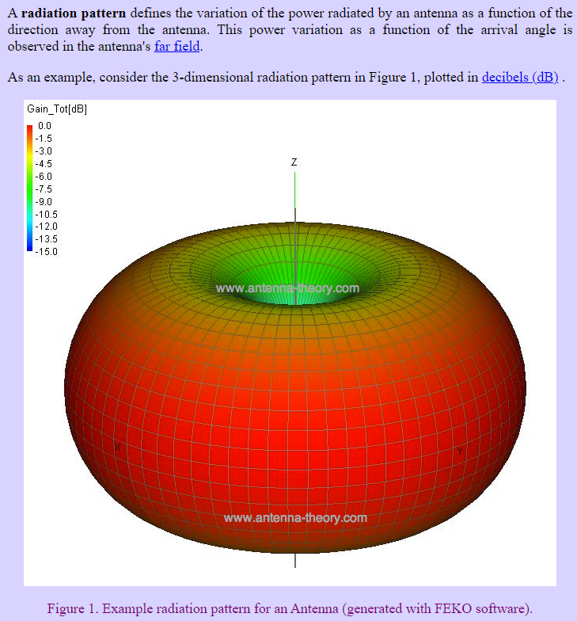
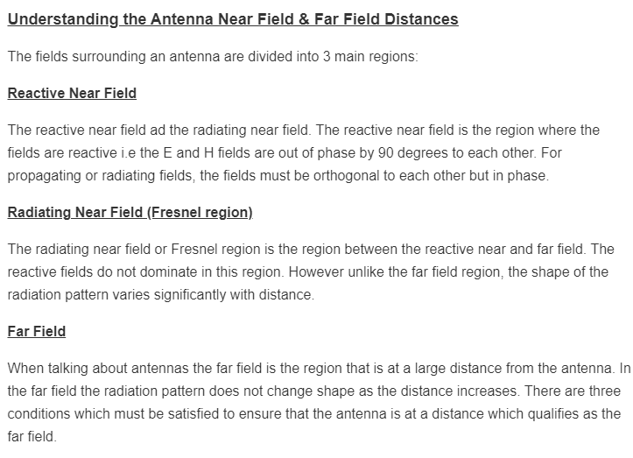
Antennas
Make sure antennas are aligned
Check antenna datasheets and make sure they are compatible with your tx frequency
Notes:
https://www.everythingrf.com/rf-calculators/antenna-near-field-distance-calculator
https://www.antenna-theory.com/basics/radpattern.php
https://kb.ettus.com/images/2/2b/ettus_research_vert900_datasheet.pdf

Slide 61
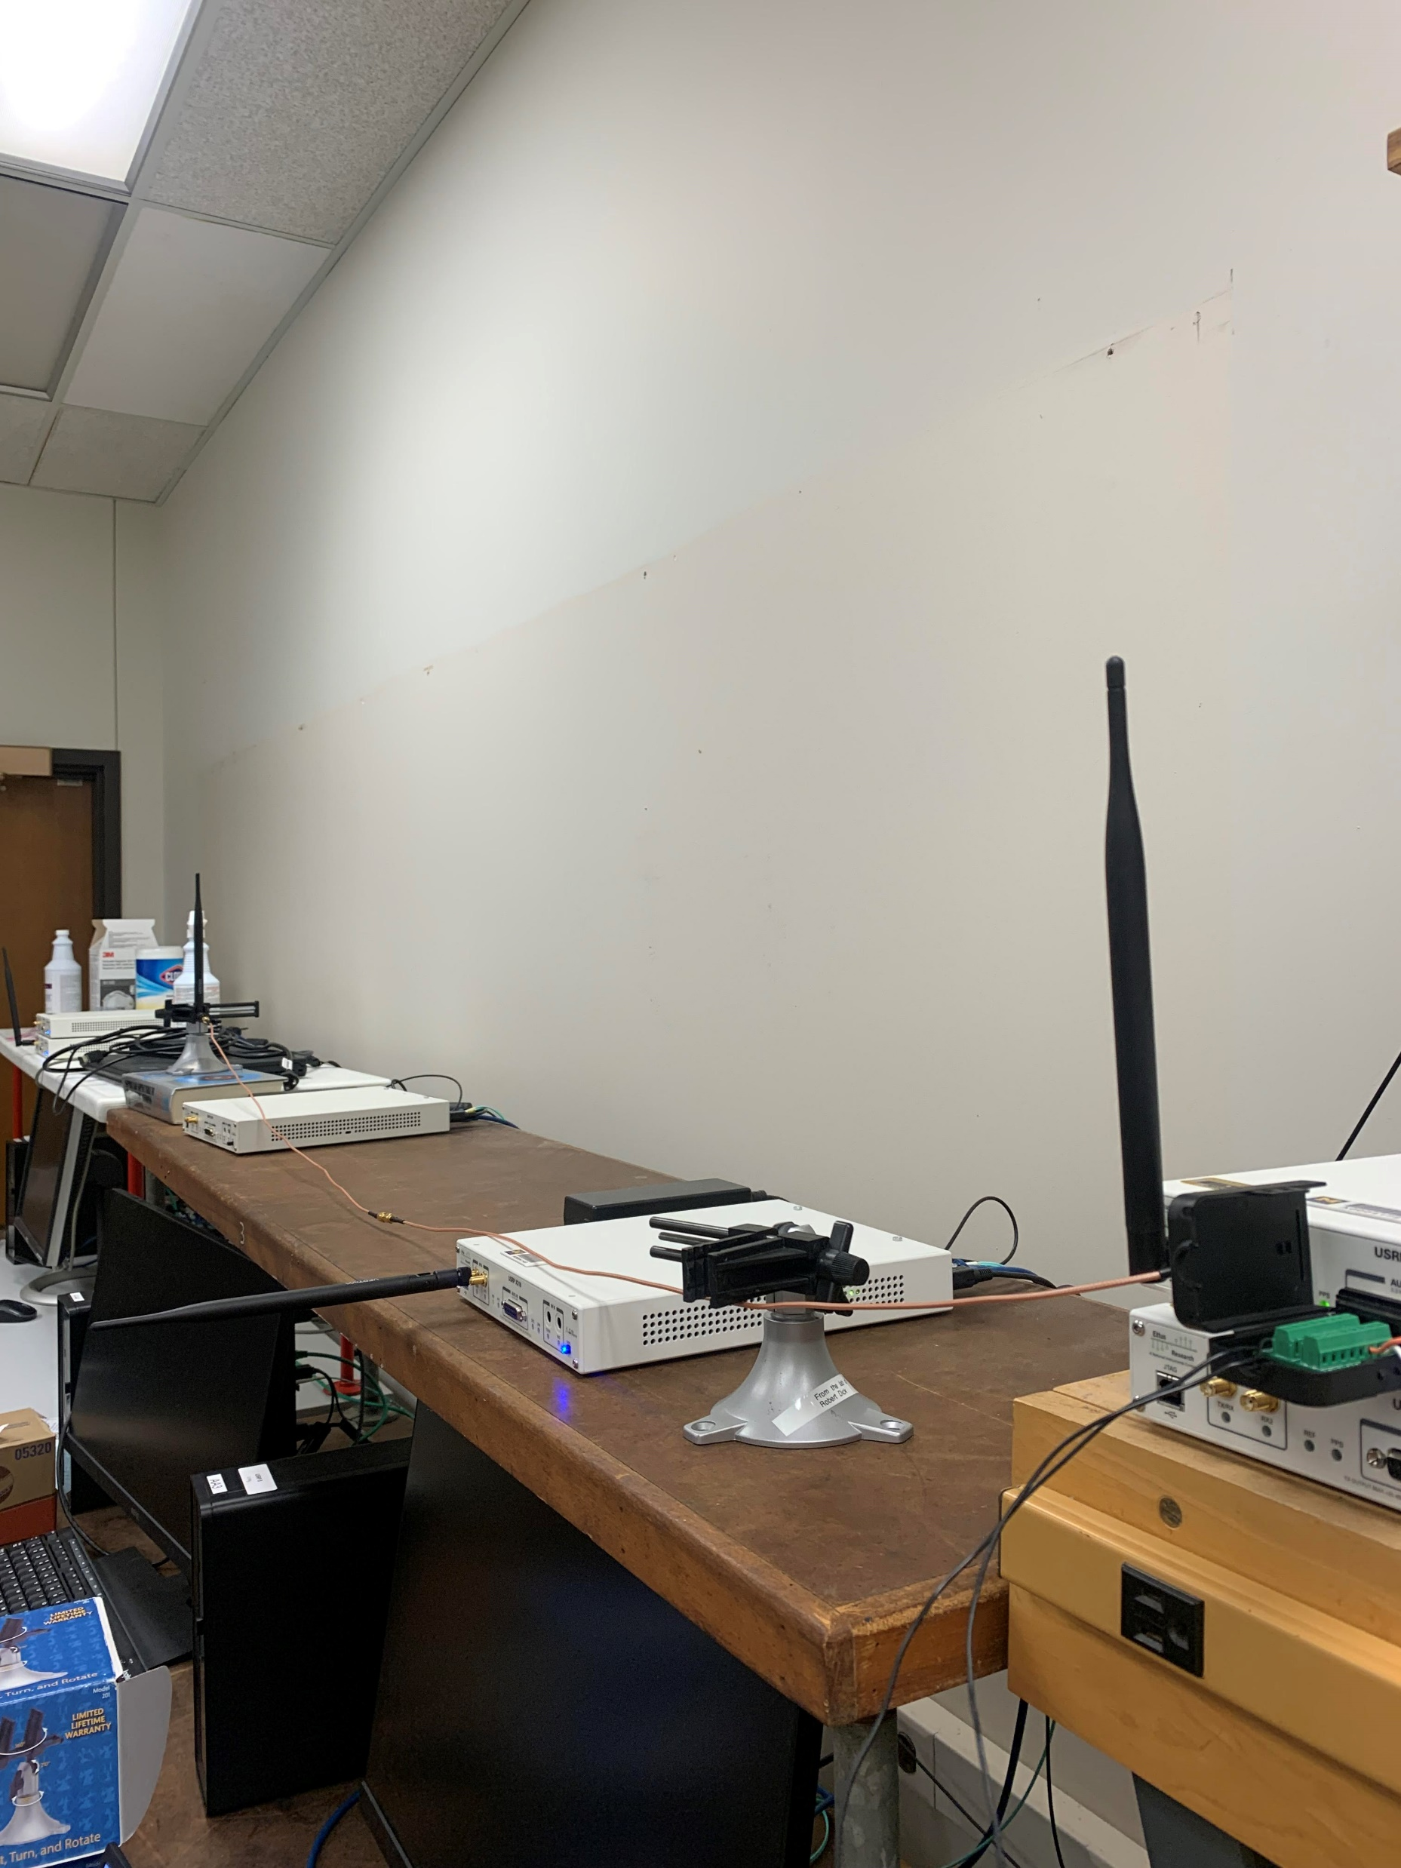
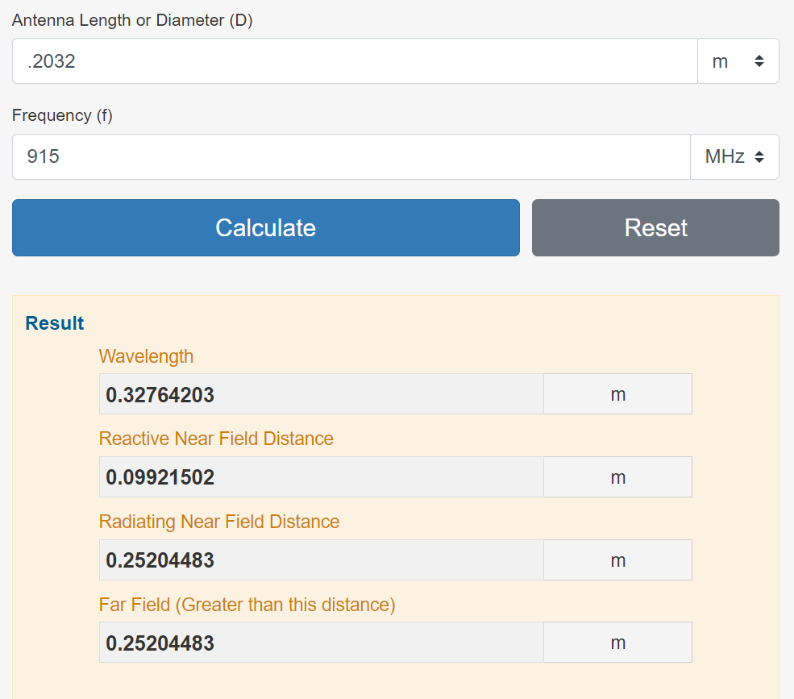
Channel characterization
8 inch antenna
2 meter distance
915 MHz
Far field measurement

Slide 62
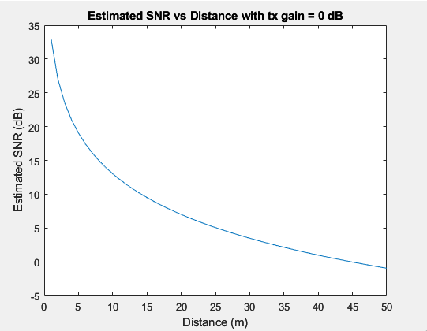

Range
How does our SNR vary with distance?
Friis’ equation (far field)

