Slide 1
SYRIATEL CUSTOMER CHURN PREDICTION
PRESENTED BY: LILIAN WANGUI
DATE: 23/07/2025

Slide 2
INTRODUCTION AND OVERVIEW
GOAL: To build a robust classification model to predict customer churn for SyriaTel.
PROBLEM: Customers discontinuing services (churn) lead to significant revenue loss.
IMPORTANCE: Proactive identification of at-risk customers enables targeted retention strategies, improving customer satisfaction and minimizing financial impact.
METHODOLOGY: Analyzing historical customer data to uncover patterns and factors indicative of churn.

Slide 3
BUSINESS PROBLEM
Core Problem: Predicting whether a customer will churn.
Impact:
1. Direct revenue loss from lost subscriptions.
2. Increased acquisition costs to replace churned customers.
3. Negative impact on brand reputation and market share.
Strategic Need: Implement effective retention strategies to enhance customer loyalty and reduce financial impact.

Slide 4
PROJECT OBJECTIVES
Our Aims: Driving Retention with Data
Develop a Churn Prediction Model - Build an effective classification model for SyriaTel.
Evaluate Model Performance – Rigorously assess effectiveness using appropriate metrics for imbalanced data(Precision, Accuracy, F1 score, ROC AUC)
Identify Key Churn Drivers – Determine which customer attributes and behaviors are most significant in predicting churn.
Propose Actionable Retention Strategies – Formulate data-driven recommendations to reduce customer attrition.

Slide 5
KEY BUSINESS QUESTIONS
Answering Critical Business Needs
1. Who is most likely to churn?
-Identifying high risk customer segments.
2. What differentiates churners from non–churners?
-Understanding the characteristics and behaviors that lead to churn.
3. How effectively can we predict churn?
-Assessing model accuracy and trade-offs of predictions.
4. How can insights inform retention strategies?
-Translating model findings into actionable business recommendations.

Slide 6
BUSINESS STAKEHOLDERS
The primary Stakeholder: SyriaTel Telecommunications Company is interested in reducing customer churn and improving customer retention.
Secondary Stakeholders:
1. Customer Care Service Teams: To develop strategies and interventions for high churn risk customers.
2. Marketing Teams: To create targeted campaigns and offers aimed at churn-risk customers.
3. Financial Analysts: To evaluate financial impact of customer churn.

Slide 7
DATA UNDERSTANDING
Data Source – Syria Tel Telecommunication Company.
Size – Over 3,000 customer records.
Structure – Each row represents a new customer.
Key Attributes – Demographics, service subscriptions, usage patterns, customer support interactions.
Target Variable – Churn (Binary: TRUE for churned, FALSE for retained)
Initial Steps – Handling missing values, correcting data types, and encoding categorical variables.

Slide 8
DATA OVERVIEW
Understanding Customer Attributes.
1. Usage Patterns:
-total day minutes, total evening minutes, total night minutes, total international minutes(and corresponding calls/charges)
Relevance: Quantify service consumption; high usage/charges could indicate satisfaction or, conversely, dissatisfaction due to high bills.
2. Customer Service Interactions: customer service calls
Relevance: A high number of calls often indicates unresolved issues or dissatisfaction, serving as a strong indicator of churn.
3. Plan Subscriptions: international and voicemail plan.
Relevance: The presence or absence of these plans can affect perceived value and churn rates.
4. Account Details: account length, state
Relevance: Longer acc correlates with lower churn. Geographic factors also play a role.

Slide 9
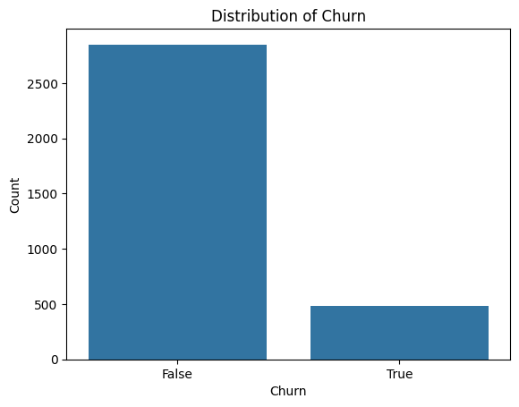
DISTRIBUTION OF TARGET VARIABLE
Observations:
- There is a significant imbalance between the two classes. The majority of customers have remained with the service (churn = False), while a much smaller proportion
have churned (churn = True).
- False (Not Churned): Approximately 2,800 customers
- True (Churned): Approximately 500 customers

Slide 10
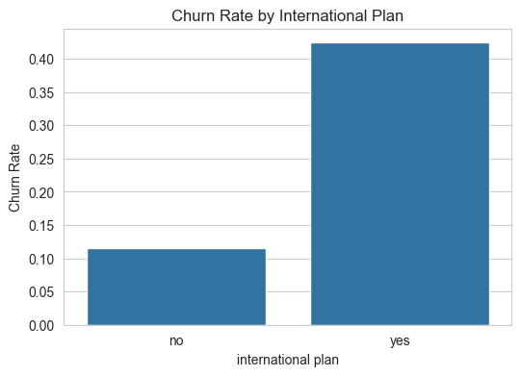
CHURN RATE BY INTERNATIONAL PLAN
Observations:
International Plan
- Customers with an international plan have a higher churn rate, 42.4%
- Customers without an international plan have a much lower churn rate, 11.5%
- ➤ This indicates that subscribing to the international plan is a strong churn signal.

Slide 11
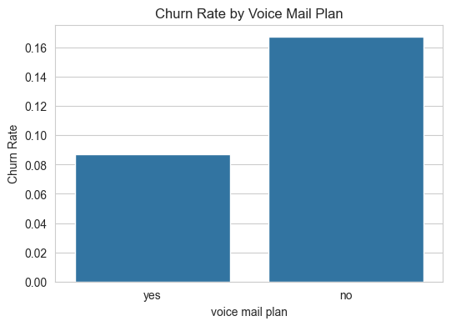
CHURN RATE BY VOICE MAIL PLAN
Observations:
Voice Mail Plan
- Customers with a voice mail plan churn less, 8.7%
- Customers without a voice mail plan churn more 16.7%
- ➤ This suggests that voice mail features may be linked to higher customer satisfaction or retention.

Slide 12
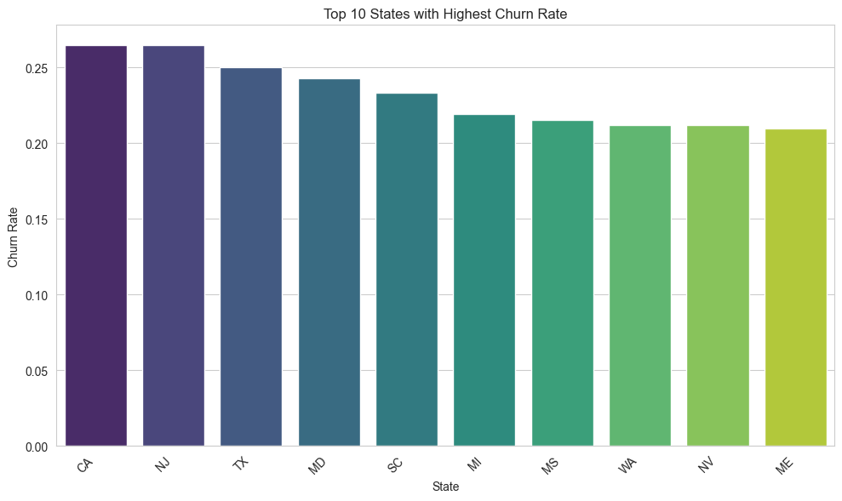
CHURN RATE BY TOP 10 STATES
Observations:
States like New Jersey, California, and Texas have more customers leaving SyriaTel. This means there could be local problems like poor service, tough competition, or unhappy customers in those areas.

Slide 13
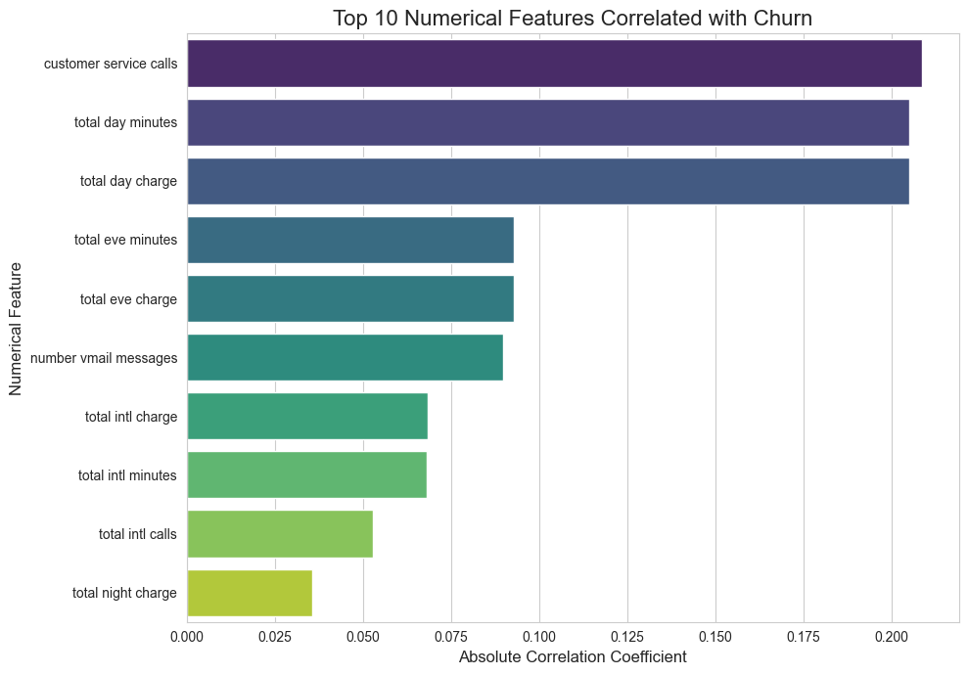
TOP FEATURES BY CHURN RATE
Observations:
Customers with 4+ service calls are most likely to churn — a sign of unresolved issues.
Churned customers show higher day and evening call usage.
Heavy usage may indicate billing frustration or poor service quality.
Key churn indicators point to dissatisfaction and unmet expectations.

Slide 14
DATA PREPARATION
Approach to Churn Prediction
1. Data Preprocessing:
- Feature Engineering: Creating new features from existing ones.
- Encoding: Converting categorical variables to numerical.
- Scaling: Normalizing numerical features.
2. Handling Imbalanced Data:
- Churn datasets are often imbalanced (fewer churners).
- SMOTE (Synthetic Minority Over-sampling Technique) was used to balance the dataset, preventing the model from being biased towards the majority class.
3. Model Selection & Training:
- Explored various classification models (e.g., Logistic Regression, Decision Tree, Random Forest).
- Random Forest emerged as the top performer.
- Hyperparameter Tuning:
- GridSearchCV was used to optimize model parameters for best performance, specifically targeting metrics relevant for imbalanced data.

Slide 15
MODELLING
Three models were used to predict customer churn:
1. Logistic Regression – A simple model to establish a baseline.
2. Decision Tree – Easy to interpret, but less accurate.
3. Random Forest – An advanced model that combines many decision trees for better accuracy.
Best Model: Tuned Random Forest Classifier
- It gave us the highest performance, especially on:
F1-Score – Balances catching churners (recall) without too many false alarms (precision).
ROC AUC – Measures how well the model separates churners from non-churners.
Why it matters: The Random Forest model identified churners more accurately than the others, making it our best tool for targeting customers at risk of leaving.

Slide 16
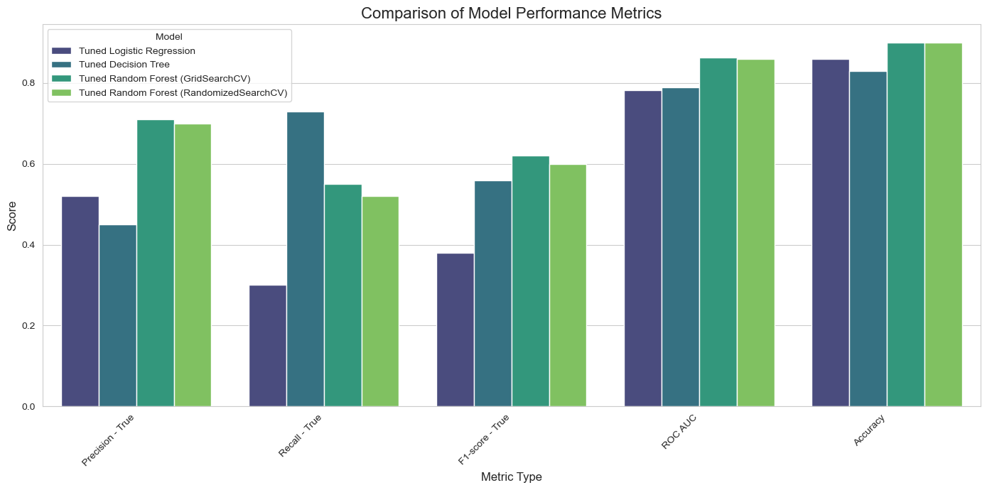
COMPARISON OF THE MODELS

Slide 17
COMPARISON SUMMARY
We tested and compared several models to find the most effective way to predict customer churn at SyriaTel:
Best Overall Model: The Tuned Random Forest (via GridSearch) gave the strongest, most balanced results. It was best at identifying customers likely to churn while minimizing wrong predictions.
Decision Tree: This model was great at catching churners but came with more false alarms (mistargeting loyal customers).
Logistic Regression: Simple and easy to interpret, but less accurate than tree-based models in this case.
Key Metrics:
F1-Score: Tuned Random Forest had the highest score — meaning it best balanced precision and recall.
ROC AUC: It also had the best ability to separate churners from non-churners.
Precision: Helped avoid mistargeting loyal customers.
Recall: Captured true churners effectively.
Conclusion: The Tuned Random Forest model is our top choice. It strikes the best balance between identifying churners and avoiding costly errors — making it the most practical and reliable tool for reducing churn at SyriaTel.

Slide 18
MODELS PERFORMANCE
Model | Accuracy | Precision (True) | Recall (True) | F1-Score (True) | ROC AUC Score
Logistic Regression | 85% | 49% | 36% | 41% | 76.25%
Tuned Logistic Regression | 86% | 52% | 30% | 38% | 78.26%
Decision Tree | 83% | 45% | 73% | 56% | 78.97%
Tuned Decision Tree | 83% | 45% | 73% | 56% | 78.97%
Random Forest | 90% | 68% | 54% | 60% | 85.81%
Tuned Random Forest | 90% | 71% | 55% | 62% | 86.25%
Tuned RF (RandomSearchCV) | 90% | 70% | 52% | 60% | 85.90%

Slide 19
MODELS PERFORMANCE: INSIGHTS
Best Performing Model: The Tuned Random Forest model outperformed others with:
The highest ROC AUC score (0.8625)
Strong balance between accuracy (90%) and recall (55%) for churned customers
Why Random Forest Wins:
Unlike Logistic Regression, which struggles with recall (36%), Random Forest better captures true churners (Recall: 55%)
High accuracy ensures overall reliability, while improved F1-score (0.62) signals better consistency for minority class
Business Impact:
Identifying 55% of potential churners can help SyriaTel proactively intervene (e.g., offer incentives, personalized plans)
Reducing churn directly saves revenue and improves customer lifetime value
Next Steps:
Deploy the Tuned Random Forest model into production
Regularly retrain with updated customer data
Use model insights to segment high-risk customers for retention strategies

Slide 20
EVALUATION
In this section, we see how well our model performed and what drives customer churn.
First, we’ll look at the confusion matrix to understand how accurately the model predicts churners versus non-churners.
Then, we’ll review the top features influencing those predictions — key customer behaviors that signal churn risk.
These insights help us know not just how the model performs, but also why customers might be leaving.

Slide 21
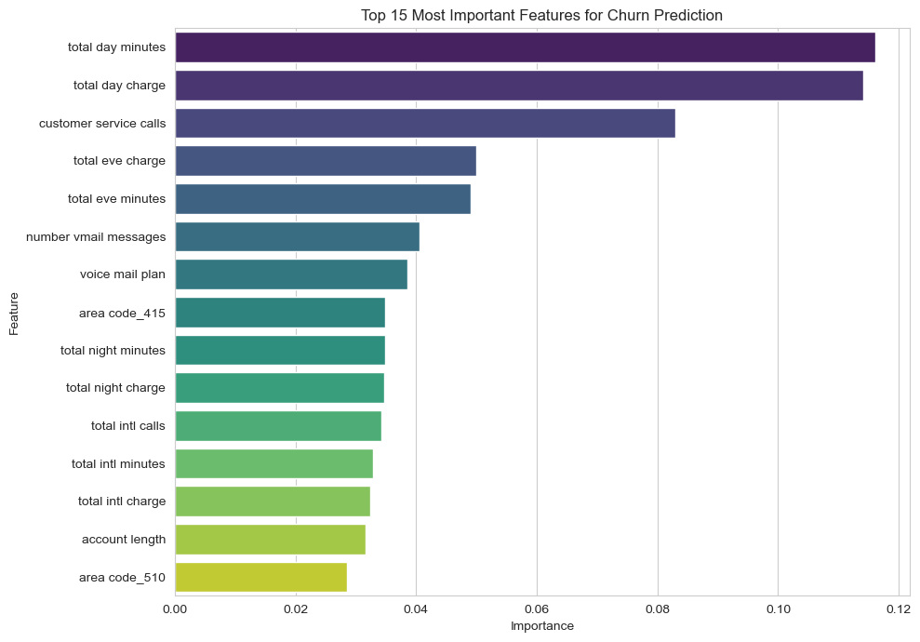
FEATURE IMPORTANCE
Observations:
Daytime usage (minutes & charges) is the strongest churn indicator.
Frequent customer service calls suggest dissatisfaction → higher churn.
Evening usage has a moderate effect on churn.
Voicemail plans are linked to lower churn → a retention opportunity.
Customers with international plans are more likely to churn.
Other moderate factors: account length, area code, night & intl. usage.
Action: Focus on improving daytime service, support quality, and promoting voicemail features.

Slide 22
FEATURE IMPORTANCE
Feature | Business Meaning | Insight
Total Day Minutes / Charge | Reflects high daytime phone usage | High usage may signal billing dissatisfaction or better offers elsewhere.
Customer Service Calls | Measures how often a customer contacts support | Frequent calls often indicate service issues — a strong churn signal.
Voicemail Plan & Messages | Reflects communication preferences | Less voicemail use may mean disengaged or tech-savvy customers.
Evening/Night Usage & Charges | Indicates off-peak engagement | Customers with lower night/eve usage may be less tied to the service.
International Calls & Charges | Reflects global connectivity needs | These users may churn if international plans are expensive or unreliable.
Area Code | Geographic customer grouping | Certain regions (e.g. 415, 510) may have higher churn — possibly due to competition or service quality.
Account Length | Tenure with SyriaTel | Shorter-tenure customers are typically more likely to churn.

Slide 23
BUSINESS TAKEAWAYS
Monitor heavy daytime users: Offer them tailored plans to match their usage.
Investigate service call reasons: High customer service contact is a red flag — consider proactive outreach.
Segment by area code: Identify geographic churn patterns and address regional competition or service issues.
Design plans for international users: Keep high-value international users engaged with competitive offers.

Slide 24
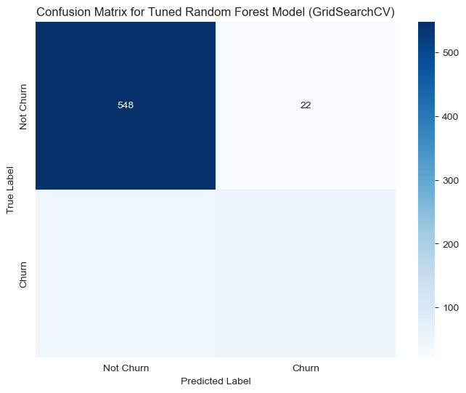
CONFUSION MATRIX
Observations:
Correctly identified loyal customers: 548
Incorrectly flagged loyal customers (false positives): 22
Missed churners (false negatives): 44
Correctly identified churners: 53
Precision: 71% – Most flagged churners were truly at risk Recall: 55% – The model caught over half of actual churners

Slide 25
MATRIX SUMMARY
What This Means:
Recall (Churn Captured): We caught 55% of actual churners.
Precision (Correct Churn Predictions): Of those we flagged as churners, 71% were truly at risk.
Business Insight
To reduce customer loss:
If every lost customer is expensive, SyriaTel might want to focus more on catching more churners (higher recall) — even if it means more false positives.
If resources for retention are limited, focusing on more accurate churn predictions (higher precision) may be better.

Slide 26
RECOMMENDATIONS
🎯 Targeted Retention Campaigns
Identify high-risk customers based on daytime usage, service calls, and international plan status.
Offer personalized incentives (e.g., discounted plans, loyalty bonuses) to encourage loyalty.
☎️ Improve Customer Service
Analyze common issues behind frequent customer service calls.
Implement proactive outreach to resolve recurring problems before customers churn.
Focus on improving first-call resolution rates.
🌍 Re-evaluate International Offerings
Investigate why customers with international plans have a higher churn risk.
Adjust pricing, features, or marketing to better align these plans with customer expectations.
📊 Monitor Usage Patterns
Set alerts for sudden spikes or drops in total day usage as potential signals of dissatisfaction or churn risk.

Slide 27
NEXT STEPS
Deploy the Tuned Random Forest Model
Integrate it into SyriaTel’s CRM system for real-time churn prediction.
Set Up Alerts for High-Risk Customers
Automatically flag customers with high churn probabilities for proactive engagement.
Refine Retention Campaigns
Use model insights to tailor personalized retention offers (e.g., loyalty rewards, discounts).
Monitor & Re-train
Schedule regular model performance checks.
Retrain model quarterly as new customer behavior data becomes available.
Explore Additional Features
Consider incorporating billing history, network quality, or competitor activity for deeper insights.

Slide 28
THANKS
Do you have any questions?
Contact info:
lilianwangui266@gmail.com
https://github.com/Wangui10/

