Slide 1
IMPLEMENTING AN APPLICATION THAT GENERATES ARTIFICIAL DATASETS AS A SOLUTION TO THE SMALL DATASET PROBLEM (A CASE STUDY OF SCHOOL EXAM PERFORMANCE DATASETS)
SCOLA WANGUI KAMANDE
SCT222-2018/2015

Slide 2
ABSTRACT
Data science has become more popular today
It has been used extensively in finance, health, education, commerce, meteorology, web, and the general business domain
Large organisation are better placed to use analytics
Small organisations only have access to small data
The small dataset problem
Notes:
It affects the development of solutions.

Slide 3
BACKGROUND INFORMATION
Data science is the use of statistics, statistical methods and models. Data is growing exponentially
Data science facets are: descriptive, diagnostic, predictive, prescriptive
Descriptive: What happened?
Diagnostic: Why did it happen?
Predictive: What is likely to happen?
Prescriptive: What action should be taken?
Notes:
It affects the development of solutions.

Slide 4
BACKGROUND INFORMATION
Small dataset is capable of impacting decisions in the present. It is small enough for human comprehension. Often tabulated
Big datasets are so large and complex that traditional data processing applications cannot deal with them
Rouse (2018) defines artificial data as information that's artificially manufactured rather than generated by real-world events. Artificial data is created algorithmically
Notes:
It affects the development of solutions.

Slide 5
RESEARCH AREA
According to Rouse (2018) in predictive modelling, data is collected, a statistical model is formulated, predictions are made, the model is validated or revised as additional data becomes available
The larger the dataset the more accurate, dependable and valid a prediction model is
Notes:
It affects the development of solutions.

Slide 6
PROBLEM STATEMENT
According to Ratner (2017) a prediction model created from a small dataset presents the constraint of information gaps that render the model unreliable, invalid and undependable
Small organisations can only have access to small data.
They can only depend on reactive forms of analytics
Notes:
It affects the development of solutions.

Slide 7
PROPOSED SOLUTION
This research project has brought about the development of an application that aids in the generation artificial datasets
Artificially generated data will bridge information gaps
Notes:
It affects the development of solutions.

Slide 8
OBJECTIVES
To investigate approaches of generating artificial data
To develop an application that implements the generation of artificial datasets
To compare predictive models generated from real and artificial datasets
Notes:
It affects the development of solutions.

Slide 9
RESEARCH QUESTIONS
What are the different ways of generating artificial data?
How are predictive models generated?
How do real data-based predictive models compare to those of artificial data?
Notes:
It affects the development of solutions.

Slide 10
JUSTIFICATION
Coca Cola – use analytics to boost customer acquisition and retention
Netflix – creating targeted advertising efforts
Trading platforms – i.e. forex use it for risk management
Amazon – innovations and product development
Notes:
It affects the development of solutions.

Slide 11
JUSTIFICATION
Large organisations have the benefit of large data
Small organisation only have access to small data and in some occasions none at all
Generation of artificial data is inexpensive
Notes:
It affects the development of solutions.

Slide 12
RESEARCH METHODOLOGY: DATA COLLECTION
Content analysis: - Analysis of existing documentation, open data sources of school examination performance and various approaches of artificial data generation
Notes:
It affects the development of solutions.

Slide 13
RESEARCH METHODOLOGY: ANALYSIS & DESIGN
Team Data Science Process - a data science project methodology
Business understanding – understanding how performance grading comes about. Information about the students
Data acquisition and understanding – acquisition and analysis of real school exam performance data. Generation of artificial data
Notes:
It affects the development of solutions.

Slide 14
RESEARCH METHODOLOGY: ANALYSIS & DESIGN
Modelling – models from both real and artificial data will be generated and verified against the original business question
Deployment – Application of the business models. Accuracy of both business models will be determined
Notes:
It affects the development of solutions.

Slide 15
RESEARCH METHODOLOGY: IMPLEMENTATION
Acquiring real school exam performance data
Generation a prediction model using the real data
Generating artificial data
Generation of prediction model based on artificial data
Predicting outcomes of a business case using both models to ascertain dependability
Notes:
It affects the development of solutions.

Slide 16
RESOURCES: HARDWARE
Personal Computer – for creation of the artificial data and testing
Server – for the generation of prediction models
Wireless Router – for internet connectivity to the server
Notes:
It affects the development of solutions.

Slide 17
RESOURCES: SOFTWARE
Python 3.6.4
RapidMiner – GUI based data science tool
Scikit-learn – open source data science tool
Trumania – a realistic scenario-based data generation library
Notes:
It affects the development of solutions.

Slide 18
LITERATURE REVIEW
The small dataset problem is not just a data science problem
Machine learning
Artificial Intelligence
Its a common misconception is all data is big data
Notes:
It affects the development of solutions.

Slide 19
INTRODUCTION
Disciplines such as medicine, sociology, psychology, geology face the small dataset problem.
Often due to their experimental nature or newly discovered phenomenon

Slide 20
PROBLEMS OF SMALL DATA
According to Brownlee (2019):
Poor approximation
Under-constrained data over-fits the training data
Results in poor performance
Too little test data results in an optimistic and high variance estimation of model performance

Slide 21
PROBLEMS OF SMALL DATA
Small data often has a large number of outliers
It is difficult to separate training data from test data when small data is involved.
According to Carremans (2018), over-fitting occurs when a good fit of the model is achieved on the training data, while it does not generalize well on new, unseen data.
Notes:
An outlier is an observation that lies an abnormal distance from other values in a random sample from a population. The analyst decided what will be considered abnormal and singles them out.
Best practice dictates separating test data from training data. The purpose of separation is to report generalized performance on unseen data i.e. test data and to tune model parameters using train data.

Slide 22
PROBLEMS OF SMALL DATA
Data involves metrics, either be predictors or targets, measured in the real world. Errors associated with those metrics tend to have a larger effect on models built from small datasets as opposed to those built from large datasets.
Notes:
An outlier is an observation that lies an abnormal distance from other values in a random sample from a population. The analyst decided what will be considered abnormal and singles them out.
Best practice dictates separating test data from training data. The purpose of separation is to report generalized performance on unseen data i.e. test data and to tune model parameters using train data.

Slide 23
ARTIFICIAL DATA GENERATION APPROACH
The concept of artificial data was originally proposed by Partha Niyogi in pattern recognition work which is to improve a 3-D view recognition of an object by increasing the amount of sample data using prior knowledge gained from a small training set.

Slide 24
METHODS OF ARTIFICIAL DATA GENERATION
Procedural Randomization - starts with a general scene. Combines it with randomly sampled dynamic elements that can yield datasets of unlimited size
Manual data modeling - This can be achieved either by rendering existing scenes, or by manually recombining objects from existing scenes to get new, specially designed scenes.
Notes:
Manual modeling allows for more specialized datasets to be created

Slide 25
METHODS OF ARTIFICIAL DATA GENERATION
Data fuzzification using bootstrap - randomly resample the original observations with replacement.
It aim is simply to increase amount of observation without necessarily filling the data gaps
Notes:
Manual modeling allows for more specialized datasets to be created

Slide 26
CONCLUSION
Well generated artificial data increases learning accuracy and dependability of models.
The small dataset problem causes poor learning performance and significant uncertainty to prediction models.

Slide 27
SYSTEMS ANALYSIS AND DESIGN
Data phase - Business understanding, data acquisition and understanding, modeling, deployment
Software development phase
Agile methodology - OOSAD.
Incorporating Kanban method.

Slide 28
TECHNICAL FEASIBILITY
The Ministry of Education and schools in Kenya are already using technnology for management.
Through the Digi-School programme launched in May 2016 has brought about the distribution of a total of 1,068,250 laptops to 19,666 schools.
More teachers are now I.T trained.

Slide 29
ECONOMIC FEASIBILITY
Rise in satisfactory exam performance
Creation of better school programs
Ease the process of acquiring relevant data
Lower staff turnover
Students will be empowered

Slide 30
OPERATIONAL FEASIBILITY
It will not drastically change how schools function.
Supplemented data collection during enrollments.
School staff such as teachers and counselors would work together to create the artificial data using their expertise and past experience.

Slide 31
REQUIREMENTS ELICITATION
Data populated in the NEMIS system regarding students includes:
Biodata
Student mobility
Performance regression
Learner talent
Hence the need to use open data on exam performance
Notes:
Other factors that affect student performance such as student background that may involve their family structure, parental presence and occupation and drug and substance abuse among others.

Slide 32
DATA COLLECTION
Content analysis of school performance in Portugal. Discovery of other important factors.
The other factors are: number of absences, parent’s job, education and alcohol consumption.
Change of focus from past evaluations to student demographics

Slide 33
DATA ANALYSIS
Pstatus - Parents cohabitation status (living together or apart)
Mjob and Fjob - Mother’s job [ teacher, health care related, civil services (e.g. administrative or police), at home or other.]
Health - Current health status (numeric: from 1 – very bad to 5 – very good)

Slide 34
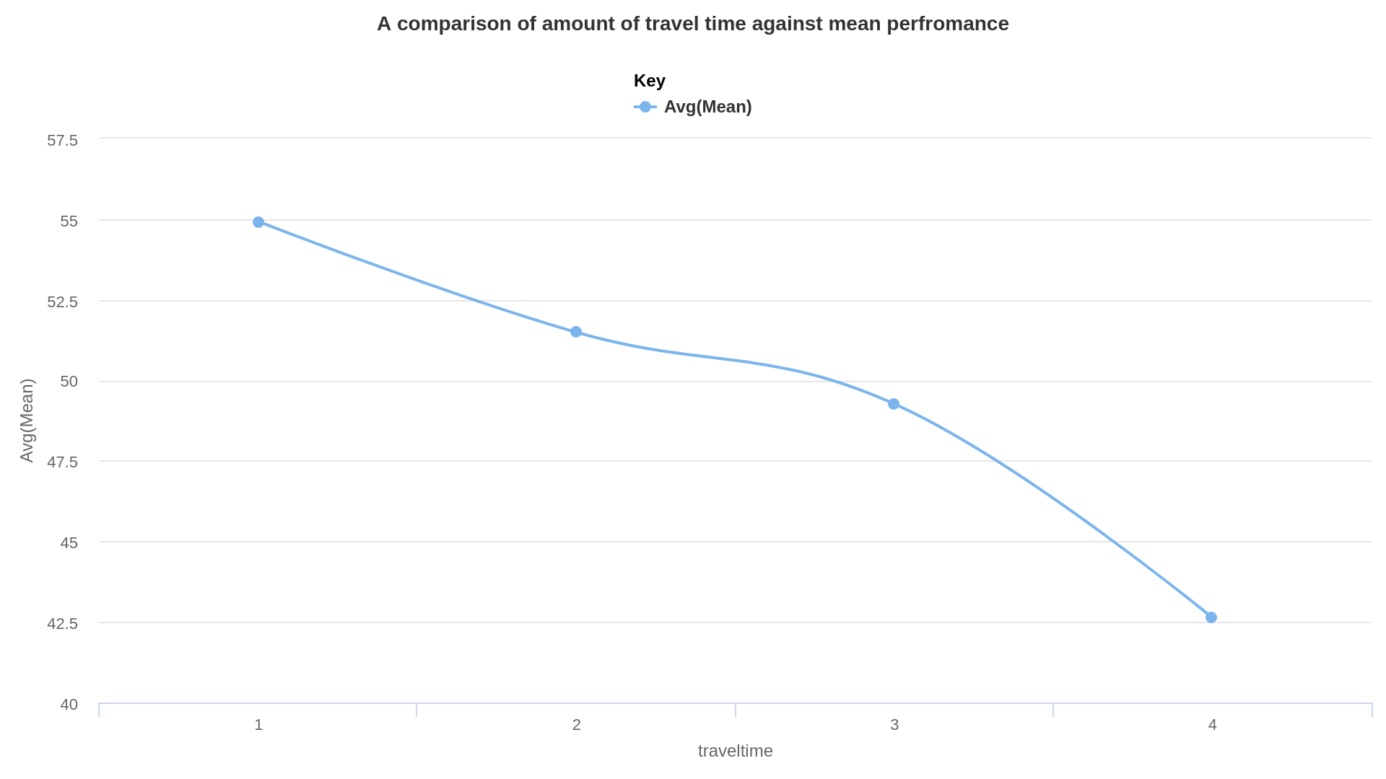

Slide 35
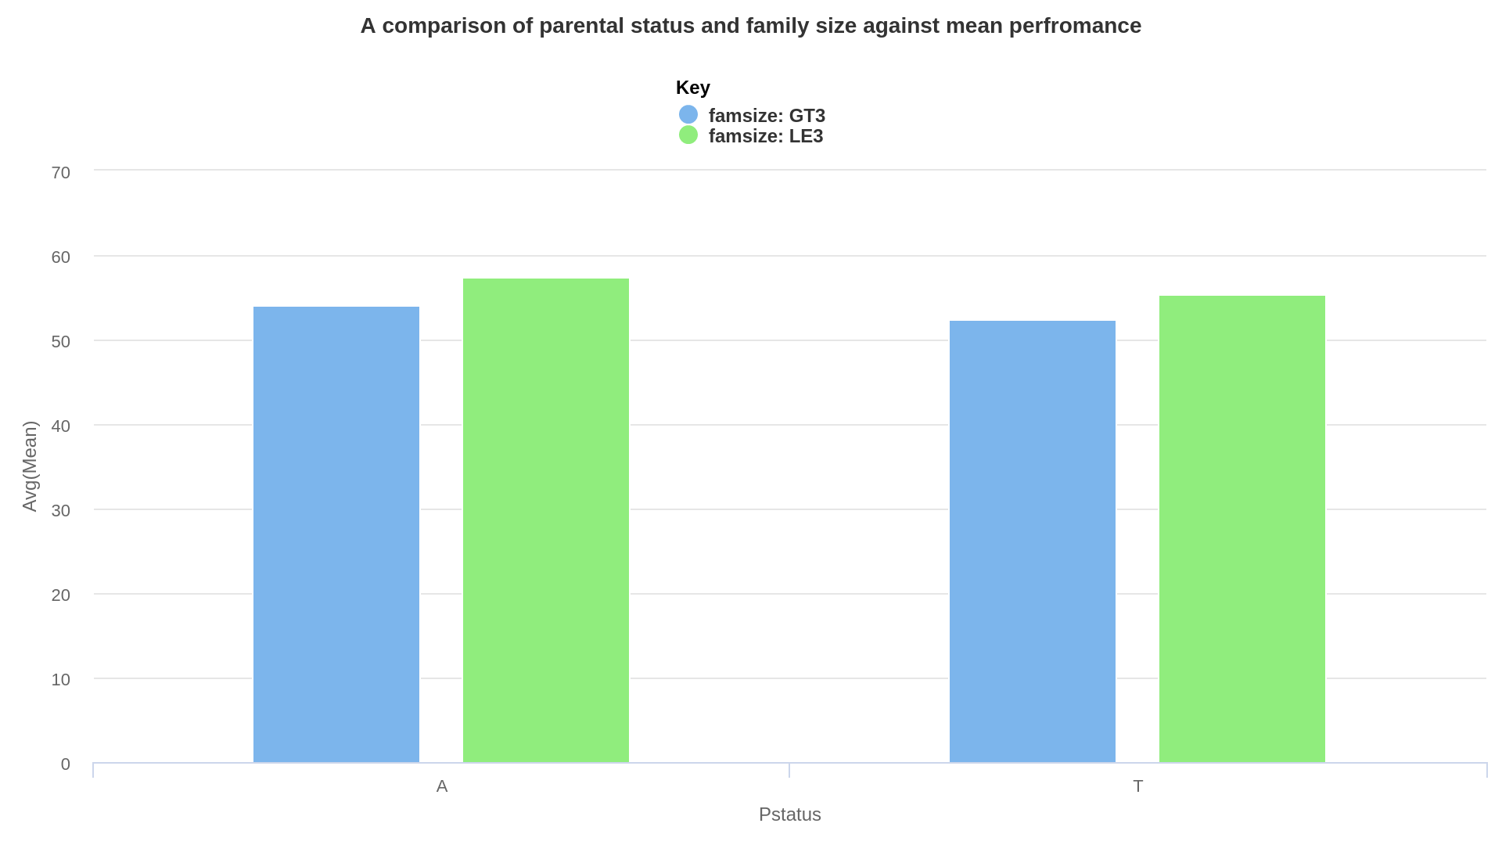

Slide 36
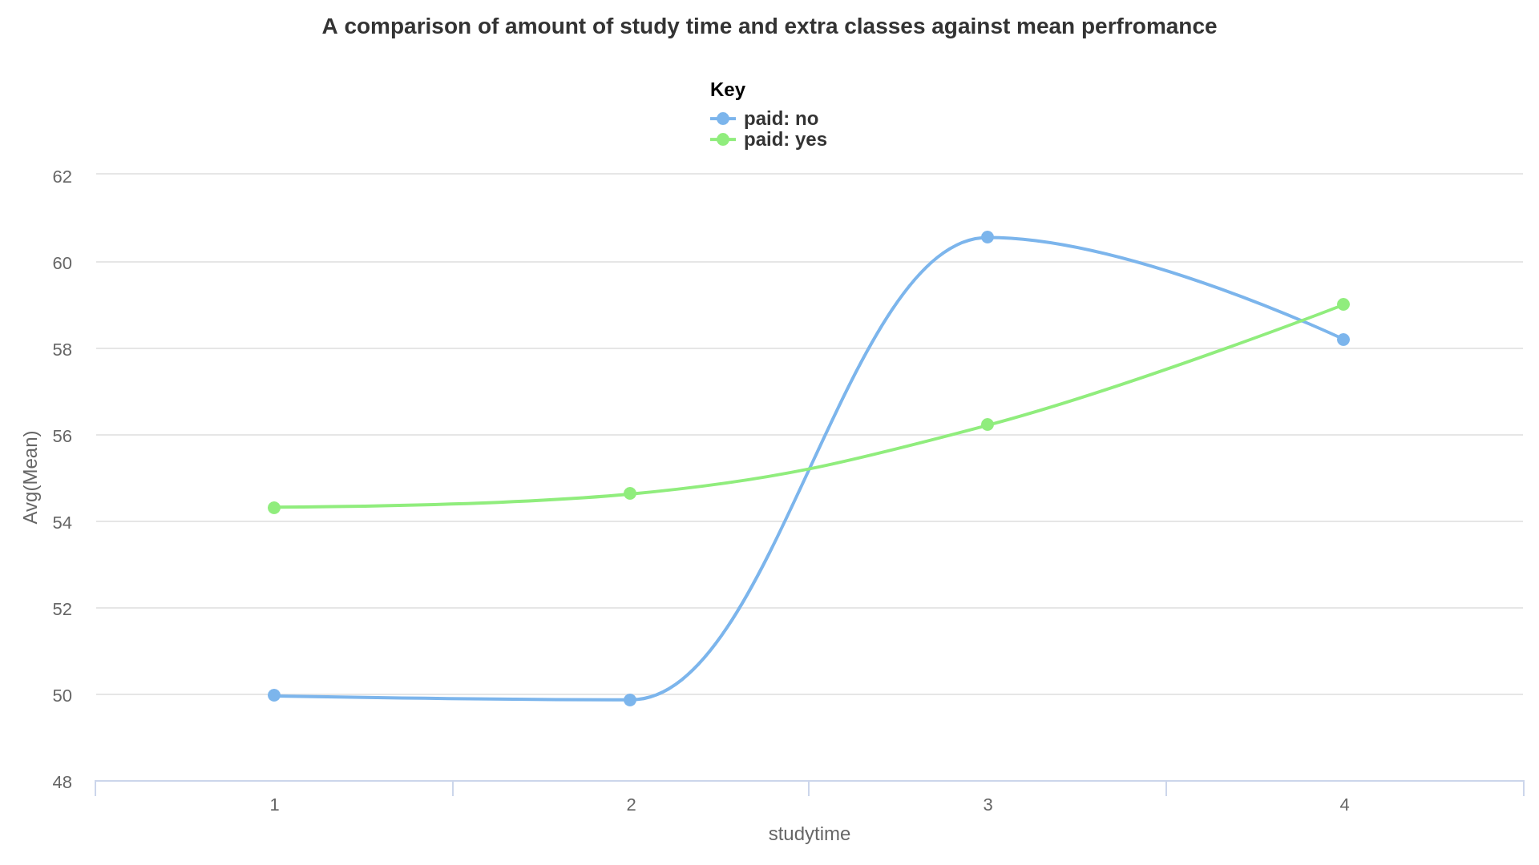

Slide 37
SYSTEMS SPECIFICATION: FUNCTIONAL REQ.
Specify the attributes for which artificial data is required
Control the range of data values required per attribute
Specify the data type of the data entries
Should be able to access, the artificial dataset

Slide 38
NON-FUNCTIONAL REQUIREMENTS
Generate large amounts of data in the least possible time
Easy to use
Offer a large degree of customization
Make it clear to the user what they can/should do next.

Slide 39
HARDWARE REQUIREMENTS
The school would need to have a desktop or laptop computer that meets the following minimum features; core 2 duo or core i3 4GB RAM and 500 GB HDD.

Slide 40
SYSTEMS DESIGN
PHYSICAL DESIGN

Slide 41


Slide 42
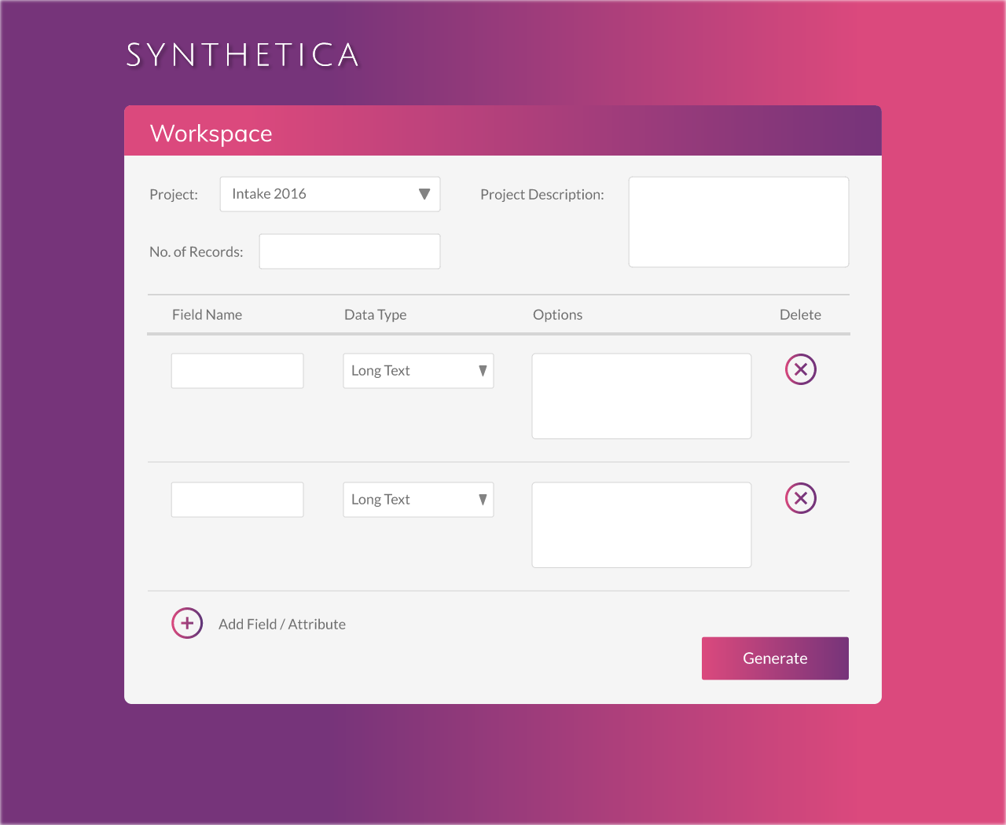

Slide 43
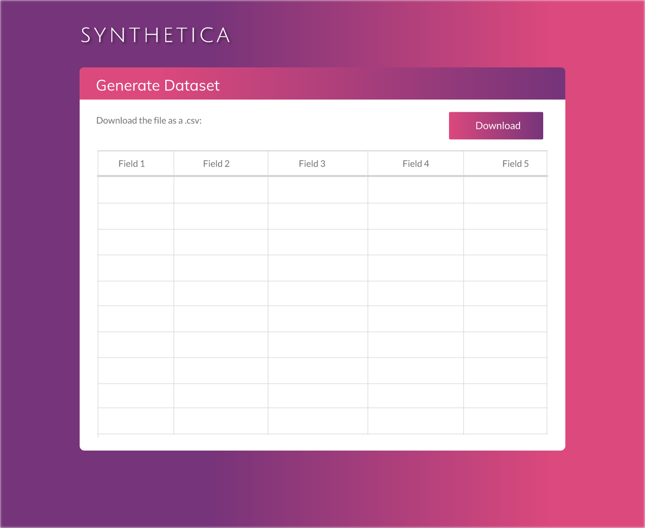

Slide 44
SYSTEMS DESIGN
LOGICAL DESIGN

Slide 45
SYSTEMS DESIGN
LOGICAL DESIGN

Slide 46
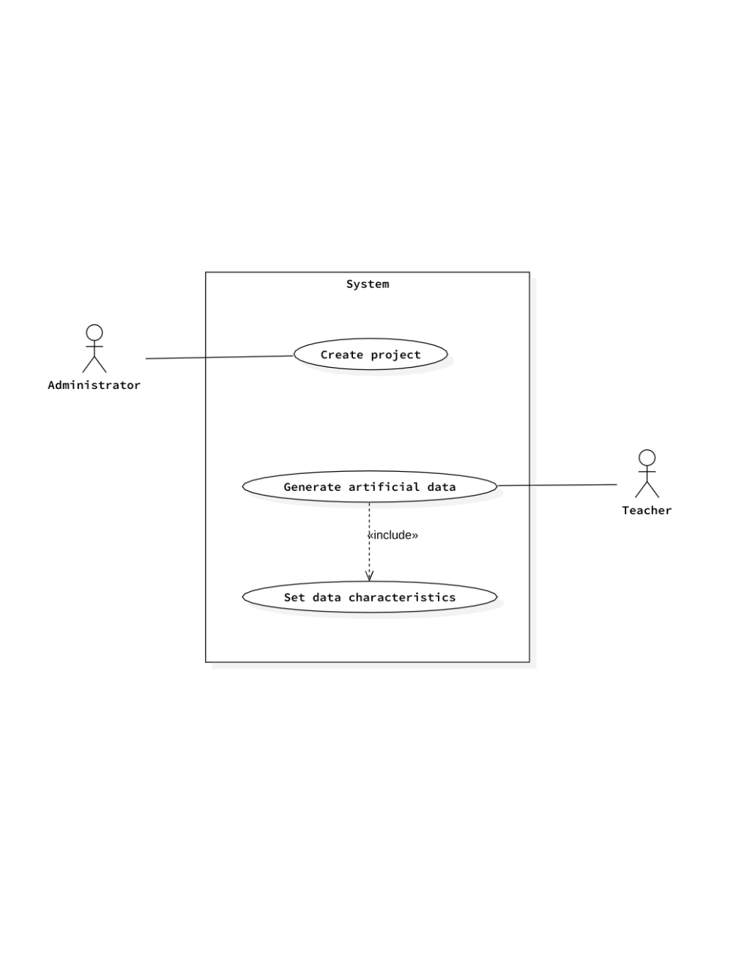

Slide 47
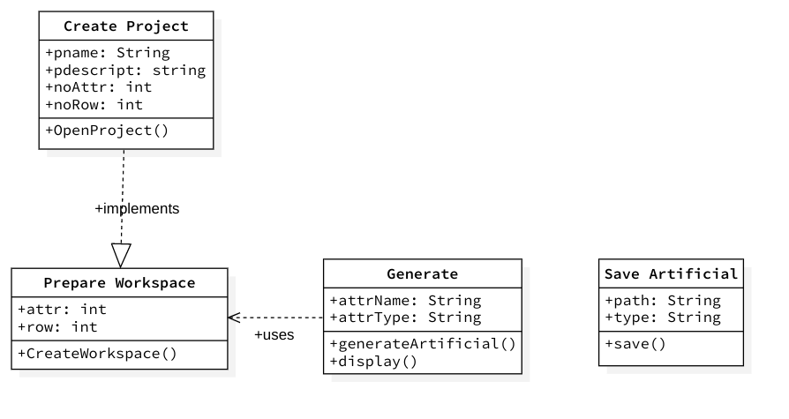

Slide 48
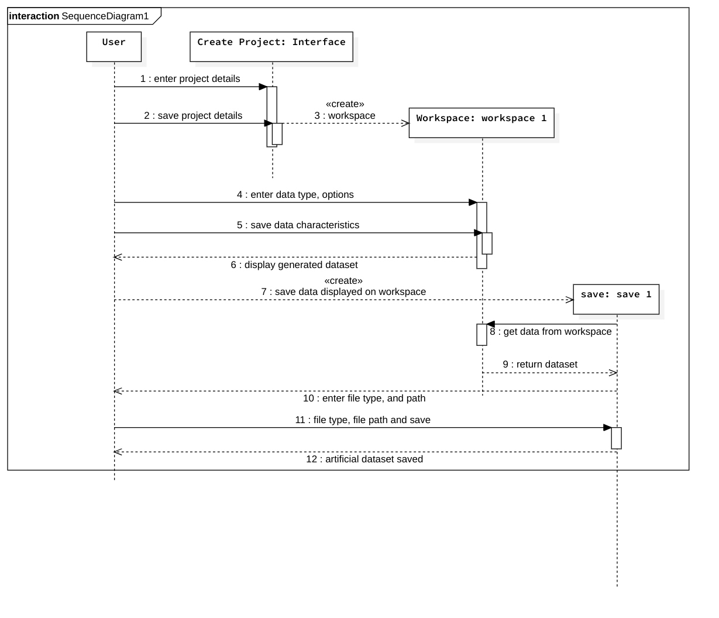

Slide 49
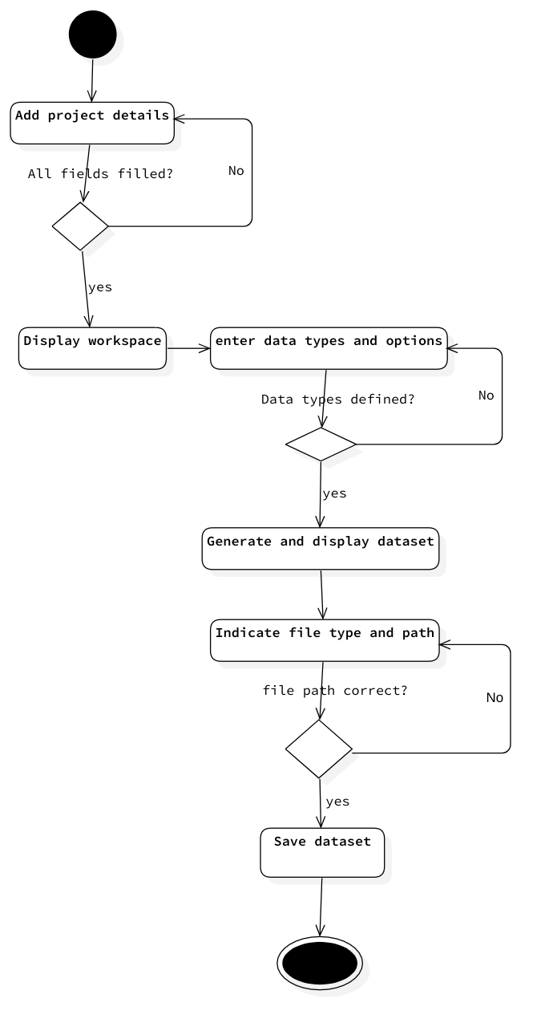

Slide 50
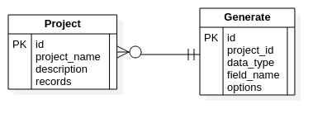

Slide 51
SYSTEM CODE GENERATION & TESTING
Python/Django for backend
HTML, CSS and JQuery for frontend (templates)
SQLite database
Hosted at Heroku
Editor: Visual Studio Code

Slide 52


Slide 53
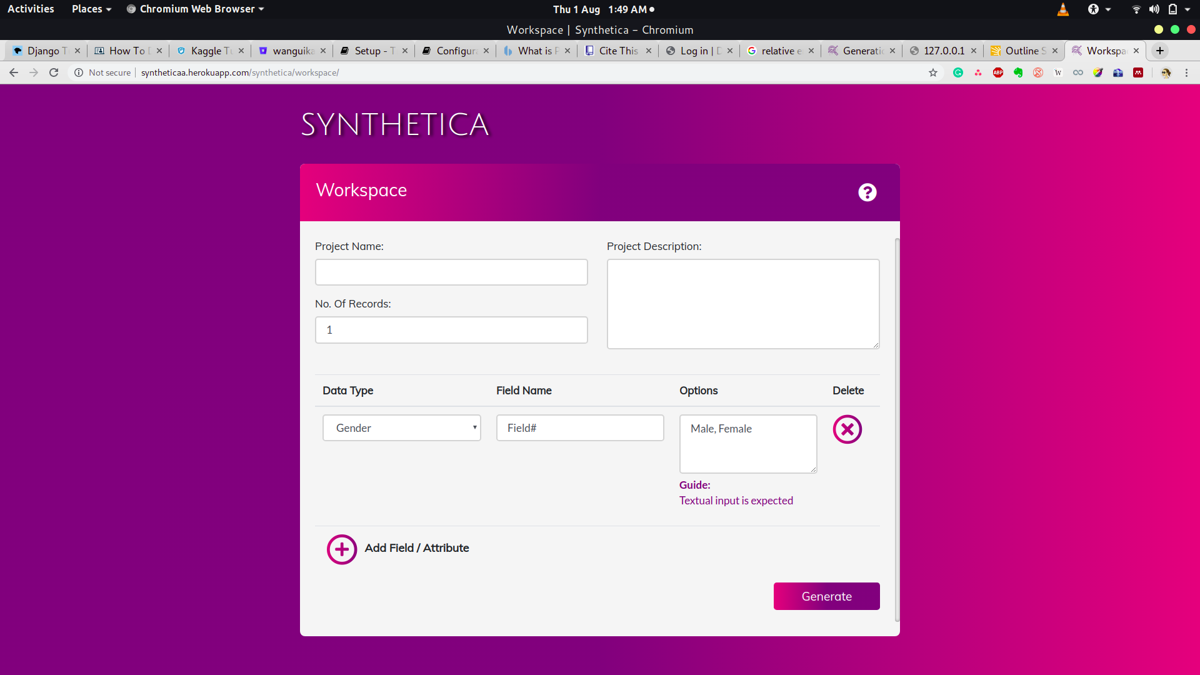

Slide 54
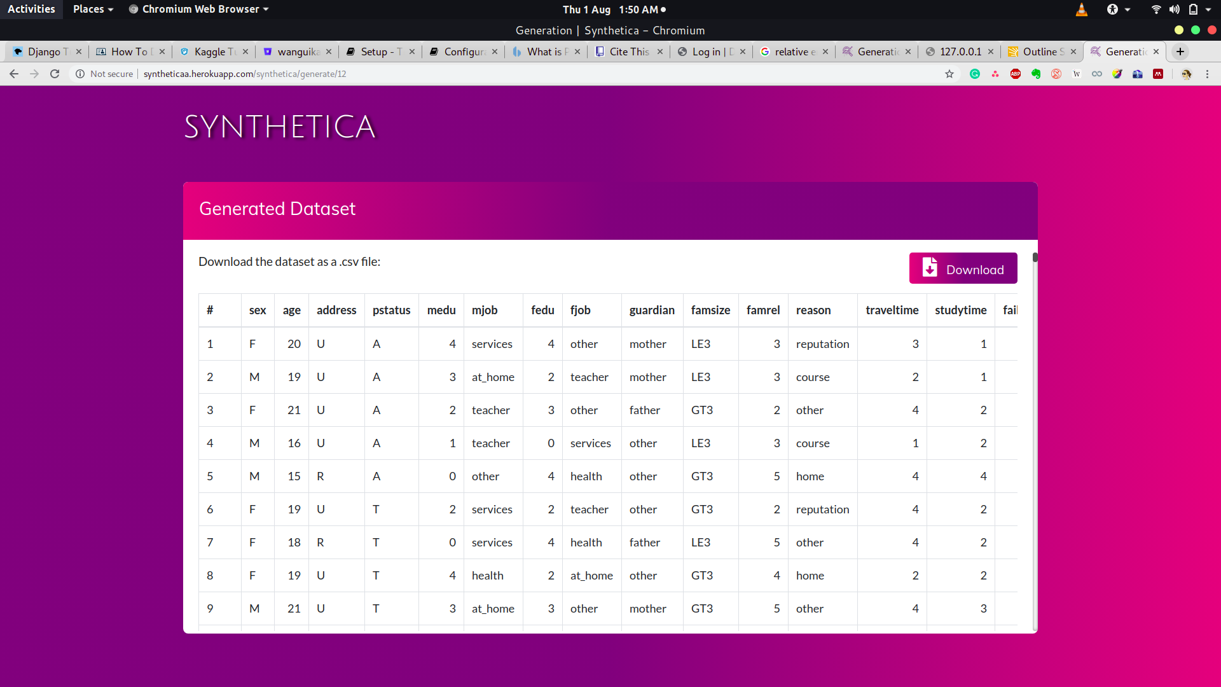

Slide 55
TESTING: INTEGRATION TESTING
Task: Data flow between SQLite database and web app
Test case:
Ability save metadata
Ability to access past created projects

Slide 56
TESTING: GUI TESTING
Task: Saving project metadata
Test case:
Ability to load the workspace page
Create project
Create fields and fields metadata

Slide 57
TESTING: ACCEPTANCE TESTING
Task: Acquiring dataset and applying onto predicting tool
Test case: User requirements

Slide 58
ANALYSIS OF PREDICITVE MODELS
A comparison of the artificial dataset model vs. the real dataset model
Real data: 395 records
Artificial data: 2000 records
Tool: RapidMiner Studio (Education License)

Slide 59
PREDICTIVE MODEL PERFORMANCE EVALUATION
Classification vs regression problem. What is evaluated depends on the business goal
School performance - regression problem

Slide 60
PREDICTIVE MODEL PERFORMANCE EVALUATION: METRICS
R-Squared - his indicates how many variables compared to the total variables the model predicted
Average error - numerical difference between the predicted and the actual values
Mean squared error - average of all difference between the predicted and actual values

Slide 61
PREDICTIVE MODEL PERFORMANCE EVALUATION: METRICS
Average absolute error - similar to average error. It is only used to balance out the differences in the outliers of the data
Median absolute error - it represents the average of the absolute differences between prediction and actual observation

Slide 62
MODELLING TECHNIQUES
General linear model - predicts the expected value of a given unknown quantity as a linear combination of a set of observed values (predictors).
Random forests - constructs a multitude of decision trees at training time and outputting the mean prediction of the individual trees
Decision trees - partitions data into subsets in order to encapsulate the data into the smallest tree.

Slide 63
GENERAL LINEAR MODEL

Slide 64
Student | 1 | 10 | 67 | 150
Actual Mean | 27 | 58 | 57 | 93
Real data model prediction | 50.042 | 50.971 | 61.903 | 60.768
Artificial data model prediction | 44.998 | 45.963 | 46.605 | 40.278

Slide 65
RANDOM FOREST MODEL

Slide 66
Student | 1 | 10 | 67 | 150
Actual Mean | 27 | 58 | 57 | 93
Real data model prediction | 48.815 | 54.174 | 56.349 | 56.038
Artificial data model prediction | 48.725 | 46.752 | 46.499 | 45.683

Slide 67
DECISION TREE MODEL

Slide 68
Student | 1 | 10 | 67 | 150
Actual Mean | 27 | 58 | 57 | 93
Real data model prediction | 56.816 | 56.816 | 56.816 | 56.816
Artificial data model prediction | 46.979 | 46.979 | 46.979 | 46.979

Slide 69
CONCLUSION
Behaviour - mean response
Independent variable X - student characteristics (predictor)
Dependent variable Y - exam mean marks (criterion)
The mean of the predicted values (Y’) is equal to the mean of the actual values (Y).

Slide 70
CONCLUSION
Artificial dataset performs better and is more dependable
Artificial dataset has many outliers due to randomization
Simulates impossible or highly unlikely scenarios
Artificial datasets are very inefficient when the focus is classification
Tree-based models are not the best when dealing with artificial data - overfitting

Slide 71
CONCLUSION
HOWEVER,
The small dataset problem is solved
Randomization ensure all information gaps are filled.
Artificial dataset are best used as a basis, and have potential for learning.
Over-dependence on artificial data should be highly discouraged - no real world scenario

Slide 72
LIMITATIONS, CONCLUSION & RECOMMENDATIONS

Slide 73
LIMITATIONS
Poor internet connectivity
New field - python, data science
Poorly documented APIs
Expensive dependent application server
Heavy processing requirements during generation of large datasets

Slide 74
PROJECT APPRAISAL: STRENGTHS
Relatively easy to use
Consistent interface
It allows for access of prior generated datasets without having to initiate a new projects

Slide 75
PROJECT APPRAISAL: WEAKNESSES
It does not include an interface for using the artificial dataset to make predictions
The system involves a lot of repetitive data entry that may become tedious
The system is dependent on an internet connection

Slide 76
CONCLUSIONS
Objectives have been met
It is possible to use artificial datasets for predicitive modelling
It is an inexpensive and legal means of acquiring data

Slide 77
RECOMMENDATIONS
Artificial data generation should be integrated in CMS, data science tools
It is necessary that research how long or what it takes for predictions of an artificial model to be improved by complimenting it with real data.

