Slide 1
Final Project Presentation
ME5413 Autonomous Mobile Robotics
Group 5
Tang Haodi
Wang Yiwen
Zhang Xinming
Min Jixin
Ma Ziheng
Tian Tan

Slide 2
Content
1. Project Description
2. Mapping
3. Navigation
3.1 Localization
3.2 Path Planning
4. Object Recognition
5. Future Improvement

Slide 3
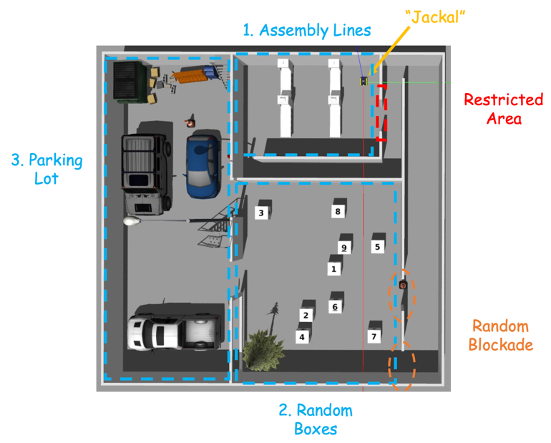
Description
A mini-factory environment in Gazebo:
3 target areas
1 restricted area.
The aim of the project is to design a robot navigation software stack that can:
From the starting point, move to the given pose within each area in sequence:
Assembly Line 1, 2
Radom Box 1, 2, 3, 4
Delivery Vehicle 1, 2, 3
Designated path:
Assembly Line 2 → Radom Box → Delivery Vehicle 3

Slide 4
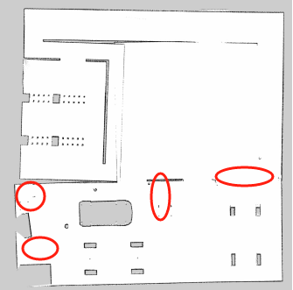
Task 1: Mapping
2D SLAM -- Gmapping
Offset
Information loss

Slide 5
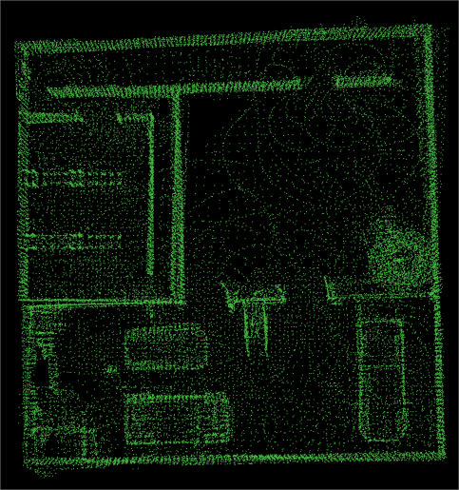
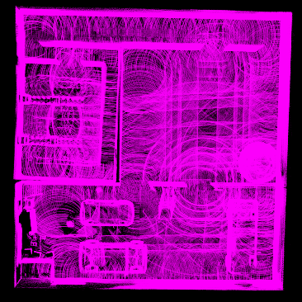
Task 1: Mapping
3D SLAM -- ALOAM & FAST-LIO
A-LOAM
FAST-LIO

Slide 6
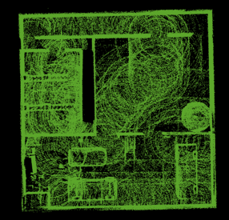
Task 1: Mapping
3D SLAM -- ALOAM & FAST-LIO

Slide 7
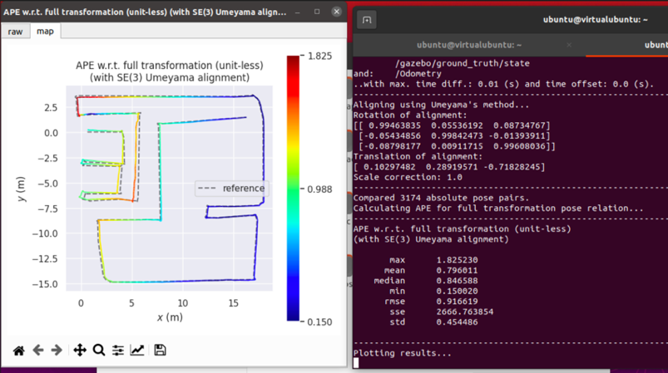
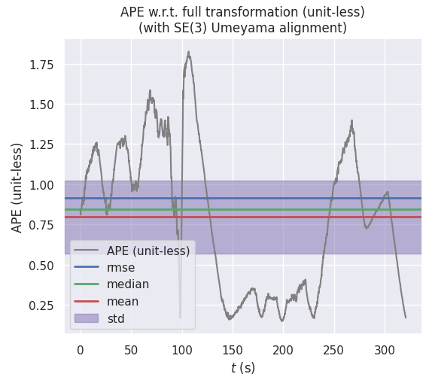
Task 1: Mapping
EVO Performance Evaluation FAST-LIO
mean alignment is 0.796011
max alignment is 1.825230
RMSE is 0.916619
-> The results show that the accuracy of algorithm performs very good.

Slide 8
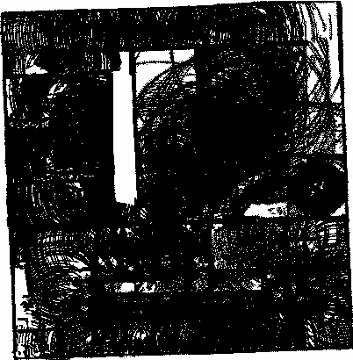
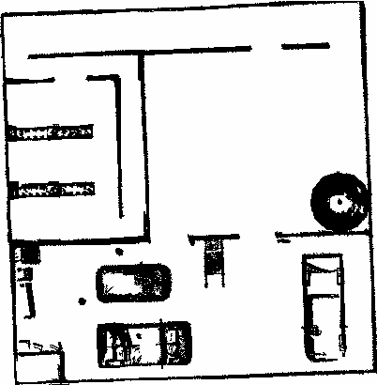
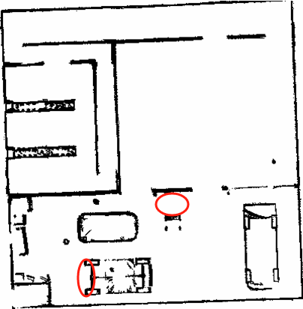
Task 1: Mapping
From PCD to Grid Map (pcd2pgm)
Origin PCD
Add a lower boundary
Add a higher boundary

Slide 9
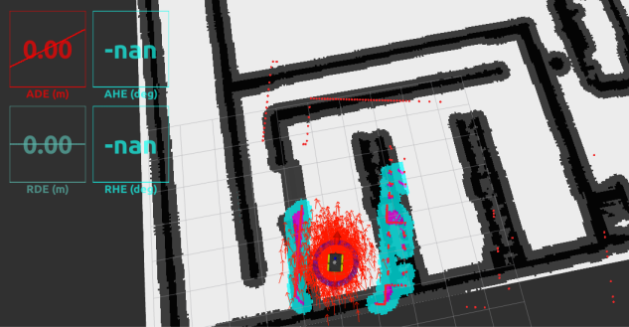
Task 2: Navigation
Localization -- Lidar Frame Drifting
AMCL
ekf_localization
Stay in position for 30s

Slide 10
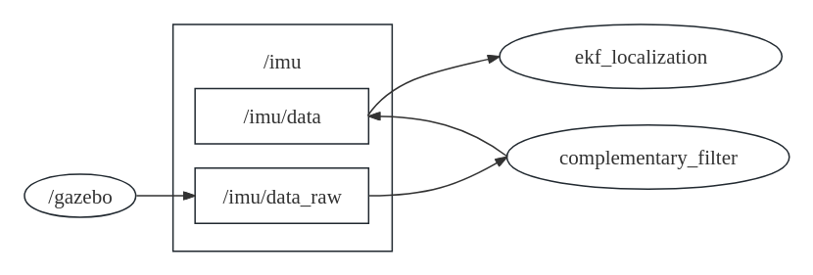
Task 2: Navigation
Localization -- Complementary Filter

Slide 11
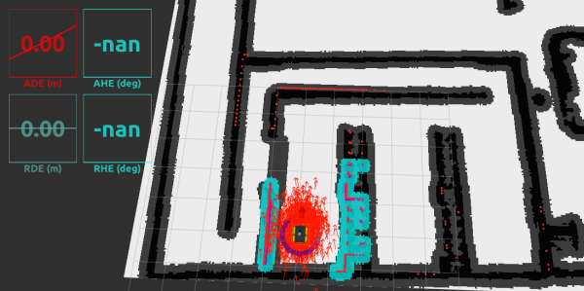
Task 2: Navigation
Localization -- Complementary Filter
Stay in position for 30s

Slide 12
Task 2: Navigation
Path Planning – Global Costmap (prohibition_layer)

Slide 13
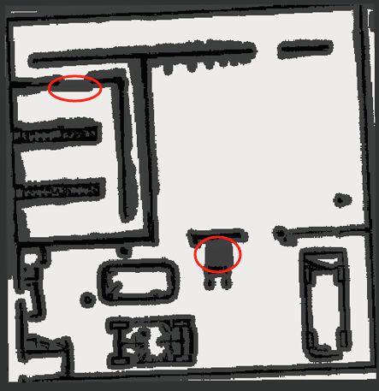
Task 2: Navigation
Path Planning – Global Costmap (prohibition_layer)

Slide 14
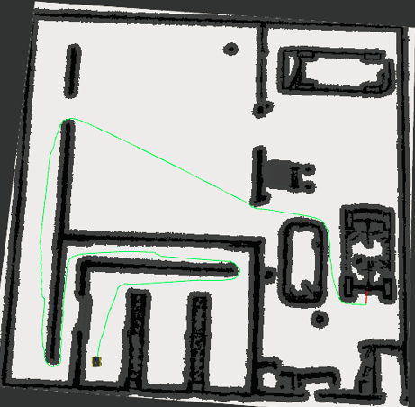
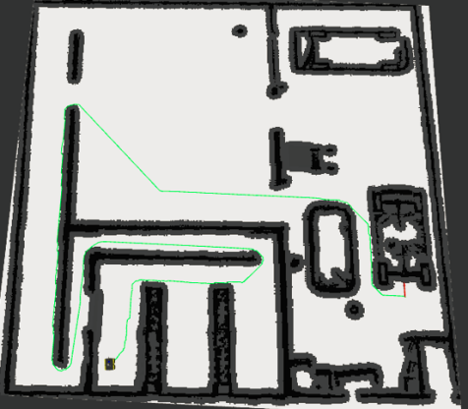
Task 2: Navigation
Path Planning – Global Planner (global_planner/GlobalPlanner)
Dijkstra
A*

Slide 15
Task 2: Navigation
Path Planning – Global Planner (global_planner/GlobalPlanner)
Dijkstra
A*

Slide 16
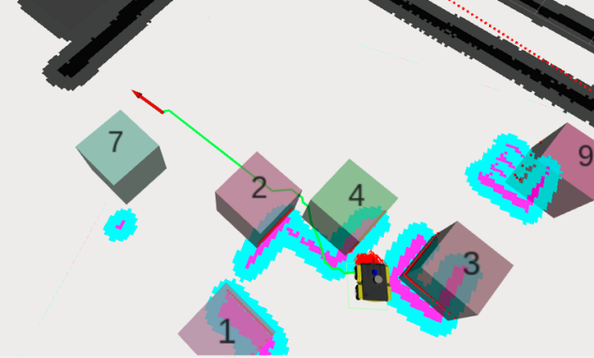
Task 2: Navigation
Path Planning – Local Planner (DWA & TEB)

Slide 17
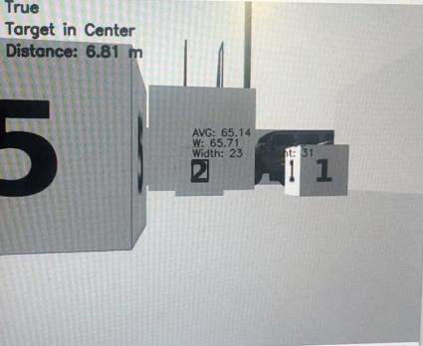



Task 2: Navigation
Object Detection--Template Matching
Different template images at different distances, angles, and lighting conditions
Preprocessing(Gaussian blur) to reduce noise—Thresholding—Template matching
Target detection results

Slide 18
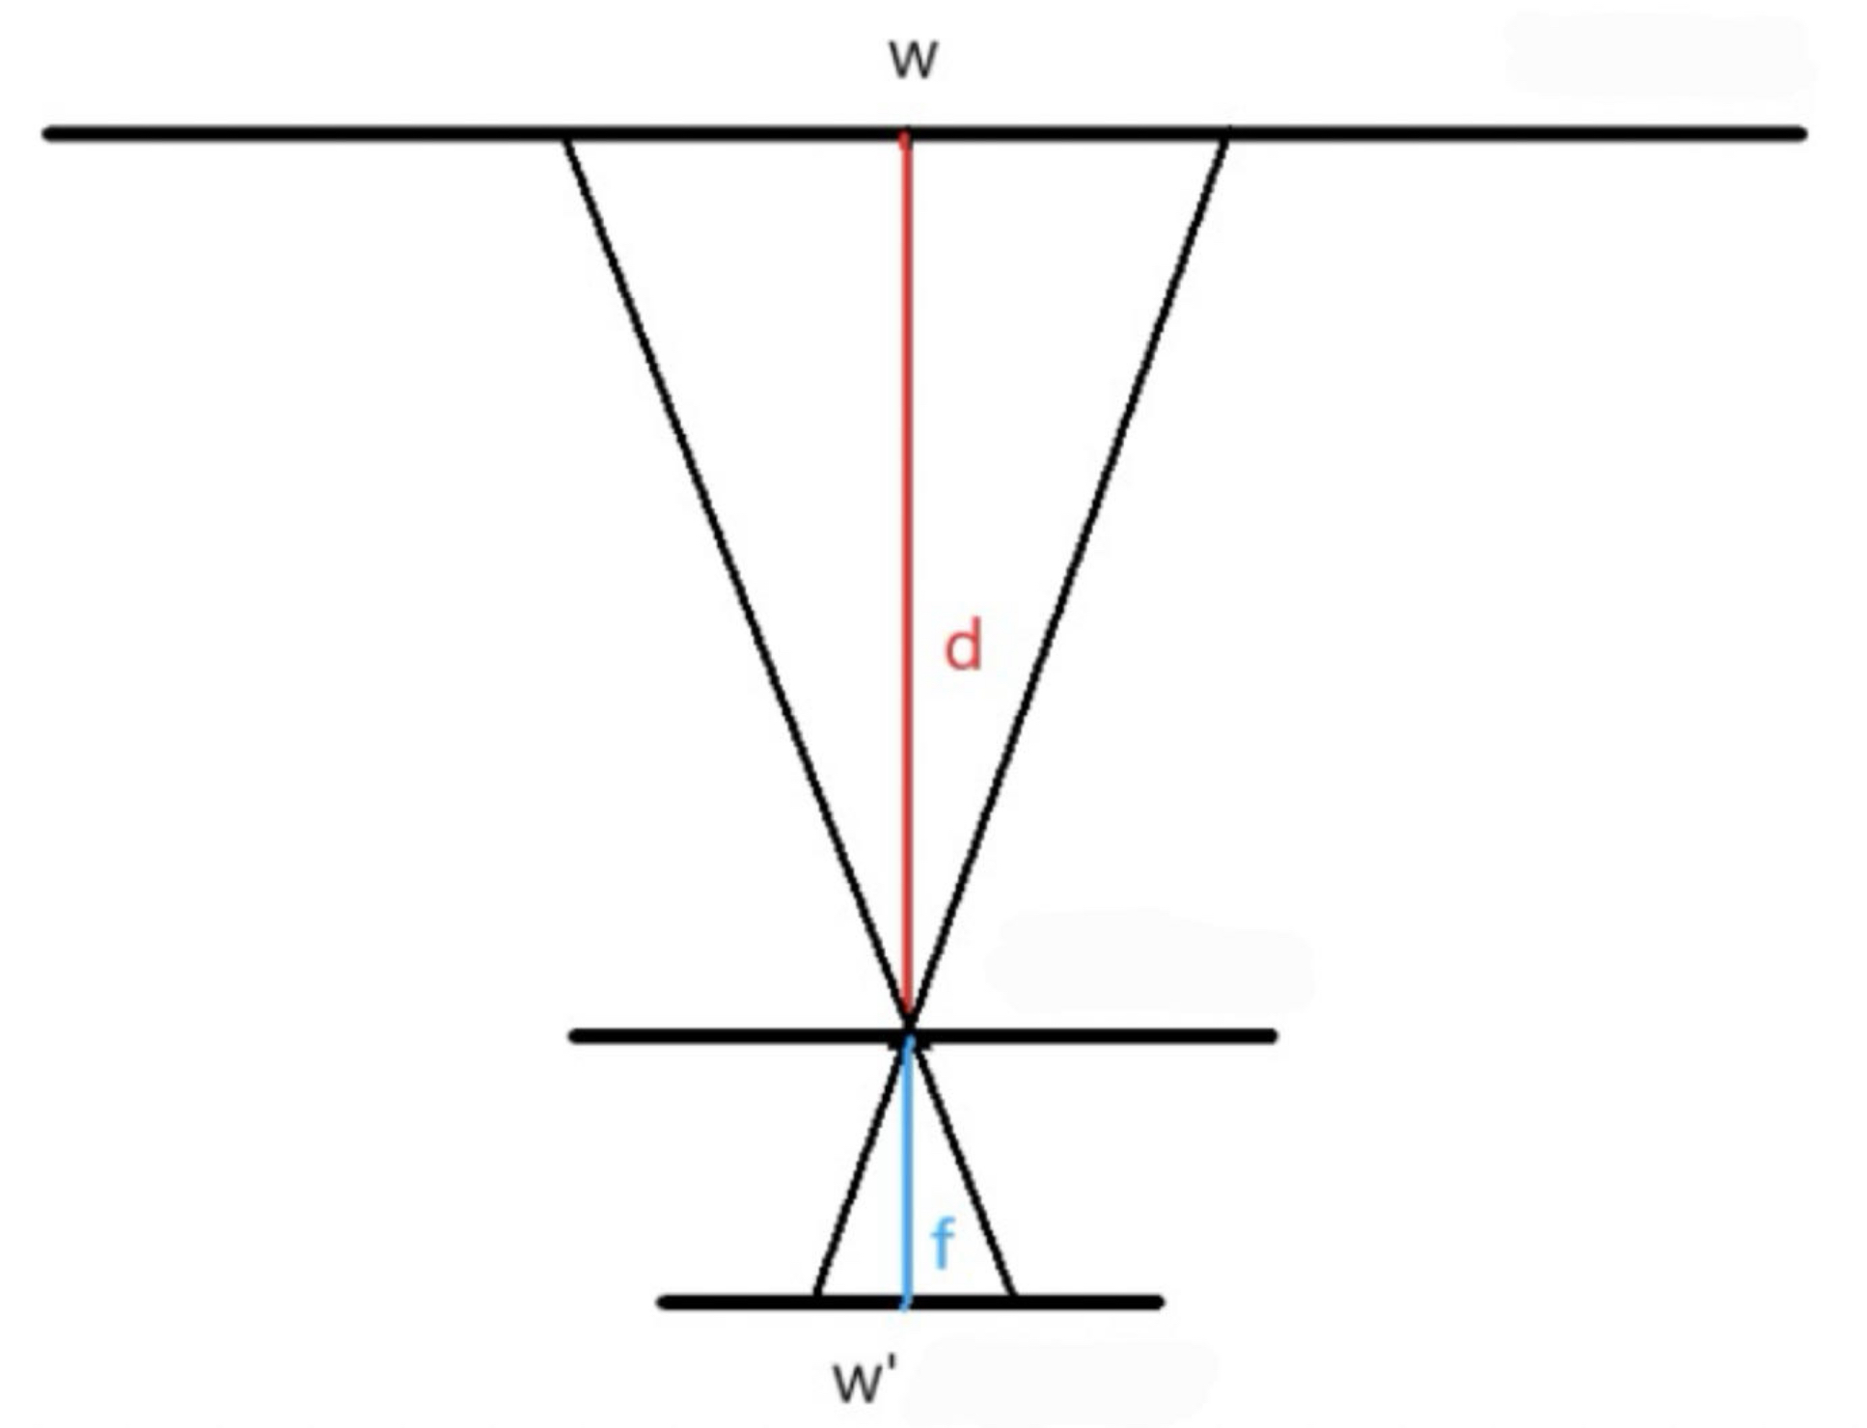
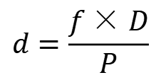
Task 2: Navigation
Camera Ranging
$$d=\frac{f×D}{P}$$
The plane of the object
‘d’: distance from the camera to the object
‘f’: the focal length — /front/camera_info
‘D’ : the actual size of the object — 0.8m
‘P’: the pixel width of the object on the imaging sensor
— calculate according to the bounding box
Pinhole plane
Image plane

Slide 19
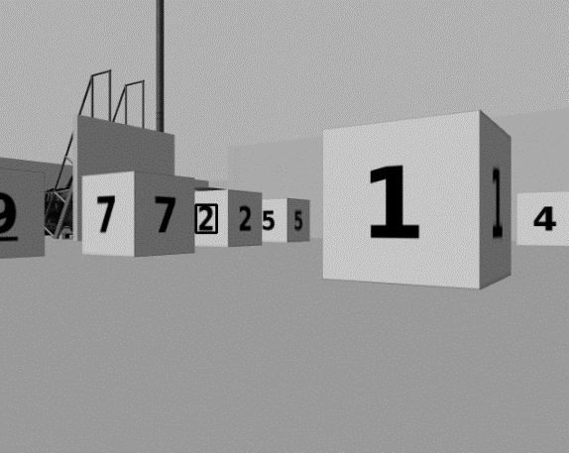
Task 2: Navigation
Difficulties and Solutions
Inconvenient to calculate coordinates when turning
Only perform detection on straight-line path
Control the value of ‘yaw’ in a certain range
False detection during the turning

Slide 20
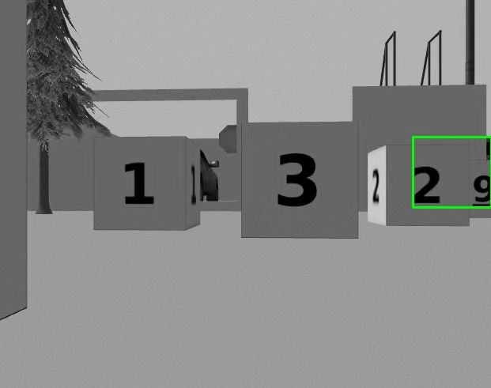
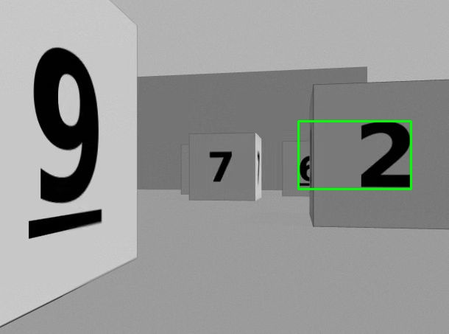
Task 2: Navigation
Object Detection--Tesseract OCR
When the numbers on the block are very close, OCR will mistakenly recognize several numbers as a whole number.
The threshold should be manually adjusted which is not realistic during robot movement.
Detection failures of OCR

Slide 21
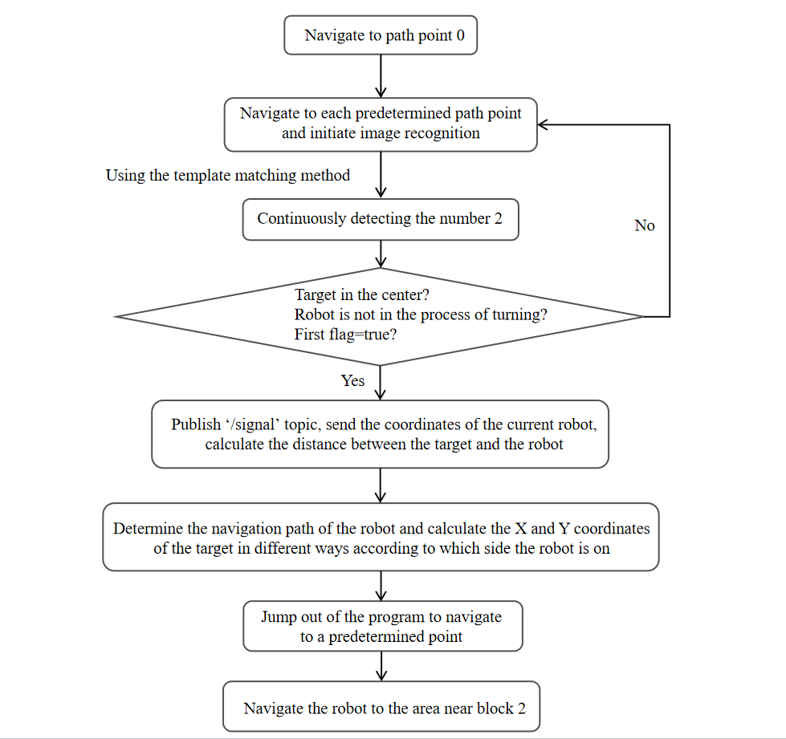
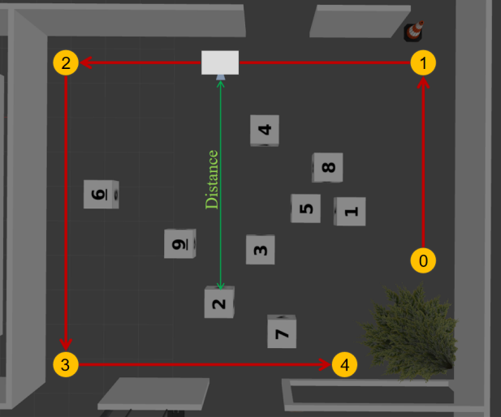
Task 2: Navigation
Path Planning
Proceed to the scheduled points in order

Slide 22
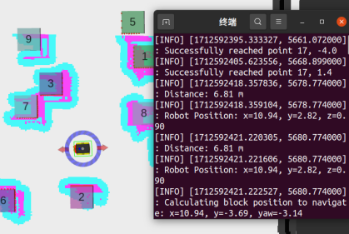
Task 2: Navigation
Navigation to the block
Output：
Reach point 0, 1, 2, 3
When target in center:
1. Calculate distance
2. Obtain position from odometry
3. Calculate block position

Slide 23
Task 2: Navigation
Difficulties and Solutions
Odometer has accumulated errors due to offset issues
Obtain the coordinates of the odometer at the starting point of the path and compare them with the coordinates we set
Add the offset error to the calculated block coordinates

Slide 24
Future Improvement
a. The quality of original PCD map can be improved by modifying the parameters of SLAM algorithms.
b. Drifting issues of odometry and IMU could be calibrated using a well-designed correction algorithm to improve the distance calculation accuracy and navigation accuracy.
c. Better path planning algorithms is recommended to handle the “V” form obstacles.
d. Learning based method can be implemented for recognition and distance calculation.

Slide 25
Thank You ! Q&A
ME5413 Autonomous Mobile Robotics

