Slide 1
Analysis of Employee Attrition —— IBM Example
By Zhe Wang
本作品分为技术建模部分（应教授的项目要求排版）以及成果阐述部分，后半部分特意翻译为中文便于理解。建模结果来自于数据抽样。

Slide 2
Project Background
Employee is one of the key elements for Enterprise Success
An unsteady employee base can lead to high training Costs and Institutional Knowledge Loss
Objective
Identify the most influential Factors in predicting employee attrition through Regression, Decision tree and PCA analysis
Notes:
Employees are the lifeblood of an enterprise. They are important resources and key elements in making the enterprise successful. unlike in the past, today’s workers are increasingly likely to switch jobs multiple times throughout their careers. This can become a burden to employers, as high turnover rates are associated with high training costs for replacing these employees. In order to minimize turnover and retain these valuable employees, it is crucial that employers are able to understand what makes an employee more or less likely to leave and act on that information.
In our analysis of the dataset, we will aim to identify the factors that are most influential in determining whether an employee is likely to leave their job. This will be done primarily through the use of regression, decision tree and PCA analysis.

Slide 3
Data Description
Variables: 37 Explanatory + 1 Target
Dataset Name:
IBM HR Analytics Employee
Attrition & Performance
Source: www. kaggle.com
Observations: 1500+ records
Notes:
Employees are the lifeblood of an enterprise. They are important resources and key elements in making the enterprise successful. unlike in the past, today’s workers are increasingly likely to switch jobs multiple times throughout their careers. This can become a burden to employers, as high turnover rates are associated with high training costs for replacing these employees. In order to minimize turnover and retain these valuable employees, it is crucial that employers are able to understand what makes an employee more or less likely to leave and act on that information.
In our analysis of the dataset, we will aim to identify the factors that are most influential in determining whether an employee is likely to leave their job. This will be done primarily through the use of regression, decision tree and PCA analysis.

Slide 4
Executive Summary
Cleaning the data: Missing values & Outliers
Partition the dataset Train & Test
Remove indecipherable variables
Exploring the model: PCA Analysis
Scree Plot & Components
Decision Tree
Outline & Evaluation
Logistic Regression
Model & Performance
Solutions: Influential Factors & Suggestions
Notes:
Employees are the lifeblood of an enterprise. They are important resources and key elements in making the enterprise successful. unlike in the past, today’s workers are increasingly likely to switch jobs multiple times throughout their careers. This can become a burden to employers, as high turnover rates are associated with high training costs for replacing these employees. In order to minimize turnover and retain these valuable employees, it is crucial that employers are able to understand what makes an employee more or less likely to leave and act on that information.
In our analysis of the dataset, we will aim to identify the factors that are most influential in determining whether an employee is likely to leave their job. This will be done primarily through the use of regression, decision tree and PCA analysis.

Slide 5
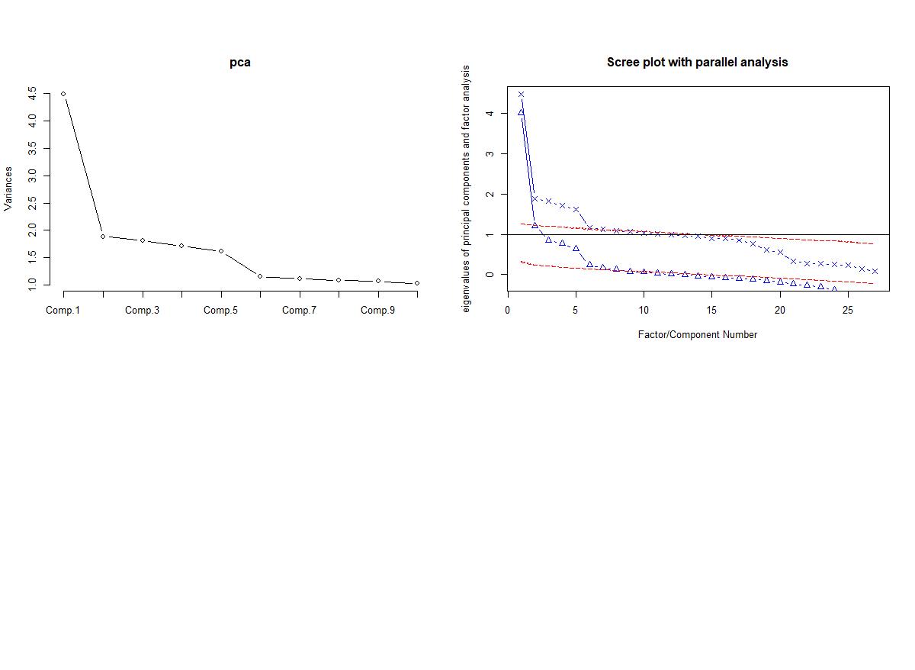
PCA Analysis – Scree Plot
Notes:
Employees are the lifeblood of an enterprise. They are important resources and key elements in making the enterprise successful. unlike in the past, today’s workers are increasingly likely to switch jobs multiple times throughout their careers. This can become a burden to employers, as high turnover rates are associated with high training costs for replacing these employees. In order to minimize turnover and retain these valuable employees, it is crucial that employers are able to understand what makes an employee more or less likely to leave and act on that information.
In our analysis of the dataset, we will aim to identify the factors that are most influential in determining whether an employee is likely to leave their job. This will be done primarily through the use of regression, decision tree and PCA analysis.

Slide 6
PCA Analysis - Components
Component 1 <- Years At Company + Years In Current Role+ Years Since Last
Promotion + Years with Current Manager
Component 2 <- Age + Job level + Monthly Income + Num Companies Worked +
Total Working Years
Component 3 <- Percent Salary Hike + Performance Rating
Component 4 <- Department + Job Role
Component 5 <- Marital Status + Stock Option Level
Component 6 <- Distance From Home + Education Field +Training Times Last Year
+ Work Life Balance
Component 7 <- Environment Satisfaction + Over Time
Component 8 <- Education + Job Involvement + Job Satisfaction
Component 9 <- Business Travel + Gender + Relationship Satisfaction
Notes:
Employees are the lifeblood of an enterprise. They are important resources and key elements in making the enterprise successful. unlike in the past, today’s workers are increasingly likely to switch jobs multiple times throughout their careers. This can become a burden to employers, as high turnover rates are associated with high training costs for replacing these employees. In order to minimize turnover and retain these valuable employees, it is crucial that employers are able to understand what makes an employee more or less likely to leave and act on that information.
In our analysis of the dataset, we will aim to identify the factors that are most influential in determining whether an employee is likely to leave their job. This will be done primarily through the use of regression, decision tree and PCA analysis.

Slide 7
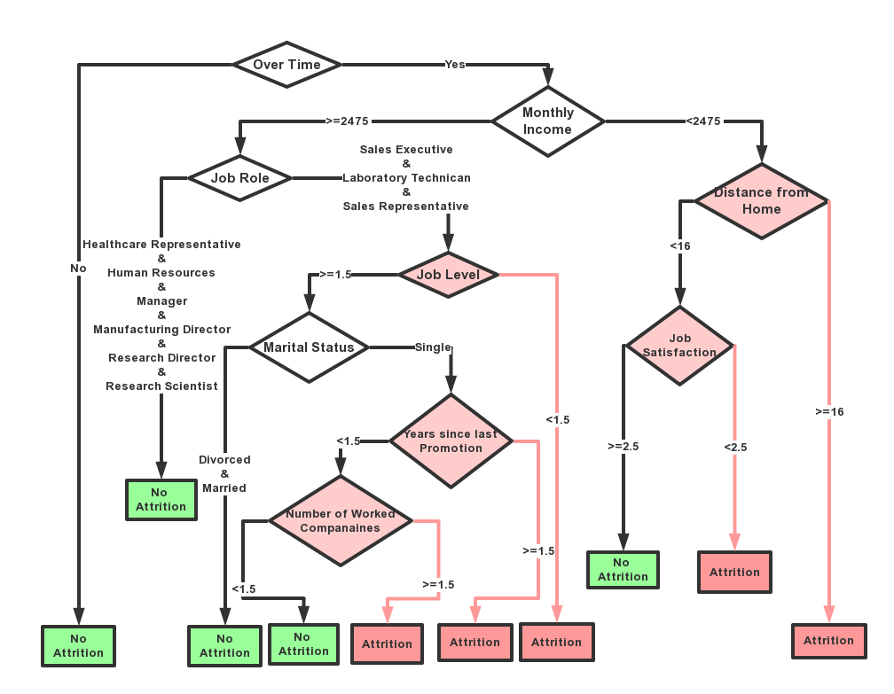
Decision Tree - Outline
Notes:
Employees are the lifeblood of an enterprise. They are important resources and key elements in making the enterprise successful. unlike in the past, today’s workers are increasingly likely to switch jobs multiple times throughout their careers. This can become a burden to employers, as high turnover rates are associated with high training costs for replacing these employees. In order to minimize turnover and retain these valuable employees, it is crucial that employers are able to understand what makes an employee more or less likely to leave and act on that information.
In our analysis of the dataset, we will aim to identify the factors that are most influential in determining whether an employee is likely to leave their job. This will be done primarily through the use of regression, decision tree and PCA analysis.

Slide 8
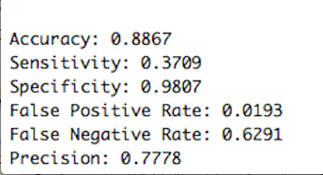
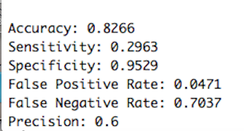
Decision Tree - Evaluation
Training Data |  | Predicted
 |  | NO | YES
Actual | NO | 813 | 16
 | YES | 95 | 56
Test Data |  | Predicted
 |  | NO | YES
Actual | NO | 324 | 16
 | YES | 57 | 24
Confusion Matrix

Slide 9
Logistic Regression - Process
Establish & Modify The Model
Screen Variables
Build Logistic Regression Model
Eliminate insignificant Variables
Reach Final Model
Model Performance Test
Significance Test
Goodness of fit Test
Prediction Accuracy
Conclusion
Notes:
Employees are the lifeblood of an enterprise. They are important resources and key elements in making the enterprise successful. unlike in the past, today’s workers are increasingly likely to switch jobs multiple times throughout their careers. This can become a burden to employers, as high turnover rates are associated with high training costs for replacing these employees. In order to minimize turnover and retain these valuable employees, it is crucial that employers are able to understand what makes an employee more or less likely to leave and act on that information.
In our analysis of the dataset, we will aim to identify the factors that are most influential in determining whether an employee is likely to leave their job. This will be done primarily through the use of regression, decision tree and PCA analysis.

Slide 10
Logistic Regression – Establish & Modify
a. Screen Variables
b. Build Logistic Regression Model
c. Remove insignificant Variables
d. Reach Final Model
 | Estimate | Std. Error | z value | Pr(>|z|)
OverTimeYes | 1.99065 | 0.24635 | 8.081 | 6.44e-16
NumCompaniesWorked | 0.24685 | 0.04931 | 5.006 | 5.54e-07
EnvironmentSatisfaction | -0.49041 | 0.10239 | -4.790 | 1.67e-06
Jobsatisfaction | -0.42332 | 0.10275 | -4.120 | 3.79e-05
JobInvolvement | -0.63338 | 0.15534 | -4.078 | 4.55e-05
DistanceFromHome | 0.04849 | 0.01316 | 3.685 | 0.000229
MaritalStatusSingle | 1.13866 | 0.31486 | 3.616 | 0.000299
Notes:
Employees are the lifeblood of an enterprise. They are important resources and key elements in making the enterprise successful. unlike in the past, today’s workers are increasingly likely to switch jobs multiple times throughout their careers. This can become a burden to employers, as high turnover rates are associated with high training costs for replacing these employees. In order to minimize turnover and retain these valuable employees, it is crucial that employers are able to understand what makes an employee more or less likely to leave and act on that information.
In our analysis of the dataset, we will aim to identify the factors that are most influential in determining whether an employee is likely to leave their job. This will be done primarily through the use of regression, decision tree and PCA analysis.

Slide 11
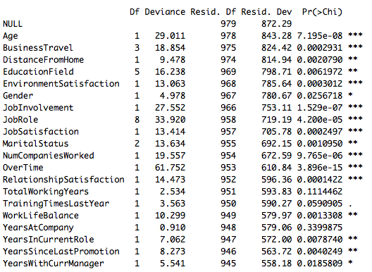
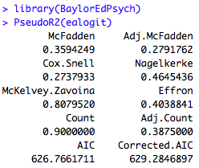
Logistic Regression - Performance
Goodness of fit Test
Significance Test
Notes:
Employees are the lifeblood of an enterprise. They are important resources and key elements in making the enterprise successful. unlike in the past, today’s workers are increasingly likely to switch jobs multiple times throughout their careers. This can become a burden to employers, as high turnover rates are associated with high training costs for replacing these employees. In order to minimize turnover and retain these valuable employees, it is crucial that employers are able to understand what makes an employee more or less likely to leave and act on that information.
In our analysis of the dataset, we will aim to identify the factors that are most influential in determining whether an employee is likely to leave their job. This will be done primarily through the use of regression, decision tree and PCA analysis.

Slide 12
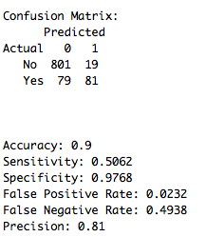
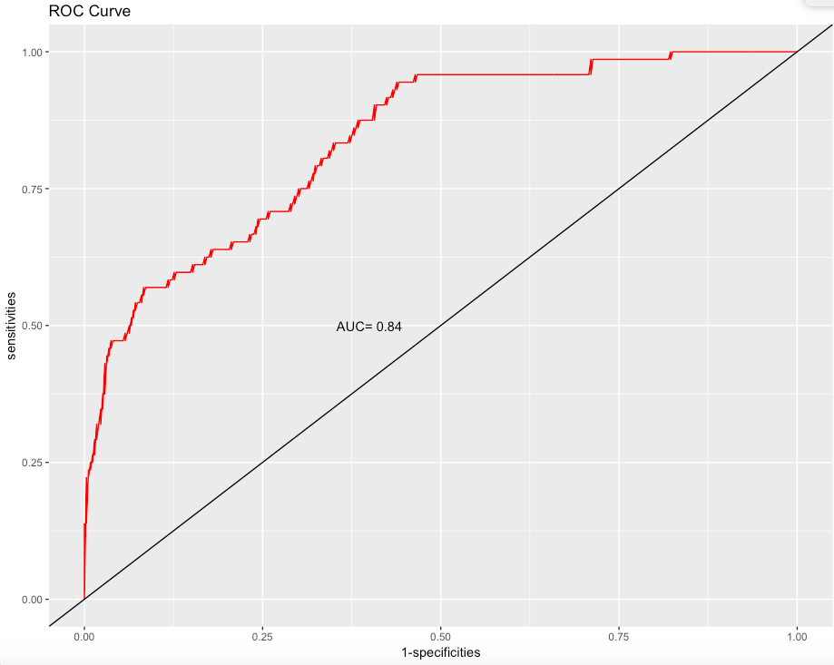
Logistic Regression - Performance
Prediction Accuracy
ROC Curve
Notes:
Employees are the lifeblood of an enterprise. They are important resources and key elements in making the enterprise successful. unlike in the past, today’s workers are increasingly likely to switch jobs multiple times throughout their careers. This can become a burden to employers, as high turnover rates are associated with high training costs for replacing these employees. In order to minimize turnover and retain these valuable employees, it is crucial that employers are able to understand what makes an employee more or less likely to leave and act on that information.
In our analysis of the dataset, we will aim to identify the factors that are most influential in determining whether an employee is likely to leave their job. This will be done primarily through the use of regression, decision tree and PCA analysis.

Slide 13
Logistic Regression – Conclusion
Make a pretty accurate prediction
Key Factors contribute to Attrition Rate
Especially great prediction for loyal employees
Need more data to optimize the prediction accuracy
Overtime working
More companies worked before
Longer commuting distance
Lower job involvement
Dissatisfaction with work environment
Single status
Notes:
Employees are the lifeblood of an enterprise. They are important resources and key elements in making the enterprise successful. unlike in the past, today’s workers are increasingly likely to switch jobs multiple times throughout their careers. This can become a burden to employers, as high turnover rates are associated with high training costs for replacing these employees. In order to minimize turnover and retain these valuable employees, it is crucial that employers are able to understand what makes an employee more or less likely to leave and act on that information.
In our analysis of the dataset, we will aim to identify the factors that are most influential in determining whether an employee is likely to leave their job. This will be done primarily through the use of regression, decision tree and PCA analysis.

Slide 14
Solutions
Make work-life balance available
Permit flexible working hours
Recruit right person for the right job
Provide good working conditions
Create positive work culture
Distribute transportation allowance
Notes:
Employees are the lifeblood of an enterprise. They are important resources and key elements in making the enterprise successful. unlike in the past, today’s workers are increasingly likely to switch jobs multiple times throughout their careers. This can become a burden to employers, as high turnover rates are associated with high training costs for replacing these employees. In order to minimize turnover and retain these valuable employees, it is crucial that employers are able to understand what makes an employee more or less likely to leave and act on that information.
In our analysis of the dataset, we will aim to identify the factors that are most influential in determining whether an employee is likely to leave their job. This will be done primarily through the use of regression, decision tree and PCA analysis.

Slide 15
Thanks!
ANY QUESTIONS?
You can send e-mails at aaronwz5276@gmail.com
以上内容是技术建模部分（英文要求）
以下内容是经过翻译的成果阐述部分（中文要求）

Slide 16
背景介绍
概述
离职率是企业用以衡量企业内部人力资源流动状况的一个重要指标，通过对离职率的考察能够了解企业对员工的吸引以及满意情况。
现状
现阶段，年轻员工由于自身鲜明个性或是追求更高职业发展机会，频频离职与跳槽，这无形之中为企业管理带来更高的难度。
目的
了解企业员工工作现状，采用适当的算法明确影响企业员工主动离职的各类因素以及相应的影响程度，建立合适的模型来预测现有员工是否存在离职倾向。

Slide 17
目标分析
数据清理
数据清理
在数据描述的基础上，识别原始数据缺失值、重复值以及异常值，对其进行处理。
数据探索
通过对数据整体分布情况的可视化处理，初步了解整体数据。
离职预测
数据探索
变量关系
分析目标
确定各变量之间是否存在联系，如果有，可以通过主成分分析、因子分析等方法尽可能削弱变量之间的联系。
离职预测
利用分类算法，对清理并分割后的数据进行建模分析，并对模型结果进行评价。
变量关系

Slide 18
数据清理
数据描述
数据描述
数据来源于Kaggle网站， IBM于2018年4月26日更新，包含变量37个变量，23532行数据。
缺失值处理
在原始数据中存在353行缺失值，使用每列变量的平均值对缺失值进行填充。
缺失值
重复值
重复值处理
数据清理
原始数据存在超过7000行的重复值，经检验为无效的重复，予以删除处理。
异常值处理
每列变量均存在100－300的异常值，通过整理分析发现这些异常值能够被合理解释，予以保留。
异常值

Slide 19
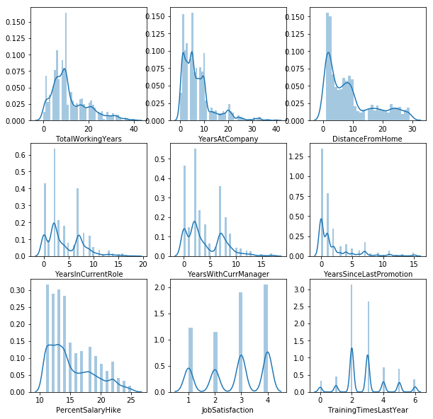
数据探索
多数员工为年轻人
去年人均培训两到三次
多数员工进企业不足十年
多数员工离家近
多数员工三年内升职
加薪幅度都在10%以上
1
2
3
4
5
6

Slide 20
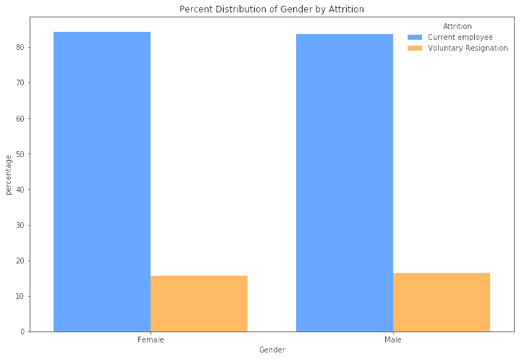
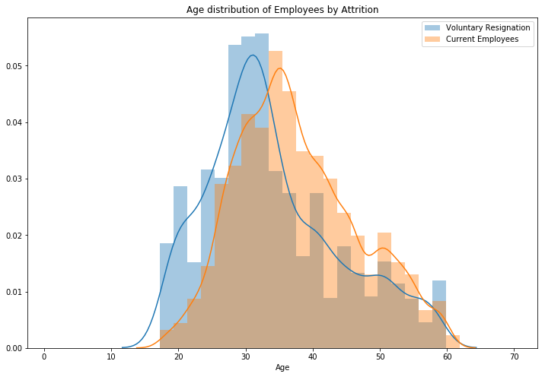
数据探索

Slide 21
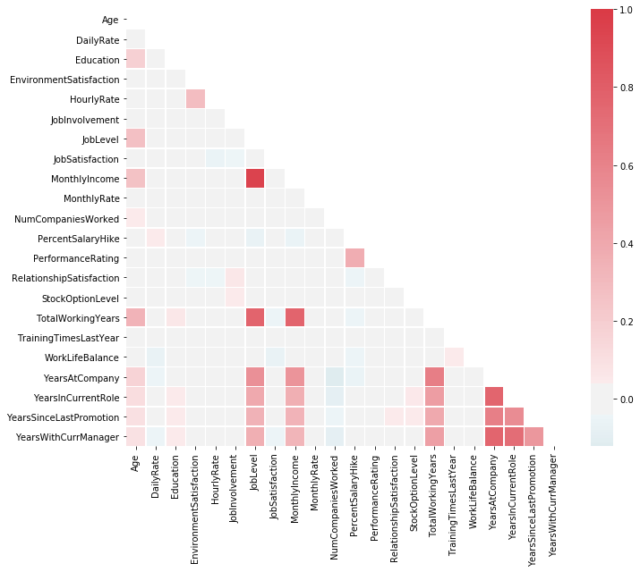
变量关系
多数变量之间不存在强相关性
月收入和工龄长短有关
月薪增幅和考核成绩有关
部分变量和其他变量无相关性
受教育程度和年龄有关
月收入和职位高低有关
1
2
3
4
5
6

Slide 22
离职预测—逻辑回归
统一数据类型
分割
训练集
测试集
选择变量
拟合模型
将干净数据中的名词性变量值转化为区间变量值，比如性别男＝0，女＝1
选择干净数据中所有格式为int64的变量，排除无用变量。
分割数据集
拟合模型
将数据集按照7:3的比例分割为训练集和测试集。
使用训练集进行逻辑回归，得到拟合后的模型，并对模型结果进行评价。
统一
数据类型
选择变量

Slide 23
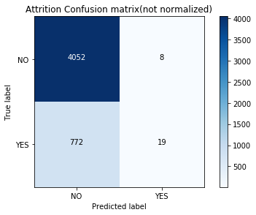
离职预测—逻辑回归
准确率
P=(4052+19)/(4052+19+8+772)
84%
70%
AUC值
50%
72%
2%
召回率
R=19/(19+772)
40%
5%
F1分数
F1=2*P*R/(P+R)

Slide 24
离职预测—随机森林
导入随机森林包
分割
训练集
测试集
选择变量
拟合模型
使用Python进行随机森林建模时需要导入第三方程序包。
选择干净数据中所有格式为int64的变量，排除无用变量。
分割数据集
拟合模型
将数据集按照7:3的比例分割为训练集和测试集。
使用训练集建立随机森林模型，得到拟合后的模型，并对模型结果进行评价。
导入随机森林包
选择变量

Slide 25
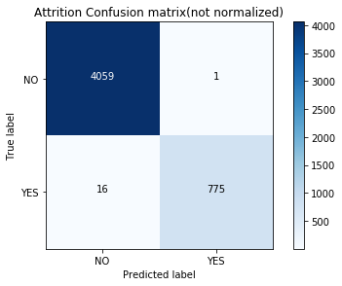
离职预测—随机森林
准确率
P=(4059+775)/(4059+775+1+16)
98%
70%
AUC值
50%
99%
98%
召回率
R=775/(16+775)
40%
98%
F1分数
F1=2*P*R/(P+R)
Notes:
可以拓展一下生存分析模型，这样不仅能够预测是否有离职倾向，还能够预测其离职时间

Slide 26




小结
工具选取
数据选取
变量选取
模型选取
原始数据行数23532，列数37，低于百万级，可以使用R语言进行数据分析。分析时可以尝试进行主成分分析，对变量进行降维，观察结果表现。
数据选取过程中，缺乏对数据来源的考虑，数据清理时存在超过7000行的重复行，占据数据总体三分之一，遇到类似情况，需要对数据源的真实性进行确认。
变量选取方法缺乏说服力，仅仅凭借主观观察的手段对变量进行初步筛选，应该在建模过程中观察变量是否显著，依据AIC值依次剔除无效变量。
在模型选取上，由于变量过多，使得逻辑回归的表现不佳。逻辑回归作为分类算法中的基础分析法，不利于对变量数较大的数据进行分析。随机森林模型得出的结果过拟合的可能性非常低。

