Slide 1


2022.07.04
食为天（SWT）外卖平台
SWT

Slide 2

项目介绍&团队成员介绍
技术选型&版本管理
目录
项目搭建
项目优化
项目实机演示
总结

Slide 3
第一节
项目介绍&团队成员介绍

Slide 4


项目介绍
本项目（食为天外卖平台）是专门为餐饮企业（餐厅、饭店）定制的一款软件产品，包括系统管理后台和移动端应用两部分。其中系统管理后台主要提供给餐饮企业内部员工使用，可以对餐厅的菜品、套餐、订单等进行管理维护。移动端应用主要提供给消费者使用，可以在线浏览菜品、添加购物车、下单等。

Slide 5

团队成员介绍
序号 | 姓 名 | 角 色
1 | 王正霆 | 项目经理
2 | 王开发 | 系统分析员、系统工程师
3 | 崔晋 | 系统工程师
4 | 杨帆 | 系统工程师
5 | 黄豪 | 测试工程师
6 | 杨寒壹 | 用户界面设计员

Slide 6
第二节
技术选型&版本管理

Slide 7
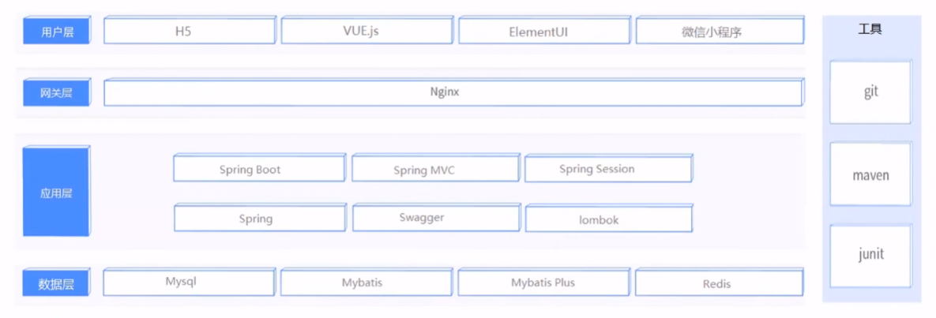
技术选型

Slide 8

版本管理
本项目使用Git来进行版本管理，功能包括代码回溯、版本切换，多人协作，远程备份
仓库地址：https://github.com/Wangzt670/swt

Slide 9
第三节
项目搭建阶段

Slide 10
1.前置任务
前置任务包括配置管理计划、软件需求规约、项目开发计划、项目进度计划、先启同行评审报告、先启阶段里程碑评审报告。
前置任务帮助了后续工作的有序进行。

Slide 11
2.基本功能
2.1 登陆界面
2.2 员工管理界面
2.3 分类管理界面
2.4 菜品管理界面
2.5 套餐管理界面
2.6 订单界面
2.7 UI设计

Slide 12

2.1 登陆页面
登录页面包含登录、退出、邮箱验证以及邮箱验证码发送功能
负责人员：王正霆

Slide 13
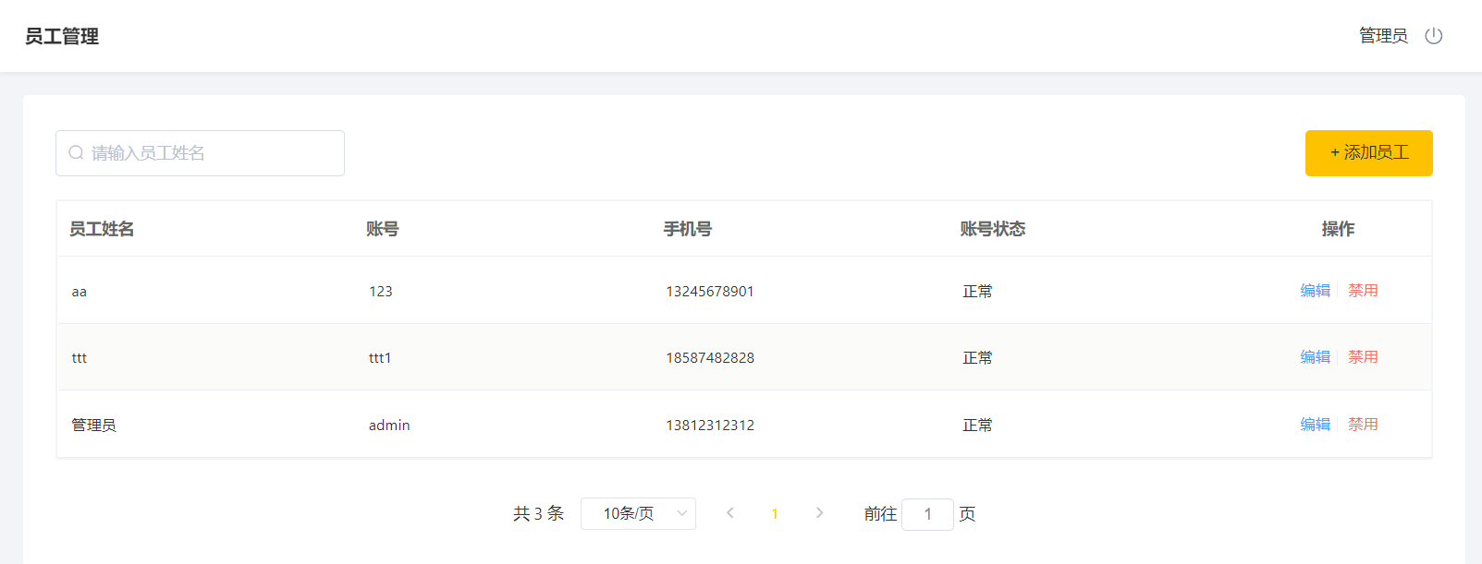
2.2 员工管理界面
员工管理界面包含新增员工、员工信息分类查询、启用禁用员工账号、编辑员工信息功能
负责人员：王开发

Slide 14
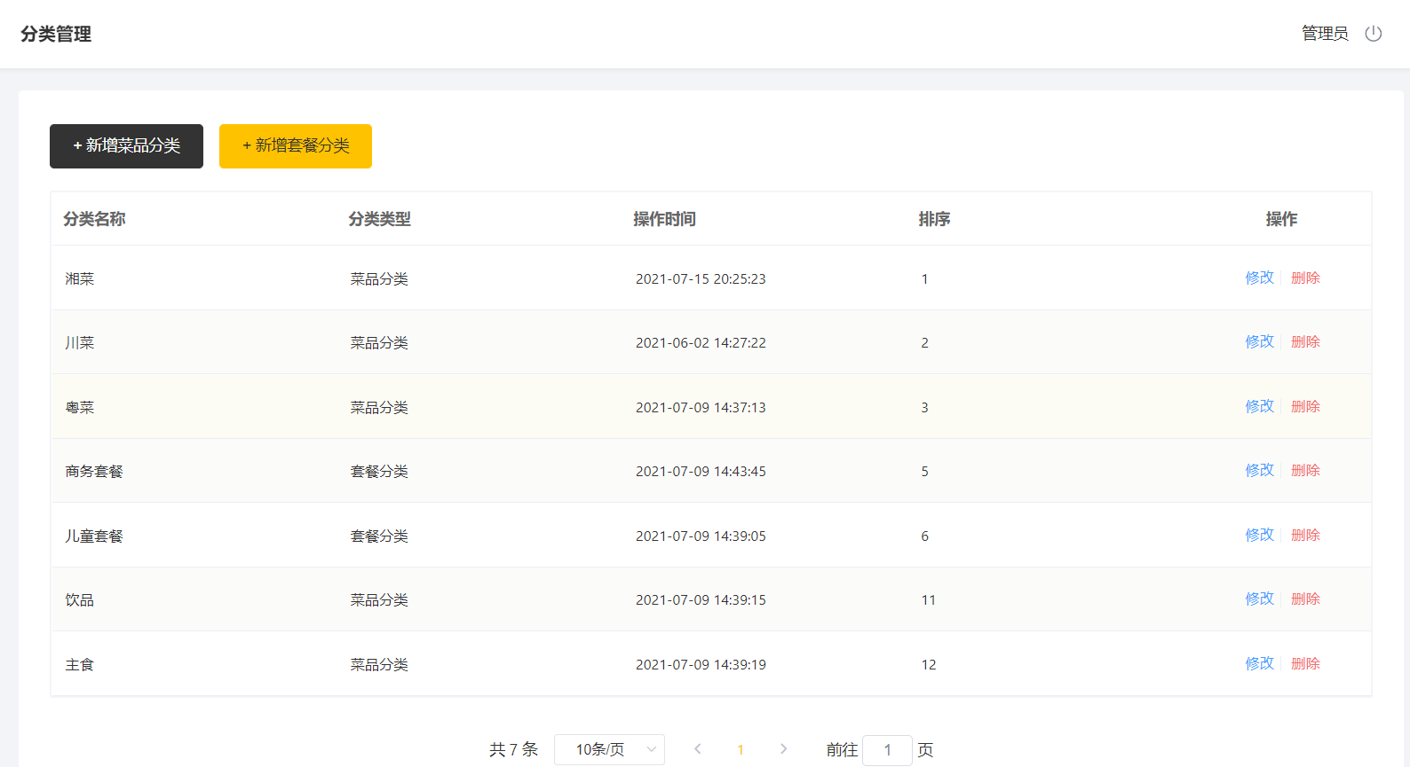
2.3 分类管理界面
分类管理界面包括新增分类、分类信息分页查询、删除分类功能
负责人员：崔晋

Slide 15
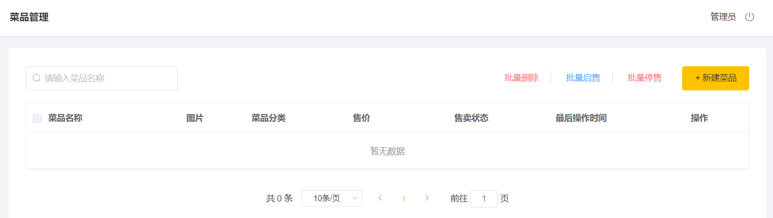
2.4 菜品管理界面
菜品管理界面包含文件上传下载、新增菜品、菜单信息分页查询、修改菜品功能
负责人员：杨帆

Slide 16
2.5 套餐管理界面
套餐管理界面包含新增套餐、套餐信息分页查询、删除套餐功能
负责人员：黄豪

Slide 17
2.6 订单界面
订单界面包含导入用户地址、菜品展示、购物车、用户下单功能
负责人员：杨寒壹

Slide 18
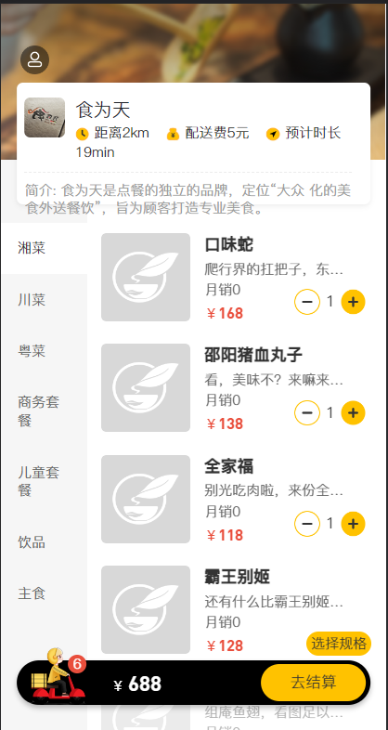
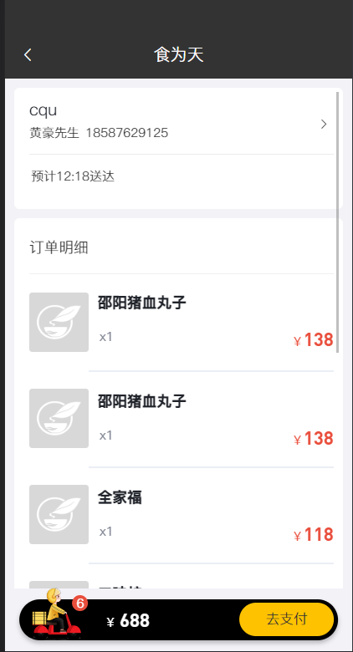
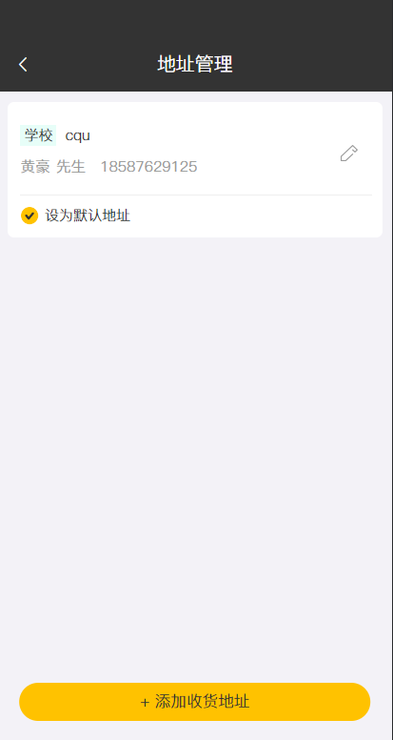
2.7 UI设计
包含对网页管理端和小程序用户端的UI设计
负责人员：杨寒壹

Slide 19
第四节
项目优化

Slide 20

项目优化
缓存邮箱验证码
缓存菜品数据
缓存套餐数据
Mysql主从复制
读写分离
前后端分离

Slide 21
项目优化
Mysql主从复制

Slide 22
项目优化
读写分离

Slide 23
项目优化
前后端分离

Slide 24
第五节
项目实际演示

Slide 25
第六节
总结

Slide 26
2022.07.04
谢谢观看
SWT

Slide 27
总结
在本次毕业实训过程中，食为天（SWT）外卖平台团队共6人，经过短短半个月完成项目开发，在时间紧迫，人力资源匮乏的条件下完成了本次实训任务。
Notes:
我们项目组的成员在整个过程中快速学习巩固了SSM框架下Spring、SpringBoot、Maven、SpringMVC、MyBatis等Java项目开发知识技能，熟练掌握了Git、Github等团队开发工具，同时对Java企业级开发、软件开发的整体流程有了清晰的认知。过程中感谢老师细心的讲解与演示，项目搭建过程中问题的解答指导，让我们项目组少走了许多弯路。
最终，系统功能完全达到预期需求，在试运行过程中对界面进行了美化,按计划2022年7月4日进行顺利验收。美中不足的是，由于项目开发期较短，最终实现的功能都还比较基础，我们项目组希望在本次实训的基础上进一步深入研究，继续完善食为天（SWT）外卖平台，完成初期设想的更趋于实际的功能，使项目更能普遍适用。

Slide 28
20XX.X.X
时尚
KEYNOTE
双击输入替换内容点击输入双击输入替换内容点击输入双击输入替换内容点击输入双击输入替换内容点击输入
BUSINESS REPORT

Slide 29
标题文字
do eiusmod tempor incididunt ut labore et dolore magna aliqua.
目录
标题文字
do eiusmod tempor incididunt ut labore et dolore magna aliqua.
标题文字
do eiusmod tempor incididunt ut labore et dolore magna aliqua.
标题文字
do eiusmod tempor incididunt ut labore et dolore magna aliqua.

Slide 30
第一节
标题文字
print the presentation and make it into a film to be used in a wider fieldprint the presentation to be wider field

Slide 31
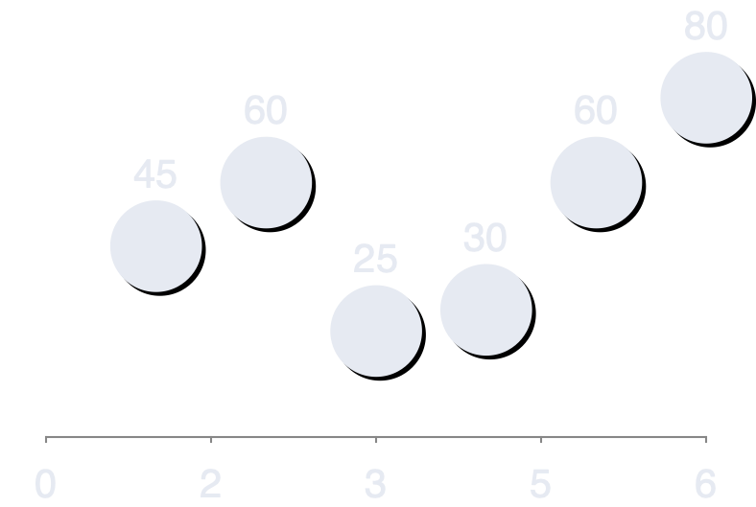
Marketing Tips.
Compellingly myocardinate cost effective materials rather than
business catalysts for change. Completely fashion distributed
metrics for vertical experiences.
Service Function
Compellingly myocardinate cost effective materials rather than
business catalysts for change.

Service Function
Compellingly myocardinate cost effective materials rather than
business catalysts for change.

Service Function
Compellingly myocardinate cost effective materials rather than
business catalysts for change.


Slide 32
Only Special Design.
Compellingly myocardinate cost effective materials rather than
business catalysts for change. Completely fashion distributed
metrics for vertical experiences.
BUSINESS & MODERN COMPANY
BEST SOLUTIONS
Business
Skill Name
90%
Section Name
Design
Section Name
Design
Section Name
Design
Skill Name
65%
Skill Name
50%

Slide 33
Service With Chart.
Compellingly myocardinate cost effective materials rather than
business catalysts for change. Completely fashion distributed
metrics for vertical experiences.
Subtittle Text
Quickly leverage other's distributed internal.
Subtittle Text
Quickly leverage other's distributed internal.
Chart Sections
72%
Chart Sections
90%
Subtittle Text
Quickly leverage other's distributed internal.
Subtittle Text
Quickly leverage other's distributed internal.
Chart Sections
60%
Chart Sections
60%

Slide 34
Only Special Design.
Compellingly myocardinate cost effective materials rather than
business catalysts for change.
BUSINESS & MODERN COMPANY
BEST SOLUTIONS
Business
BUSINESS & MODERN COMPANY
BEST SOLUTIONS
Business
Skill Name
90%
Skill Name
90%
Skill Name
65%
Skill Name
65%
Skill Name
50%
Skill Name
50%

Slide 35
Creative Team Work
Compellingly myocardinate cost effective materials rather than
e-business catalysts for change.
Justin Mayer
Compellingly myocardinate cost effective materials than.
Andrey Moor
Compellingly myocardinate cost effective materials than.
Jonathan Mack
Compellingly myocardinate cost effective materials than.
Selena Mier
Compellingly myocardinate cost effective materials than.

Slide 36
第二节
标题文字
print the presentation and make it into a film to be used in a wider fieldprint the presentation to be wider field

Slide 37
Only Special Design.
Compellingly myocardinate cost effective materials rather than
business catalysts for change. Completely fashion distributed
metrics for vertical experiences.
Image Product Name
Design

Slide 38
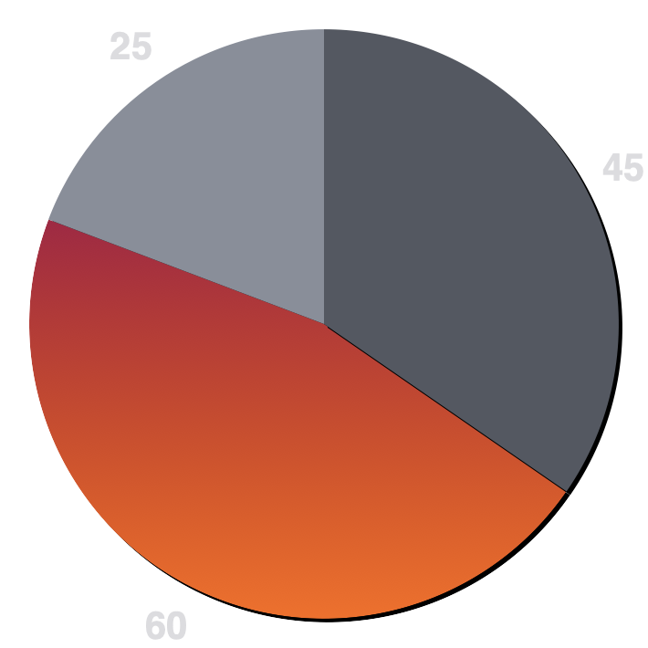
Only Special Design.
Compellingly myocardinate cost effective materials rather than
business catalysts for change.
BUSINESS & MODERN COMPANY
BEST SOLUTIONS
Business
Chart Essential Tittle
Application
Business
Forum
Mode
Programm
Design
Development
Type
Software
Tech
Creative

Slide 39
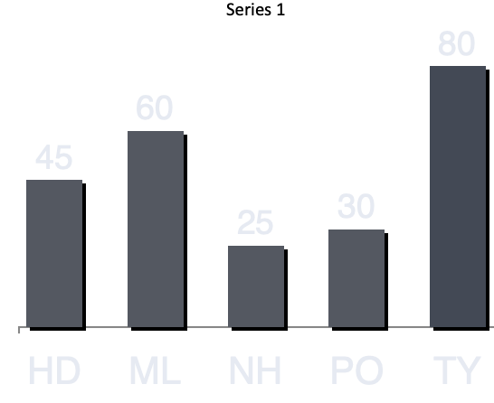
39
Only Special Design.
01.
Infographic Shape Name Here
Editable
Compellingly myocardinate cost effective materials rather than
business catalysts for change.
02.
Infographic Shape Name Here
Editable
BUSINESS & MODERN COMPANY
BEST SOLUTIONS
Business
03.
Infographic Shape Name Here
Editable
04.
Infographic Shape Name Here
Editable
05.
Infographic Shape Name Here
Editable

Slide 40

Doughnut Features.
43%
Essential Options
60%
Essential Options
80%
Essential Options
95%
Essential Options
Service Name
Compellingly myocardinate cost effective materials rather than
Service Name
Compellingly myocardinate cost effective materials rather than
Service Name
Compellingly myocardinate cost effective materials rather than
Service Name
Compellingly myocardinate cost effective materials rather than

Slide 41
Only Special Design.
Compellingly myocardinate cost effective materials rather than
business catalysts for change.
Service Function
Compellingly myocardinate cost effective materials rather than catalysts for change.

BUSINESS & MODERN COMPANY
BEST SOLUTIONS
Business
Service Function
Compellingly myocardinate cost effective materials rather than catalysts for change.

Chart Name
60%
Chart Name
60%
Chart Name
60%
Service Function
Compellingly myocardinate cost effective materials rather than catalysts for change.


Slide 42
第三节
标题文字
print the presentation and make it into a film to be used in a wider fieldprint the presentation to be wider field

Slide 43

50$
BUSINESS & MODERN COMPANY
BEST SOLUTIONS
Business
60$
BUSINESS & MODERN COMPANY
BEST SOLUTIONS
Business
88$
BUSINESS & MODERN COMPANY
BEST SOLUTIONS
Business
95$
BUSINESS & MODERN COMPANY
BEST SOLUTIONS
Business

Slide 44
Only Special Design.
Compellingly myocardinate cost effective materials rather than
business catalysts for change.
01
Quickly leverage internal.
02
Quickly leverage internal.
Chart Sections
72%
03
Quickly leverage internal.
Chart Sections
90%
Chart Sections
60%
04
Quickly leverage internal.
Chart Sections
60%

Slide 45
Portfolio Sections.
Compellingly myocardinate cost effective materials rather than
e-business catalysts for change.
Image Product Name
Design
Image Product Name
Development
Image Product Name
Marketing
Image Product Name
Inspire
Image Product Name
Modern

Slide 46
Part One.
Part Two.
Part Three.
Part Four.
What Is A Solutions?
Compellingly myocardinate cost
effective materials rather than business catalysts for change. Completely
fashion distributed metrics for vertical experiences.
What Is A Solutions?
Compellingly myocardinate cost
effective materials rather than business catalysts for change. Completely
fashion distributed metrics for vertical experiences.
What Is A Solutions?
Compellingly myocardinate cost
effective materials rather than business catalysts for change. Completely
fashion distributed metrics for vertical experiences.
What Is A Solutions?
Compellingly myocardinate cost
effective materials rather than business catalysts for change. Completely
fashion distributed metrics for vertical experiences.

Slide 47
Only Special Design.
Compellingly myocardinate cost effective materials rather than
business catalysts for change.
01.
Service Function
Compellingly myocardinate cost effective materials rather than business catalysts.
02.
Service Function
Compellingly myocardinate cost effective materials rather than business catalysts.
03.
Service Function
Compellingly myocardinate cost effective materials rather than business catalysts.
04.
Service Function
Compellingly myocardinate cost effective materials rather than business catalysts.

Slide 48
第四节
标题文字
print the presentation and make it into a film to be used in a wider fieldprint the presentation to be wider field

Slide 49

Essential Features.
Compellingly myocardinate cost effective materials rather than
e-business catalysts for change.


Service Tittle Here
Photos
Service Tittle Here
Analysis


Service Tittle Here
Inbox
Service Tittle Here
Research

Slide 50
BUSINESS & MODERN COMPANY
BEST SOLUTIONS
Business
Chart Sections
72%
Chart Sections
90%
Compellingly myocardinate cost effective materials rather than business catalysts for change.
Chart Sections
60%
01.
Infographic Shape Name Here
Editable
02.
Infographic Shape Name Here
Editable
03.
Infographic Shape Name Here
Editable

Slide 51
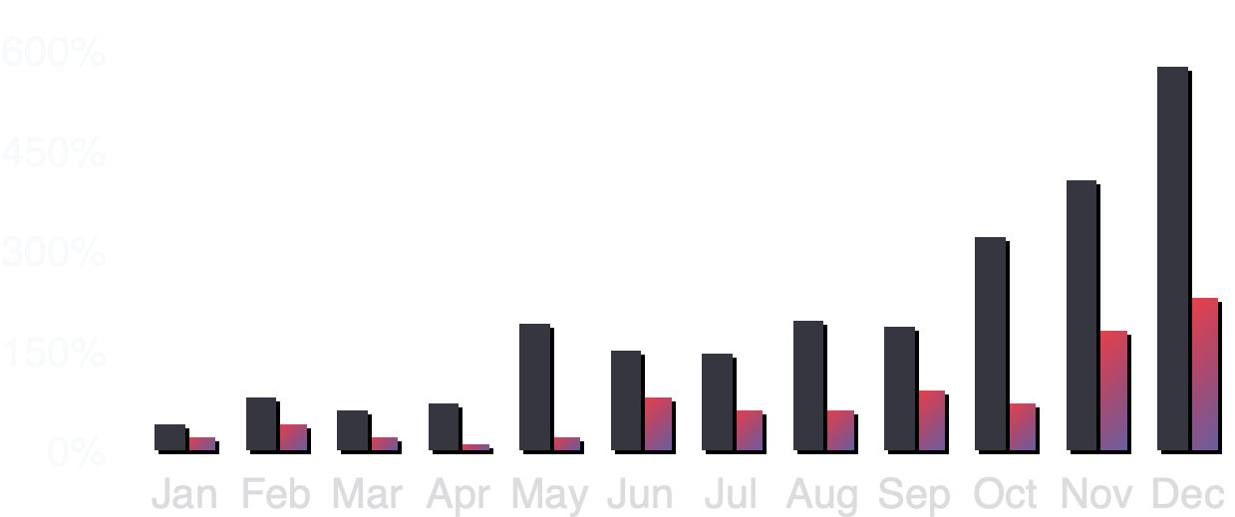
Only Special Design.
Compellingly myocardinate cost effective materials rather than
business catalysts for change.
Business Section
17,835$
Business Section
17,835$
Business Section
17,835$
Forum
Mode
BUSINESS & MODERN COMPANY
BEST SOLUTIONS
Business
BUSINESS & MODERN COMPANY
BEST SOLUTIONS
Business
BUSINESS & MODERN COMPANY
BEST SOLUTIONS
Business

Slide 52
版权声明
感谢您下载平台上提供的PPT作品，为了您和熊猫办公以及原创作者的利益，请勿复制、传播、销售，否则将承担法律责任！熊猫办公将对作品进行维权，按照传播下载次数进行十倍的索取赔偿！
1.在熊猫办公出售的PPT模板是免版税类（RF：Royalty-Free）正版受《中国人民共和国著作法》和《世界版权公约》的保护，作品的所有权、版权和著作权归熊猫办公所有，您下载的是PPT模板素材的使用权。
2.不得将熊猫办公的PPT模板、PPT素材，本身用于再出售，或者出租、出借、转让、分销、发布或者作为礼物供他人使用，不得转授权、出卖、转让本协议或者本协议中的权利。
更多精品PPT模板：http://www.tukuppt.com/ppt/
点击进入

Slide 53
20XX.X.X
谢谢
KEYNOTE
双击输入替换内容点击输入双击输入替换内容点击输入双击输入替换内容点击输入双击输入替换内容点击输入
BUSINESS REPORT

