Slide 1
FlowState Ops AI Event Congestion Decision Support System

Slide 2
FlowState Ops
AI Event Congestion Decision Support System
From Reactive Traffic Management to Predictive Traffic Operations
Problem Theme: Event-Driven Congestion (Planned & Unplanned)
Bengaluru Demo Scenario:
6 simultaneous city events overlapping:
🏏 IPL Match – Chinnaswamy Stadium
📢 Political Rally – Freedom Park
💻 Tech Summit – Palace Grounds
🎸 Music Festival – Whitefield
🏗️ Trade Expo – BIEC
🛕 Temple Festival – Basavanagudi
One-Line Value Proposition:
Predict congestion before it happens, recommend interventions, optimize resource deployment, and continuously learn from every event.

Slide 3
Why Current Traffic Management Fails
The Operational Challenge
Every major city faces recurring congestion during political rallies, sports events, festivals, and sudden incidents.
The Current Process:
Event Occurs ➔ Traffic Builds Up ➔ Authorities React ➔ Gridlock Already Happened
The 5 Key Failures of Today:
Event impact is not quantified beforehand.
Resource deployment is experience-driven (gut feeling).
Diversion planning is largely manual.
No post-event learning system exists.
The same mistakes repeat every year.
The Status Quo Example:
Event: IPL Match (40,000 attendees).
Current System: Deploy officers based on what a commander remembers from last year.
Result: Unpredictable congestion, over-exhausted police forces, and paralyzed CBD routes

Slide 4
FlowState Ops Architecture
From Data to Decisions
1. Data Inputs
Planned Events: Type, Location, Time, Expected Attendance
Unplanned Events: Breakdowns, Roadblocks, Accidents
Live Traffic Data: Speeds, Congestion levels, Corridor utilization
Historical Archive: Previous actions, Outcomes, Lessons learned
2. Actionable Output
Congestion Forecast & Delay Prediction
Resource Plan (Officers, Barricades, Tows)
Diversion Plan & Risk Assessment

Slide 5
FlowState Ops Architecture
Event Appears
AI Analyzes Event
Impact Forecast Generated
Resources Planned
Stations Instructed
Action and Outcome Monitoring
Knowledge Stored
3. Live Event Lifecycle
4. Key Innovation
FlowState treats every event as an operational workflow rather than a dashboard entry.

Slide 6
AI + ML + RAG Engine
Under the Hood: Intelligence tied to Operations
Here is how we translate raw machine learning into operational directives:
How it works in practice (IPL Match - 40k attendees):
Output: 51 min delay expected | 126 officers required | Route B Diversion
GenAI Explanation: "91% similarity to IPL Final 2023. Diversion Route B reduced congestion by 41% in similar historical events."
Component | Purpose (The Business Value)
Duration Predictor (LightGBM) | Predicts exactly how long the congestion will last.
Impact Model (LightGBM) | Predicts severity to establish priority level.
Geospatial Clustering (DBSCAN) | Detects physical hotspot corridors
Similar Event Retrieval (FAISS) | Gives the city a "memory" by finding historical matches.
Rule-Based Engine | Generates exact manpower and barricading requirements.
GenAI Explanation Layer | Translates complex model data into plain English for operators.

Slide 7
Live Operations Dashboard
The Command Center
Our UI is divided into four operational quadrants:
1. Event Intelligence (Left):
Calculates the Event Impact Score, Forecasts Crowd sizes, and provides Historical Context.
2. Live Operations (Center):
Dynamic Bengaluru Map, Congestion Heatmaps, and Active Incidents overlay.
3. Decision Support (Right):
Precise Resource Planning, Diversion Plan execution, and a "What-If" Action Simulator.
4. Learning & KPIs (Bottom):
Tracks Prediction Accuracy, Identifies Similar Events, and grades Playbook Improvements.

Slide 8
Demo Scenario
Watch the System in Action
The Situation:
An IPL Match and a Religious Procession overlap during evening peak hours.
System Prediction (No Action):
Congestion Score: 87 / 100
Delay Expected: 51 minutes
Collateral: 47 junctions affected
FlowState Recommended Actions:
Deploy 24 Officers and 8 Barricades.
Establish BMTC Bus-Only Corridor.
Execute API Navigation Reroute away from MG Road.
The Simulation (The "What-If" Click):
Without Action: 51 Min Delay
With Action: 18 Min Delay
Result: 64% Reduction in Gridlock.

Slide 9
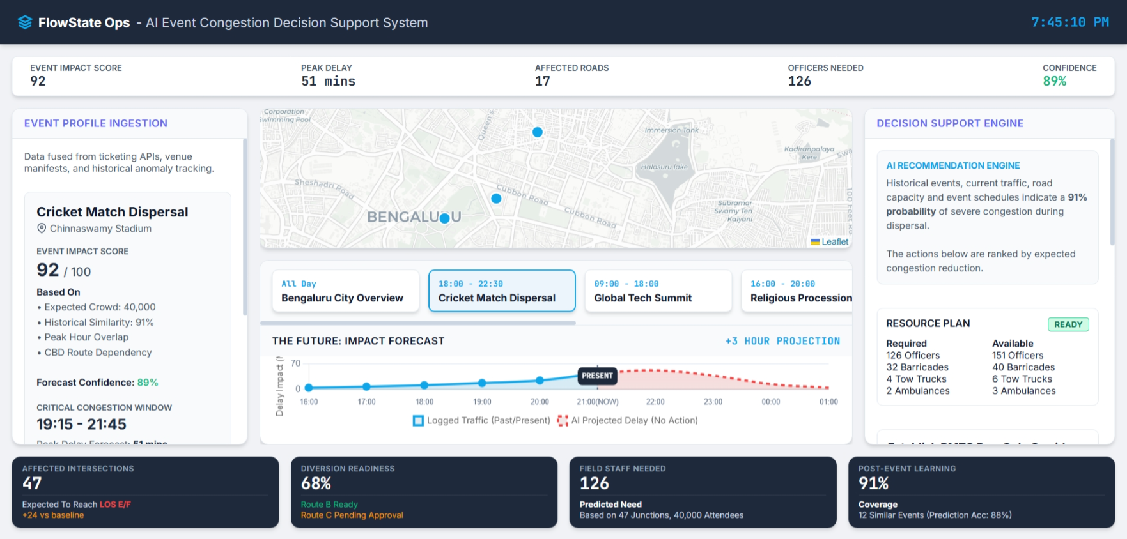

Slide 10
Impact & Future Vision
Predict ➔ Recommend ➔ Simulate ➔ Deploy ➔ Learn
Immediate Operational Benefits:
Quantified event impact replacing guesswork.
Optimized resource deployment (saving city budgets).
Faster response times and significantly reduced congestion.
Long-Term Civic Benefits:
Creates a city-wide, continuously learning event intelligence platform.
Reduces overall operational costs for traffic authorities.
Massively improves the daily commuter experience.
The Roadmap:
Phase 1 (MVP): Event forecasting & Resource recommendations (What we built today).
Phase 2: Live integration with Google Maps APIs and local transit feeds.
Phase 3: Autonomous API execution (e.g., adaptive signal control and automated VMS sign updates).

Slide 11
THANK YOU
-FlowState Ops transforms traffic management from a reactive scramble to a predictive science.

