Slide 1
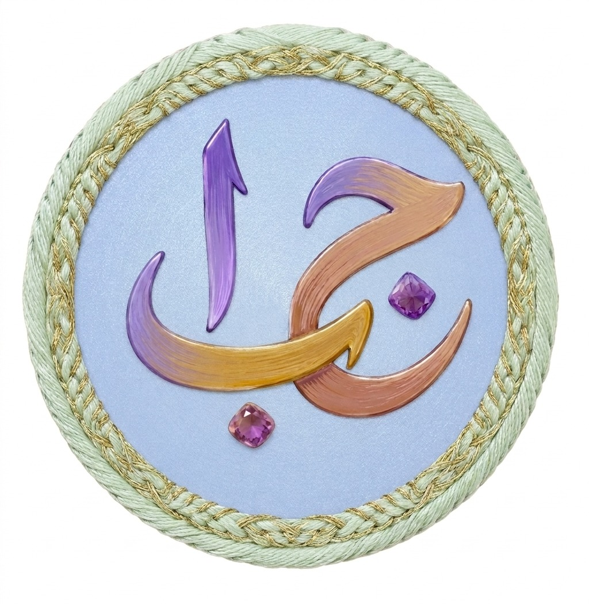
ZABANDAAN
Learn Urdu.
Play your way.
A gamified Urdu-learning experience for the new generation and everyone ready to reconnect with the language.
Built to make practice feel like progress.
PROJECT PRESENTATION

Slide 2
01 / THE GAP
Urdu learning should not feel like a chore.
The motivation is there. The learning experience often is not.
Low engagement
Fragmented practice
Fear of getting it wrong
Traditional practice can feel repetitive, especially for learners who grew up with interactive digital experiences.
Learners need one place to build fundamentals, vocabulary, comprehension, pronunciation, and confidence.
Without immediate feedback, handwriting, pronunciation, and word meaning remain difficult to practice alone.
The opportunity
Turn Urdu practice into a small, rewarding habit: choose a challenge, get feedback, earn points, come back tomorrow.

Slide 3
02 / WHO IT SERVES
One app, several reasons to learn.
Zabandaan meets learners at different starting points without making anyone feel behind.
The new generation
Heritage learners
1
2
Wants a playful, visual, mobile-first way to connect with Urdu.
Wants to rebuild vocabulary, reading confidence, and cultural connection.
Curious beginners
Everyday improvers
3
4
Wants a welcoming entry point with clear progress and no pressure.
Wants short practice sessions that fit around real life.
The common need
A learning space that feels inviting, useful, and distinctly Urdu.

Slide 4
03 / THE SOLUTION
Zabandaan makes language practice feel playable.
A structured learning journey wrapped in feedback, variety, and small wins.
01
02
03
04
Choose
Practice
Listen
Earn
Pick a skill or challenge
Learn through interaction
Hear Urdu aloud
Collect points and progress
The result
Progress is visible. Practice is varied. Urdu feels alive.

Slide 5
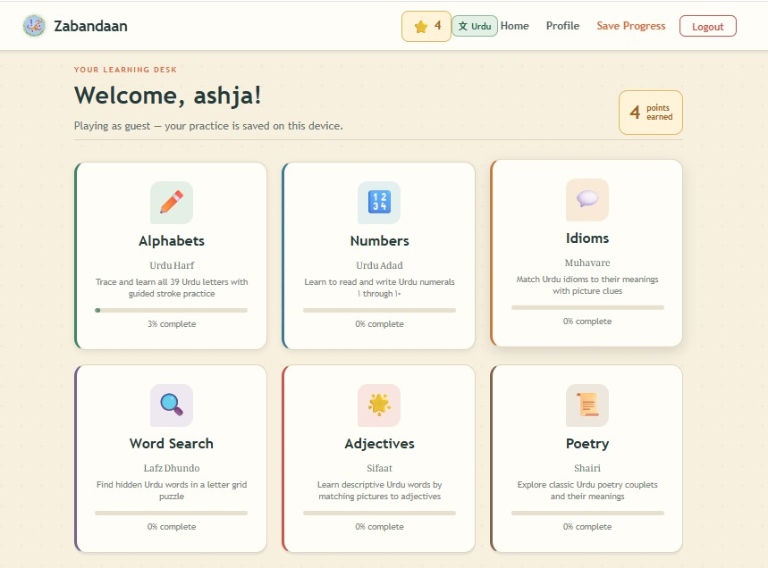
04 / THE EXPERIENCE
Six ways to build an Urdu habit.
The dashboard turns a broad language goal into focused, approachable choices.
Alphabets
Numbers
Adjectives
A
Trace, recognize, and build writing confidence.
1
Practice number recognition and recall.
Aa
Grow useful vocabulary through levels.
Idioms
Poetry
Word search
!
Discover expressions and what they really mean.
Po
Read, listen, and explore meaning.
WS
Turn vocabulary review into a puzzle.
The learning desk

Slide 6
05 / THE LEARNING LOOP
Every interaction has a job.
Zabandaan combines exposure, action, feedback, and repetition in one continuous loop.
See
Visual examples make new words memorable.
Know
REPEAT
WITH
CONFIDENCE
Do
Points and levels make progress tangible.
Trace, match, solve, choose, and search.
Hear
Audio pronunciation makes Urdu audible.

Slide 7
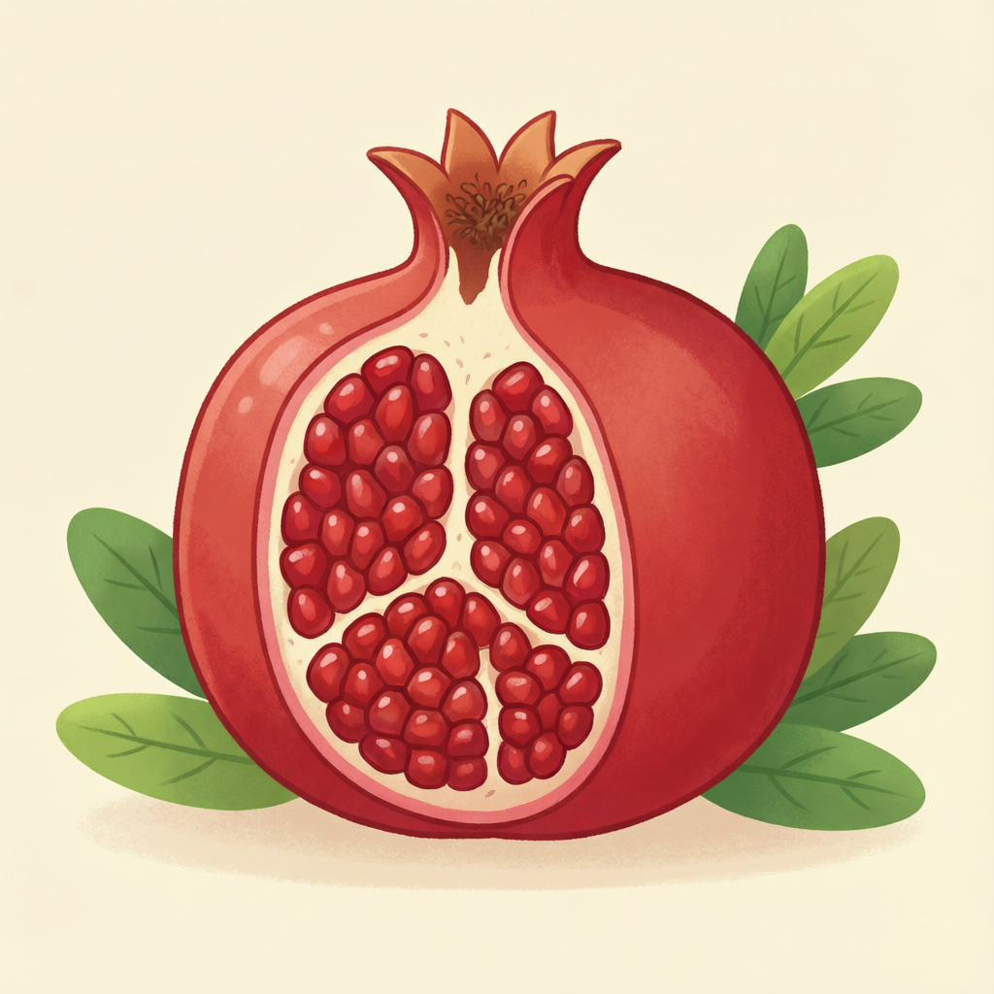
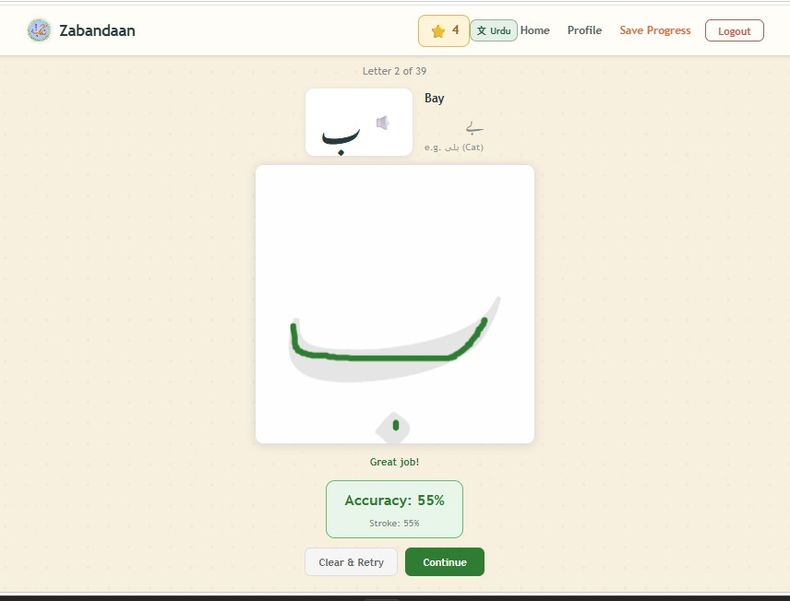
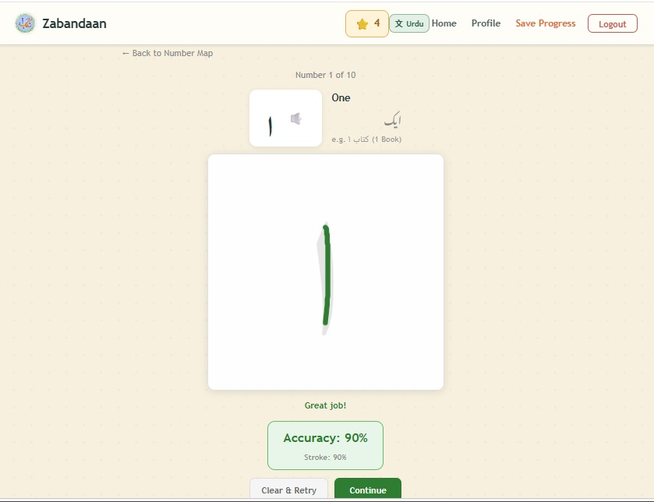
06 / CORE FEATURE
Start with the shape of the language.
Alphabet tracing turns recognition into muscle memory, with accuracy feedback along the way.
Trace
Check
Follow the guided letter path and build writing confidence.
Accuracy feedback helps learners understand and improve.
Recognize
Listen
Connect the letter shape to a familiar word and image.
Hear pronunciation while learning the sound-symbol link.
ا
Alif / anar
Practice screens from the working app

Slide 8
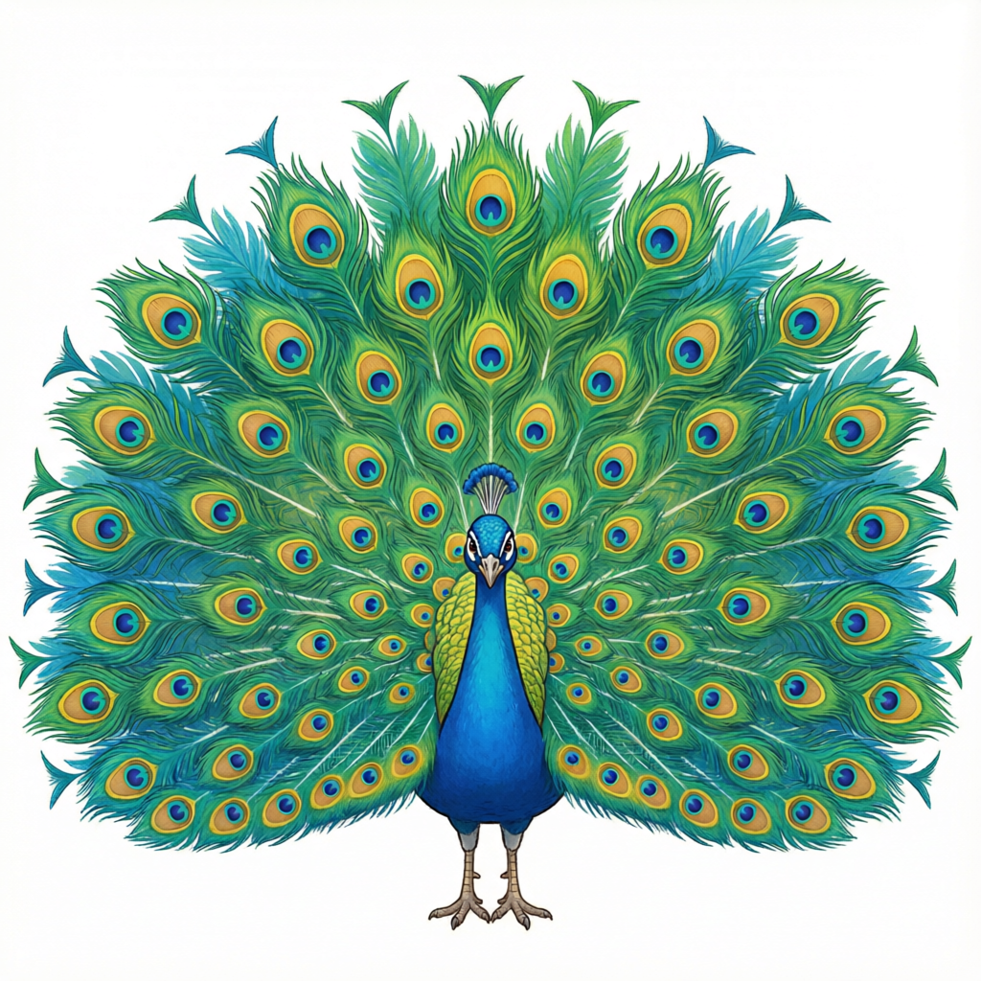
07 / VOCABULARY IN CONTEXT
Words become easier when they have a world around them.
Images, audio, and escalating difficulty turn memorization into meaningful recall.
Build vocabulary
Level up
Adjectives and everyday words arrive with a visual anchor.
Difficulty grows so learners can move from familiar to fluent.
Use audio
Practice recall
Listen and repeat wherever pronunciation matters.
Word search and challenges make review active, not passive.
خوبصورت
khoobsurat / beautiful

Slide 9
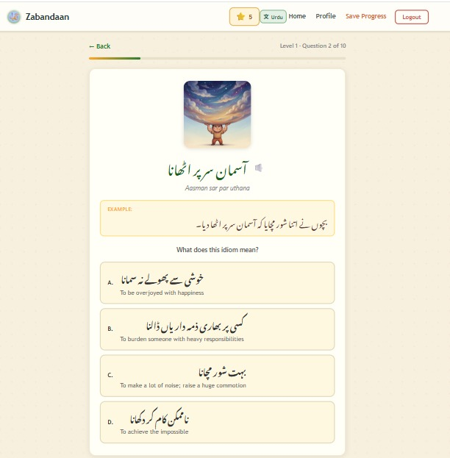
08 / CULTURAL FLUENCY
Idioms teach the Urdu behind the words.
Zabandaan helps learners understand expression, not only translation.
From literal words to lived meaning
IMAGE
Recognize the visual idea
MEANING
Connect it to natural English
LEVELS
Progress from approachable to challenging
AUDIO
Hear how it sounds in Urdu
آنکھوں کا تارا
aankhon ka tara / apple of one's eye

Slide 10
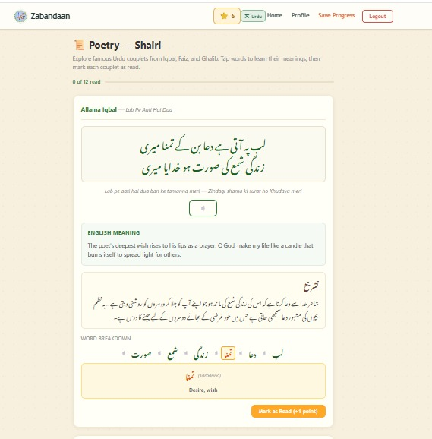
09 / LANGUAGE WITH A VOICE
Poetry makes Urdu feel close.
Meaning and sound work together: read the couplet, explore the words, listen aloud.
Read a couplet.
Unlock its meaning.
Hear it come alive.
Audio is available across the experience, so pronunciation is never an afterthought.
♪
Listen anywhere

Slide 11
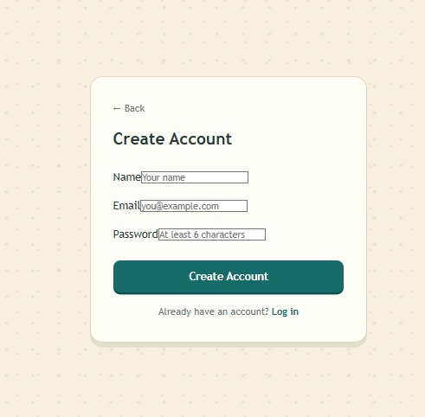
10 / MOTIVATION ARCHITECTURE
Progress should be easy to see.
Accountability is optional. Momentum is always available.
Login to grow
Play as a guest
Earn points
Save points, track progress, and build a personal learning journey.
Start immediately and explore without a commitment barrier.
Make effort visible and give every session a satisfying finish.
Optional account creation keeps the first step welcoming.
LOW FRICTION
→
REPEATED PRACTICE
→
VISIBLE PROGRESS
→
LASTING HABIT

Slide 12
11 / WHAT MAKES IT DIFFERENT
The innovation is in the combination.
Zabandaan connects literacy, culture, sound, and game design in one coherent experience.
01
Culturally grounded
Idioms and poetry make the app about how Urdu is actually lived.
02
Multi-sensory
Visuals, handwriting, text, and audio reinforce one another.
03
Adaptive by design
Difficulty levels support both first steps and deeper practice.
04
Welcoming by default
Guest mode lowers the barrier; accounts reward commitment.

Slide 13
12 / TECHNOLOGY
A focused stack for a focused experience.
The architecture keeps the learning loop fast, persistent, and easy to extend.
FRONTEND
React + Vite
Responsive learning UI, routes, game modules, tracing canvas
API
Node.js + Express
Authentication, content, progress, and points endpoints
DATA
SQLite
Local-first persistence for users, content, progress, and scores
MEDIA
Audio + visual assets
Pronunciation clips and illustrated learning content
Built for a real product workflow: content can grow without rewriting the learning experience.

Slide 14
13 / FEASIBILITY
This is more than an idea. It is working software.
The core experience is already built, connected, and ready to demonstrate.
AUTH
CONTENT
FEEDBACK
✓
Login and guest access
✓
Six learning modules
✓
Tracing accuracy and game results
PROGRESS
MEDIA
DATA
✓
Points and saved progress
✓
Audio and visual learning assets
✓
Seeded content and API routes
Demo-ready today
A learner can enter, choose, practice, listen, earn, and return.

Slide 15
ZABANDAAN
Urdu is not just
something to study.
It is something to feel.
A playful path to language, culture, and confidence.
Learn Urdu. Play your way.
THANK YOU

