Slide 1
CMZ / DIGITAL IMAGE PROCESSING
Civet behavior analysis
Phase 2: trained behavior pilot and automatic CCTV evidence
Walking · Feeding · Unknown
Wanikkasit Nopthiraitthikun · 652115043
Thanachai Naksomboon · 662115020
Phase 2 · automatic model proposals
01
Notes:
Good afternoon. Our project uses CCTV video to analyze a civet's behavior. Phase 2 presents a trained pilot, sampled results and an automatic image experiment.
Evidence: OPEN_THIS_FIRST.md in github.com/Wanikkasit65/civet_project. Refer to the source-linked report for scope and method settings.

Slide 2
CMZ / DIGITAL IMAGE PROCESSING
Project goal and Phase 1 continuity
One civet, four connected rooms, four CCTV cameras
Goal: turn CCTV video into traceable behavior information.
Keep behavior separate from visibility and camera conditions.
Continue the Phase 1 pipeline and structured observations.
Use a pretrained detector and a trained behavior classifier.
Phase 2 · automatic model proposals
02
Notes:
We study one civet in four connected rooms with four cameras. We keep the Phase 1 goal and behavior definitions. The implementation now uses a pretrained detector and a trained behavior classifier.
Evidence: OPEN_THIS_FIRST.md in github.com/Wanikkasit65/civet_project. Refer to the source-linked report for scope and method settings.

Slide 3
CMZ / DIGITAL IMAGE PROCESSING
Behavior definitions and current support
The target ethogram is broader than the trained pilot
Behavior / condition | Activity group | Current output
Walking / Climbing | Active | Walking pilot / Climb unsupported
Feeding | Active | Feeding pilot
Visible resting / sitting | Inactive | Verified result unavailable
Other visible behavior | Depends on behavior | No trained Other class
Hidden / unclear / unsupported | Unknown | Unknown
Phase 2 · automatic model proposals
03
Notes:
Walking, climbing and feeding belong to Active. Visible resting belongs to Inactive. Our trained pilot supports Walking and Feeding. Hidden, unclear and unsupported cases stay Unknown.
Evidence: OPEN_THIS_FIRST.md in github.com/Wanikkasit65/civet_project. Refer to the source-linked report for scope and method settings.

Slide 4
CMZ / DIGITAL IMAGE PROCESSING
Data and source coverage
A completed sampling plan across all discovered unique videos
31 original videos from cameras A01–A04.
109.84 camera-hours include overlapping views of one animal.
1,319 camera windows, each nominally 2 seconds.
348 fused nominal times, including 310 with all four cameras.
Phase 2 · automatic model proposals
04
Notes:
The historical sampling plan includes all 31 discovered videos. Their 109.84 camera-hours overlap across views of one animal. We process 1,319 short camera windows and combine them into 348 nominal time points.
Evidence: OPEN_THIS_FIRST.md in github.com/Wanikkasit65/civet_project. Refer to the source-linked report for scope and method settings.

Slide 5
CMZ / DIGITAL IMAGE PROCESSING
Automatic analysis workflow
Animal presence and behavior classification have different jobs
1. Inventory files and decode by presentation timestamps.
2. MegaDetector V5A proposes animal presence.
3. Motion features feed the trained Random Forest.
4. Keep uncertain cases as Unknown and combine camera times.
5. Export source-linked tables, plots and evidence.
Phase 2 · automatic model proposals
05
Notes:
First, we decode video using presentation timestamps. MegaDetector proposes animal presence. A Random Forest uses motion features to propose behavior. We preserve uncertain cases and export source-linked tables.
Evidence: OPEN_THIS_FIRST.md in github.com/Wanikkasit65/civet_project. Refer to the source-linked report for scope and method settings.

Slide 6
CMZ / DIGITAL IMAGE PROCESSING
What we trained
Nine existing reviewed clips supply a small supervised pilot
Training item | Value
Feeding / Walking reviewed duration | 60 s / 14 s
Derived two-second segments | 30 Feeding + 7 Walking = 37
Motion representation | 18 features, 96 × 96 grayscale full frames
Random Forest | 200 trees, depth 8, balanced weights
Phase 2 · automatic model proposals
06
Notes:
We retain nine reviewed clips, with 60 seconds Feeding and 14 seconds Walking. They provide 37 derived segments. We calculate 18 motion features and train a Random Forest with 200 trees. Segments from the same events are dependent.
Evidence: OPEN_THIS_FIRST.md in github.com/Wanikkasit65/civet_project. Refer to the source-linked report for scope and method settings.

Slide 7
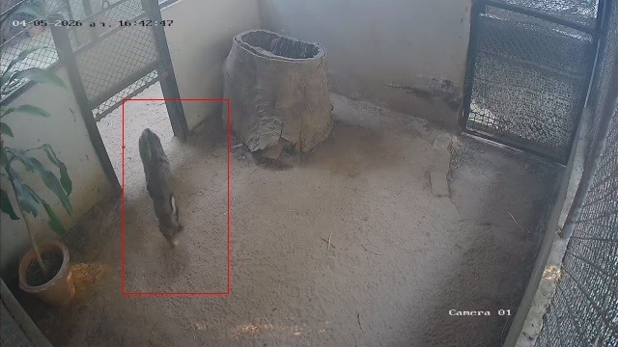
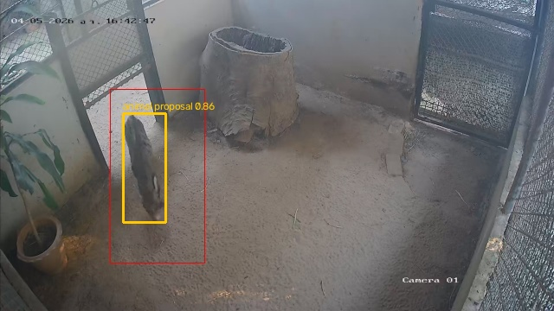
CMZ / DIGITAL IMAGE PROCESSING
Animal detection with MegaDetector
Pretrained YOLOv5 detector for animals, people and vehicles
The detector proposes an animal box and score.
It does not classify eating or sleep.
Control pass: 640-pixel input.
Animal threshold: 0.4.
Detector input 640
Detector input 1280
Same saved audit image. The red outline already exists in the input. Yellow shows the new proposal.
Phase 2 · automatic model proposals
07
Notes:
MegaDetector is a pretrained YOLOv5 animal detector. We did not train a new civet detector. It does not classify eating or sleep. The red outline already exists in these saved images. Yellow shows a new detector proposal.
Evidence: OPEN_THIS_FIRST.md in github.com/Wanikkasit65/civet_project. Refer to the source-linked report for scope and method settings.

Slide 8
CMZ / DIGITAL IMAGE PROCESSING
Image improvement experiment
Twelve saved audit stills, paired settings, identical detector weights
Variant / input size | Detected at 0.4 | Detected at 0.2
raw / 640 | 1 / 12 | 3 / 12
raw / 1280 | 9 / 12 | 9 / 12
clahe / 1280 | 8 / 12 | 9 / 12
gamma_0.7 / 1280 | 9 / 12 | 9 / 12
Saved stills include ROI outlines. Extra proposals do not establish better accuracy.
Phase 2 · automatic model proposals
08
Notes:
We use the same 12 preselected saved images for all settings. At threshold 0.4, raw input 640 detects proposals in one image, while 1280 detects proposals in nine. CLAHE gives eight and gamma gives nine. Existing ROI outlines and possible false positives prevent an accuracy claim.
Evidence: OPEN_THIS_FIRST.md in github.com/Wanikkasit65/civet_project. Refer to the source-linked report for scope and method settings.

Slide 9
CMZ / DIGITAL IMAGE PROCESSING
Sampling and multi-camera fusion
One reproducible nominal two-second window in each five-minute stratum
Only 43.97 camera-minutes were sampled, about 0.67%.
Combine matching nominal camera times once per animal.
Conflicting proposals become Unknown.
Do not fill unsampled gaps or turn Unknown into Inactive.
Phase 2 · automatic model proposals
09
Notes:
The historical plan selects one two-second window in each five-minute interval. That covers about 0.67 percent of the camera footage. We combine matching nominal times, but we do not fill gaps or call Unknown inactive.
Evidence: OPEN_THIS_FIRST.md in github.com/Wanikkasit65/civet_project. Refer to the source-linked report for scope and method settings.

Slide 10
CMZ / DIGITAL IMAGE PROCESSING
Main results from 348 sampled times
Historical run: model proposals with an explicit Unknown category
Walking 53 15.23%
Feeding 9 2.59%
Unknown 286 82.18%
Active proposals: 62 / 348
Verified Inactive: unavailable
Phase 2 · automatic model proposals
10
Notes:
From 348 fused sample points, the model proposes Walking at 53, Feeding at nine, and Unknown at 286. Walking and Feeding give 62 Active proposals. Verified Inactive is unavailable. These are sampled proposals rather than whole-day behavior durations.
Evidence: OPEN_THIS_FIRST.md in github.com/Wanikkasit65/civet_project. Refer to the source-linked report for scope and method settings.

Slide 11
CMZ / DIGITAL IMAGE PROCESSING
Hourly sampled activity proposals
Each hourly bin contains 12 nominal sampled times
Peak: 9 Active proposals at 03:00 on 5 April. Zero proposals does not establish rest.
Phase 2 · automatic model proposals
11
Notes:
Each hourly bin contains 12 nominal sample times. The peak is nine Active proposals at three in the morning on 5 April. A bin without Active proposals does not prove that the animal was resting.
Evidence: OPEN_THIS_FIRST.md in github.com/Wanikkasit65/civet_project. Refer to the source-linked report for scope and method settings.

Slide 12
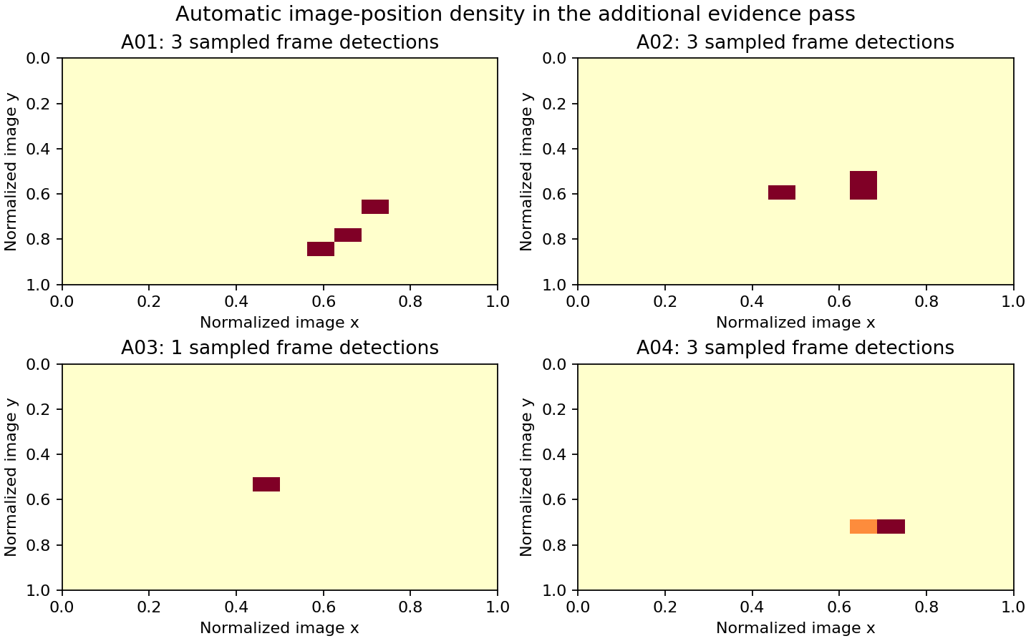
CMZ / DIGITAL IMAGE PROCESSING
Additional automatic evidence
Saved audit clips and one additional original video form separate cohorts
77 / 77 windows completed
548 detector frames
10 frames with animal proposals
0 processing errors
Image-coordinate density counts detected centroids. It does not measure room occupancy.
Phase 2 · automatic model proposals
12
Notes:
The additional control pass includes 53 saved audit clips and 24 windows from one extra original video. All 77 windows complete without processing errors. The 640-input detector finds proposals in ten of 548 sampled frames. This separate image-position plot cannot establish room occupancy.
Evidence: OPEN_THIS_FIRST.md in github.com/Wanikkasit65/civet_project. Refer to the source-linked report for scope and method settings.

Slide 13
CMZ / DIGITAL IMAGE PROCESSING
Evaluation and error analysis
Software correctness and behavior accuracy are separate checks
Historical table arithmetic and fusion: passed.
Software suite: 34 tests passed.
Walking development replay: 18 / 30 seconds proposed Walking.
Independent multi-class accuracy, precision, recall and F1: unavailable.
Phase 2 · automatic model proposals
13
Notes:
The software suite passes 34 tests, and the exported tables agree. A development Walking replay recovers 18 out of 30 seconds. The 60 percent ratio is development recovery, not overall accuracy. Independent behavior precision, recall and F1 remain unavailable.
Evidence: OPEN_THIS_FIRST.md in github.com/Wanikkasit65/civet_project. Refer to the source-linked report for scope and method settings.

Slide 14
CMZ / DIGITAL IMAGE PROCESSING
Reproducibility and fast trace
Open OPEN_THIS_FIRST.md in the GitHub repository
Training question: open model settings and annotation register.
Result question: open fused, per-video or hourly CSV.
Test question: open software checks or development replay evidence.
Method question: open source code and the automatic analysis report.
Phase 2 · automatic model proposals
14
Notes:
The GitHub guide connects each question to evidence. We can open training settings, annotations, raw results and test records directly. Software tests and behavior evaluation have separate links, so we do not confuse their meanings.
Evidence: OPEN_THIS_FIRST.md in github.com/Wanikkasit65/civet_project. Refer to the source-linked report for scope and method settings.

Slide 15
CMZ / DIGITAL IMAGE PROCESSING
Conclusions
A working trained pilot with source-linked automatic results
The run produced Walking and Feeding proposals with Unknown.
Automation exports animal boxes, motion proxies and scoped plots.
Sampled results cannot establish a full-day activity budget.
Verified Inactive and independent behavior accuracy remain unavailable.
Phase 2 · automatic model proposals
15
Notes:
We demonstrate a trained pilot with traceable automatic results. Unknown preserves uncertainty. The current evidence does not establish verified Inactive behavior or a continuous full-day activity budget. Thank you.
Evidence: OPEN_THIS_FIRST.md in github.com/Wanikkasit65/civet_project. Refer to the source-linked report for scope and method settings.

