Slide 1
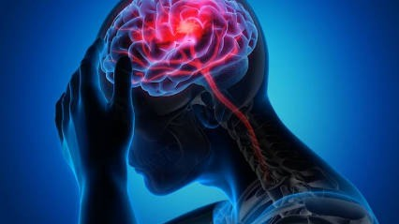

STROKE RISK PREDICTION
USING MACHINE LEARNING MODELS TO PREDICT STROKE RISK
Emma Kahoro| Data Scientist

Slide 2
INTRODUTION
Stroke is an NCD occurring when blood flow to the brain is interrupted.
Stroke is the 2nd leading cause of death attributing to 11% of total deaths (WHO).
Screening can help early detection, guide preventive intervention and public health action to control the disease.

Slide 3
OBJECTIVES
Main Objective
To build and evaluate supervised machine learning models for stroke classification using healthcare data.
Specific objectives
Identify stroke risk factors.
Optimize recall/sensitivity to ≥ 90%.
Clinical Utility of the best model.

Slide 4
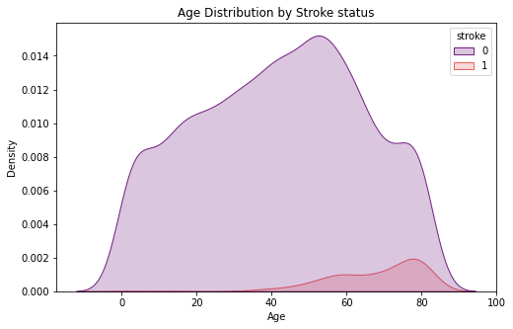
Stroke Risk Factors
Demographic Risk - Age
Clinical Risk – Hypertension, High glucose level

Slide 5
Model Performance
Model | Accuracy | Recall(Sensitivity) | F1 - score
Logistic Regression(Balanced Classes) | 0.75 | 0.73 | 0.25
Lasso Regression | 0.75 | 0.73 | 0.29
Decision Tree | 0.80 | 0.63 | 0.27
Decision Tree(0.3 Threshold) | 0.52 | 0.93 | 0.18
SMOTE(0.2 Threshold) | 0.74 | 0.71 | 0.24
Recall is the best metric to use;
It is better to have a false positive than a missed positive case, further tests can be done to be sure.
The best model is the decision tree with the 0.3 threshold.

Slide 6
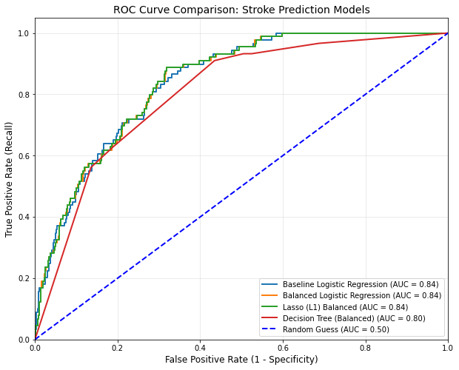
ROC/AUC Curves
The Lasso Model provided the best balance of AUC(0.84).
Decision tree maintained a high AUC(0.80) while meeting a recall of >90%.

Slide 7
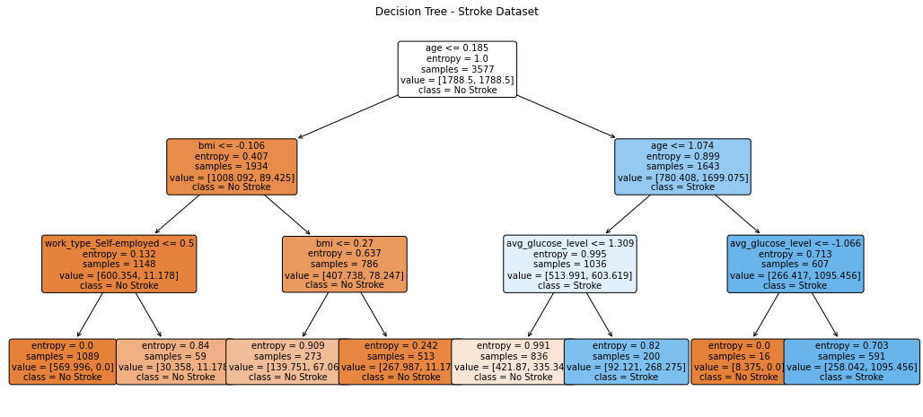
Decision Tree
In older individuals stroke driven by age and glucose levels.
For younger populations, the model confidently classifies most cases as non-stroke using BMI.

Slide 8
Clinical Utility
The model is best used for screening stroke cases.
Age, blood pressure and glucose levels can be used to flag individuals for further tests.
The 30% threshold aims to ensure that as many as possible stroke cases are detected with even 30% chance of a positive case.
Due to high false-positive rate (precision), this should be a risk flagging tool rather than a diagnostic tool.

Slide 9
Recommendations & Conclusion
1. The model is highly effective as a preliminary screening mechanism for patient intake portals.
2. Flagged individuals should immediately receive blood pressure and glucose screenings.
3. Because of the high false-positive rate, this tool should be used for risk-flagging only, not as a definitive medical diagnosis.

Slide 10


