Slide 1

prediction algorithm of hokey players
By Wanjin Yoo, Nelson Dai, Khaled Gabr, Peter Cheplev

Slide 2
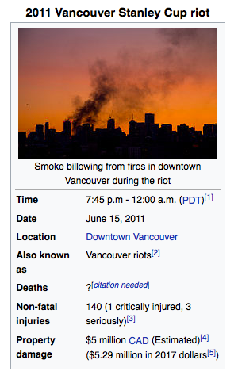
Why?
Because of the event of Vancouver Stanley riot in 2011
It was a sad year for most Vancouver reisdent, especially for those die-hard
fans of Canuks.
If Vancouver figured out which players they should have assigned and
position was best suit for those players, then the sad story should not have
happend

Slide 3
WHAT?
This report analyzes each players’s statisctic

