Slide 1
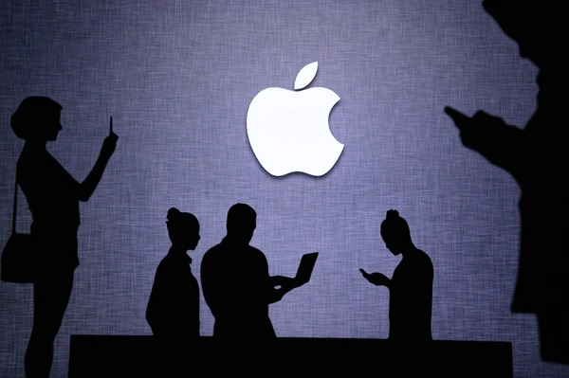
Apple Twitter Sentiment Analysis
Group 5 Project

Slide 2
Why Sentiment Analysis Matters?
Social media sentiment impacts brand perception, sales, and stock performance.
Apple’s customer feedback on Twitter reveals trends, concerns, and opportunities.
Social media (Twitter) serves as a real-time pulse of public opinion.

Slide 3
Business Problem
Understanding public sentiment toward Apple on Twitter is challenging due to short, informal text and varying contexts.
Misclassifying sentiment can lead to inaccurate insights, affecting company’s decisions.
This project aims to determine the most effective sentiment analysis model by comparing traditional machine learning and deep learning approaches to achieve the highest accuracy.

Slide 4
Project Objectives
Main:
To develop an accurate sentiment analysis model for Apple-related tweets by comparing traditional machine learning and deep learning approaches.
Specific:
To preprocess Apple-related tweets by cleaning, tokenizing, and normalizing text data to ensure high-quality input for analysis.
To handle data imbalance and enhance dataset quality using techniques such as SMOTE and other resampling methods to create a well-balanced training set.
To develop and compare multiple sentiment classification models, including traditional machine learning such as Logistic Regression, and XGBoost and deep learning approaches such as LSTM and CNN, to identify the most effective model.
To evaluate model performance using appropriate metrics such as accuracy ensuring the best-performing model provides reliable sentiment insights.

Slide 5
Data Overview
Dataset: 3,886 tweets
Sentiment Labels:
3 - Neutral – Majority class
1 - Negative – Significant portion
5 - Positive – Minority class
Challenges:
Imbalanced dataset
Varying confidence scores
Presence of irrelevant tweets

Slide 6
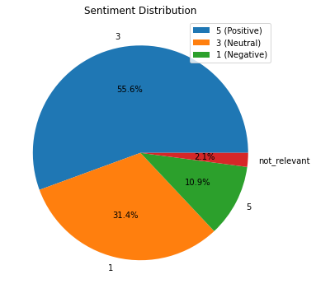
Key Findings 1. Sentiment Distribution

Slide 7
Observation:
Most tweets are Neutral (55%), followed by Negative (31%), and Positive (11%).
Neutral sentiments dominate, indicating mixed public perception.
There is Presence of Not relevant(2%) tweets

Slide 8
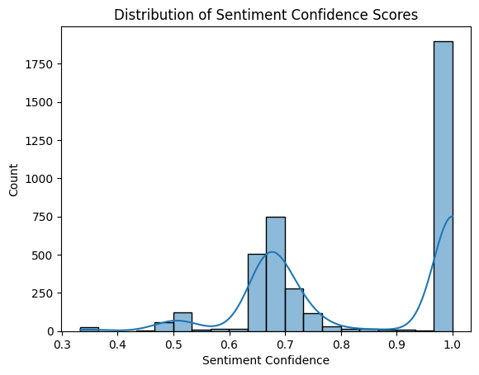
2. Sentiment Confidence Scores

Slide 9
Observation:
Confidence scores range 0.3 - 1.0.
Peaks at 0.7 and 1.0, indicating different levels of reliability.
Filtering out low-confidence tweets could improve model accuracy.

Slide 10
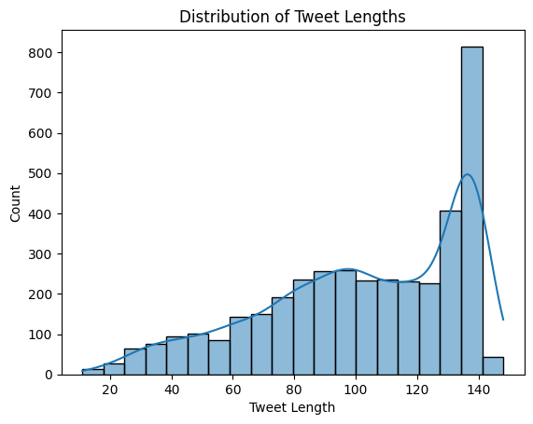
3. Tweet Length Analysis

Slide 11
Observation:
Most tweets are 100-140 characters.
Longer tweets contain detailed opinions, which may indicate subjectivity in sentiment
Most of the longer tweets also convey negative sentiments

Slide 12
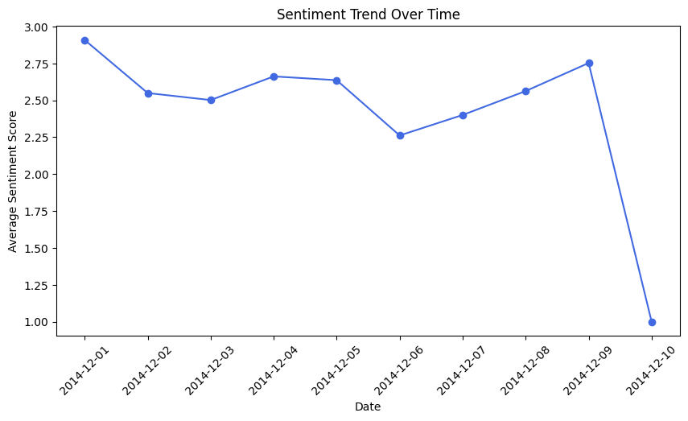
4. Sentiment Over Time

Slide 13
Observation:
Sentiment fluctuates based on product launches, stock market trends, and major news.
Negative sentiment spikes during controversies or product issues.
Positive sentiment increases after successful events or announcements.
Business Impact:
Apple can anticipate sentiment shifts and proactively address concerns.
Correlation with stock movements and brand perception can be leveraged for strategic planning.

Slide 14
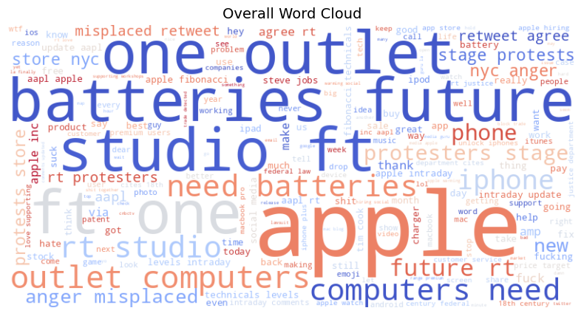
5. Frequent Words

Slide 15
Observation:
Positive sentiments include words like "thank," "new," "great," and "love" -suggests that users are expressing appreciation for Apple products or services.
Negative sentiments include words like "fuck," "suck," and "fix“-possibly related to product issues or customer service complaints.
Neutral words like "studio," "outlet," "computers," and "batteries“ -indicates general discussions about Apple products without a strong emotional tone

Slide 16
Model Performance
Models Tested:
Logistic Regression
Random Forest
XGBoost
Stacked Model (Best Performer)
Deep Learning Models (LSTM, CNN)

Slide 17
Deep Learning Model Performance
LSTM & CNN were tested for sentiment classification.
Challenges:
Required high computational power.
Needed more training data to outperform traditional ML models.
Stacked Model outperformed deep learning models due to data limitations

Slide 18
Best Performing Model
Best Model: Stacked Model with Class Weights
Achieved the highest accuracy of 75%.
Strong recall for class '3' (largest class), ensuring effective classification.
Balanced performance across precision , recall , and F1-score
Why the Stacked Model?
Combines multiple classifiers for better accuracy.
Handles class imbalance effectively using class weighting.
Outperforms others in accuracy metric.

Slide 19
Business Insights
1. Market Sentiment Monitoring
Negative sentiment highlights pain points.
Neutral sentiments suggest indecision—opportunity to influence perception.
2. Product Feedback & Customer Service
Negative tweets highlight issues with updates, pricing, and customer support.
Proactive engagement can reduce dissatisfaction.
3. Sentiment-Driven Marketing
Use sentiment insights to refine messaging and product launches.

Slide 20
Recommendations
Analyze recurring negative themes and implement targeted improvements to enhance brand perception.
Use positive feedback in marketing campaigns to strengthen brand loyalty and engage satisfied customers.
Align promotional efforts with peak discussion times to maximize engagement and impact.
Improve accuracy by integrating external metadata, refining preprocessing techniques, and fine-tuning model parameters.
Conduct competitive benchmarking with competitors to identify areas for differentiation and strategic advantage.

Slide 21
Conclusion
Sentiment analysis of Apple-related tweets provides real-time insights to enhance decision-making.
The Stacked Model with Class Weights offers a reliable and scalable solution for sentiment classification, helping Apple track customer sentiment effectively.
By leveraging these insights, Apple can improve brand perception, refine marketing strategies, and enhance customer experience.
Addressing negative sentiment, amplifying positive engagement, and optimizing responses to neutral sentiment will strengthen customer loyalty.
Further improvements, such as expanding the dataset and integrating external sentiment trends, can enhance accuracy and business impact.

Slide 22
Questions?
Feel free to ask anything.
Let’s connect!
Github: https://github.com/BetsyGitije/Sentiment-Classification-System

Slide 23


