Slide 1


CSS Property - Background
Backgrounds - CSS background properties are used to add background effects for elements.
background-color
Background Image
Background-repeat
Background Shorthand
div { background-color: lightblue; }
div {background-image: url("bgWallppr.jpg"); }
body { background-image: url("img_tree.png"); background-repeat: no-repeat;
Background-size:100px 200px;
Background-size:cover; }
div {background: #ffffff url("img_tree.png") no-repeat;}
www.credosystemz.com © Copyright 2021 | credosystemz | All Rights Reserved

Slide 2
CSS Properties
Colors - Colors are specified using predefined color names, or RGB, HEX, HSL, RGBA, HSLA values.
Text Color
Border Color
Background Color
Color Values - In CSS, colors can also be specified using RGB values, HEX values, HSL values:
<h1 style="color:blue;">Hello World</h1>
<h1 style="border:2px solid Tomato;">Hello World</h1>
<h1 style="background-color:DodgerBlue;">Hello World</h1>
Tomato
rgb(255, 99, 71)
#ff6347
hsl(9, 100%, 64%)
www.credosystemz.com © Copyright 2021 | credosystemz | All Rights Reserved

Slide 3
CSS Property - Fonts
Fonts
font-family
font-style
font-weight
font-size
p {font-family: "Times New Roman", Times, serif; }
p {font-style: italic;}
p {font-weight: bold;}
p {font-size: 14px;}
www.credosystemz.com © Copyright 2021 | credosystemz | All Rights Reserved

Slide 4
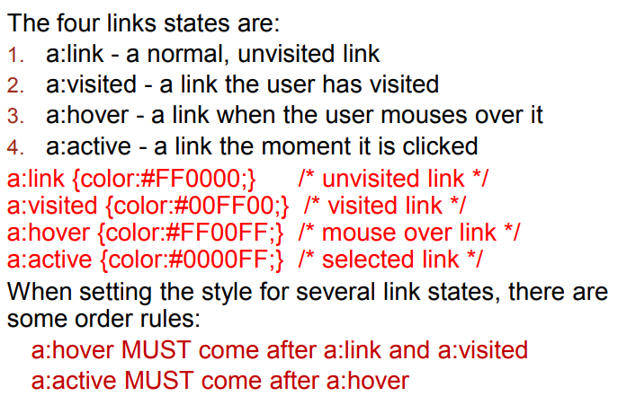
CSS Property – Link Properties
www.credosystemz.com © Copyright 2021 | credosystemz | All Rights Reserved

Slide 5
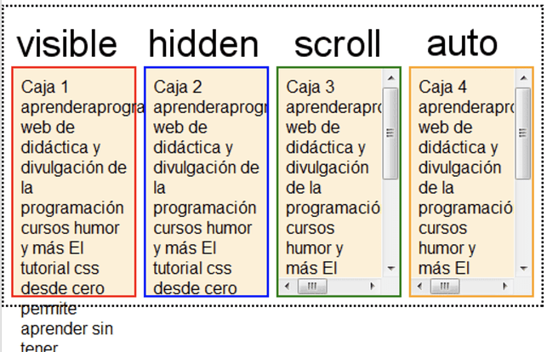
CSS Property - overflow

