Slide 1


CSS - Training

Slide 2
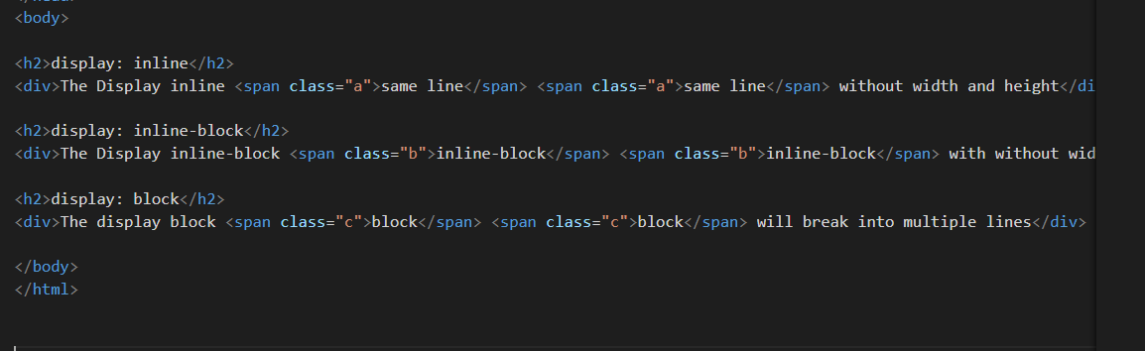
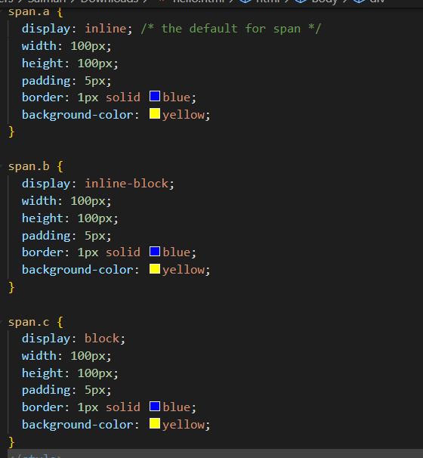
Display:inline,display:inline-block,display:block

Slide 3
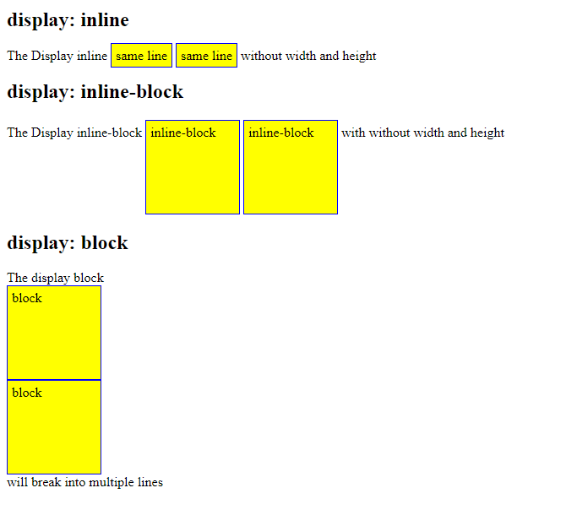
Display:inline,display:inline-block,display:block

Slide 4
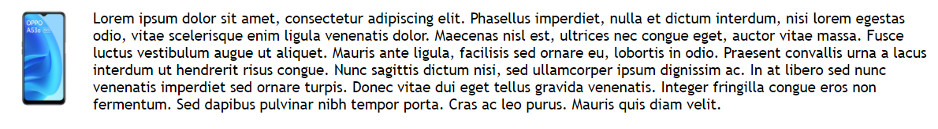
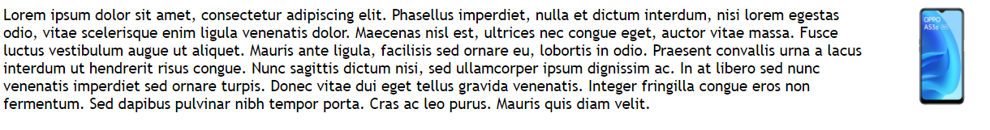
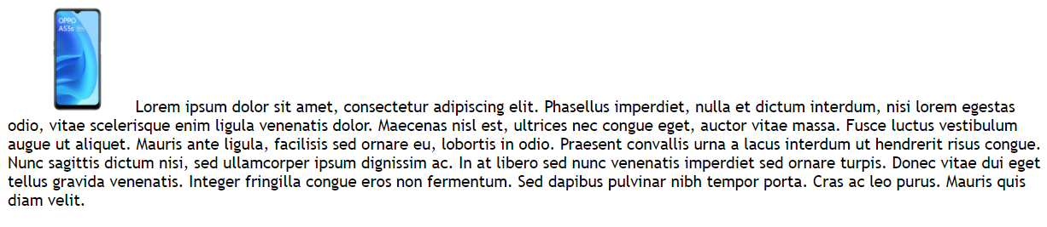

CSS Property - Float
Float - The CSS float property specifies how an element should float.
float: left
float: right
float: none
img {
float: left;
}
img { float: right; }
img { float: none; }
www.credosystemz.com © Copyright 2021 | credosystemz | All Rights Reserved

