Slide 1
Weekly Report
2021.06.18
Hongsik Kim
Mobile & Network Intelligence Laboratory

Slide 2
AI
Explanable AI
Paper: Explaining black-box classifiers using post-hoc explanations-by-example: The effect of explanations and error-rates in XAI user studies

Slide 3
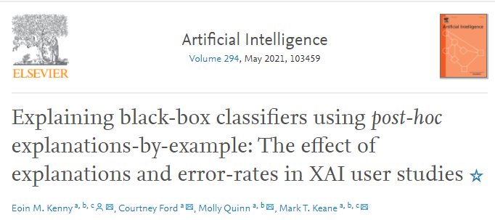
Paper: Explaining black-box classifiers using post-hoc explanations-by-example: The effect of explanations and error-rates in XAI user studies
https://www.sciencedirect.com/science/article/pii/S0004370221000102

Slide 4
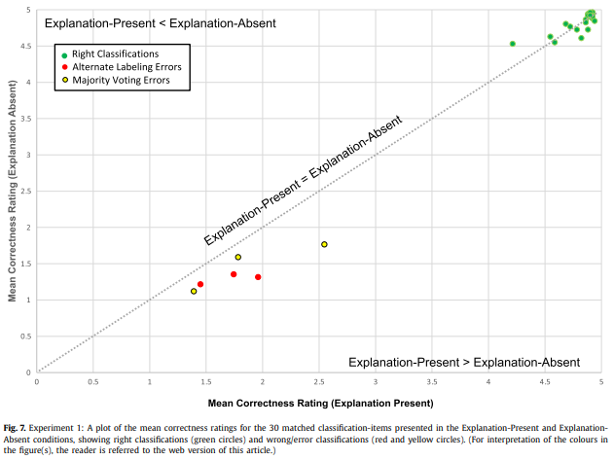
Paper: Explaining black-box classifiers using post-hoc explanations-by-example: The effect of explanations and error-rates in XAI user studies
실험 결과 – Explanation이 있을 때와 없을 때의 Mean Correctness Rating과 Classification의 종류

Slide 5
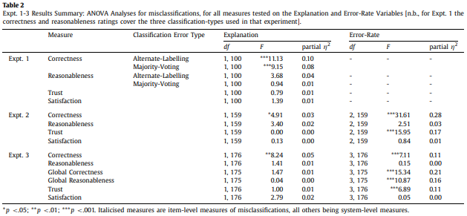
Paper: Explaining black-box classifiers using post-hoc explanations-by-example: The effect of explanations and error-rates in XAI user studies
실험 결과 – Missclassification에 대한 ANOVA 분석

Slide 6
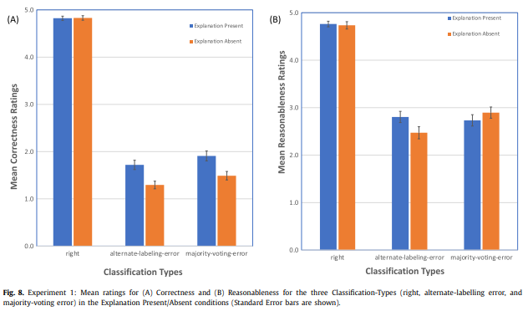
Paper: Explaining black-box classifiers using post-hoc explanations-by-example: The effect of explanations and error-rates in XAI user studies
실험 결과 – Classification의 종류에 따른 correctness 및 reasonableness

Slide 7
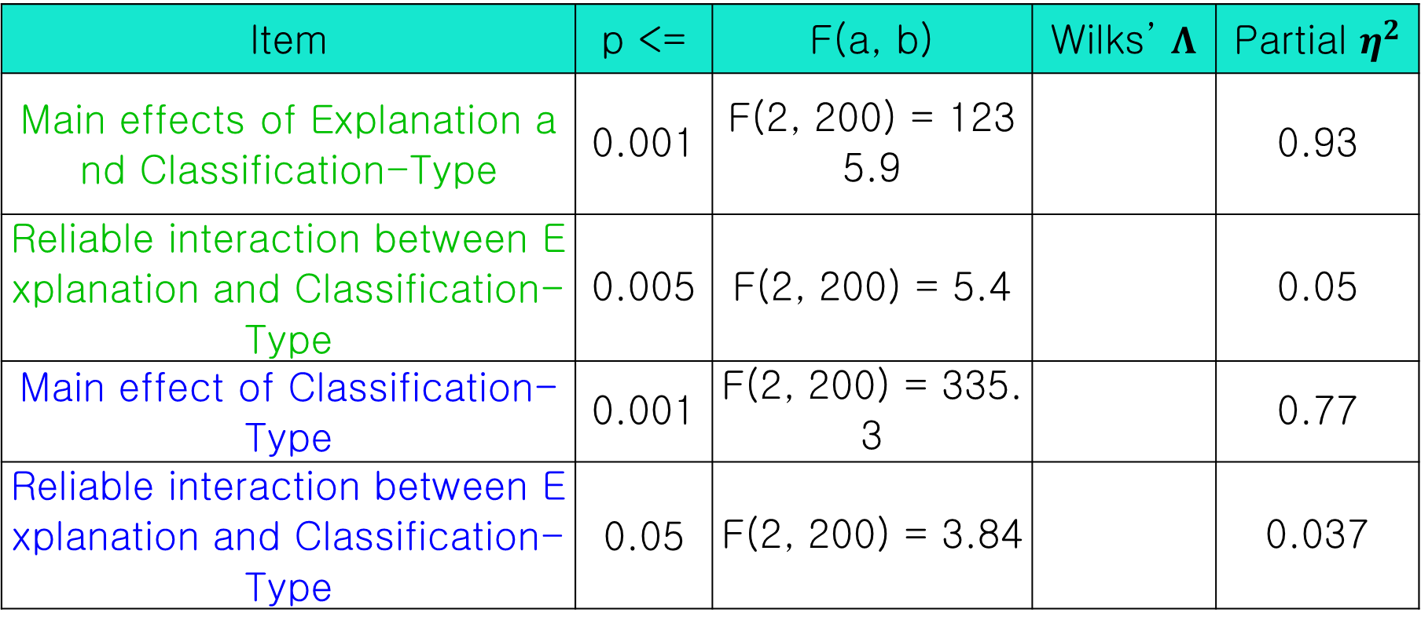
Paper: Explaining black-box classifiers using post-hoc explanations-by-example: The effect of explanations and error-rates in XAI user studies
실험 결과 – Classification의 종류에 따른 correctness 및 reasonableness
Item | p <= | F(a, b) | Wilks’ $Λ$ | Partial $η^{2}$
Main effects of Explanation and Classification-Type | 0.001 | F(2, 200) = 1235.9 |  | 0.93
Reliable interaction between Explanation and Classification-Type | 0.005 | F(2, 200) = 5.4 |  | 0.05
Main effect of Classification-Type | 0.001 | F(2, 200) = 335.3 |  | 0.77
Reliable interaction between Explanation and Classification-Type | 0.05 | F(2, 200) = 3.84 |  | 0.037

Slide 8
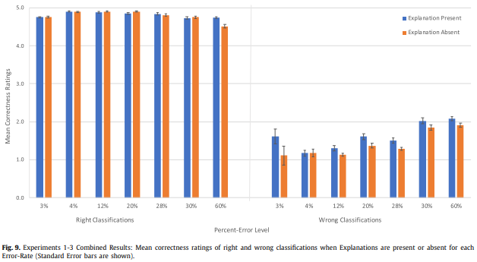
Paper: Explaining black-box classifiers using post-hoc explanations-by-example: The effect of explanations and error-rates in XAI user studies
실험 결과 – Right Classification 및 Wrong Classification의 Percent-Error Level 및 Explanation의 유무에 따른 평균 correctness ratings

Slide 9
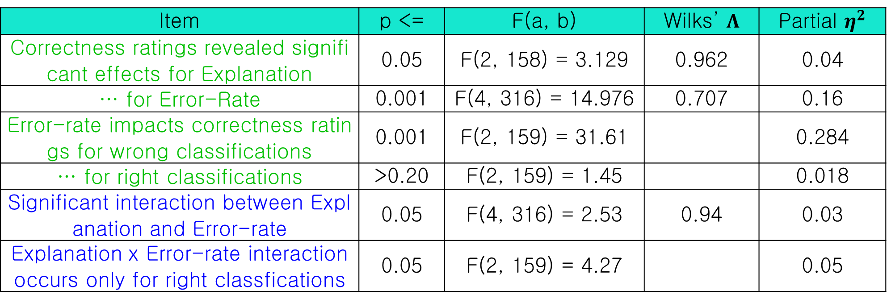
Paper: Explaining black-box classifiers using post-hoc explanations-by-example: The effect of explanations and error-rates in XAI user studies
실험 결과 – Right Classification 및 Wrong Classification의 Percent-Error Level 및 Explanation의 유무에 따른 평균 correctness ratings
Correctness Ratings Reasonableness Ratings
Item | p <= | F(a, b) | Wilks’ $Λ$ | Partial $η^{2}$
Correctness ratings revealed significant effects for Explanation | 0.05 | F(2, 158) = 3.129 | 0.962 | 0.04
… for Error-Rate | 0.001 | F(4, 316) = 14.976 | 0.707 | 0.16
Error-rate impacts correctness ratings for wrong classifications | 0.001 | F(2, 159) = 31.61 |  | 0.284
… for right classifications | >0.20 | F(2, 159) = 1.45 |  | 0.018
Significant interaction between Explanation and Error-rate | 0.05 | F(4, 316) = 2.53 | 0.94 | 0.03
Explanation x Error-rate interaction occurs only for right classfications | 0.05 | F(2, 159) = 4.27 |  | 0.05

Slide 10
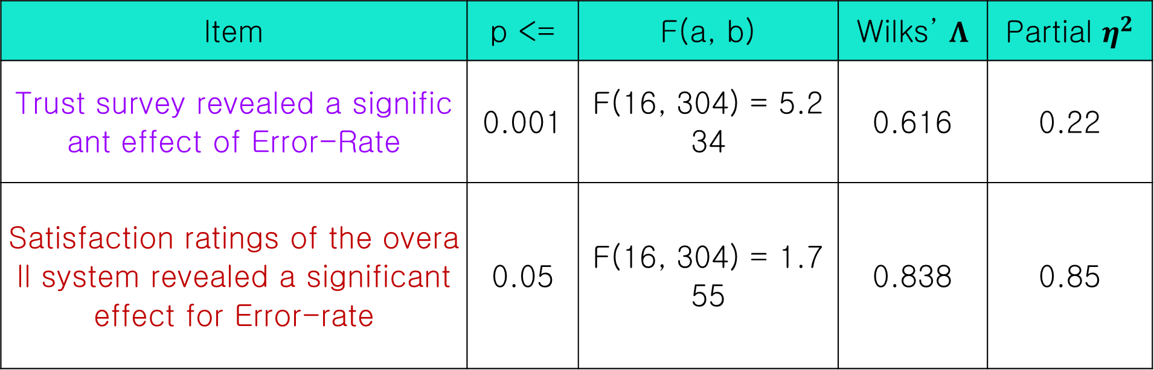
Paper: Explaining black-box classifiers using post-hoc explanations-by-example: The effect of explanations and error-rates in XAI user studies
실험 결과 – Right Classification 및 Wrong Classification의 Percent-Error Level 및 Explanation의 유무에 따른 평균 correctness ratings
Trust Satisfaction
Item | p <= | F(a, b) | Wilks’ $Λ$ | Partial $η^{2}$
Trust survey revealed a significant effect of Error-Rate | 0.001 | F(16, 304) = 5.234 | 0.616 | 0.22
Satisfaction ratings of the overall system revealed a significant effect for Error-rate | 0.05 | F(16, 304) = 1.755 | 0.838 | 0.85

Slide 11
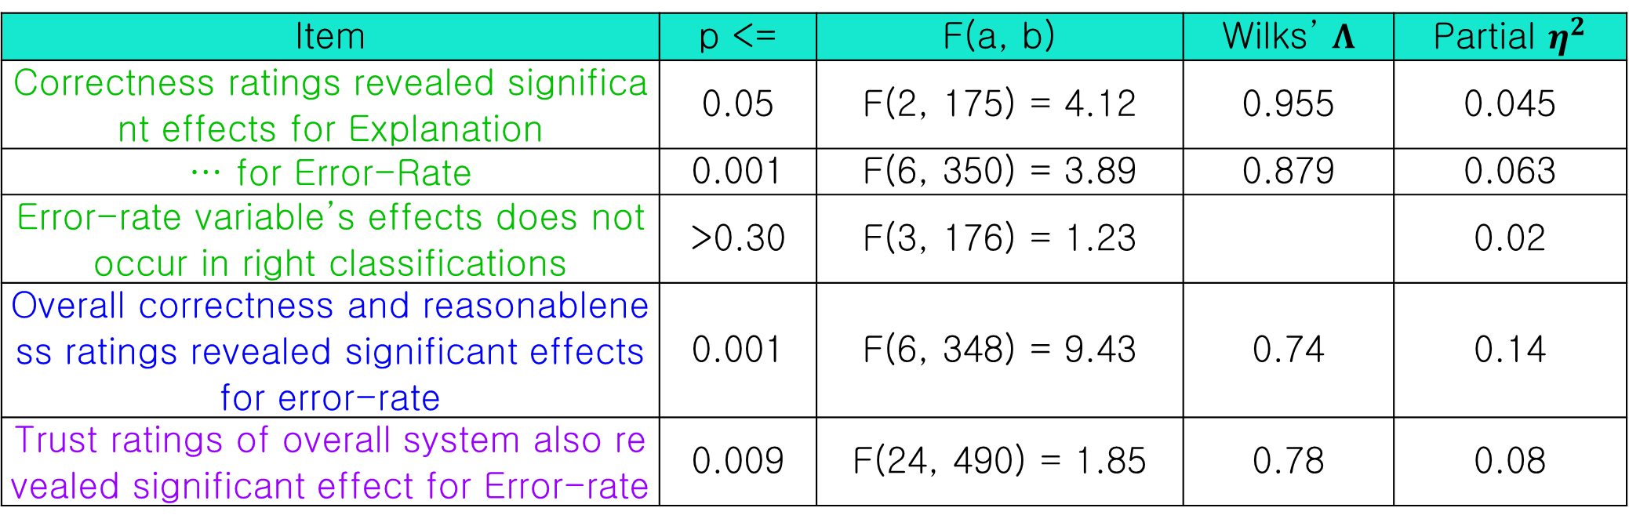
Paper: Explaining black-box classifiers using post-hoc explanations-by-example: The effect of explanations and error-rates in XAI user studies
실험 결과 – The effects of explanation and low-end error-rates
Correctness and Reasonableness Ratings Overall correctness and reasonableness Trust and Satisfaction
Item | p <= | F(a, b) | Wilks’ $Λ$ | Partial $η^{2}$
Correctness ratings revealed significant effects for Explanation | 0.05 | F(2, 175) = 4.12 | 0.955 | 0.045
… for Error-Rate | 0.001 | F(6, 350) = 3.89 | 0.879 | 0.063
Error-rate variable’s effects does not occur in right classifications | >0.30 | F(3, 176) = 1.23 |  | 0.02
Overall correctness and reasonableness ratings revealed significant effects for error-rate | 0.001 | F(6, 348) = 9.43 | 0.74 | 0.14
Trust ratings of overall system also revealed significant effect for Error-rate | 0.009 | F(24, 490) = 1.85 | 0.78 | 0.08

Slide 12
Github
https://github.com/WannaBeSuperteur/2020/tree/master/

